Slide 1



Year 1 | Week 5 | Day 1
5 7

Slide 2

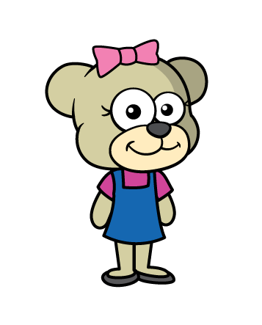
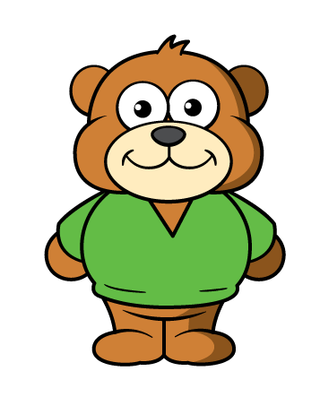
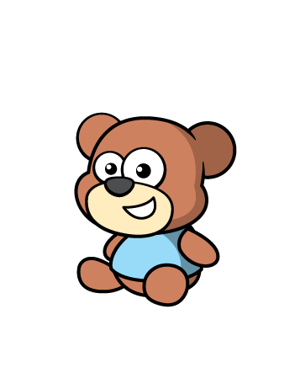
Year 1 | Week 5 | Day 2

Slide 3

Year 1 | Week 5 | Day 3

Slide 4
Year 1 | Week 5 | Day 4

Slide 5
Year 1 | Week 5 | Day 5

Slide 6

Year 1 | Week 6 | Day 1

Slide 7

Year 1 | Week 6 | Day 2

Slide 8



Year 1 | Week 6 | Day 3

Slide 9

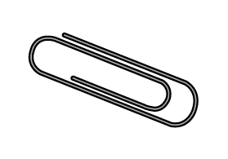
Year 1 | Week 6 | Day 4

Slide 10

Year 1 | Week 6 | Day 5

Slide 11


Year 1 | Week 7 | Day 1
$$=$$
$$=$$

Slide 12

Year 1 | Week 7 | Day 2
A
B
C

Slide 13
Year 1 | Week 7 | Day 3

Slide 14
Year 1 | Week 7 | Day 4

Slide 15

Year 1 | Week 7 | Day 5

Slide 16
Year 1 | Week 8 | Day 1

Slide 17
Year 1 | Week 8 | Day 2

Slide 18
Year 1 | Week 8 | Day 3

Slide 19
Year 1 | Week 8 | Day 4

Slide 20
Year 1 | Week 8 | Day 5

