Slide 1





Notes:
What is the same about all the times?
Where does the minute had always point to when it is o’clock?

Slide 2

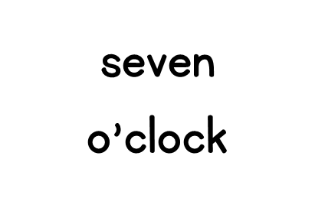
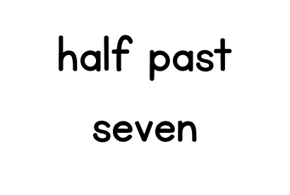
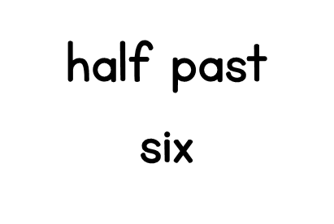
Notes:
Which number does the minute hand point at when it is half past?
Where would the hour hand be if it was half past six?

Slide 3






Notes:
Can you think of other activities to go in each group?

Slide 4

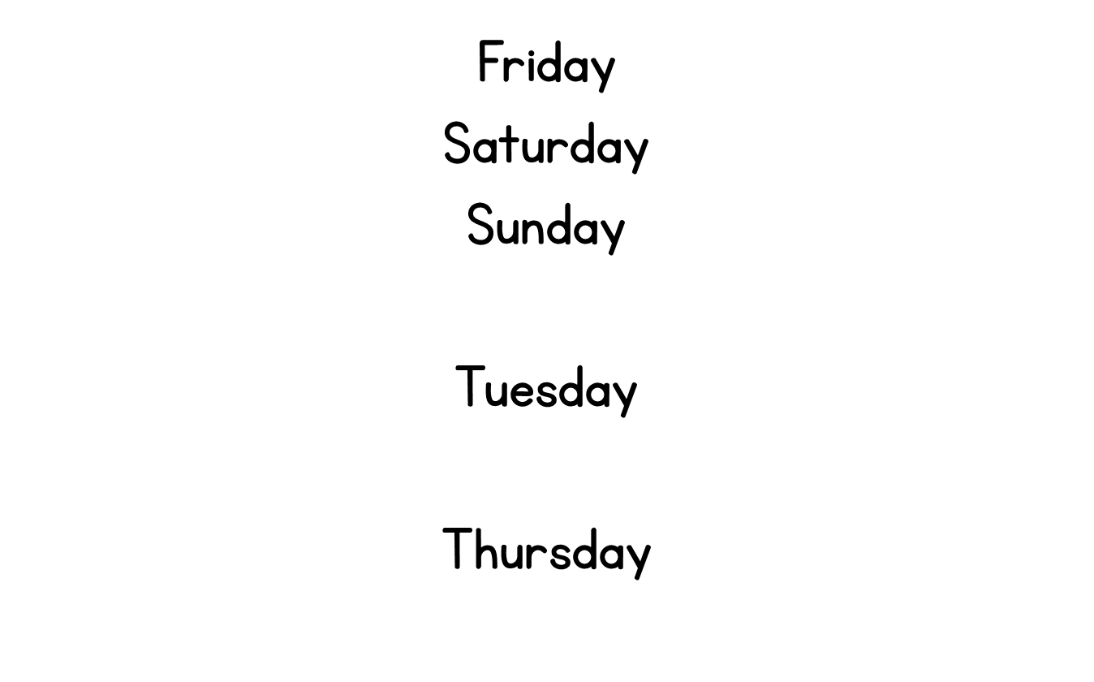
Notes:
What day comes after Sunday?
What day comes before Thursday?
Today is Tuesday, what day was it yesterday?
Today is Friday, what day is it tomorrow?

Slide 5
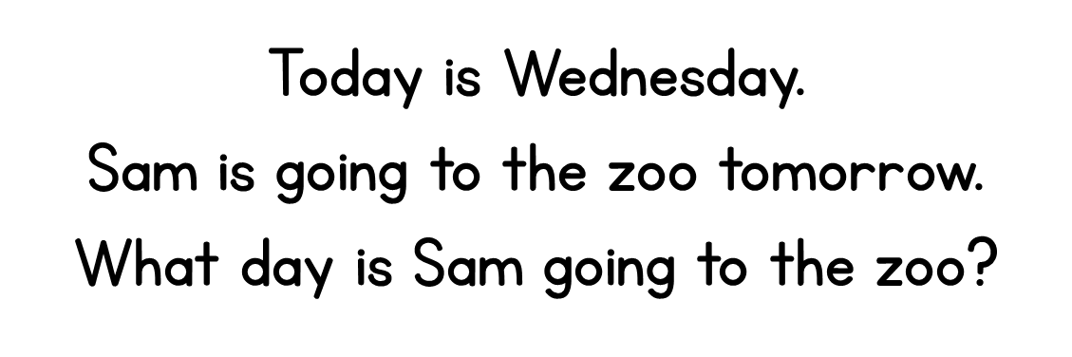

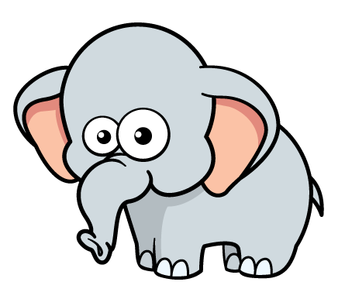

Notes:
Sam went to the cinema yesterday, what day did Sam go to the cinema?

Slide 6







Notes:
Can you think of activities that last about an hour?
How long does it take you to write your name?
How many star jumps can you do in a minute?
Can we think of a nursery rhyme, how long do you think it lasts?

Slide 7
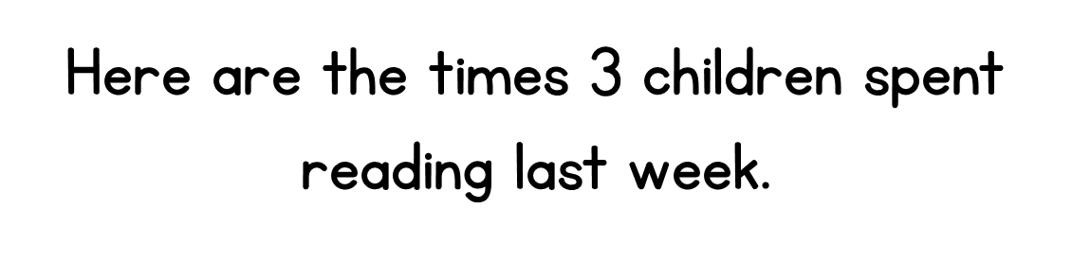



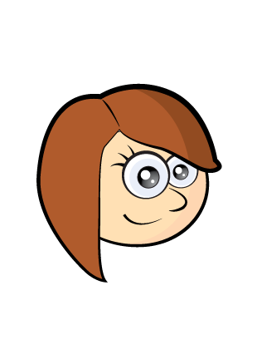


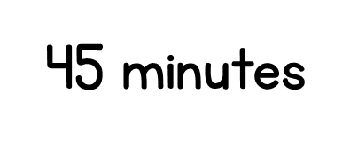
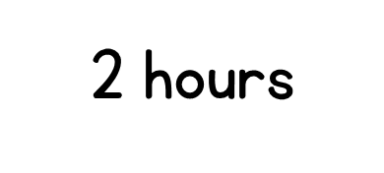
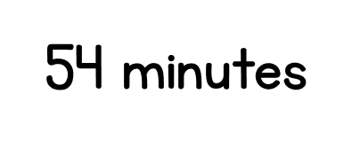

Notes:
Do we just need to look for the largest number?
What is different about Rosie’s time?
How do we know that 2 hours is longer than 54 minutes?

