Slide 2
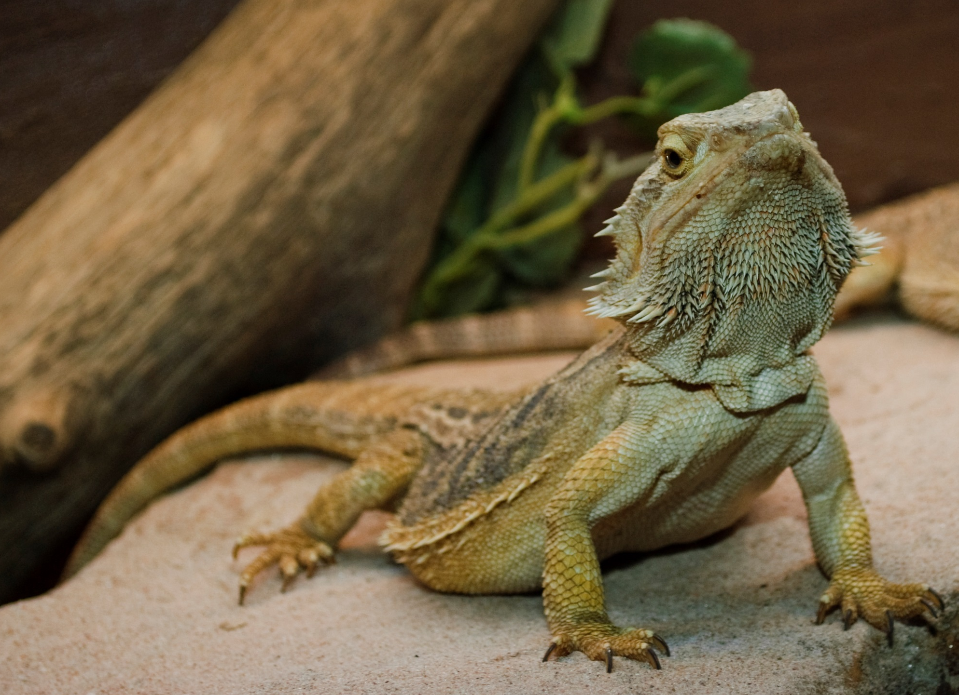
Bearded dragon
Photo courtesy of frankps (@flickr.com) - granted under creative commons licence – attribution

Slide 3
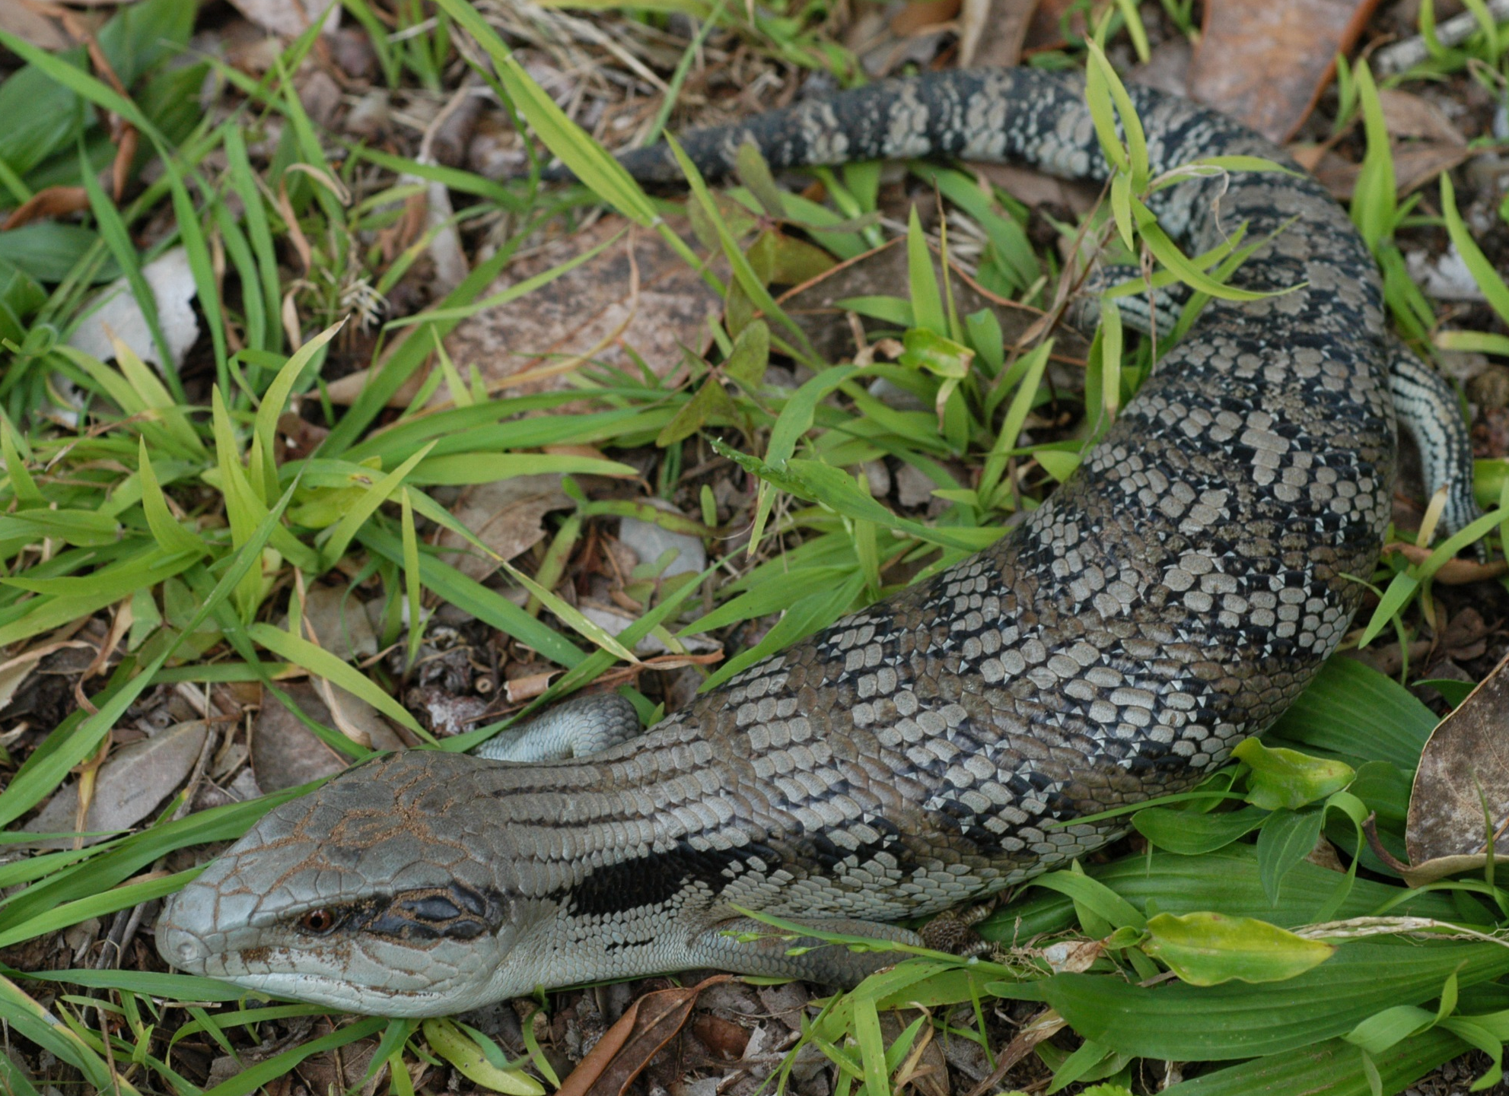
Blue-tongue lizard
Photo courtesy of Doug Beckers (@flickr.com) - granted under creative commons licence – attribution

Slide 4
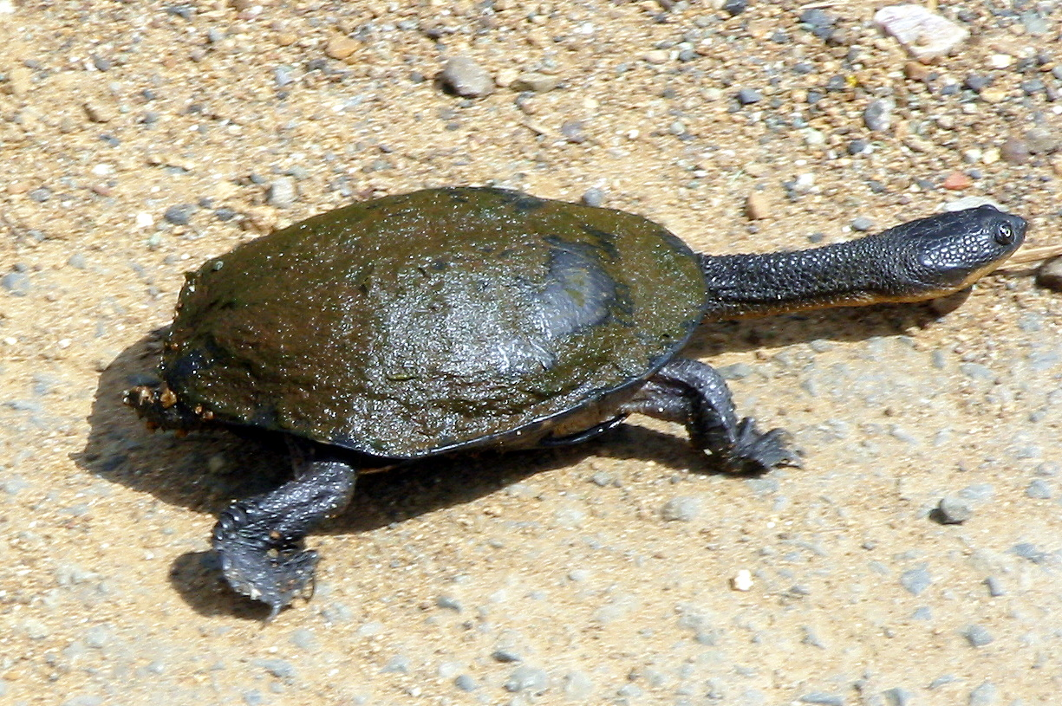
Snake-necked turtle
Photo courtesy of wollombi (@flickr.com) - granted under creative commons licence – attribution

Slide 5
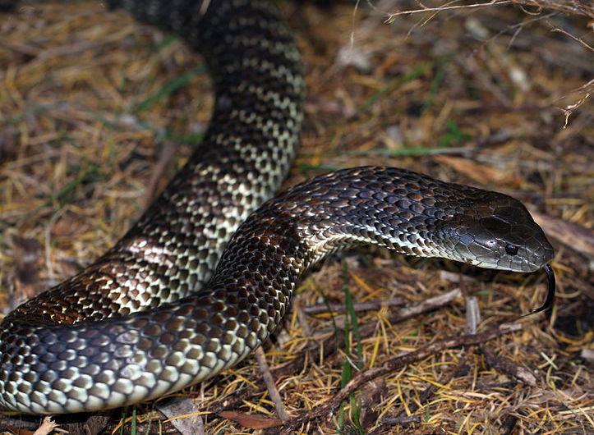
Tiger snake
Photo courtesy of https://commons.wikimedia.org/wiki/User:Lomita - granted under creative commons licence – attribution

Slide 6
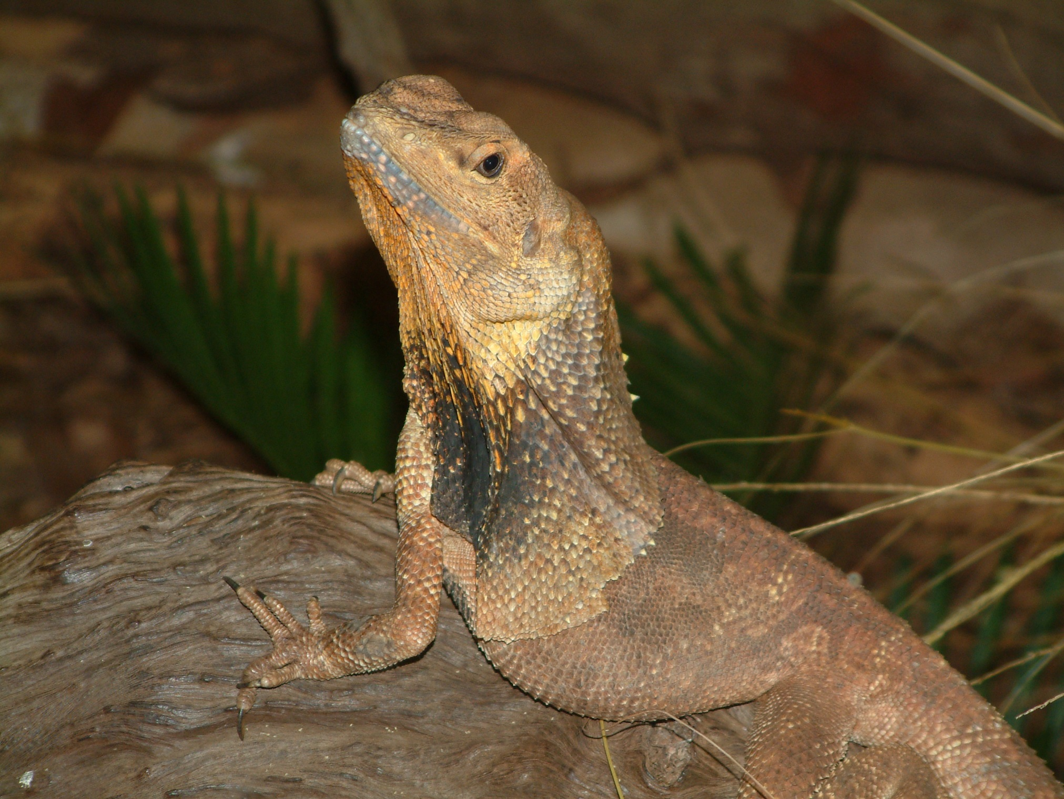
Frilled lizard
Photo courtesy of Stephen Michael Barnett (@flickr.com) - granted under creative commons licence – attribution

Slide 7
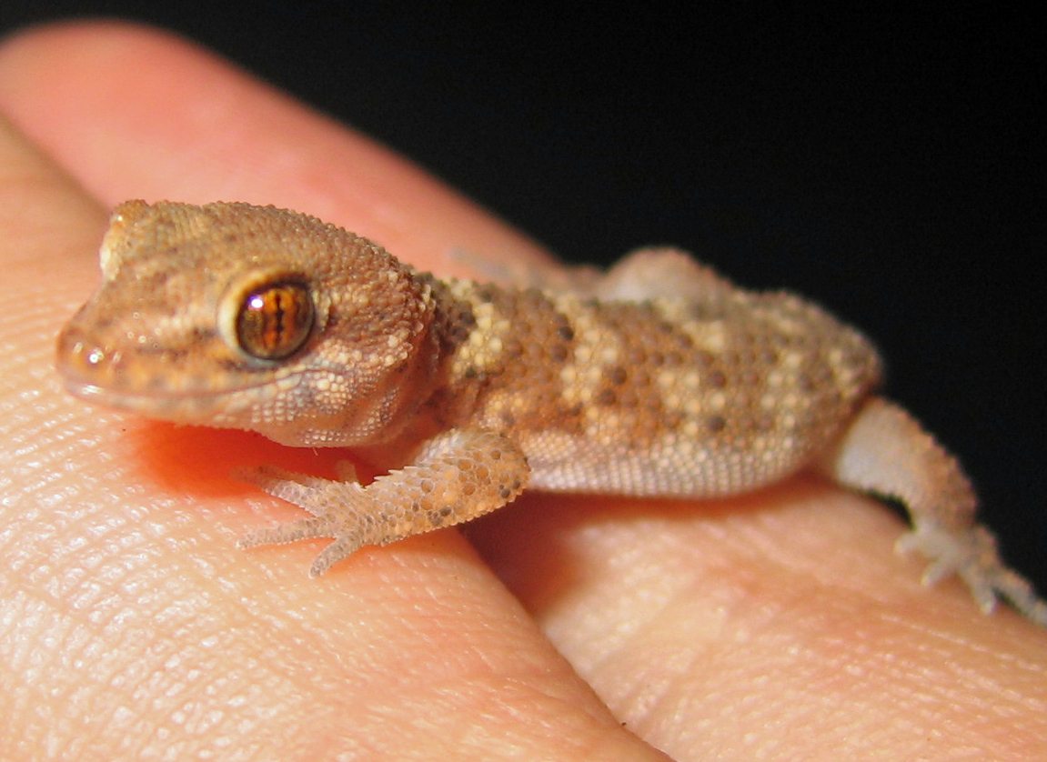
Gecko
Photo courtesy of GregTheBusker (@flickr.com) - granted under creative commons licence – attribution

Slide 8
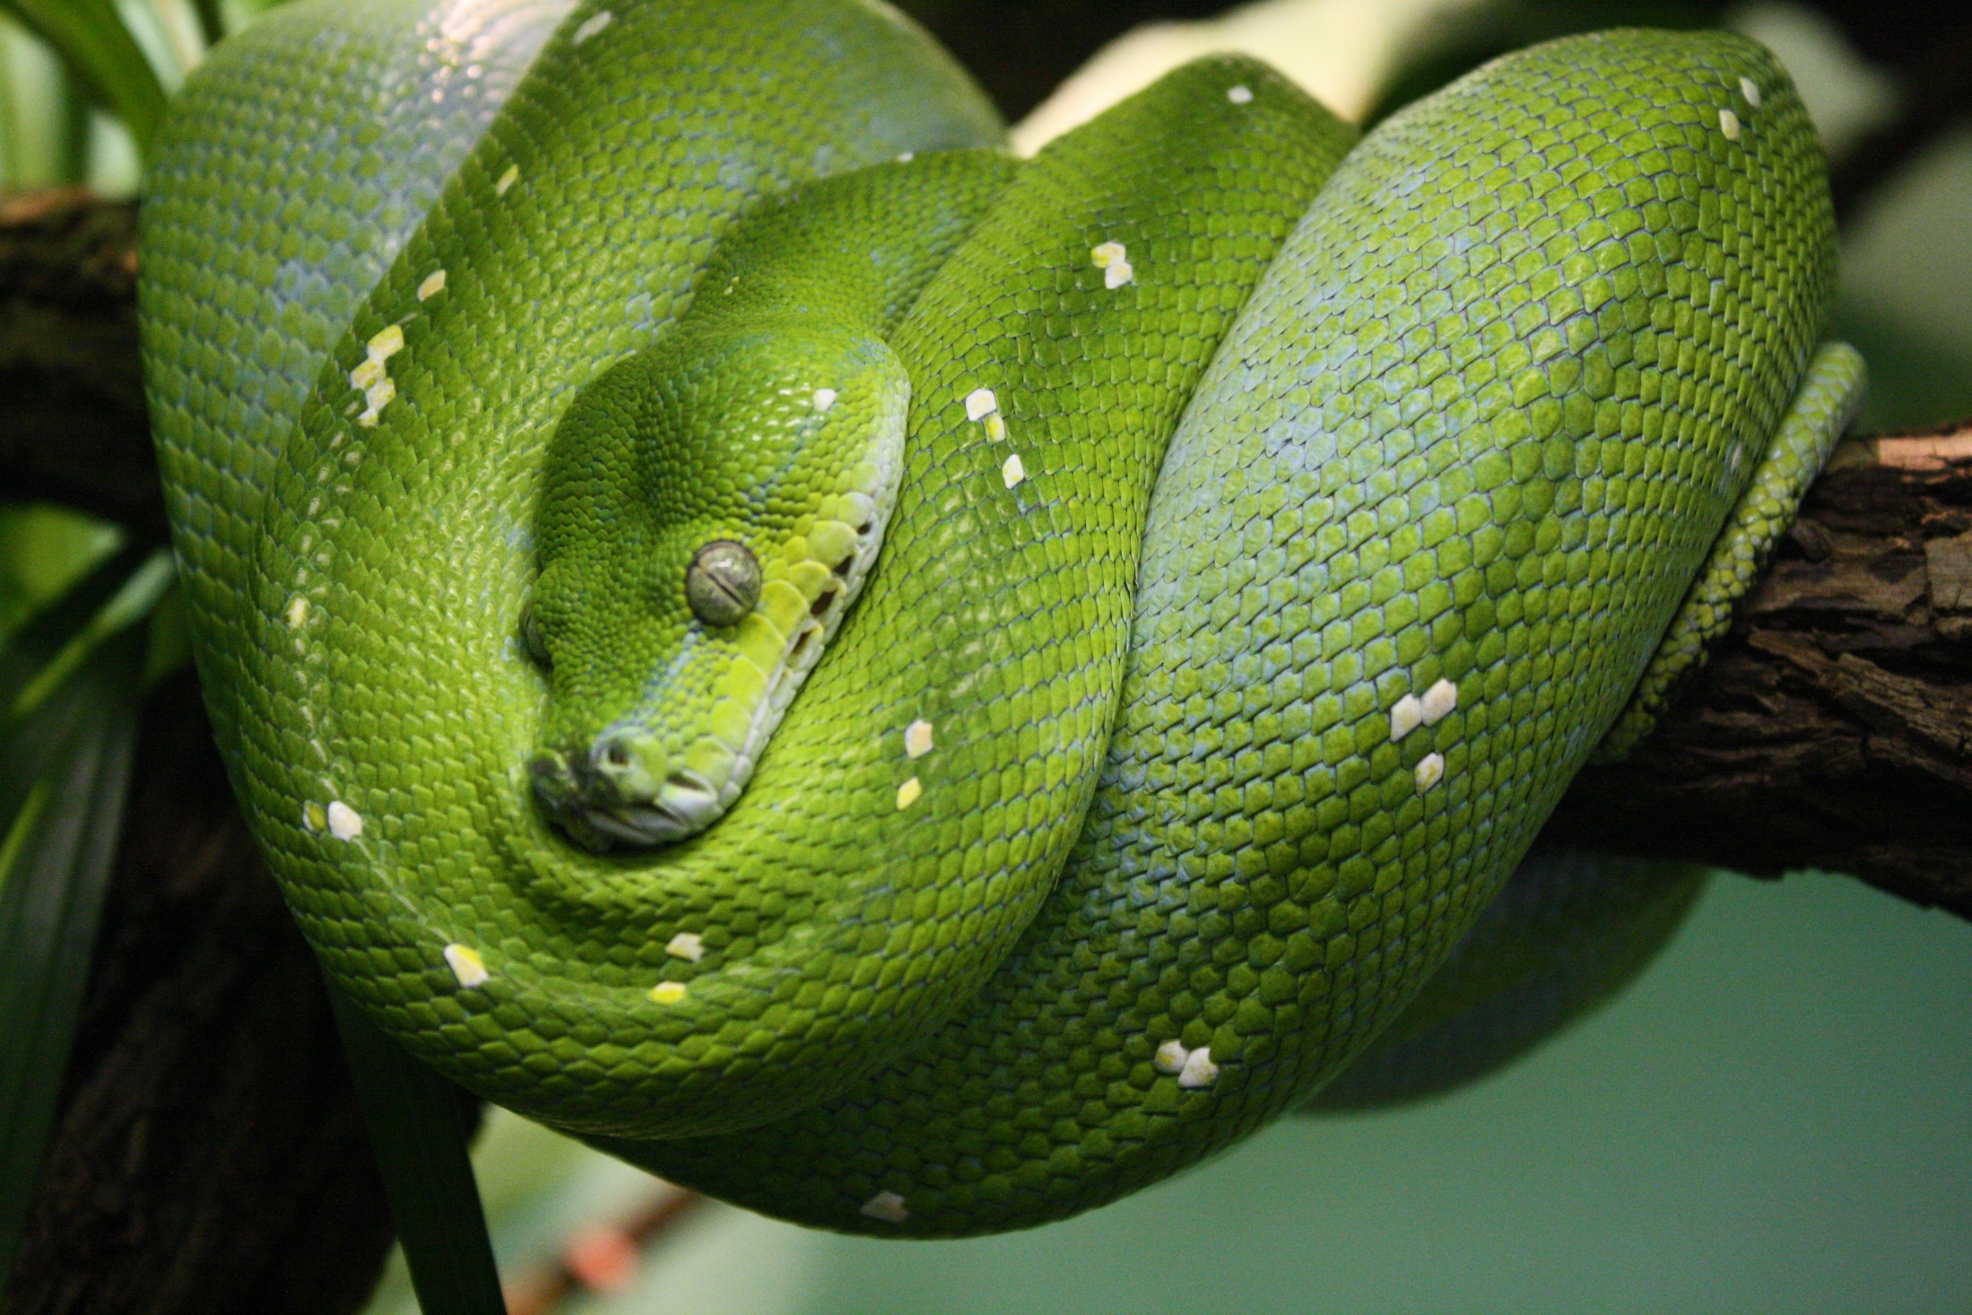
Green python
Photo courtesy of .RGB. (@flickr.com) - granted under creative commons licence – attribution

Slide 9
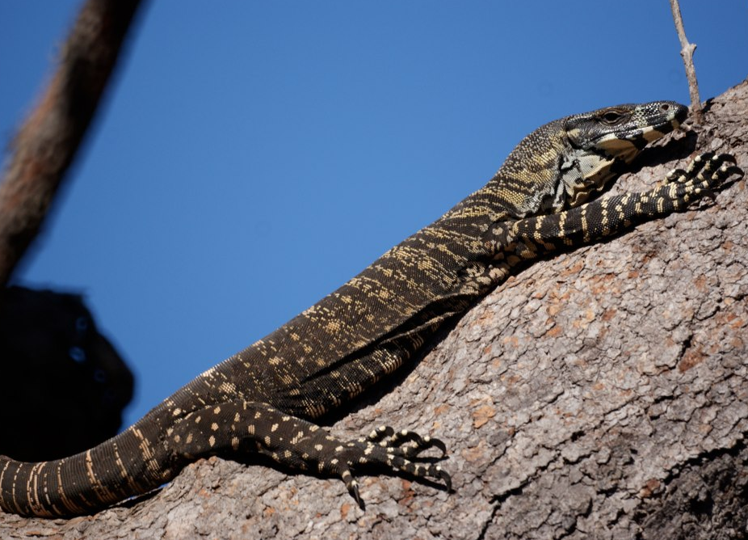
Lace monitor
Photo courtesy of Avia55 (@flickr.com) - granted under creative commons licence – attribution

Slide 10
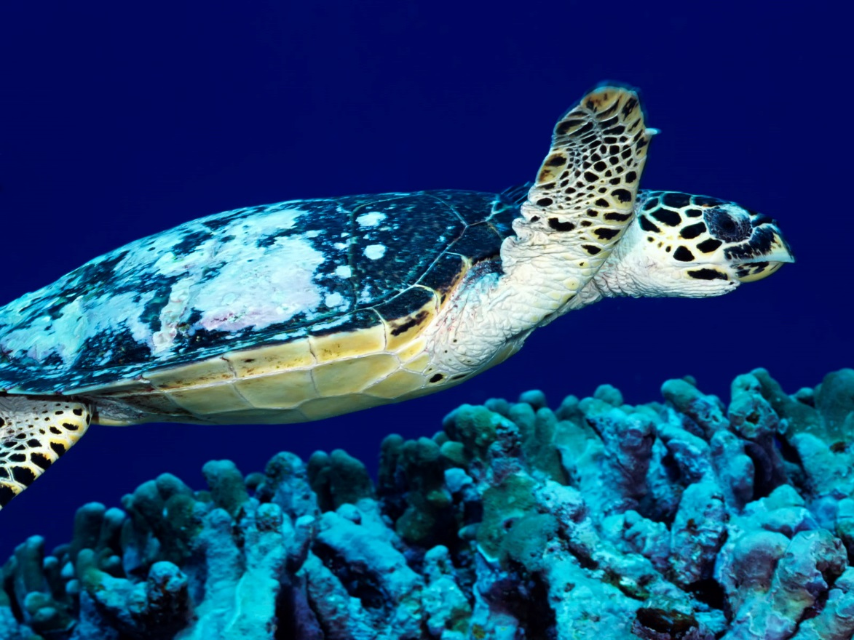
Loggerhead turtle
Photo courtesy of Angell Williams (@flickr.com) - granted under creative commons licence – attribution

Slide 11
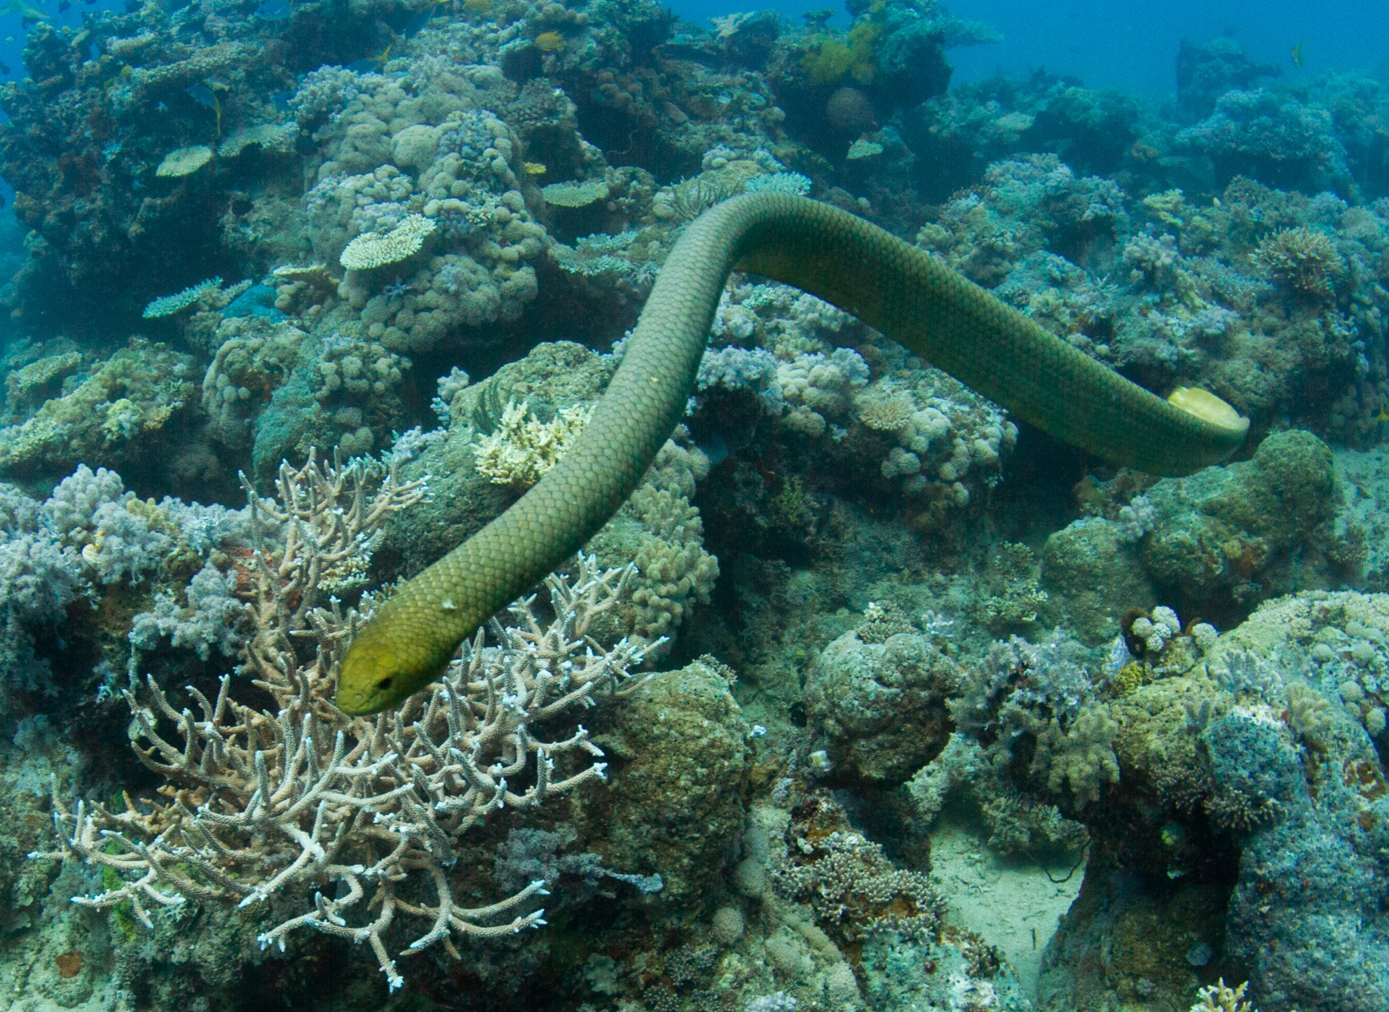
Olive sea snake
Photo courtesy of Tchami (@flickr.com) - granted under creative commons licence – attribution

Slide 12
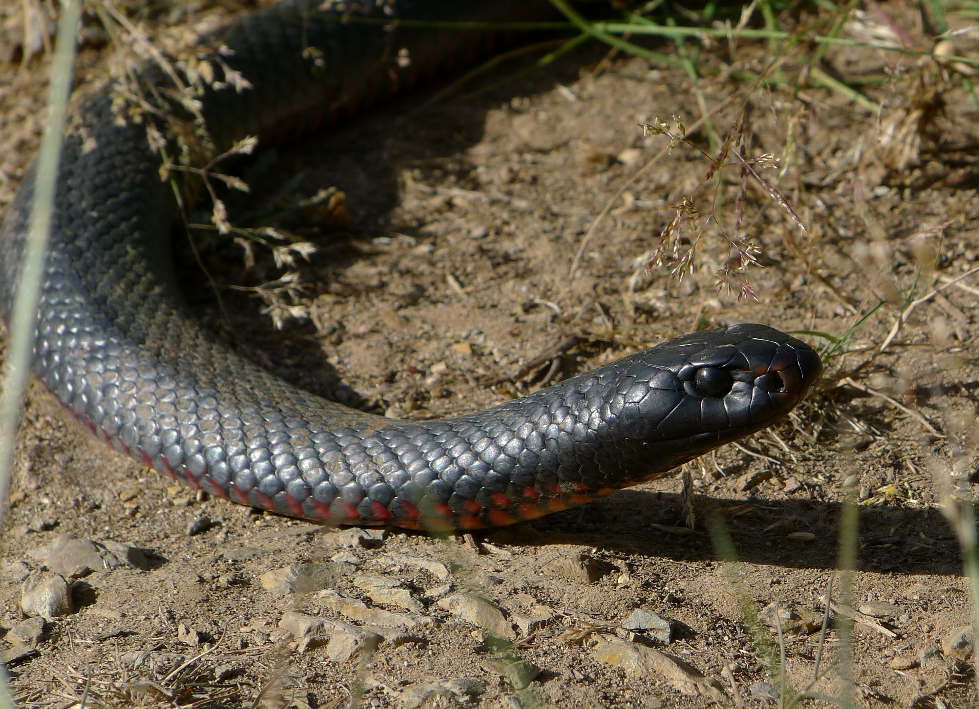
Red-bellied black snake
Photo courtesy of John Tann (@flickr.com) - granted under creative commons licence – attribution

Slide 13
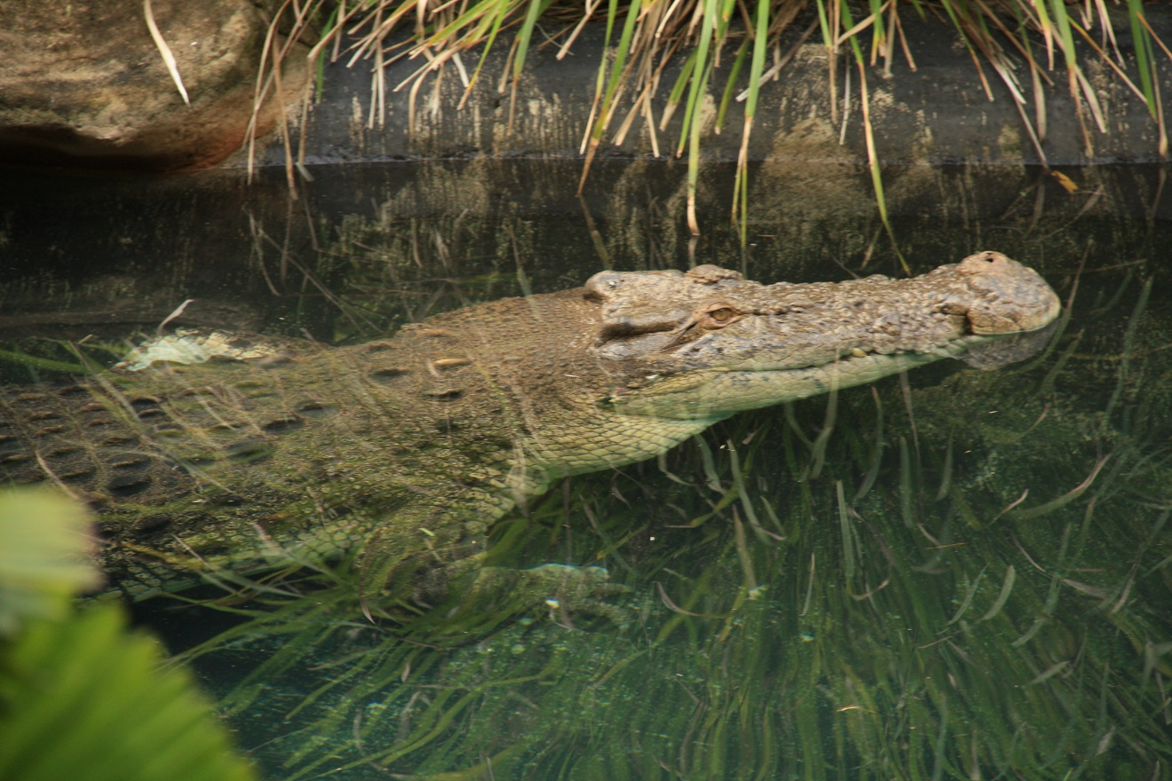
saltwater crocodile
Photo courtesy of Allan Henderson (@flickr.com) - granted under creative commons licence – attribution

Slide 14
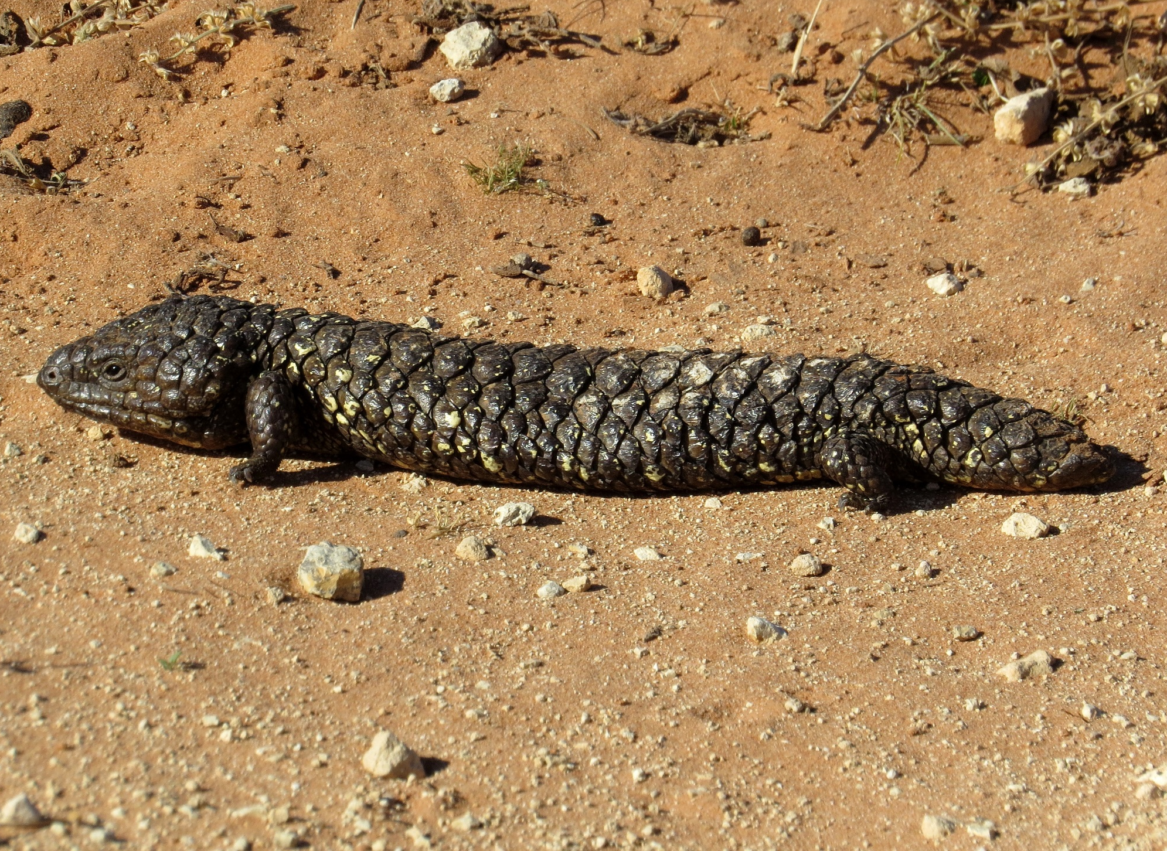
Shingleback lizard
Photo courtesy of John Tann (@flickr.com) - granted under creative commons licence – attribution

Slide 15
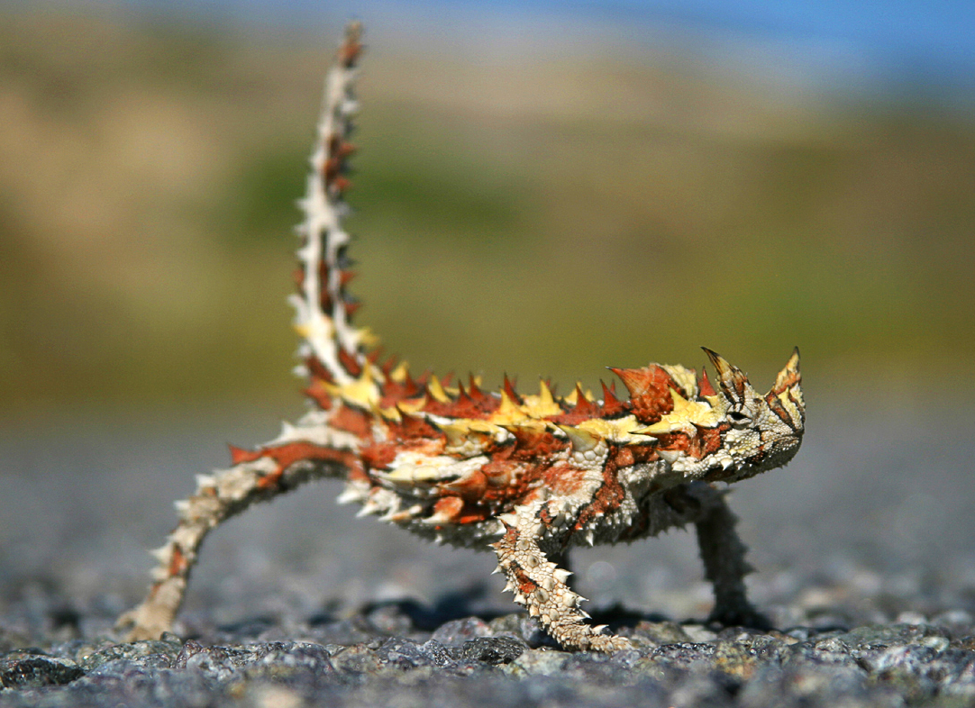
Thorny devil
Photo courtesy of electricnerve (@flickr.com) - granted under creative commons licence – attribution

