Slide 1

Outdoor Explorers
EYFS
Outdoor Explorers | Winter | Lesson 1 | Winter Wonderland

Slide 2


Slide 3
Aim
I can describe some of the signs of winter.
Success Criteria
I can identify some of the signs of winter.
I can say what happens to wildlife in winter.
I can say how to care for wildlife in winter.

Slide 4

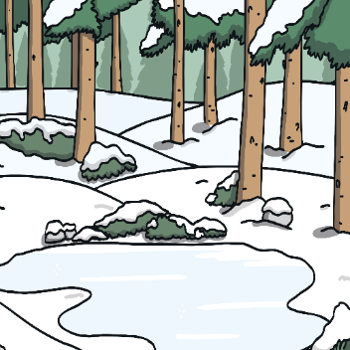
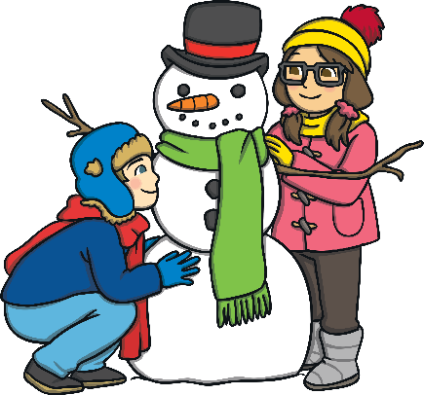
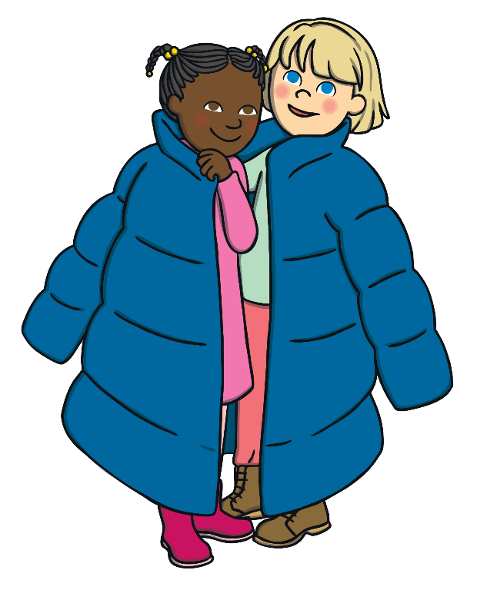
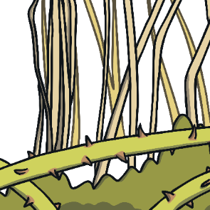
Outdoor Explorer Safety Rules
Stay in the safe zone –
never wander off alone.
Make sure that you always stay in the outside area that your teacher has marked with ribbons or cones.
Walk, don’t run – a bump is not fun.
Look out for other children when you are moving around your outside area.
Look out for dangers all around –
up high and on the ground.
Look out for prickly bushes, low branches or other dangers in your outside area.

Slide 5
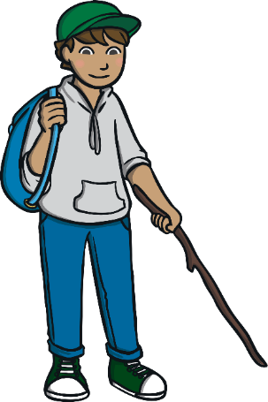
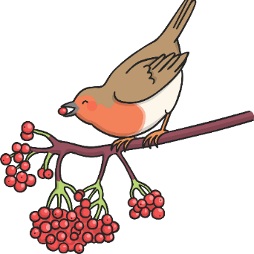

Outdoor Explorer Safety Rules
Keep sticks low - if sticks go high, they can poke you in the eye!
Always carry sticks pointing downwards. If you need to move larger sticks or branches, always drag them behind you.
Unless you are shown –
leave berries alone.
Never touch, pick or eat any berries, leaves or fungi as they could harm you.
Wash hands after play to keep
the germs away!
Always wash your hands before eating and after being outdoors.

Slide 6




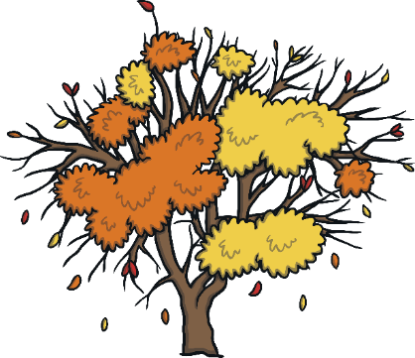



Winter
Winter is one of the four seasons. The months of winter in the UK are December, January and February.
spring
summer
autumn
winter

Slide 7
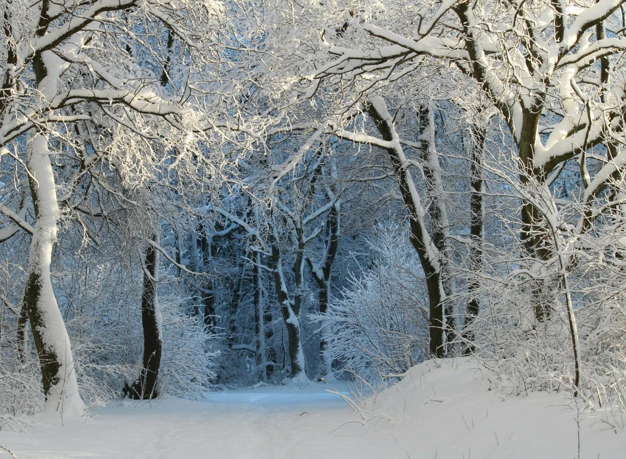

What Is Winter Like?
What is winter like?
What changes can you see outside?
How does winter make you feel?

Slide 8
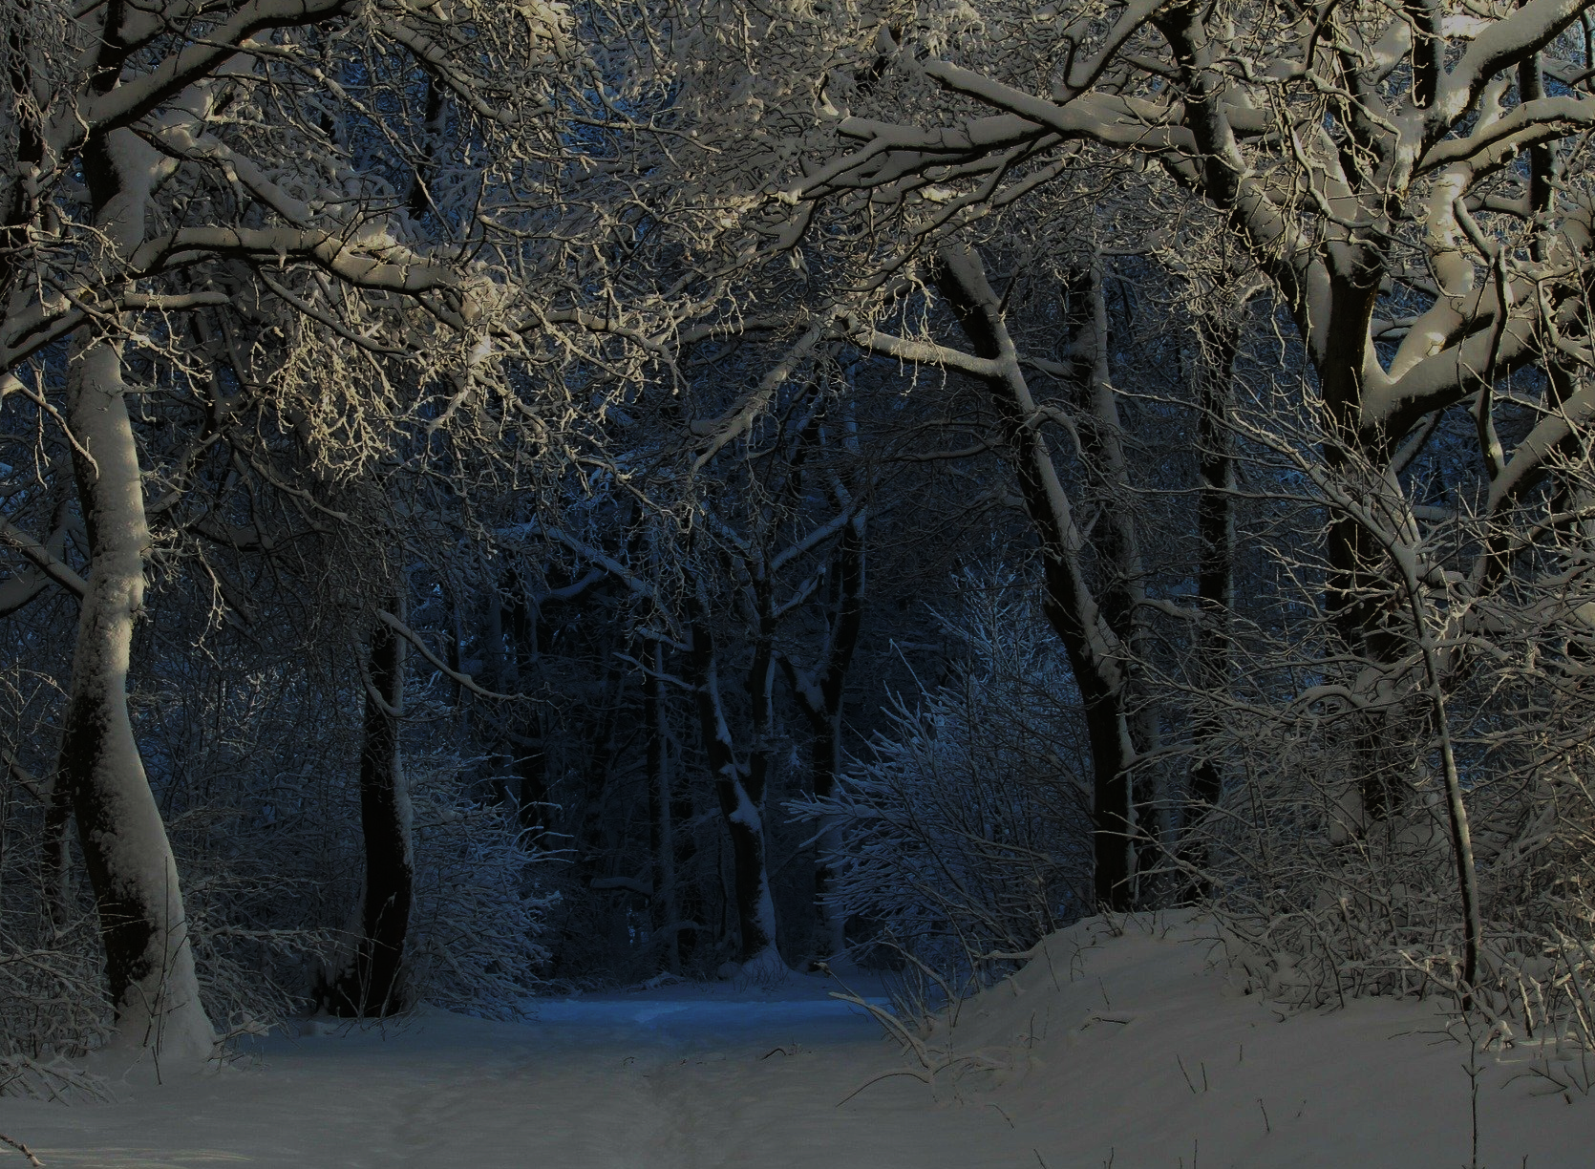

What Is Winter Like?
It can be very cold outside. There might be some frost or snow.
Many trees have bare branches.
During winter, it becomes dark much earlier in the evening…
…. and it is often dark in the morning when you wake up!

Slide 9
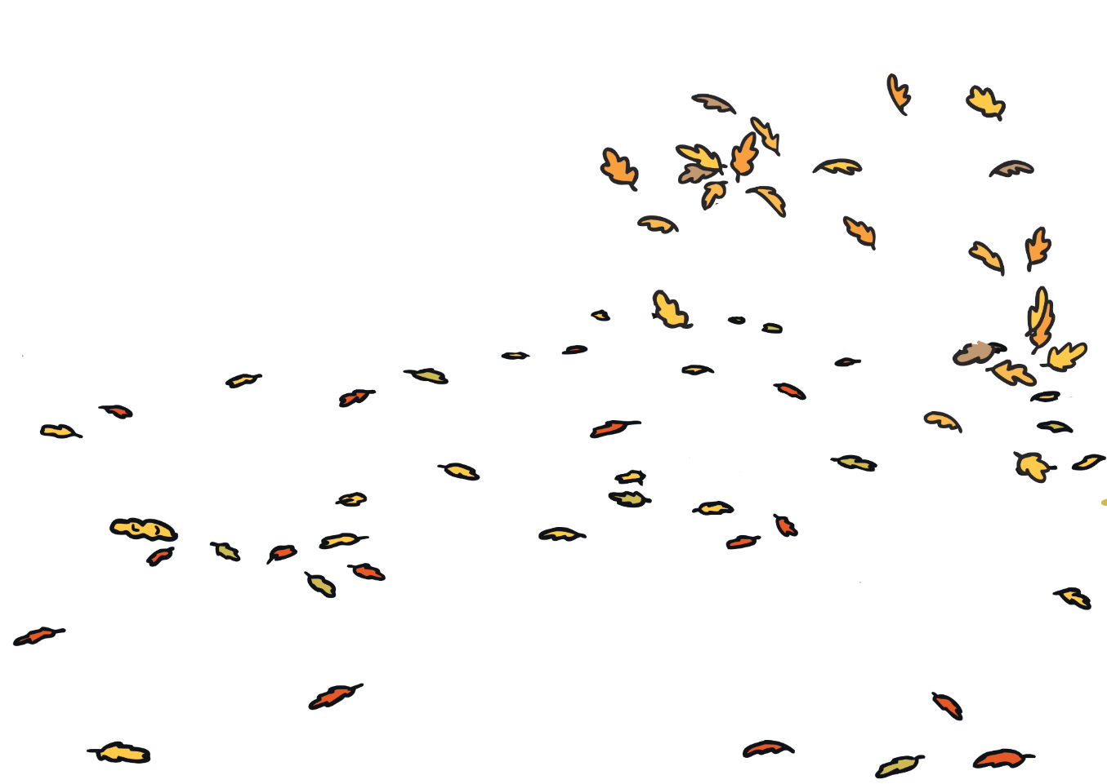
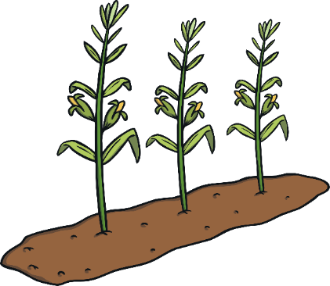
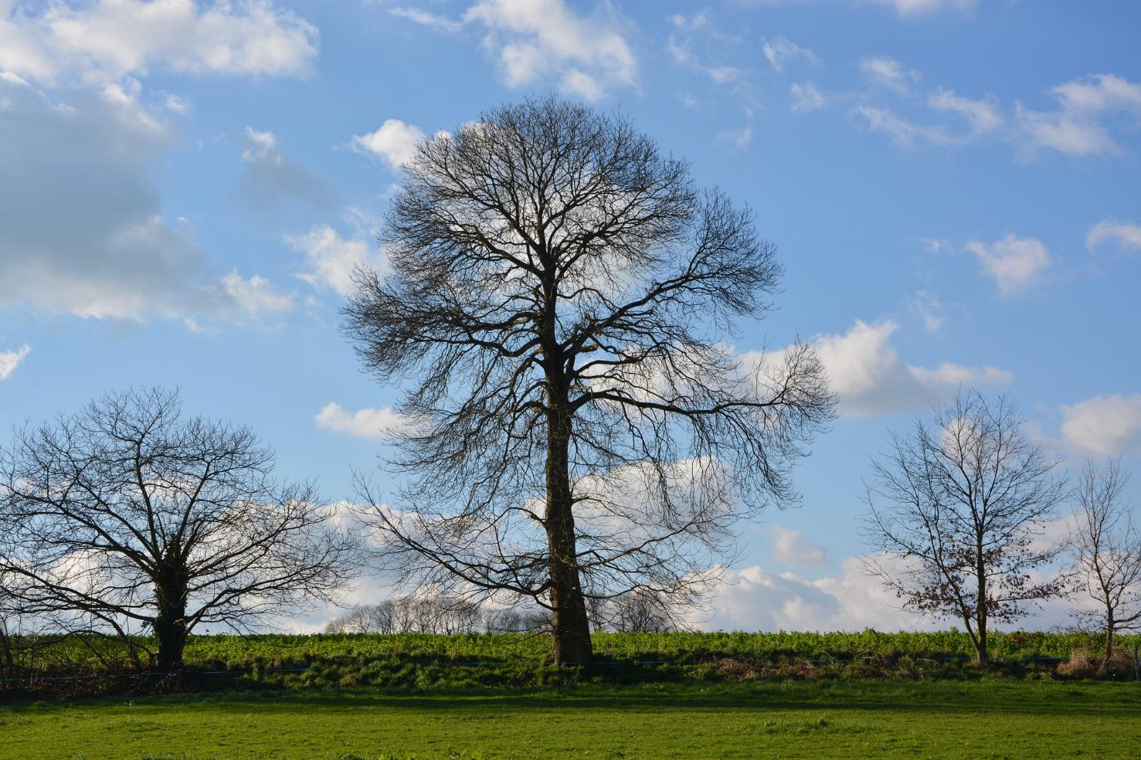






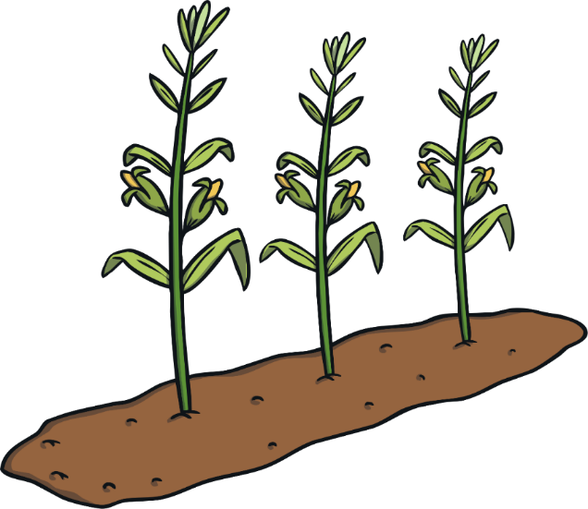

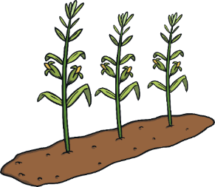
What Happens to Trees in Winter?
In the winter, deciduous trees have bare branches as they will have lost their leaves in autumn. Tiny buds can be seen gradually appearing on the branches.
These will grow into new leaves in spring. Evergreen trees keep their green leaves all year.

Slide 10
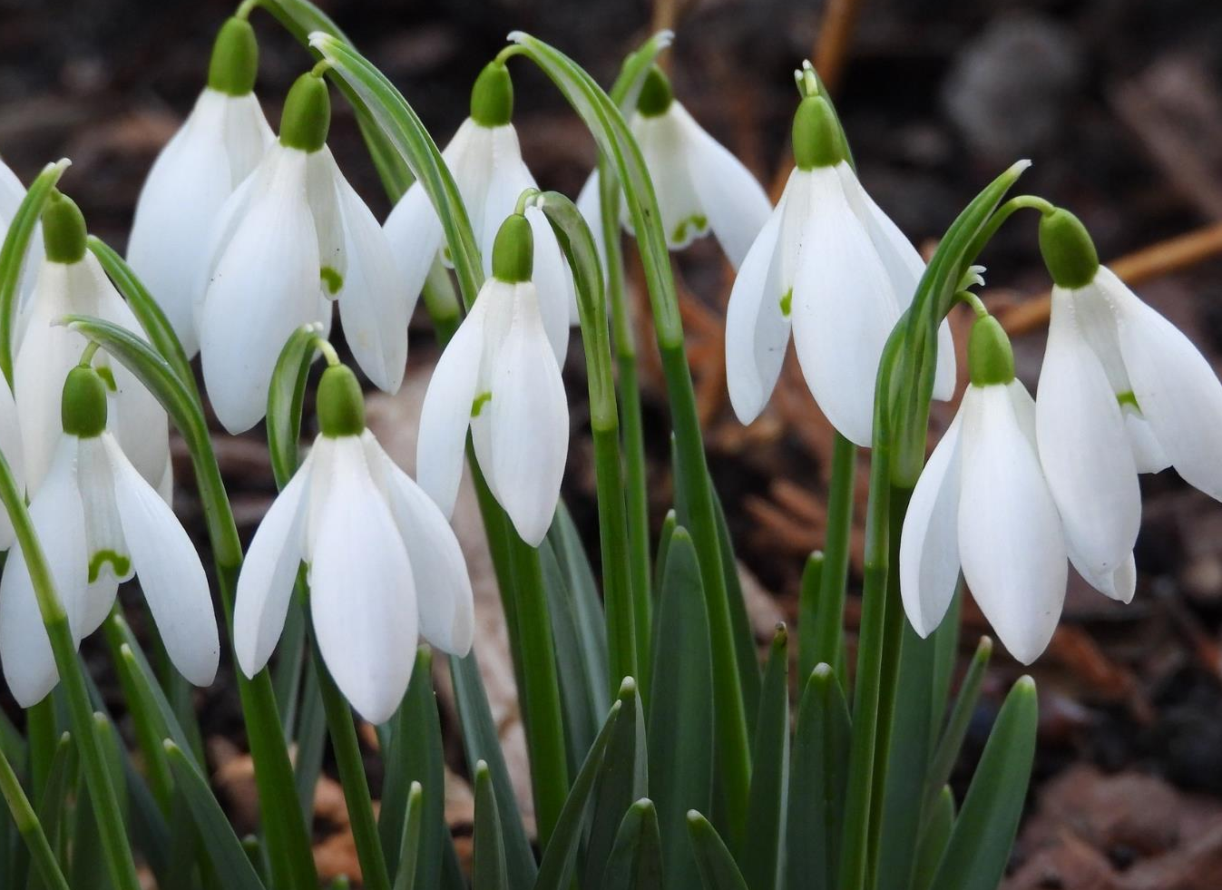
What Happens to Plants in Winter?
Many plants stop growing or die in winter due to the cold temperatures. Some plants will start growing in winter and produce flowers or berries.
These pretty snowdrops start to grow in January.

Slide 11
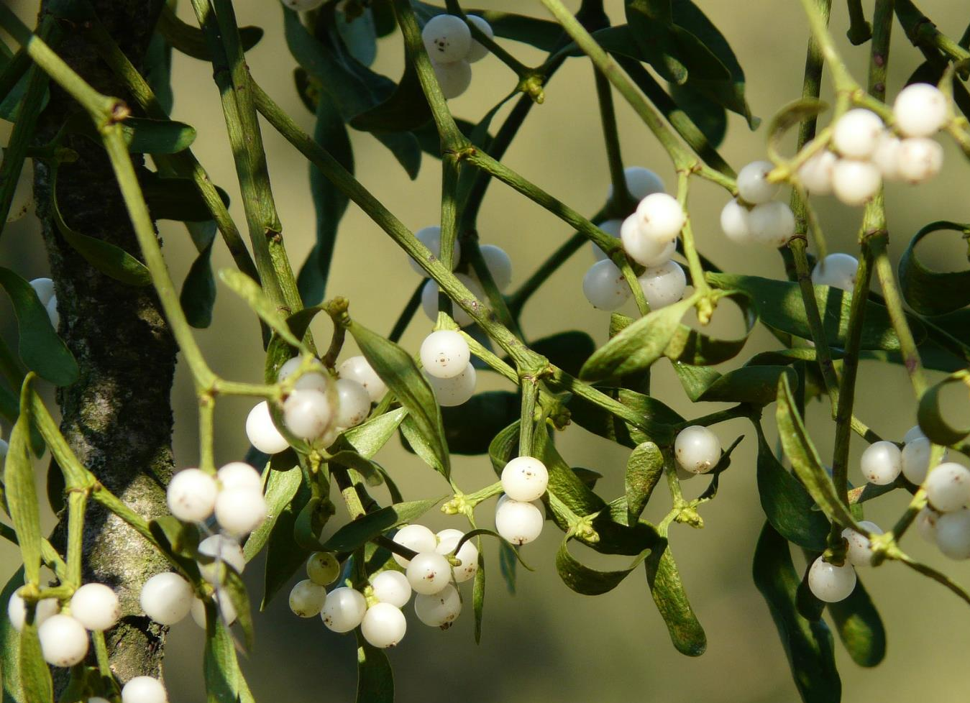
What Happens to Plants in Winter?
Many plants stop growing or die in winter due to the cold temperatures. Some plants will start growing in winter and produce flowers or berries.
Mistletoe berries can be seen in winter.

Slide 12
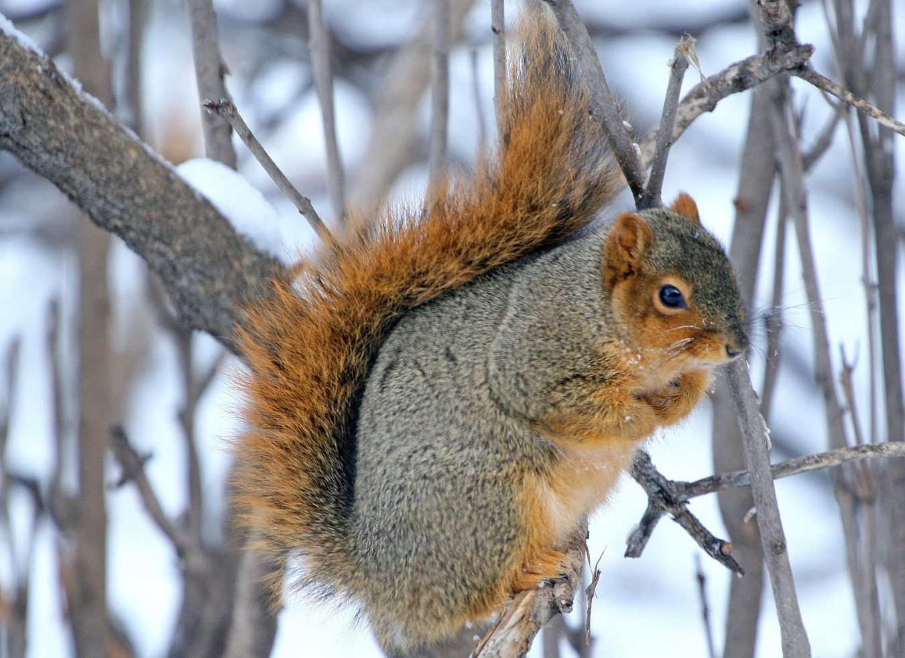
\
What Happens to Animals in Winter?
Some animals, such as foxes, badgers and squirrels, grow thicker fur in the winter to help keep themselves warm. Hedgehogs, dormice and bats hibernate, while frogs and toads often sleep through winter in the mud at the bottom of a pond.
This squirrel has grown a thick fur coat to keep out the cold!

Slide 13
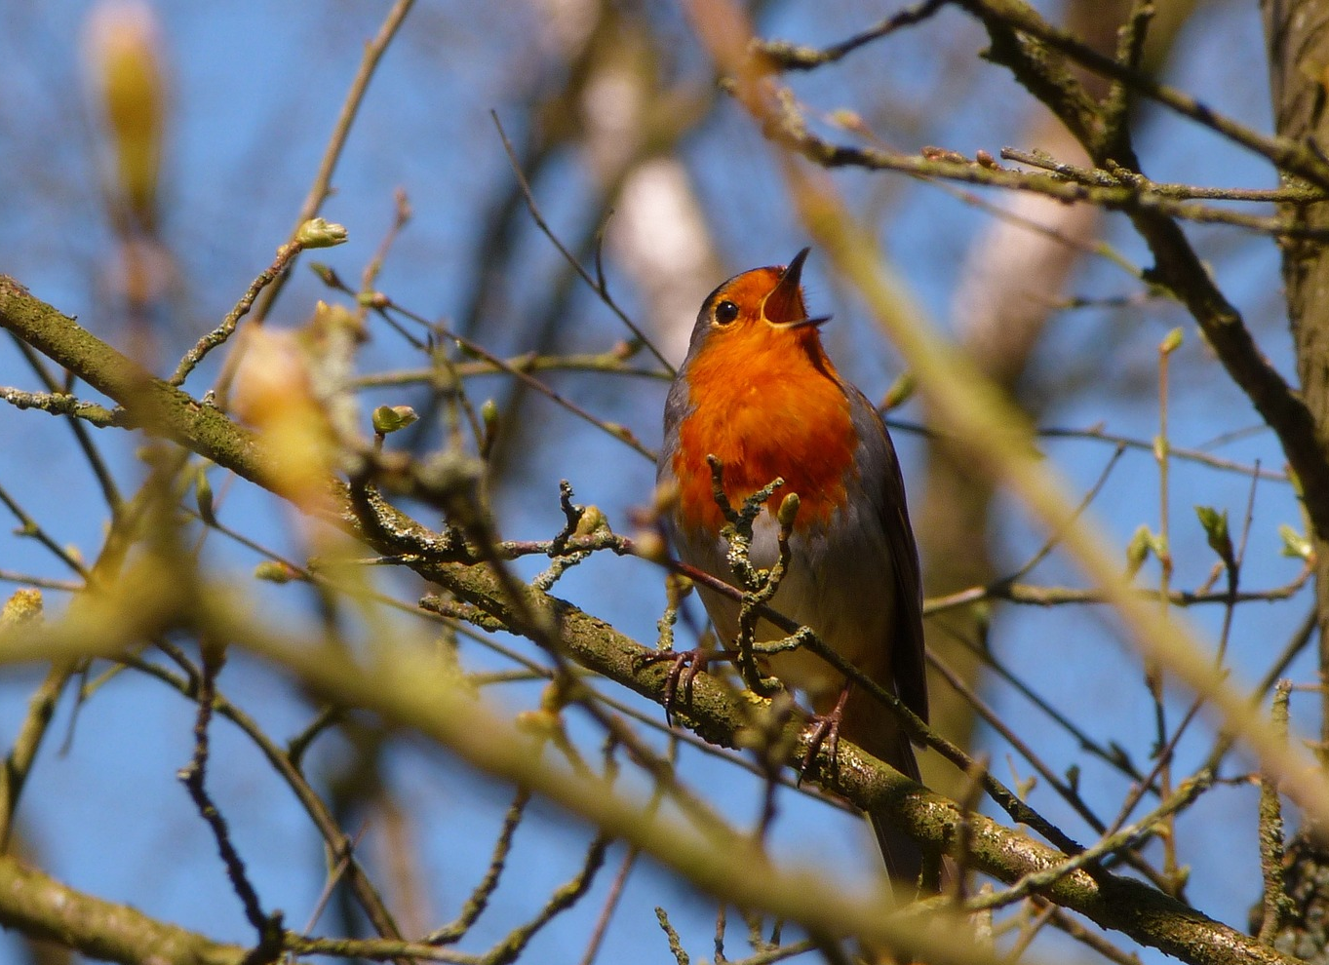

What Happens to Birds in Winter?
In winter, birds grow more feathers to help to keep themselves warm. Some birds, such as starlings, rooks and wrens, huddle together for warmth at night.
Migrating birds, such
as swallows, spend the winter in warmer countries before returning to the UK
in the spring.
\

Slide 14
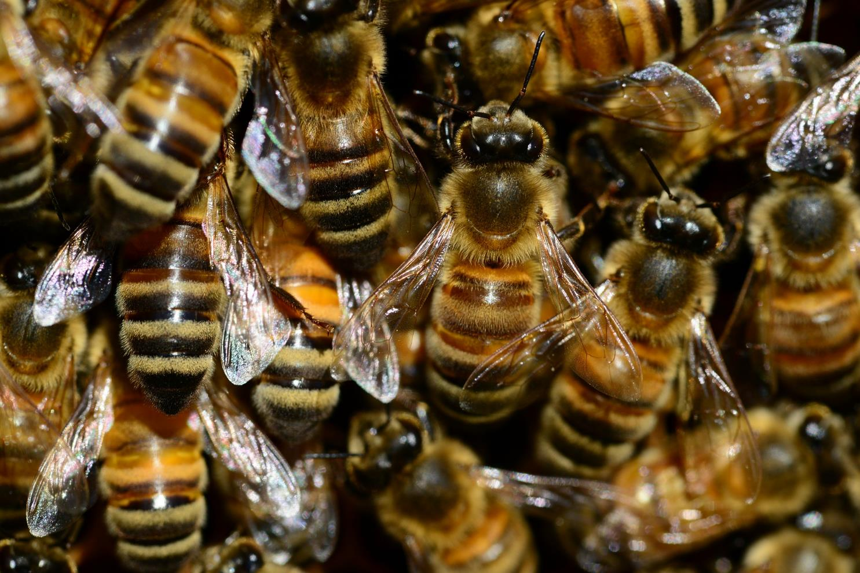
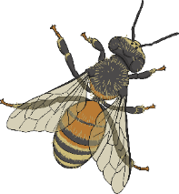
What Happens to Minibeasts in Winter?
Fewer minibeasts can be seen in winter. Many die after laying their eggs, while others shelter or hibernate under piles of logs or in holes in trees. The Painted Lady butterfly flies all the way to Africa for the winter!
These honey bees spend the winter huddling together in their hive to keep warm.

Slide 15
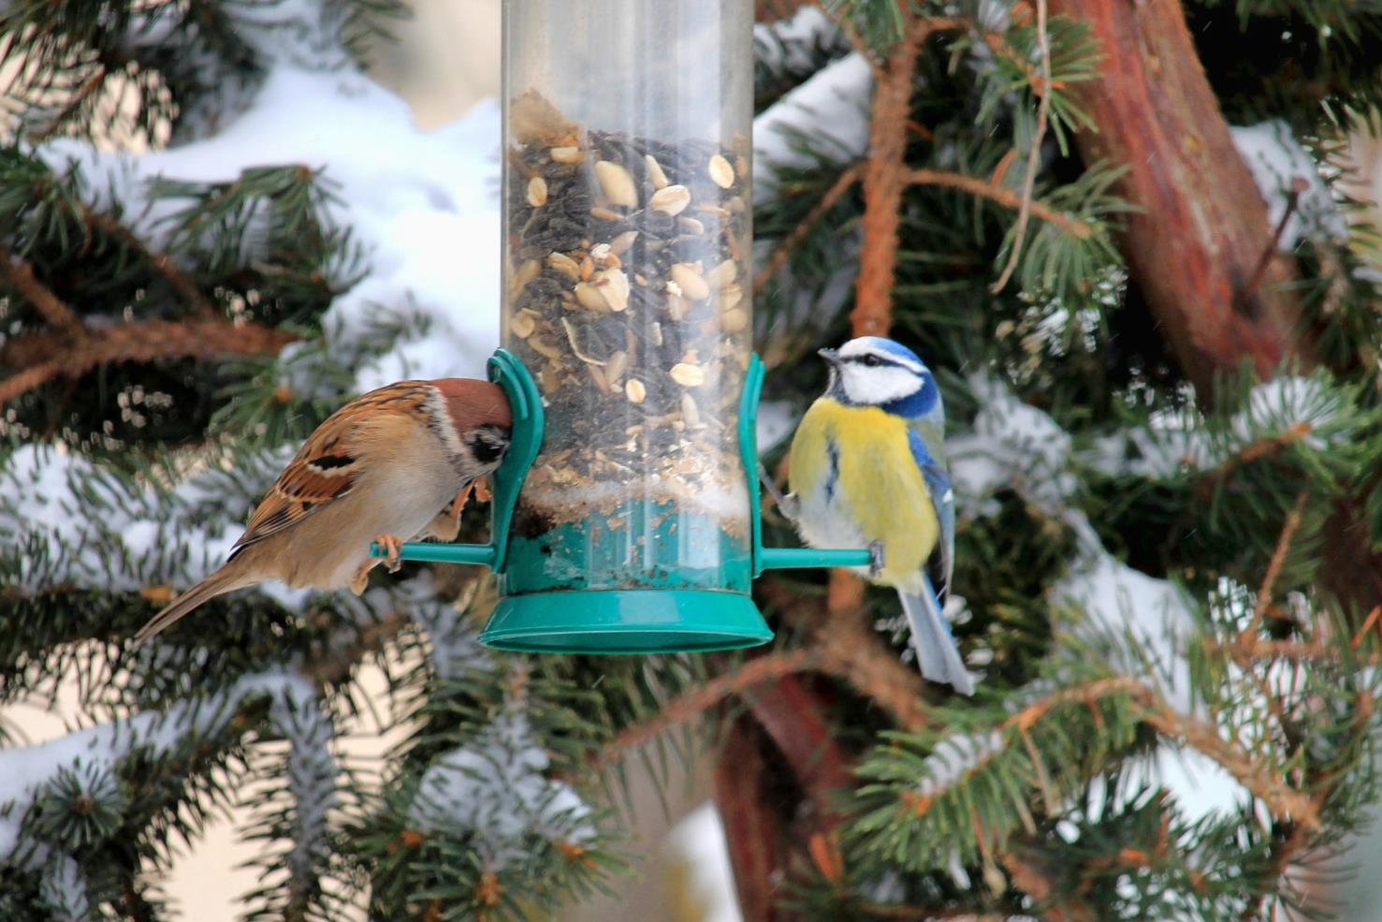

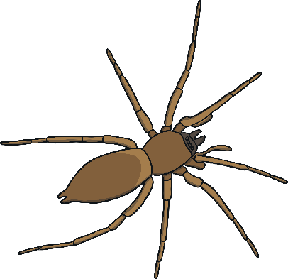
How Can We Look after Nature in Winter?
Winter can be hard for wildlife as it is cold and there is less food.
You can help birds by putting up a bird feeder in your garden.
A pile of logs or stones would make an ideal place for insects to shelter in over the winter.

Slide 16
Aim
I can describe some of the signs of winter.
Success Criteria
I can identify some of the signs of winter.
I can say what happens to wildlife in winter.
I can say how to care for wildlife in winter.

