Slide 2
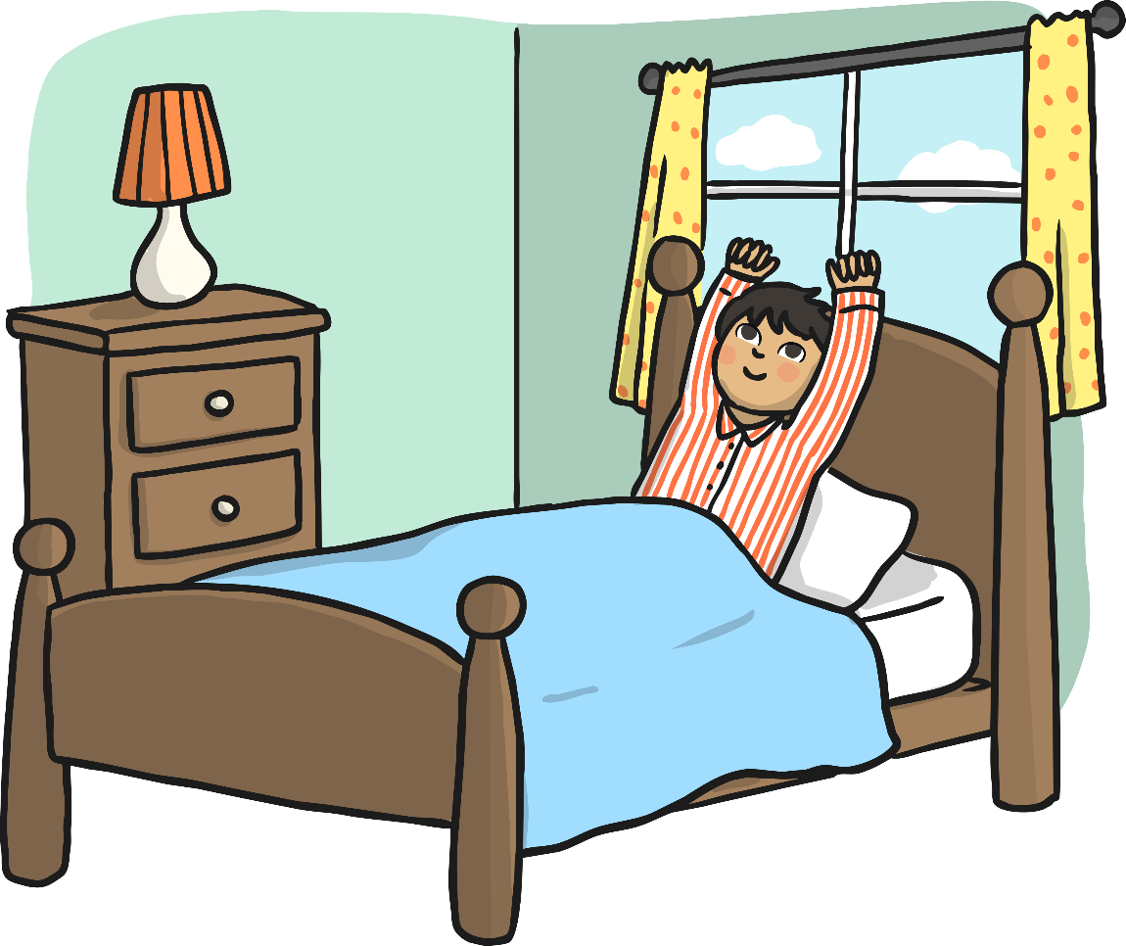
Luke woke up suddenly as his alarm clock rang loudly. He sleepily rubbed his eyes and then remembered what day it was – it was Easter Sunday! He smiled and stretched – Easter Sunday was one of his favourite days of the year.

Slide 3
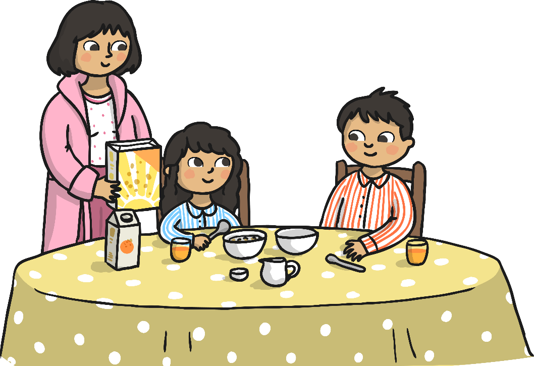
Luke and his little sister Chloe had cornflakes for breakfast. Mum said, “Happy Easter, Luke!”
“Happy Easter, Mum!” said Luke.
“We are going to church soon,” said Mum, “so when you’ve finished breakfast you can get washed and dressed. Dad has put a little surprise for each of you on your beds. You can wear them to church today!” Luke and Chloe looked at each other and smiled.
“Hooray – Easter gifts!” said Chloe. They quickly finished their breakfast and then went upstairs.

Slide 4
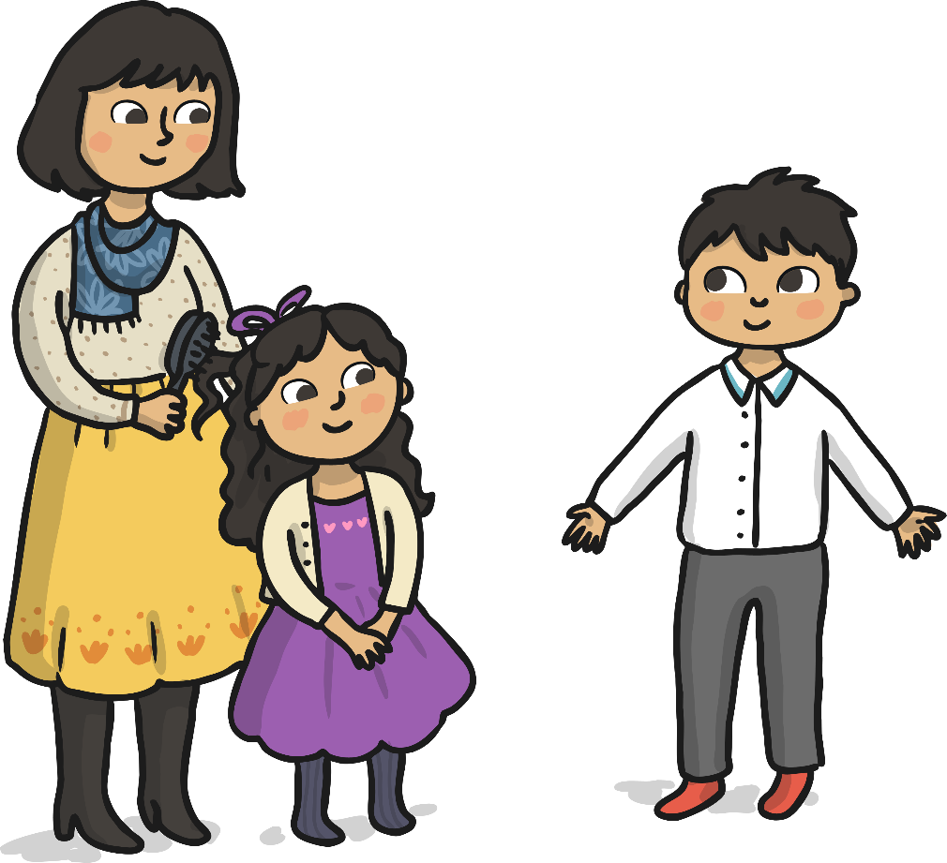
On Luke’s bed was a new pair of smart trousers and a smart shirt. Luke quickly got washed and dressed and then came back downstairs. Chloe had a new dress to wear too.

Slide 5
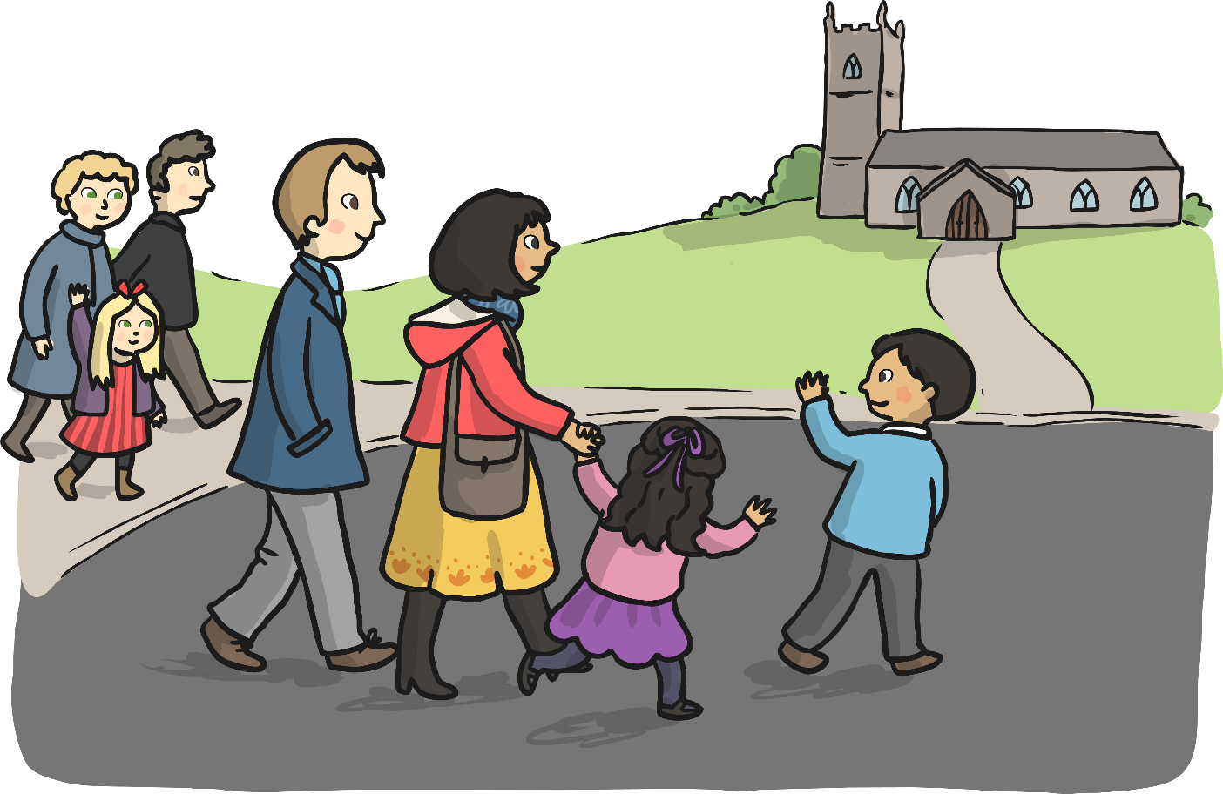
Then they were off to church. The church was only a short walk from their house and they saw some of their neighbours on their way to church too. Luke saw his friend Amy and waved.
“Happy Easter, Amy!” he called and Amy waved back.

Slide 6
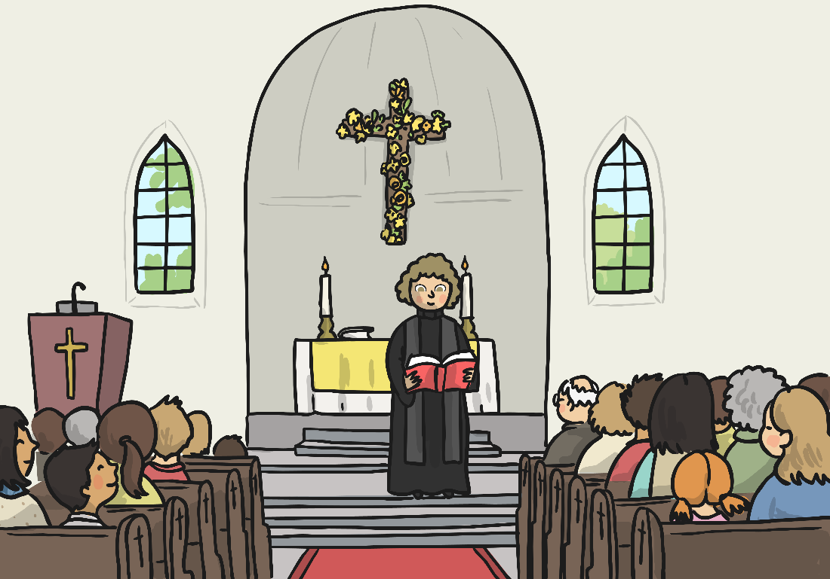
The church had been decorated with lots of flowers, palm leaves and candles.
“It looks very pretty in here.” said Chloe and they sat down on the pews.
“The flowers are to celebrate new life and the candles remind us that Jesus is the light of the world,” said Mum. “It looks beautiful doesn’t it? Even the cross has been decorated with bright yellow daffodils!”
The family listened carefully as the priest read from the Bible and told the story of how Jesus died on the cross but came back to life again.

Slide 7
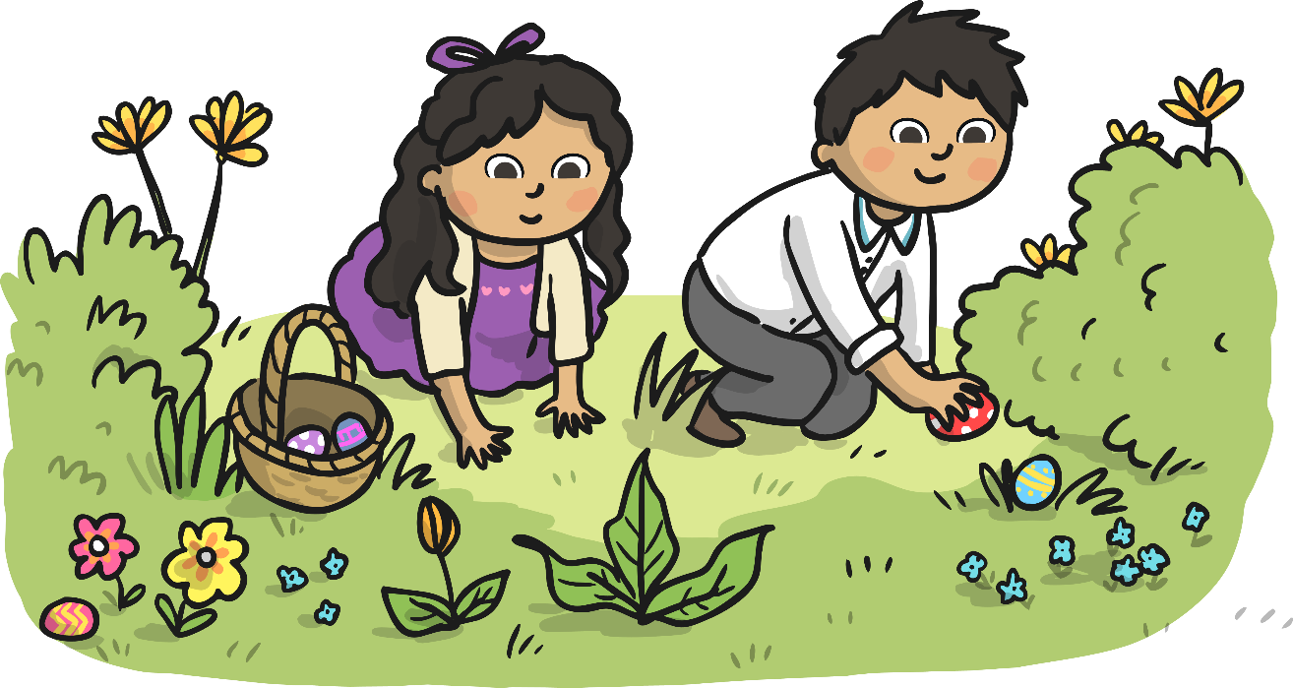
After the service, everyone went outside. Luke and Chloe were very excited as it was time for the Easter egg hunt! All the children were given a basket and then ran around the church garden looking for Easter eggs. Luke and Chloe ran happily around the garden and carefully collected some more eggs and then rushed back over to Mum and Dad.
“Look!” cried Chloe, “We found lots of eggs! I’ve got 1, 2, 3, 4, 5! 5 eggs – the purple one is my favourite!”
“I found 5 too!” said Luke, “I like the red one best!”
Luke and Chloe ate some of their eggs and then put the rest in their baskets to take home.

Slide 8
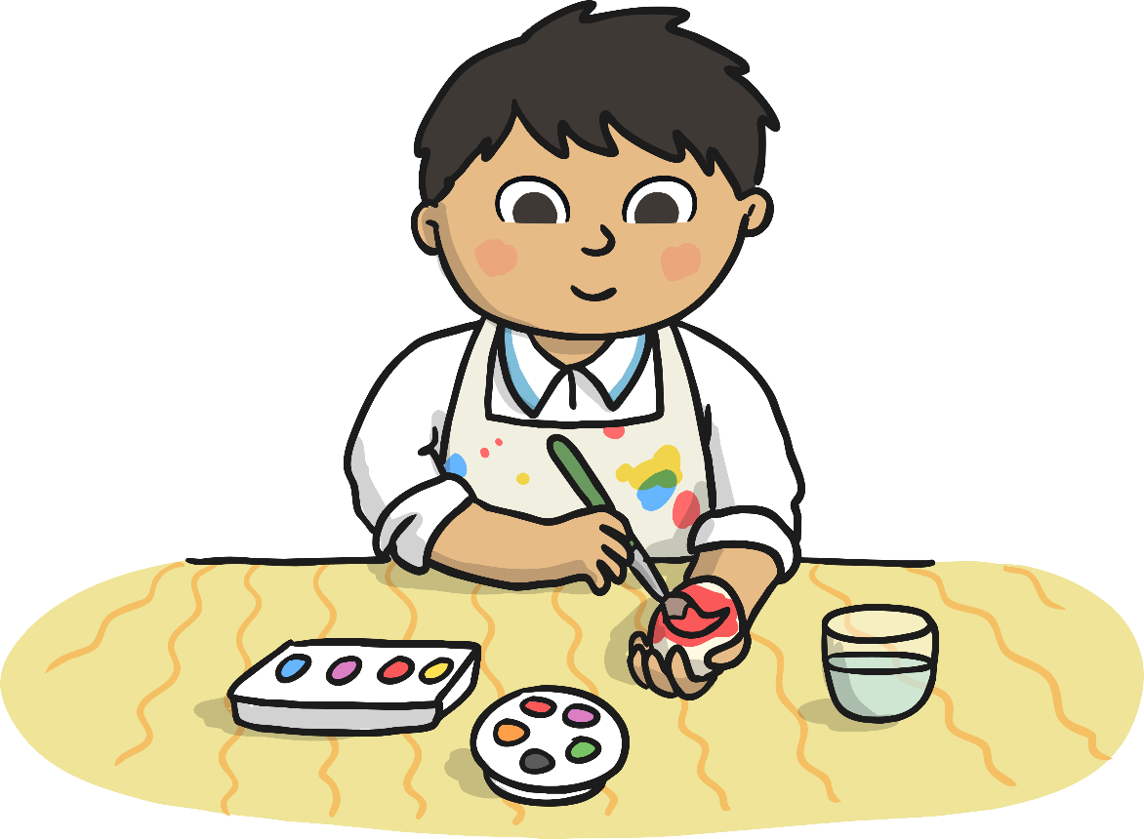
A lady from the church was helping some children to make Easter bonnets. Chloe wanted to make one so Dad stayed to help Chloe whilst Luke and Mum went to look at the egg decorating table. A man had a table with lots of paints, brushes and hard-boiled eggs. Luke chose an egg and began painting it red. Soon he had finished painting and the man asked if he was going to take part in the egg rolling competition!

Slide 9
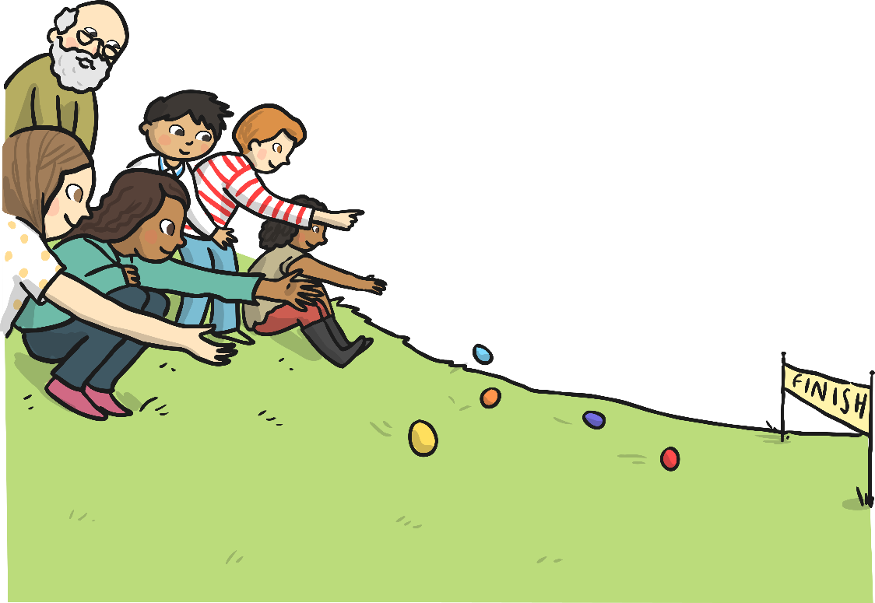
Luke picked up his egg and went to ask Mum about the egg rolling competition. Mum told Luke that every year people stand at the top of the little hill and roll their egg down the hill!
“The egg that gets to the finish line first wins a prize!” said Mum. “Why don’t you have a go, Luke?”
Chloe and Dad came to see what Luke and Mum had been doing. Chloe was wearing her new Easter bonnet and also holding a large Easter egg wrapped in shiny gold paper!
“Look, Luke! I won a prize for making my Easter hat! We can share it!”
“Wow! That’s great!” smiled Luke, “I’m going to enter the egg rolling race with my red egg! Come and watch.”

Slide 10
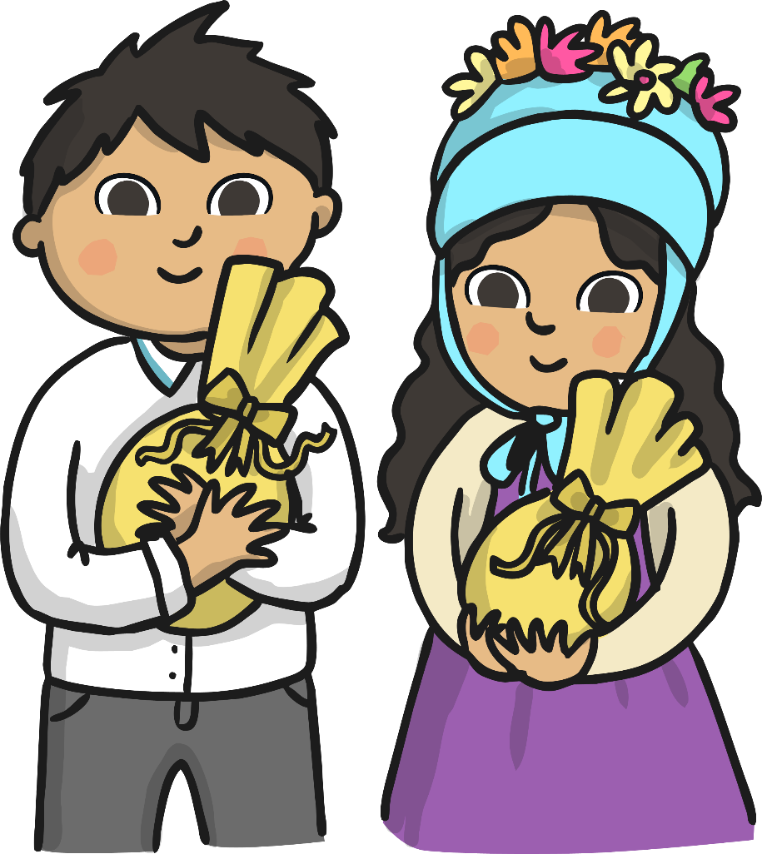
Everyone went to watch the egg rolling race. Chloe cheered for Luke and then he took the lead. His little red egg went whizzing and bouncing down the hill and crossed the finish line first!
“Hooray!” shouted Chloe!
The priest came up to Luke and gave him a shiny gold Easter egg, just like Chloe’s! Luke and Chloe rushed back to Mum and Dad to show them their prizes!
“Well done both of you! What a lovely Easter treat!” said Dad.

Slide 11
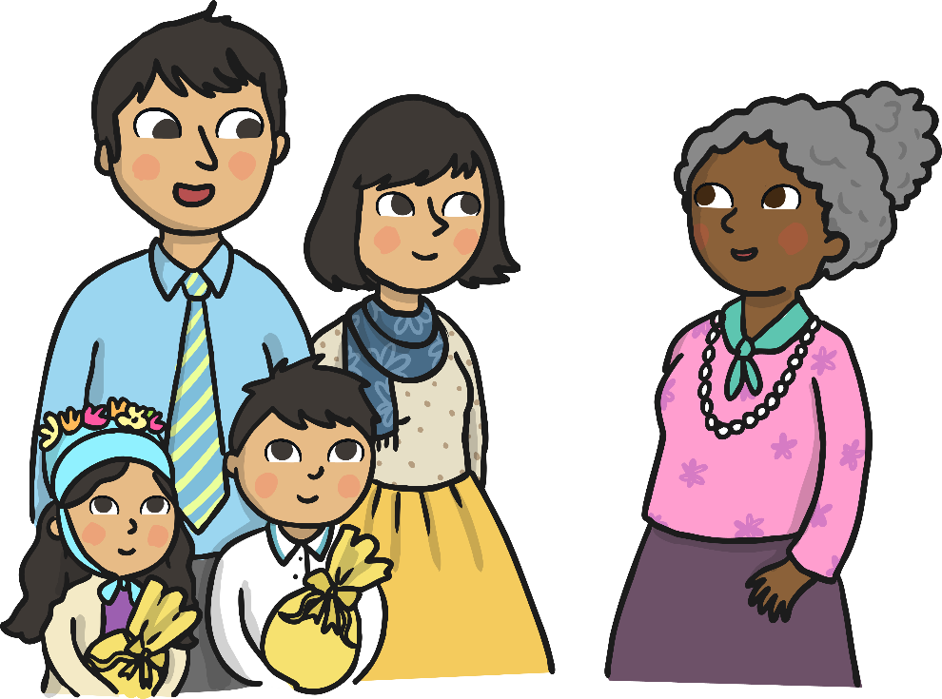
“We’ve been talking to Mrs Sunbury. She was telling us that she gave up chocolate for Lent – I don’t know if you could do that, Luke!” chuckled Dad.
“Maybe next year I will!” giggled Luke, “Well, I’ll try!”
“We gave up eating sweets this year,” said Chloe. “It was really hard, but we did it!”
“You both did really well,” said Mum. “It is very difficult to give something up. It was hard for Dad and me to stop eating cake, but we did it too!”
“I liked it when we made pancakes before Lent started,” said Luke. “We made lots!”
“It was funny when you tried to
toss the pancake, Dad, and it nearly
got stuck on the ceiling!” laughed Chloe!
“Hmm,” said Dad remembering the
mess he had made!

Slide 12
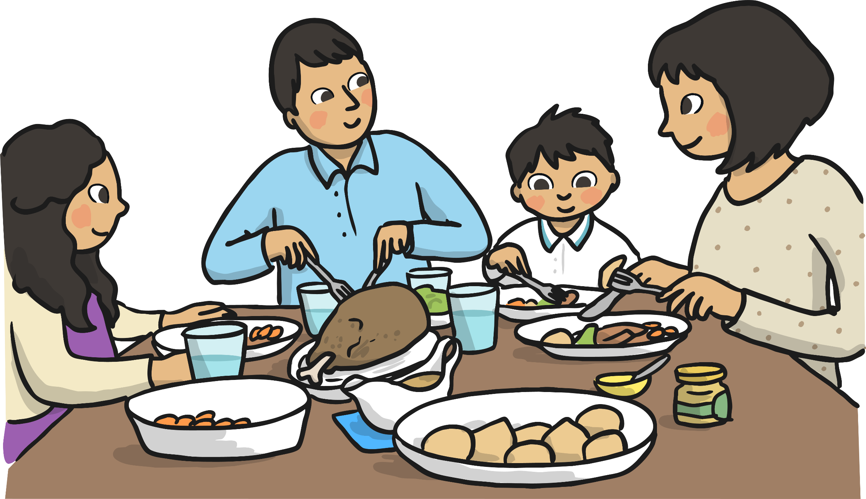
Soon it was time to go home. When they got home they helped Mum to make lunch. They were having roast lamb, vegetables and mint sauce. Soon, lunch was ready and the family had a lovely meal together. After lunch, Mum toasted some hot cross buns for everyone.
“Yummy!” shouted Luke, “My favourite!”

Slide 13
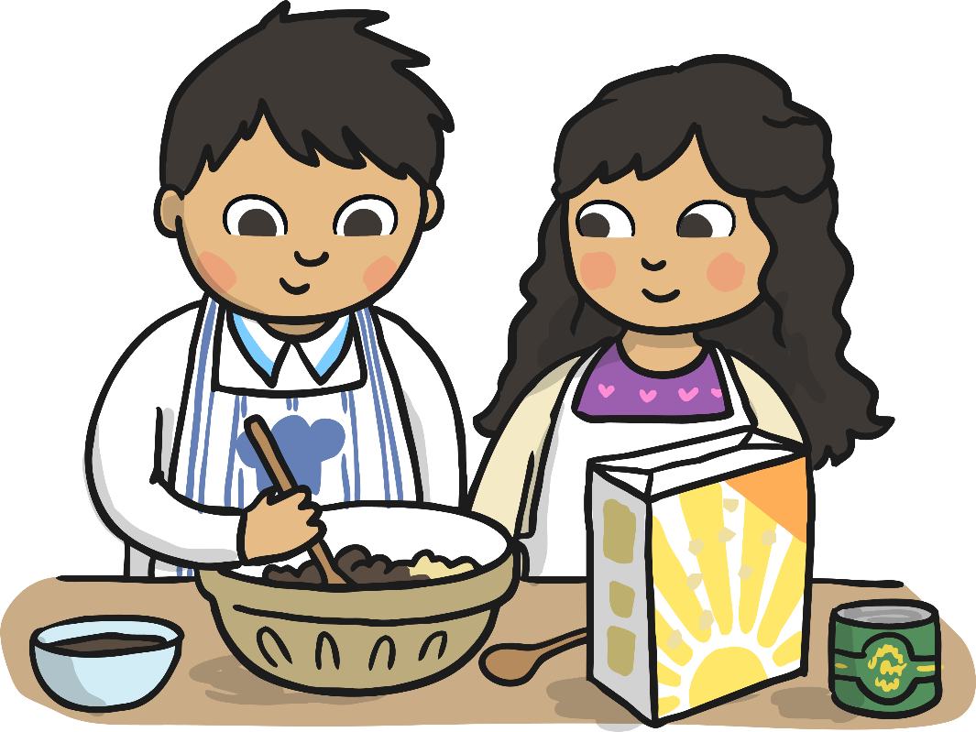
Then Luke and Chloe decided to help Dad with some baking. “I’m making your Mum’s favourite, simnel cake,” said Dad. “It will be a lovely Easter treat after Lent!”
Then Luke had an idea: “We could make some Easter nest cakes, Chloe! I saw some children making them at the church, we need some chocolate and some cornflakes!”
“Cornflakes!” said Chloe “Like I had for breakfast?”
“Yes, that’s right!” said Luke. “We can melt my golden egg for the chocolate!” Dad helped them to mix all the ingredients together and then put the mixture into the some cake cases. Then they put some of their little chocolate eggs on top.

Slide 14
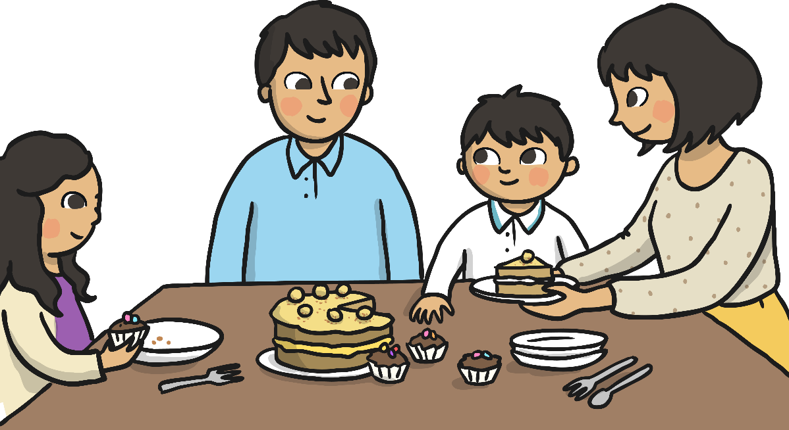
Soon the simnel cake was done too and Chloe and Luke helped to put the marzipan on top and roll some marzipan balls to decorate the cake. Mum had been busy putting some flowers into vases and came to see what Dad, Luke and Chloe had been making.
“Oh, yummy, my favourite – I love simnel cake!” cried Mum.
“We made Easter nest cakes too,” said Chloe, showing Mum the plate of chocolate cakes.
“Well, I might have to have one of those too!” giggled Mum. Everyone enjoyed eating the simnel and Easter nest cakes and Chloe also shared some of her golden egg with everyone.

Slide 15
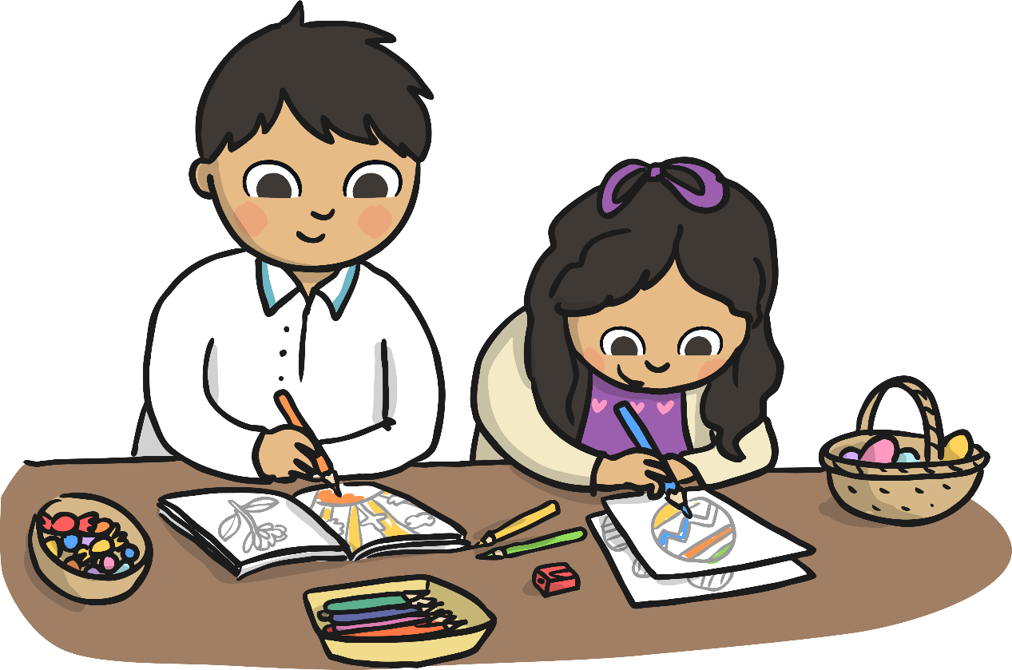
After tea and cake, Mum and Dad said they had a little surprise for Luke and Chloe – an Easter colouring book and a little basket of sweets!
“Yummy! Thanks, Mum and Dad,” said Luke and Chloe.
They coloured the Easter egg pictures and also stuck on some of the golden wrapper that had wrapped their chocolate Easter eggs. Luke and Chloe continued colouring until dinner time.

Slide 16
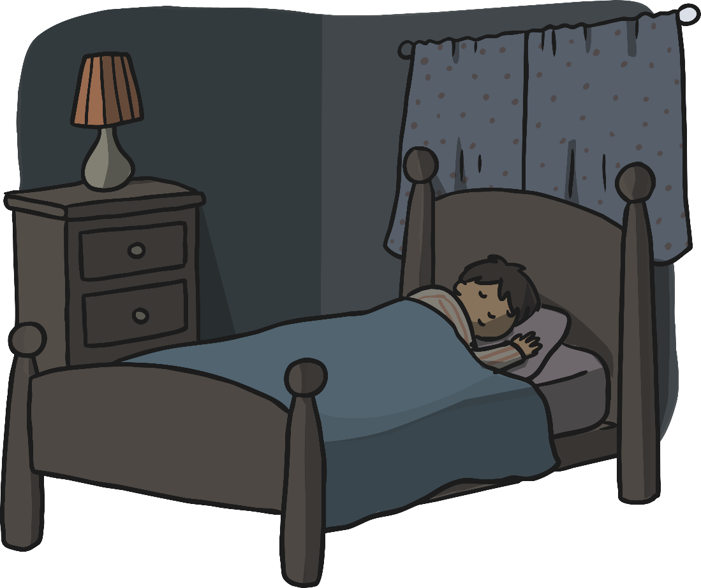
After dinner it was time for a bath, a story and bed.
“Thanks for a great Easter, Mum,” said Luke as Mum tucked him into bed.
“Thank you too, Luke. It was a lovely day and your chocolate Easter nest cakes were delicious!” Luke smiled and closed his eyes and slowly drifted off to sleep.

