Slide 1

Outdoor Explorers
EYFS
Outdoor Explorers | Winter | Lesson 5 | Winter Birds

Slide 3
Aim
I can explain how birds survive during the winter.
Success Criteria
I can identify some birds that live in the UK in winter.
I can say how birds keep warm in winter.
I can say how to look after birds in winter.

Slide 4

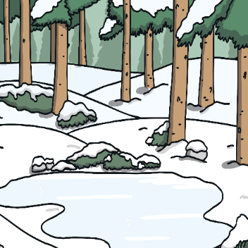
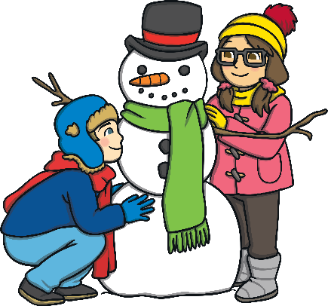
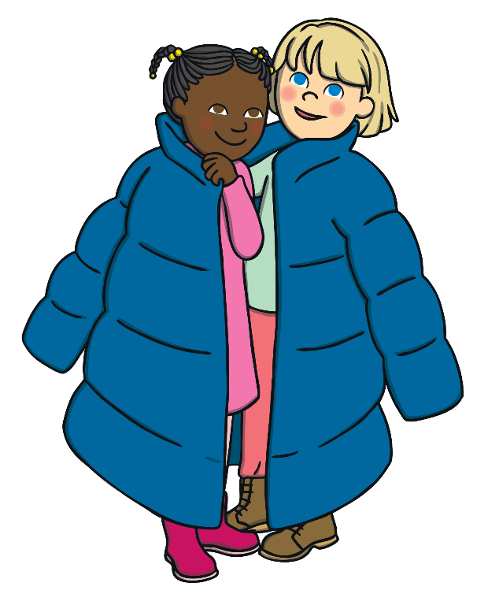

Outdoor Explorer Safety Rules
Stay in the safe zone –
never wander off alone.
Make sure that you always stay in the outside area that your teacher has marked with ribbons or cones.
Walk, don’t run – a bump is not fun.
Look out for other children when you are moving around your outside area.
Look out for dangers all around –
up high and on the ground.
Look out for prickly bushes, low branches or other dangers in your outside area.

Slide 5

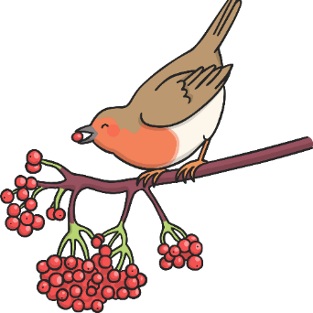

Outdoor Explorer Safety Rules
Keep sticks low - if sticks go high, they can poke you in the eye!
Always carry sticks pointing downwards. If you need to move larger sticks or branches, always drag them behind you.
Unless you are shown –
leave berries alone.
Never touch, pick or eat any berries, leaves or fungi as they could harm you.
Wash hands after play to keep
the germs away!
Always wash your hands before eating and after being outdoors.

Slide 6



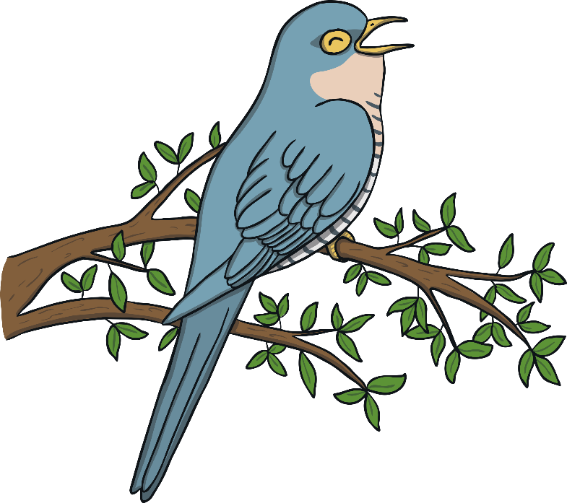
What Happens to Birds in the Winter?
Winter is a great time of year to see birds. They will be visiting your garden or outdoor area in search of food, water and shelter and they will be easier to see among the bare branches of trees and bushes.
While some birds have been here all year, others have flown for hundreds of miles from Scandinavia, Russia and Central Europe to spend the winter in the UK!

Slide 7

How Do Birds Keep Warm in Winter?
Fluffy Feathers
Birds grow lots of new, fluffy feathers in winter. Feathers are slightly waterproof and birds can fluff them up to keep warm.
Snuggling Up
Some birds, such as starlings, rooks and wrens, huddle together in the night to keep warm. This is called roosting.
All About Food
Birds try to eat as much food as they can during the autumn so that when winter comes they have an extra layer of fat to help keep them warm.

Slide 8
Which Birds Live in the UK All Year Round?
This is a robin.
Robins are easy to spot with their orange bib. They are often pictured on Christmas cards!
Robins are found in woodland, gardens and parks in the UK all year round. In winter, we often see visiting robins that have migrated from Europe too.
Robins are friendly birds and will often fly close to you for a tasty mealworm! They can be heard singing in winter.

Slide 9
Which Birds Live in the UK All Year Round?
Starlings look a little like blackbirds but they have speckled, metallic, green and purple feathers.
This is a starling.
Starlings are found in the UK all year round. In winter, they are joined by visiting starlings from colder parts of Europe.
Starlings form large flocks which can be seen at dawn and dusk. Starlings often copy sounds like car alarms and ringing phones!

Slide 10
Which Birds Live in the UK All Year Round?
This is a blackbird.
Male blackbirds are completely black with a yellow beak and eye ring. Females are brown with a darker yellow beak.
Blackbirds can be seen in gardens and woodlands in the UK all year round. In winter, they are joined by visiting blackbirds that have migrated from Scandinavia and Europe.

Slide 11
Which Birds Are Winter Visitors?
This is a fieldfare.
Fieldfares have a grey head and tail and brown wings and back.
Fieldfares migrate to the UK from northern Europe in the winter. They are often seen in hedgerows.
Fieldfares form large flocks. They feed on berries, fruit and windfall apples.

Slide 12
Which Birds Are Winter Visitors?
This is a redwing.
Redwings have red patches under their wings and mottled feathers on their front.
Redwings arrive in the UK in the early autumn from northern Europe, Russia and Iceland. They can be found in hedgerows, parks and fields of crops.
Redwings eat berries and fruit.

Slide 13
Which Birds Are Winter Visitors?
This is a waxwing.
Waxwings look quite different to other birds. They have grey feathers, a black bib under their beak and a black eye mask.
Waxwings migrate to the UK in the winter from Scandinavia and Siberia.
Waxwings like eating berries.

Slide 14
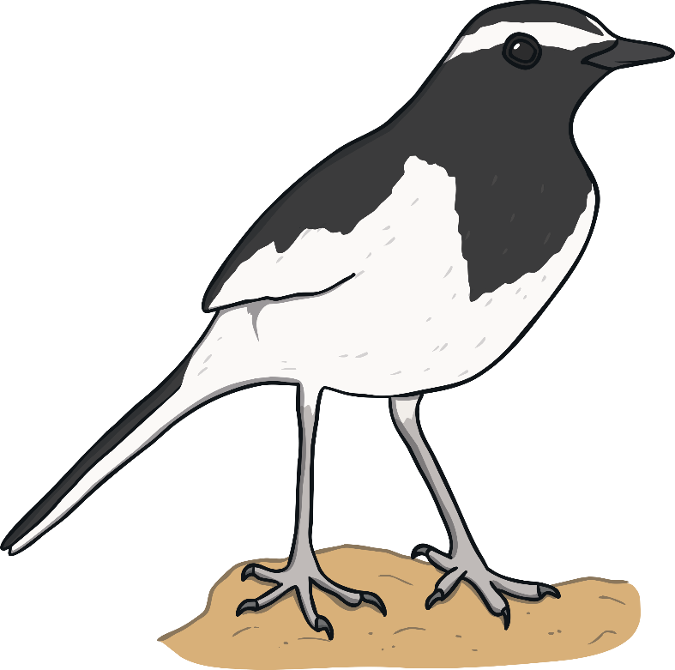



How Can We Look After Birds in Winter?
As temperatures fall and there is less food available for birds, you may see more birds coming into your garden.
You can help birds by:
putting out fresh, ice-free water for drinking and bathing
hanging up fat balls or bird feeders
having places in your garden where birds can shelter, such as hedges or ivy

Slide 15
Aim
I can explain how birds survive during the winter.
Success Criteria
I can identify some birds that live in the UK in winter.
I can say how birds keep warm in winter.
I can say how to look after birds in winter.

