Slide 1



Slide 2
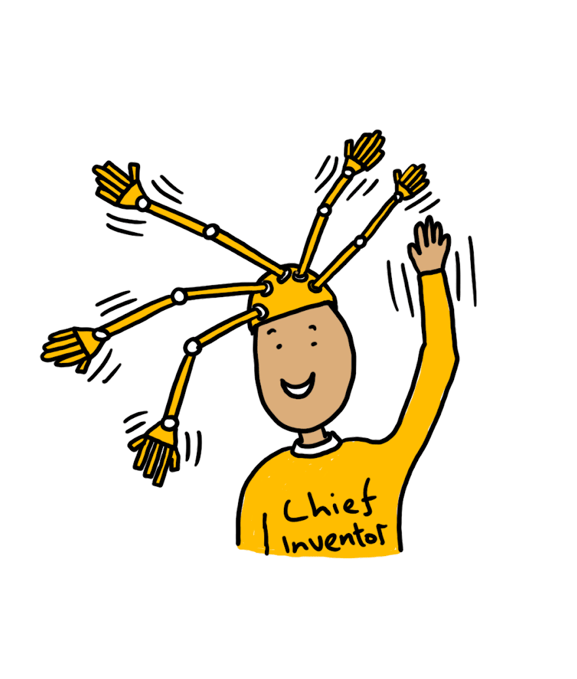
I’m Dominic Wilcox, the Chief Inventor at Little Inventors and...
I challenge you!
I know a lot of you will now be at home and we want to make sure those brains of yours are kept busy during this time. I present to you, the Little Inventors Daily Challenge!
Here are my first 15 challenges in one place - you could do one, two or all of them if you want! There are challenges that deal with all sorts of problems, some serious and some just good fun. There will be more soon!
Whatever challenge you take, we would love to see it! So upload it to littleinventors.org or share it on our social media with tag #timeforcreativity.
We will choose our favourite invention every week and the winner will receive their own copy of the Little Inventors Handbook to keep the ideas flowing!

Slide 3
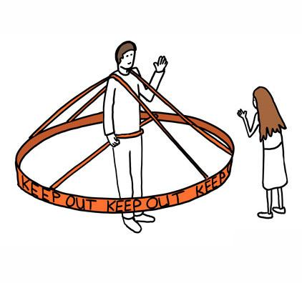


Daily Challenge
Draw an invention
to keep people two metres apart
Idea by Dominic Wilcox

Slide 4
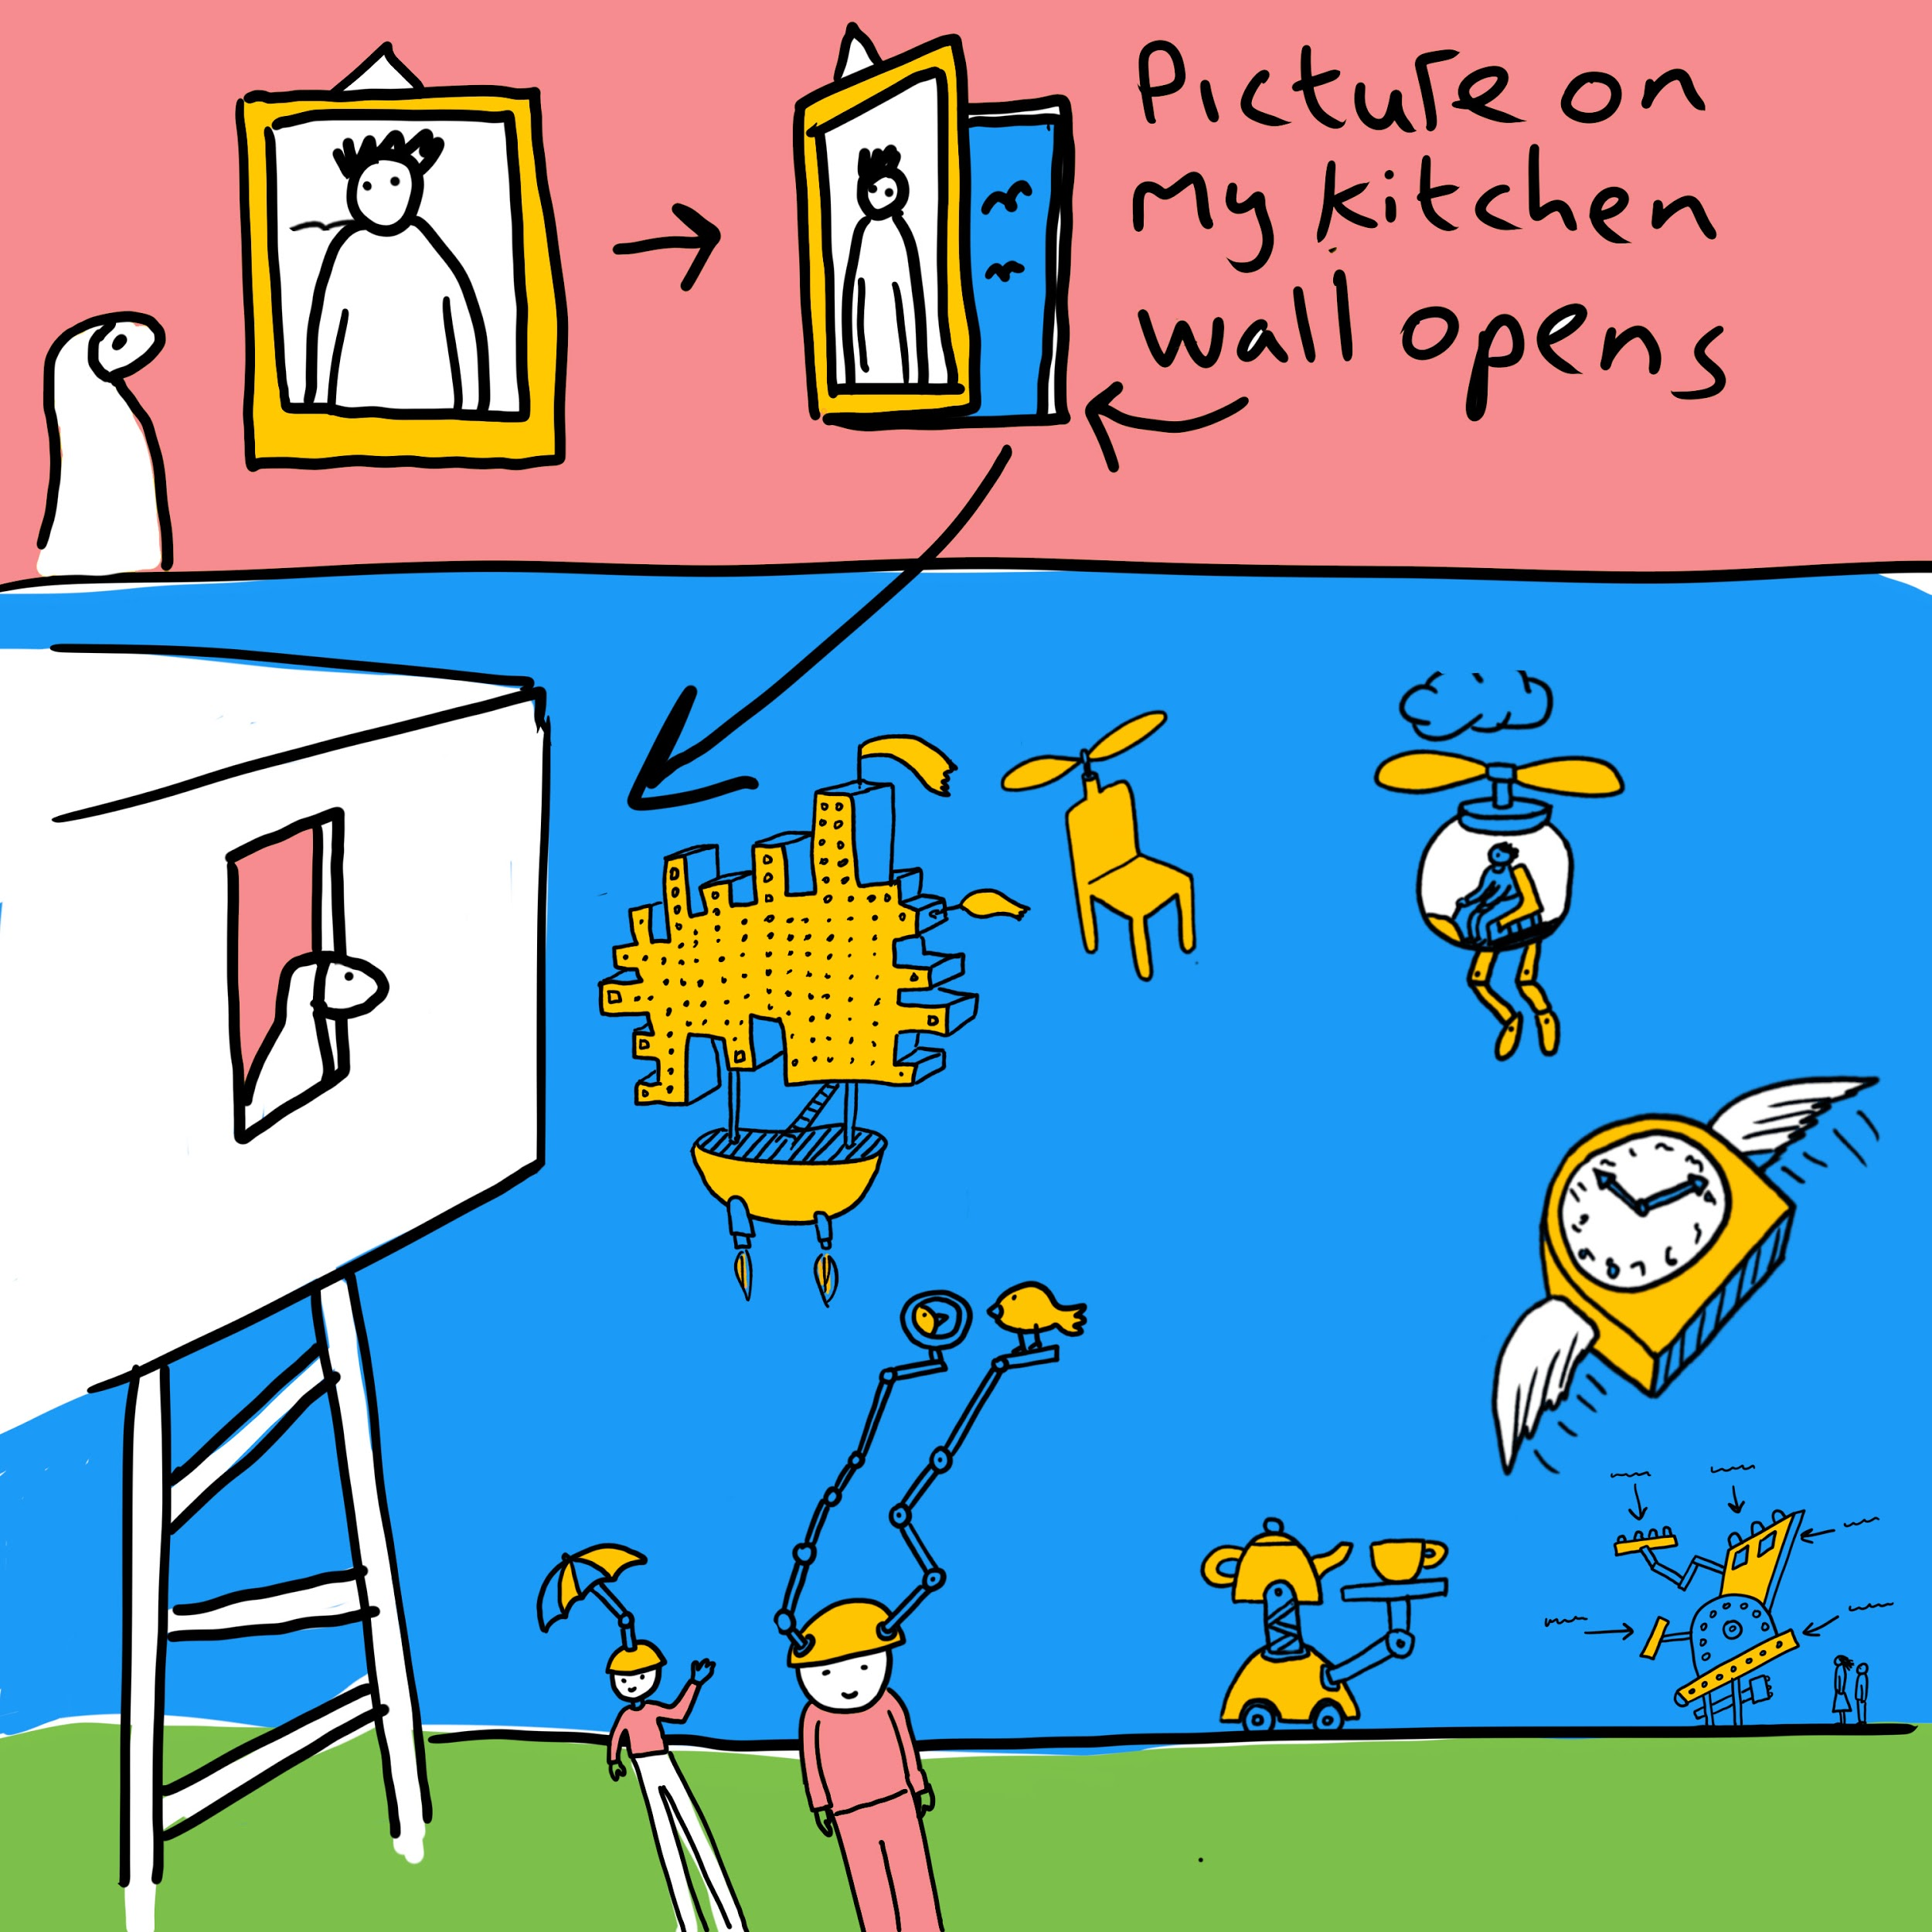
Daily Challenge
Imagine a secret door in your home that leads to a magical place. Draw the door and the place

Slide 5
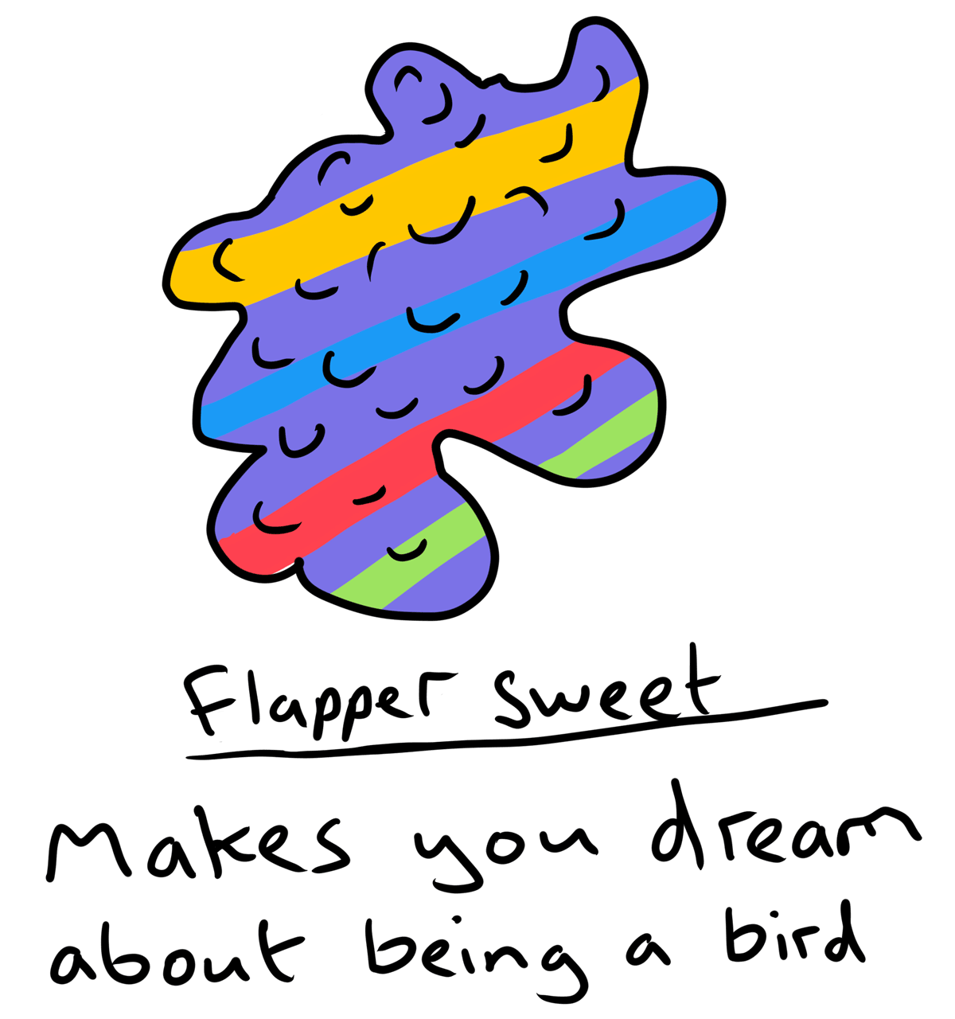
Daily Challenge
Draw magic sweets and draw or write what
happens if you eat them

Slide 6
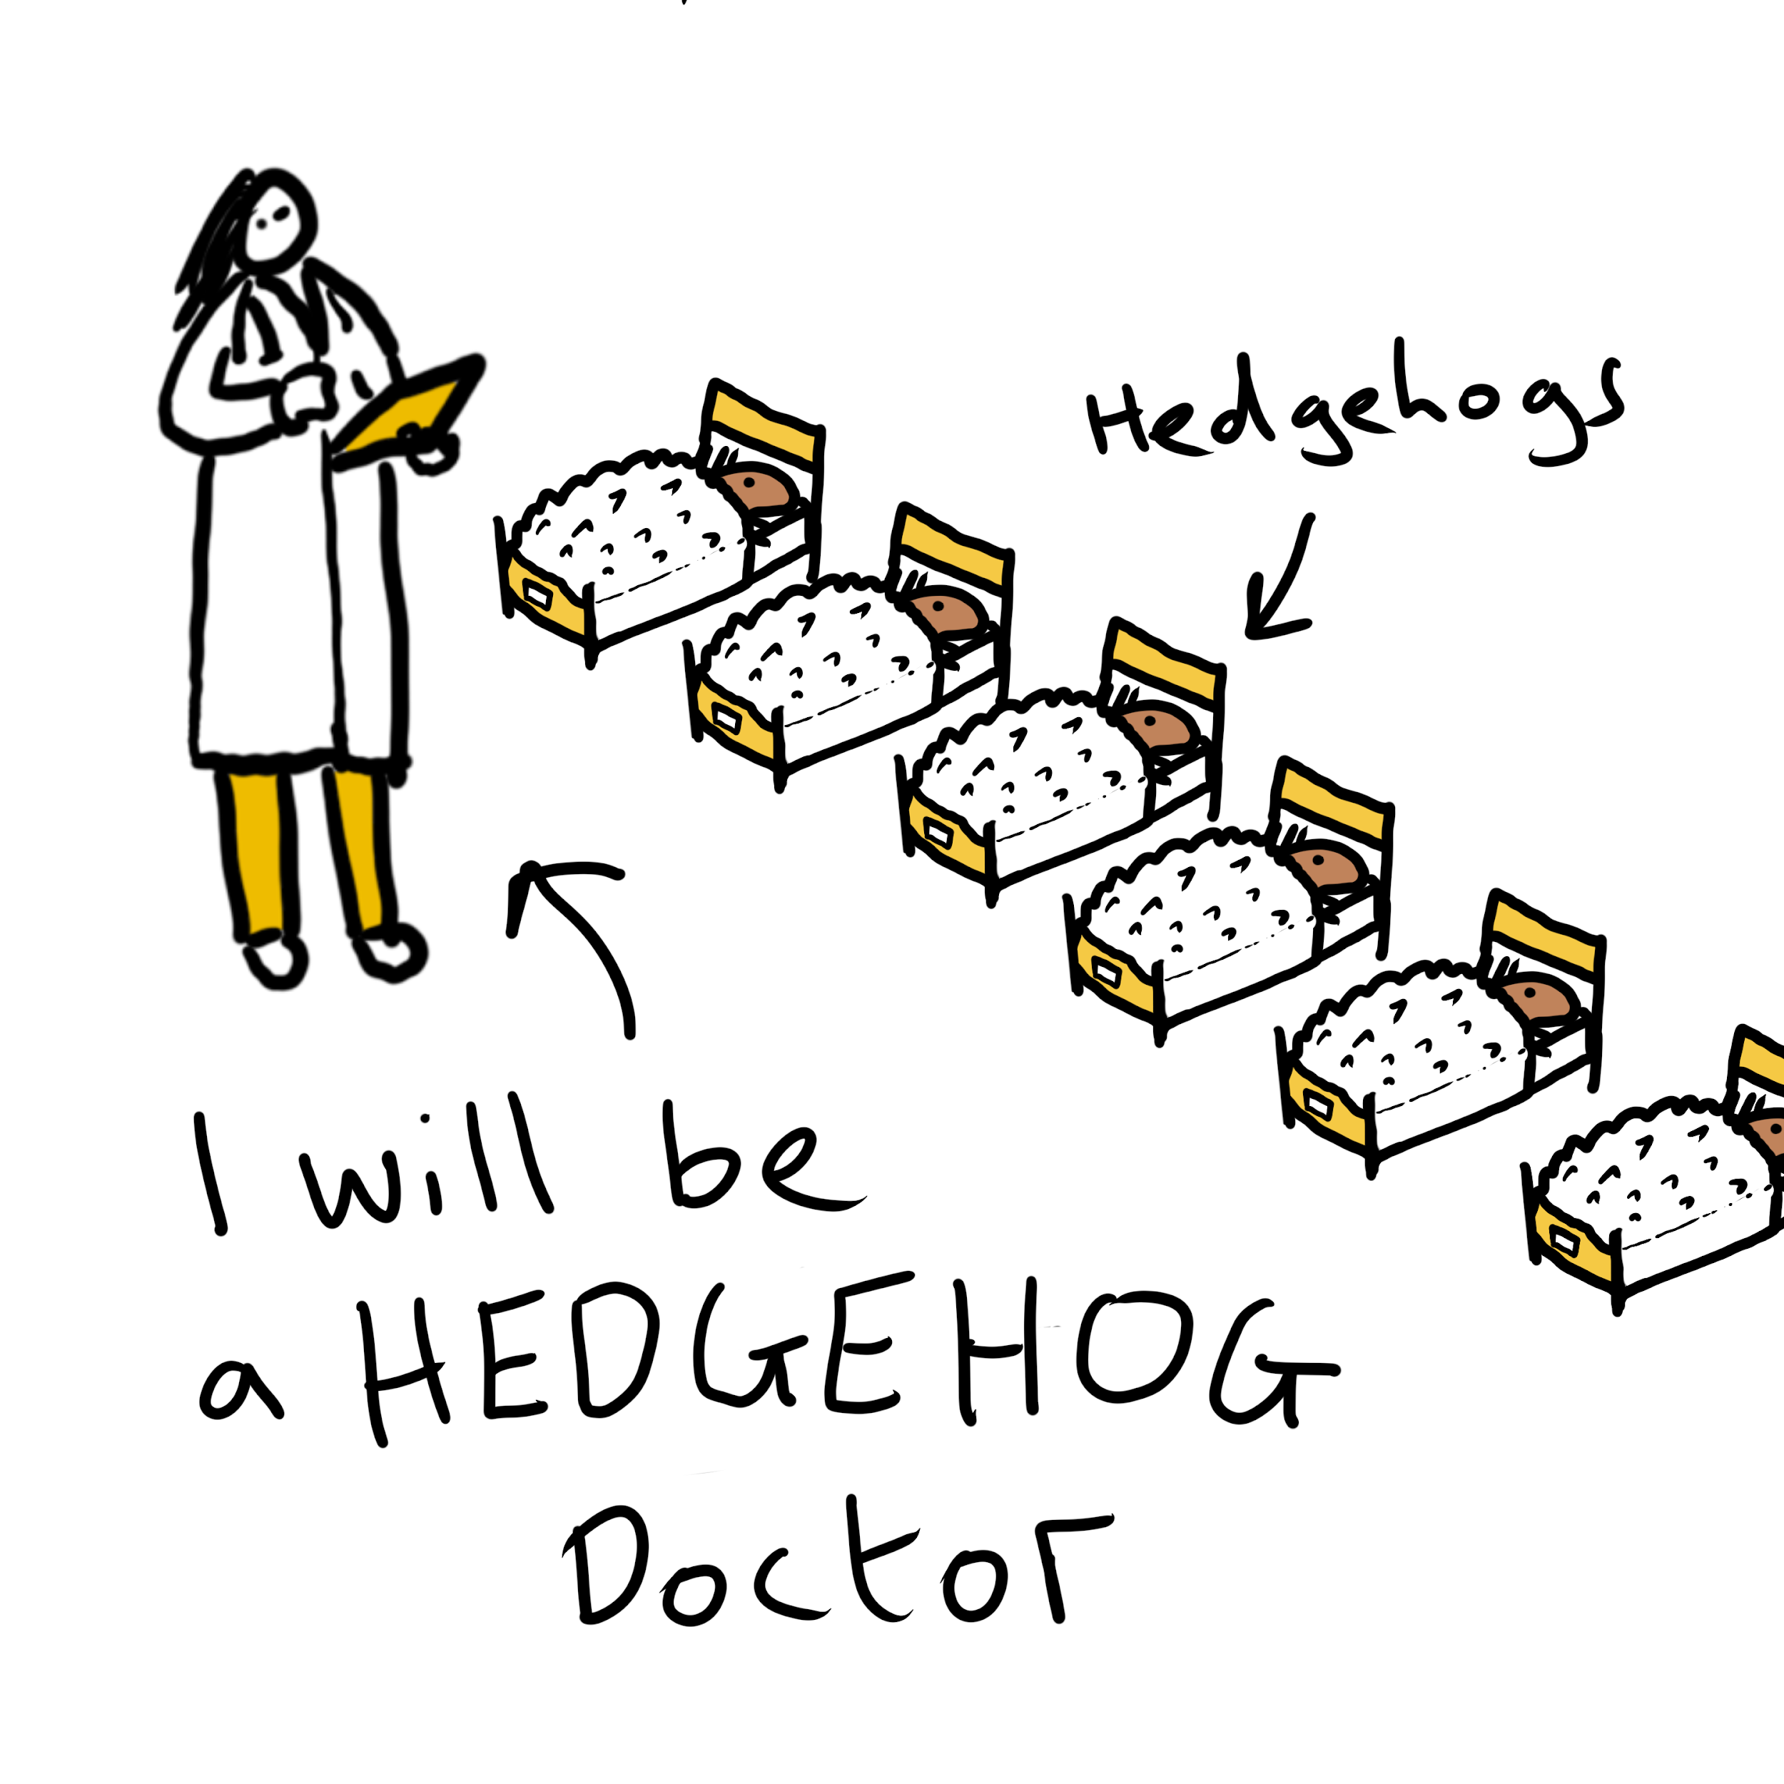
Daily Challenge
Draw yourself doing the job you want to do in 20 years time

Slide 7

Daily Challenge
Draw or make something creative to say thank you to the doctors and nurses

Slide 8
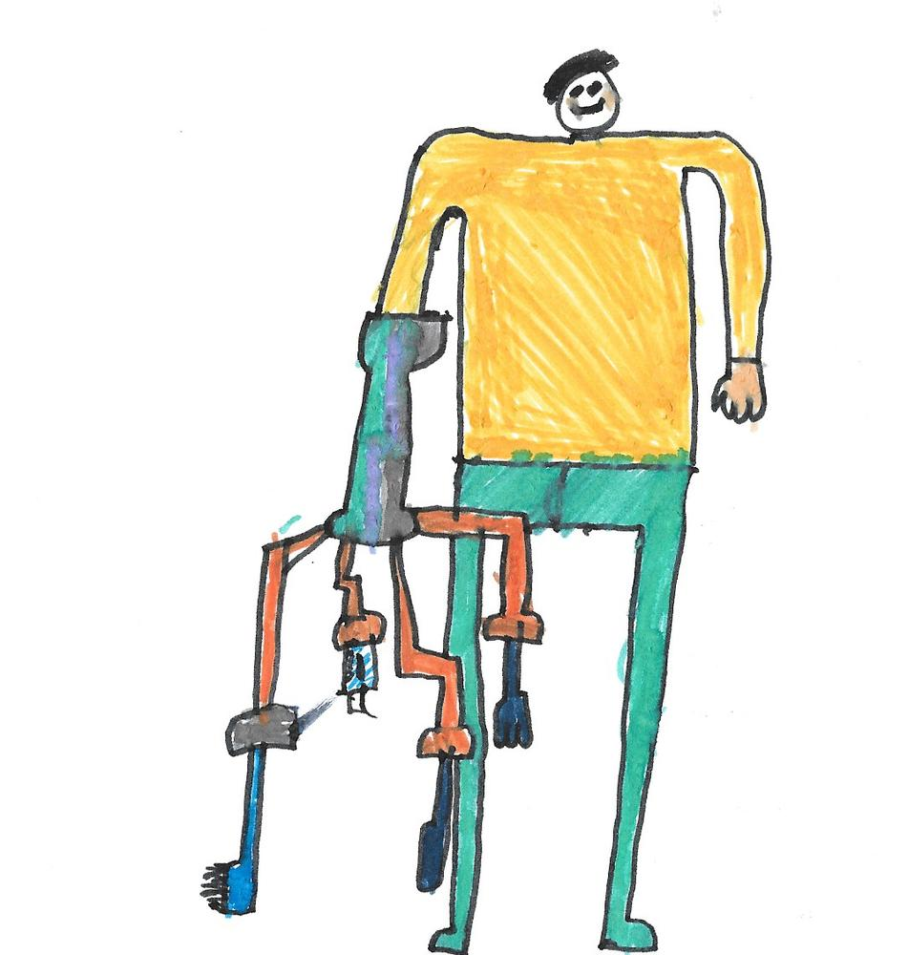
Daily Challenge
Draw a robotic arm that helps you do something amazing, useful or fun
‘Helping Hand’ Finlay, Age 9, UAE

Slide 9

Daily Challenge
Draw a ‘SUPER CHAIR’ to
help an older person
FLY, SWIM or have FUN

Slide 10
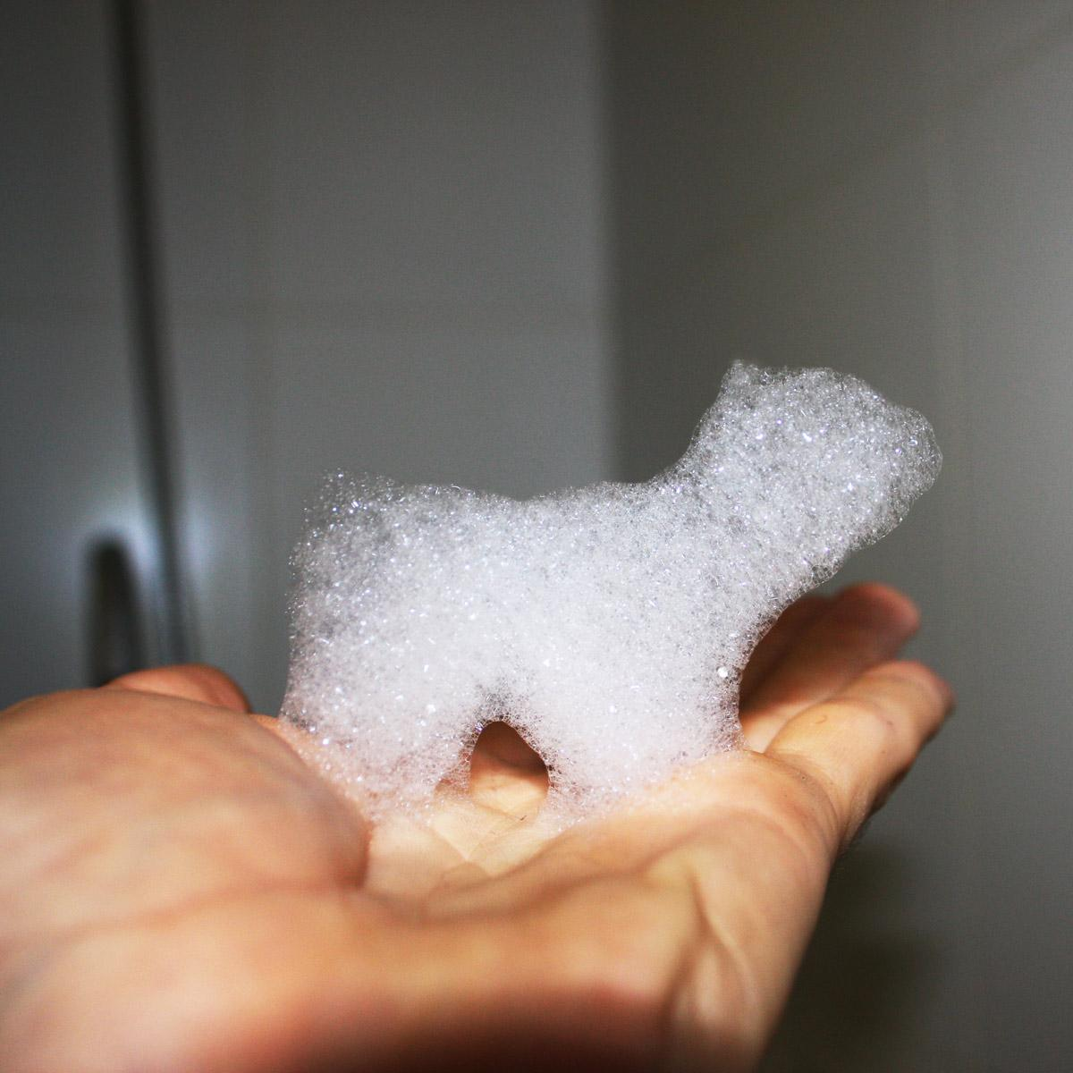
Daily Challenge
Make an animal or creature from BATH FOAM and draw things made only
of BUBBLES
‘Foam Bath Dog’ by Dominic Wilcox, 2009

Slide 11

Daily Challenge
Draw or make something to help LONELY people

Slide 12
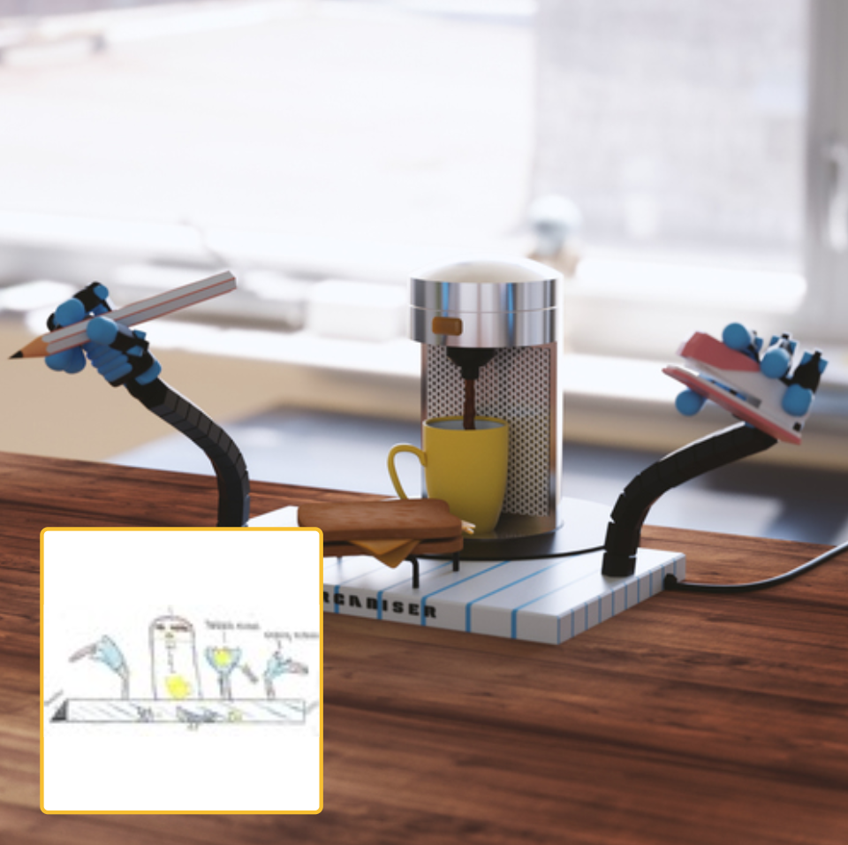
Daily Challenge
Draw an invention for your teacher
‘Self Organiser’ idea by Sarah, age 10, UK
3D model by Matthias Moedl

Slide 13
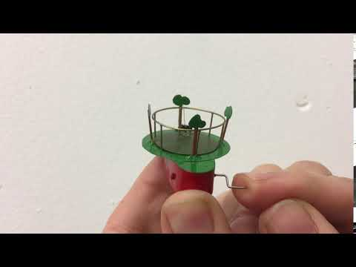
Daily Challenge
Draw a machine to exercise a pet indoors

Slide 14

Daily Challenge
Draw an invention to
brush your teeth
without a toothbrush

Slide 15
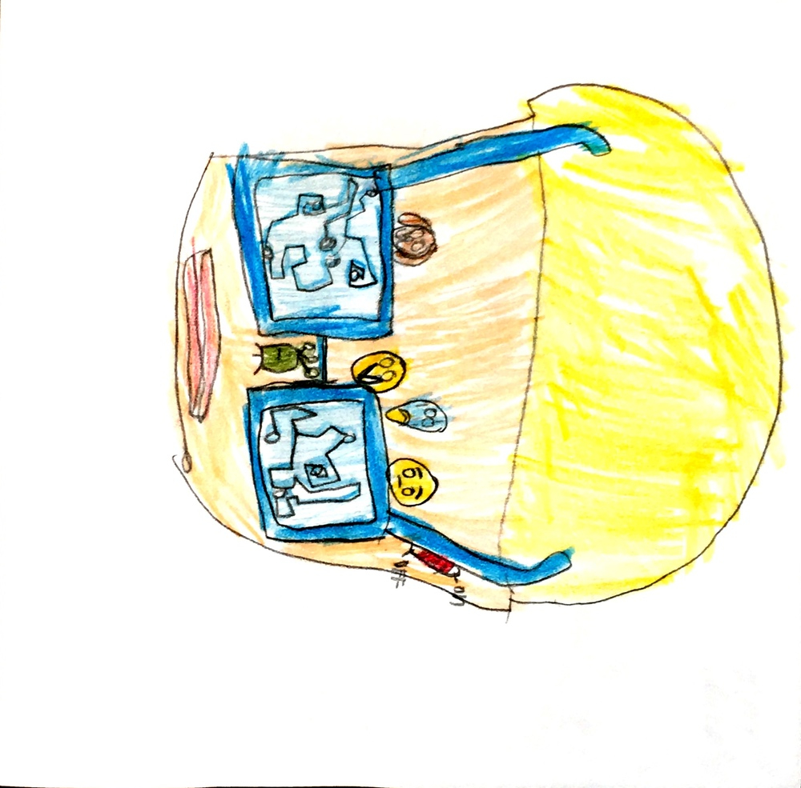
Daily Challenge
DRAW A MIND READING MACHINE
By Radha, Age 8, London, Uk

Slide 16
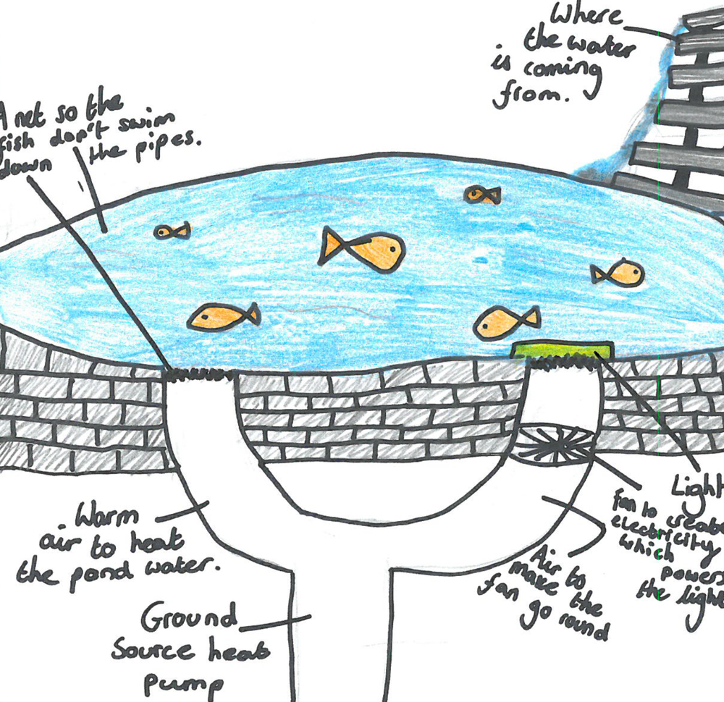
Daily Challenge
DRAW AN AMAZING HOME FOR FISH
By Evie, Age 11, Hexham, UK

Slide 17
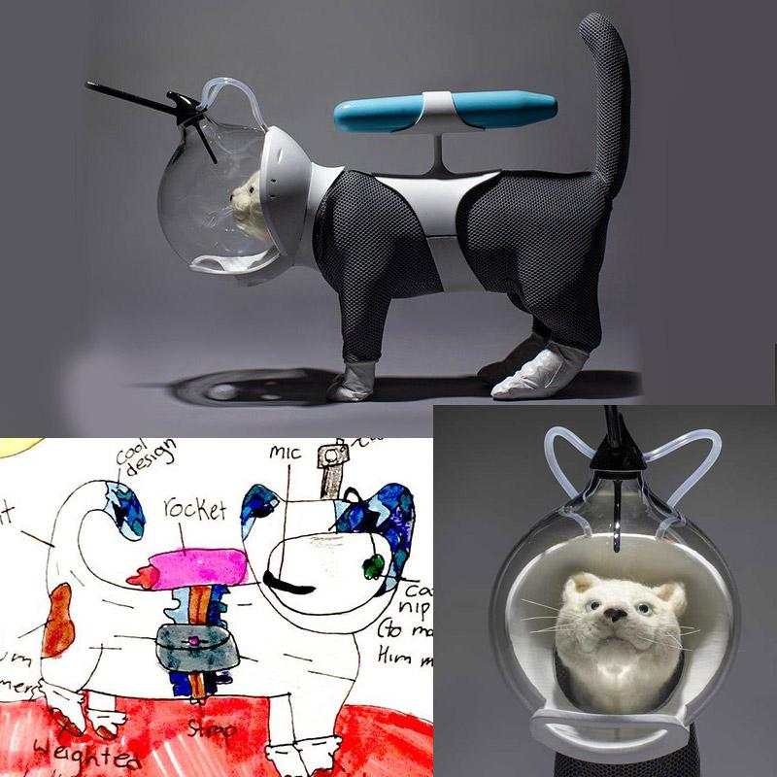
Daily Challenge #15
Draw a spacesuit for an animal and write a story about its adventures.
Cat space suit by Ella age 11, Canada. Made real by Radical Norms.

Slide 18
littleinventors.org
(Keep inventing!!)

