Slide 1
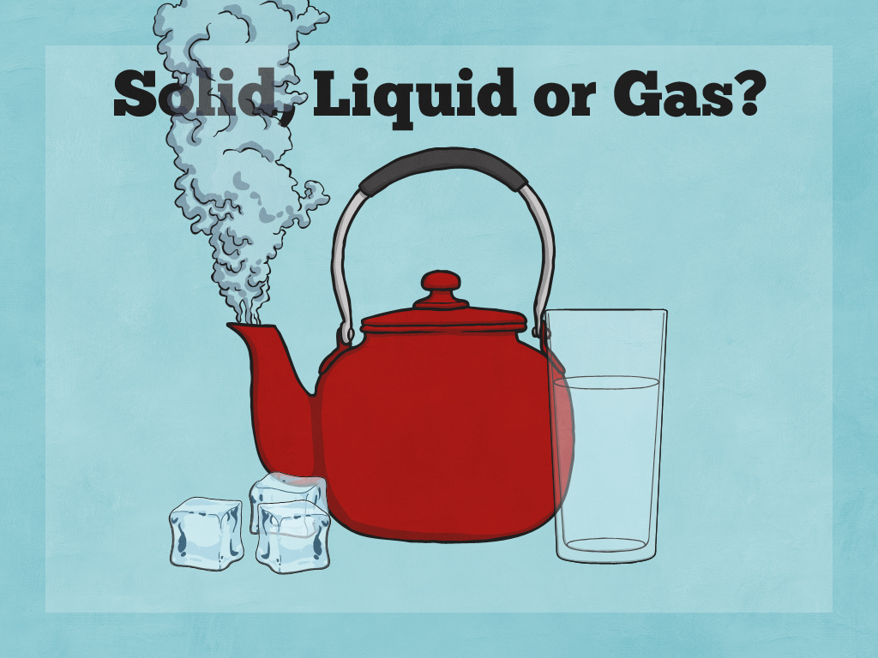
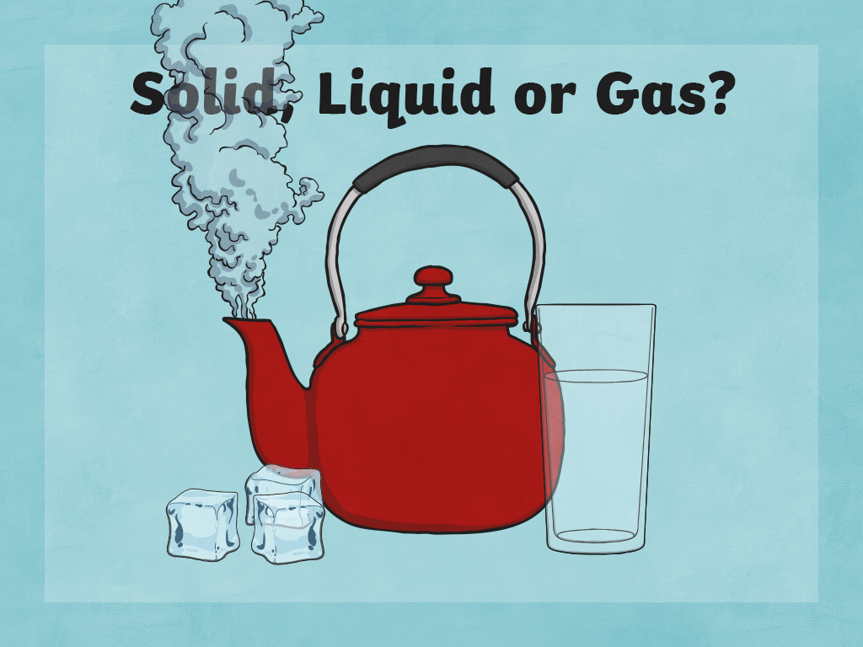



Slide 2
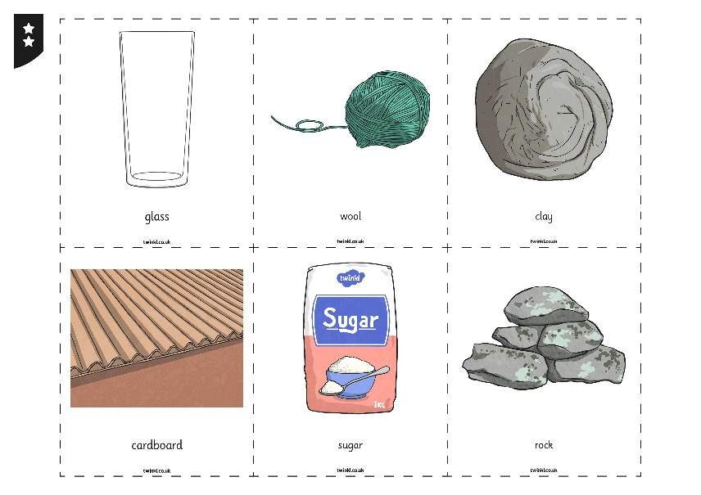
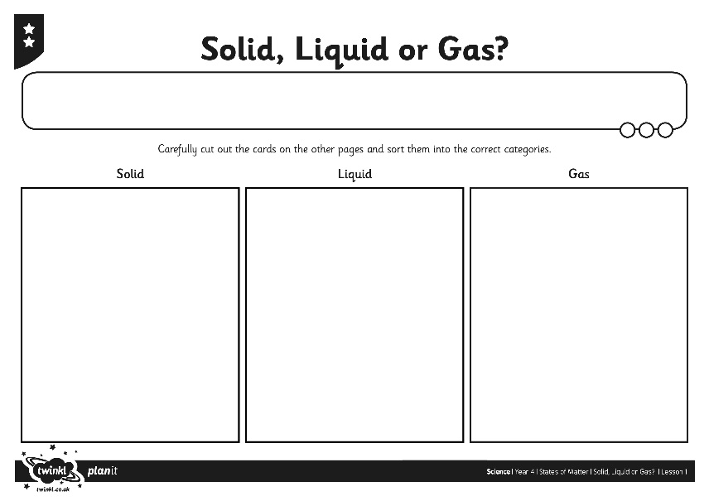
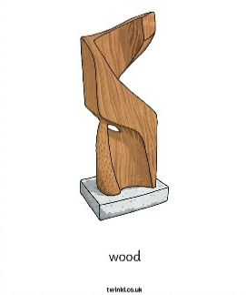

Sorting Materials
A material may be in one of three states: solid, liquid or gas.
Can you sort the materials into solids, liquids or gases?
Think carefully about each one.
If you are not able to print out the pictures, just list the objects under the headings; solid, liquid, gas.

Slide 3





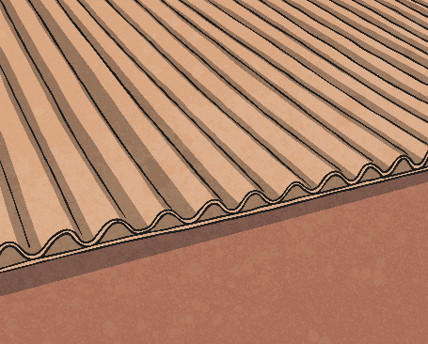
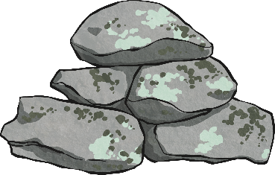
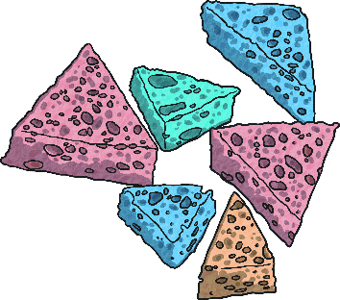

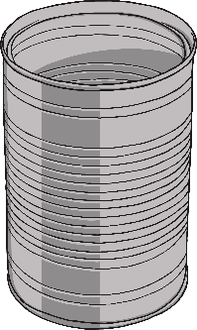

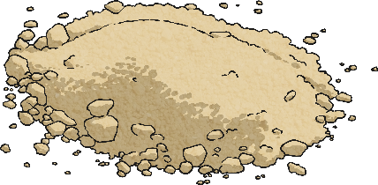
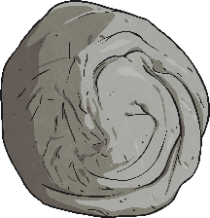




Properties of Materials: Solids
These items are all solids!
What do they have in common? Share the adjectives you thought of.
Materials in a solid state keep their shape unless a force is applied to them.
Solids can be cut, squashed or twisted. They will not change shape on their own.
Solid materials always take up the same amount of space. They do not spread out or flow. Solids do not have to be hard. They can be squashy or soft.

Slide 4



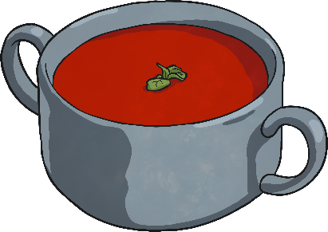

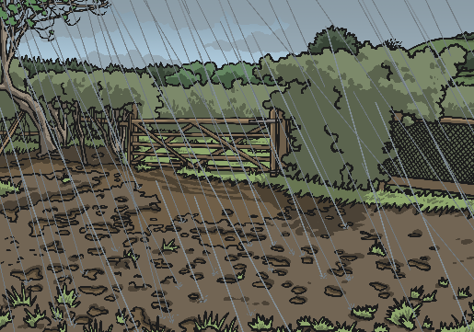





Properties of Materials: Liquids
Materials in a liquid state take the shape of the container they are in.
Although liquids can change shape, they do not change their volume. This means they still take up the same amount of space.
Liquids are pulled down to the bottom of a container by gravity.
Liquids can flow or be poured.
These items are all liquids!
What do they have in common? Share the adjectives you thought of.

Slide 5





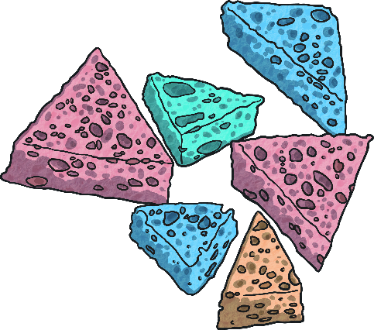
Properties of Materials: Gases
These items are all gases!
What do they have in common? Share the adjectives you thought of.
Materials in a gaseous state can spread out to completely fill the container or room they are in.
Gases have weight.
Gases can be squashed.
Gases do not keep their shape.

Slide 6




Properties of Materials
Can you match the properties with the correct state?
Talk to your partner to help you.
solid
liquid
gas
Spreads out to
fill a space.
Keeps its shape.
Can be cut,
squashed or torn.
Takes the shape of the container it is in.
Can be poured.
Does not have
any fixed shape.

Slide 7


Particles
We can explain the differences between solids, liquids and gases by knowing what they are made of.
Scientists have found out that all materials are made of very tiny particles. These particles are so small that we cannot see them with our eyes, or even with a microscope!
The position and behaviour of
the particles is different in
solids, liquids and gases.
Click here to find out more!

Slide 8
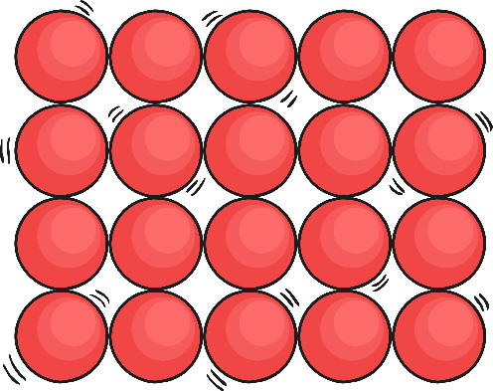
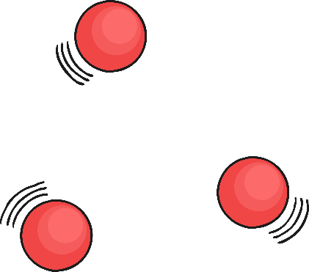
Particles and Properties
You are going to work as groups to demonstrate the differences in each state!
Follow the instructions on your group’s Particle Information Card to find out what you need to do.
Then watch each others’ demonstrations to learn about the behaviour of particles in solids, liquids and gases.

Slide 9
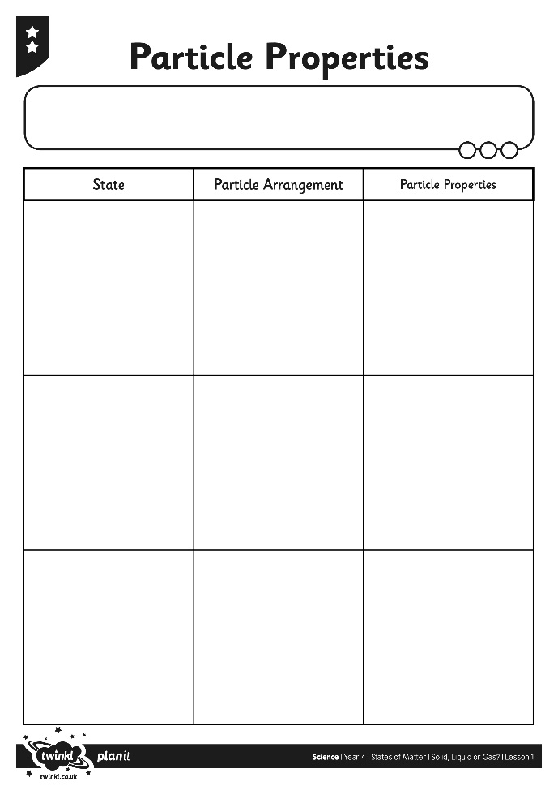
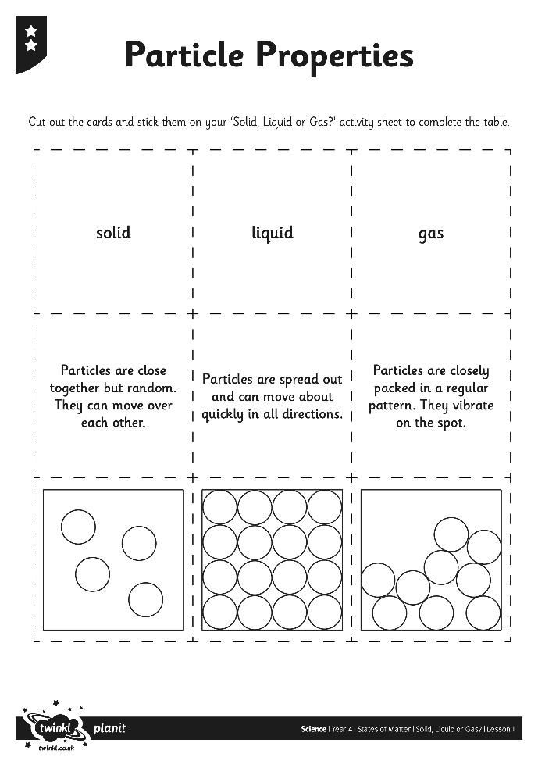
Particles and Properties
Now you have watched the demonstrations, have a look at the information boxes on your Particles and Properties Activity Sheet.
Can you work out which diagram and explanation goes with each state?
If you are not able to print out the sheets, you can draw your own table and fill it in.
There are 3 challenge levels. If the 1 star task looks easy, then try the 2 or 3 star challenges.

Slide 10




Spotting States of Matter
Watch this short film containing clips of different solids, liquids and gases.
See which materials you can spot, and which states of matter they are.
Share your ideas with the rest of the class.

