Slide 1


Geography
All Around the World
Year One
Geography | Year 4 | All Around the World | In the Tropics | Lesson 4

Slide 2
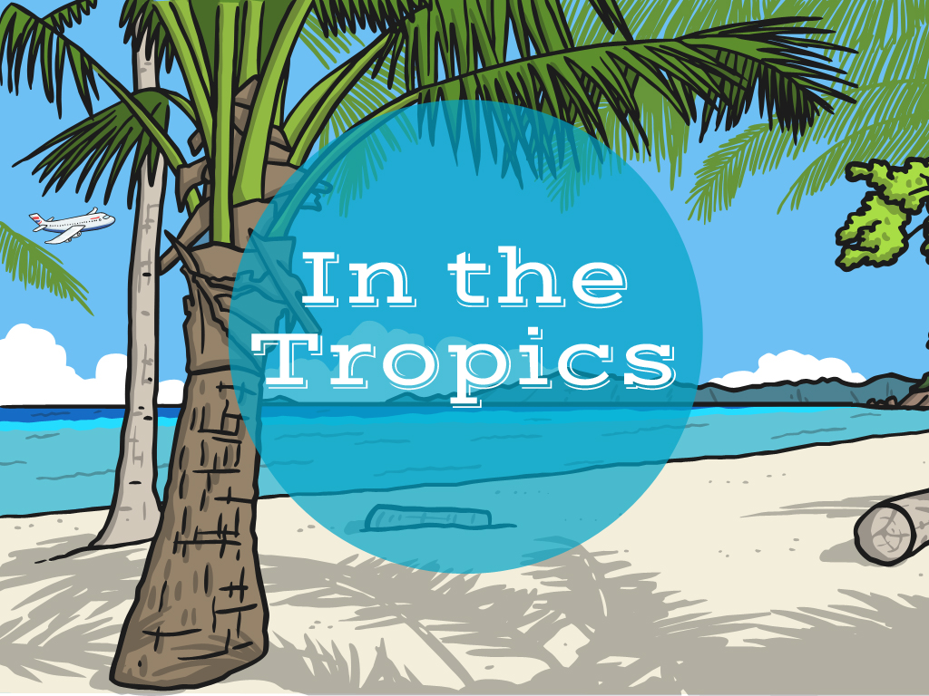


Slide 3
Aim
I can compare the climate of the tropics with the UK climate.
Success Criteria
I can identify the location of the Tropics of Cancer and Capricorn.
I can identify differences between the UK and the tropics.
I can identify similarities between the UK and the tropics. I can describe the climate in the tropics.

Slide 4
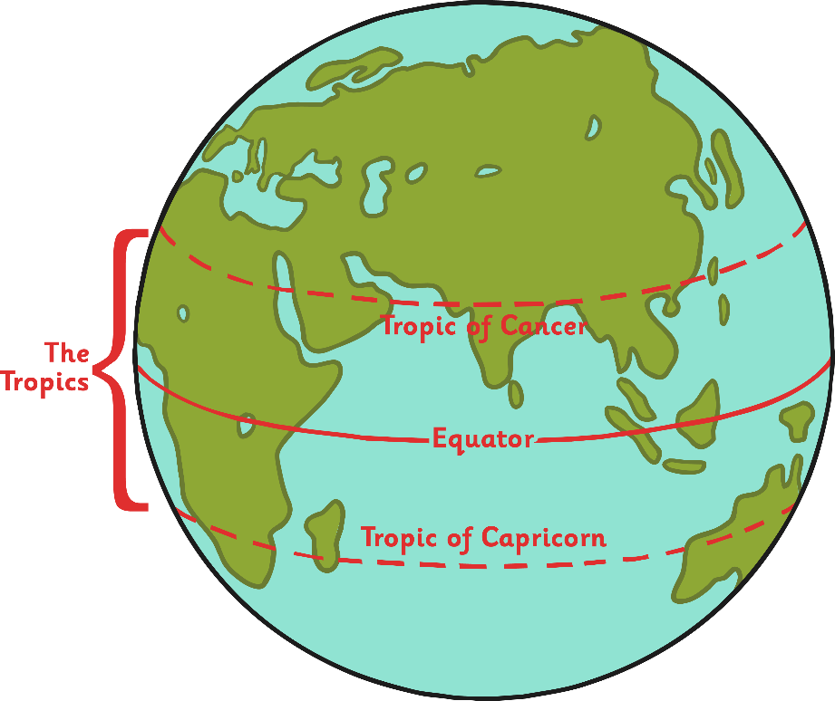
Where Are the Tropics?
The Tropic of Cancer, or the Northern Tropic, is the circle of latitude on the Earth that marks the most northerly position at which the Sun can be directly overhead.
It currently lies around 23.4° north of the Equator.
The Tropic of Capricorn, or Southern Tropic, marks the most southerly latitude on the Earth at which the Sun can be directly overhead.
It currently lies around 23.4° south of the Equator.

Slide 5

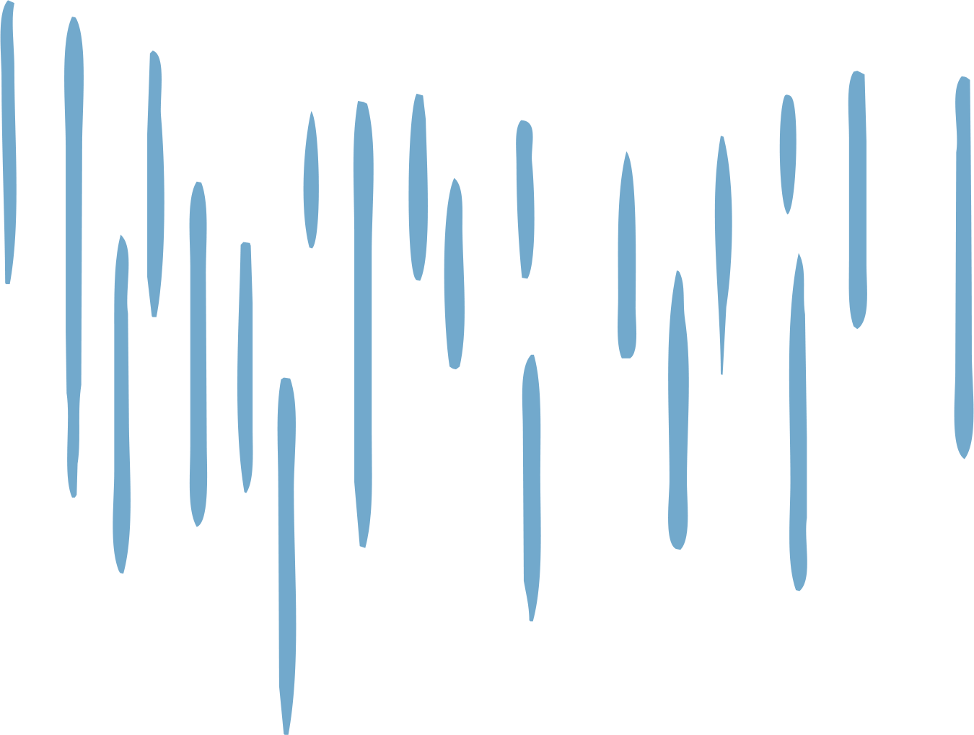
What Is It like in the Tropics?
Between the Tropics of Cancer and Capricorn, the weather is hot all year round.
Rainfall can be very varied in tropical locations – some areas have very little rain, some have a rainy season and some have fairly consistent rainfall throughout the year.
Rainforests have
an average monthly rainfall
of at least 60mm.
Click each habitat to find out more:
tropical rainforests;
tropical coniferous forests;
When you’re ready to move on, click here!
tropical dry forests;
tropical grasslands.

Slide 6
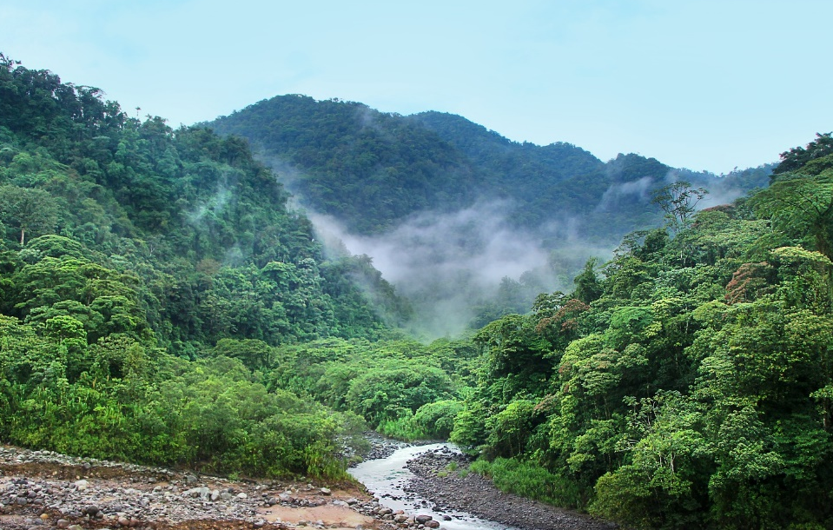
Tropical Rainforests
Tropical rainforests are located in South America, Africa and Southeast Asia. These areas are constantly warm and experience an average precipitation* of at least 60mm every month. There is no dry season in these forests.
Due to this climate, the tropical rainforests are lush and full of life. The world’s tropical rainforests are
home to over 15 million species
of plants and animals. Look
carefully, and you might spot the
breath-taking Blue Morpho Butterfly
or the Scarlet Macaw fluttering
through the trees, or even the
Brown-Throated Three-Toed Sloth
hanging around in the canopy.
*Precipitation – water falling from the sky as rain, sleet, snow or hail.

Slide 7
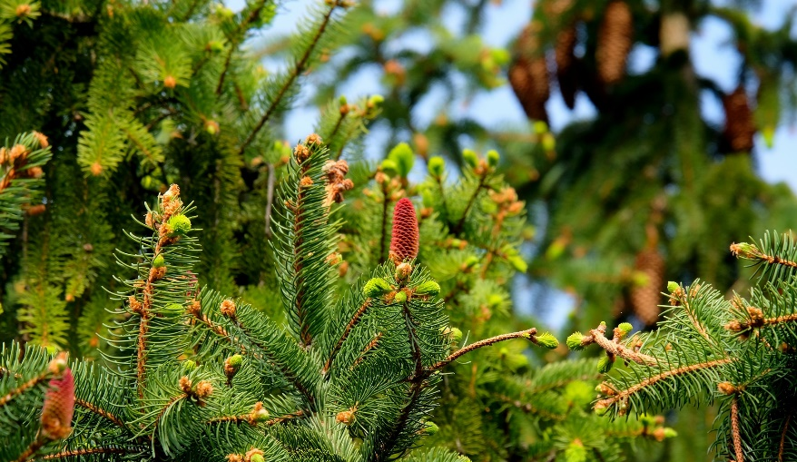
Tropical Coniferous Rainforests
Tropical coniferous rainforests are mostly found in North and Central America, but there are some in Asia. They take their name from the huge range of conifer trees that grow in these areas. Conifers are trees that grow cones, such as pine trees and Douglas firs.
Temperatures in tropical coniferous forests are usually steady throughout the year and precipitation levels are low.
These forests are home to many birds and
butterflies that have left cooler climates
to spend the winter months here (migrate).
The trees overhead provide a heavy
canopy, or cover, which means that it is
dark on the forest floor. Many fungi and
ferns grow here.

Slide 8
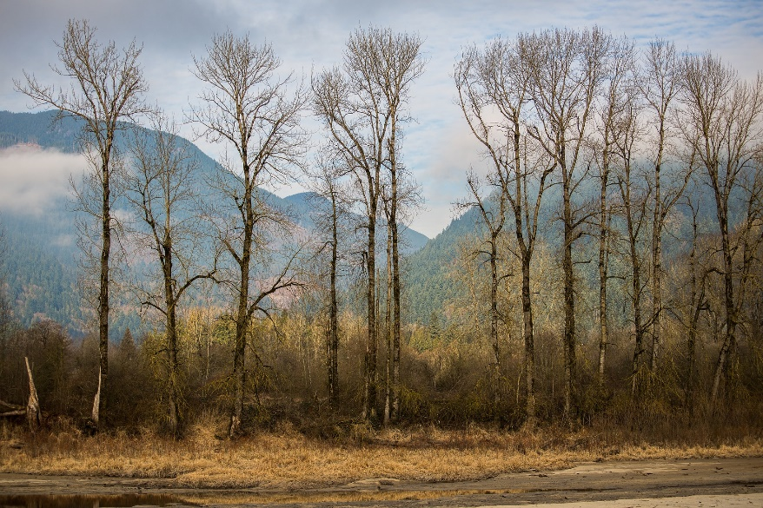
Tropical Dry Forests
Tropical dry forests grow in many locations around the world, including southern Mexico, central Brazil and along the coasts of Ecuador and Peru, Southeast Asia and in India.
These forests, like tropical rainforests, are warm all year round and can receive several thousands of millimetres of rainfall each year. However, unlike tropical rainforests, tropical dry forests also experience long dry seasons.
Most of the trees in these forests are deciduous. This means that in the dry season, their leaves die and drop off, allowing them to conserve their water supply. Animals that are found in these areas include: monkeys, parrots, deer and large cats.

Slide 9
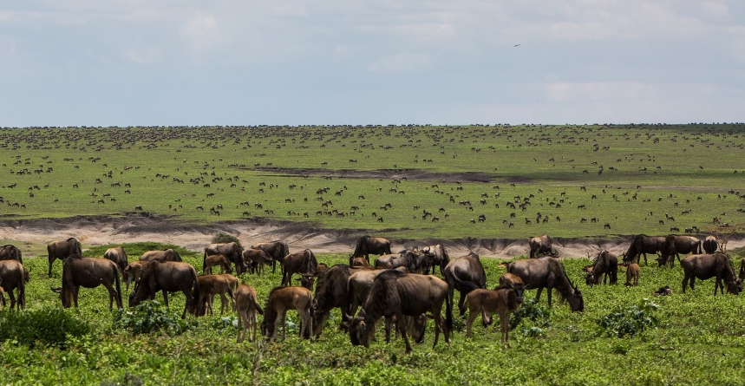
Tropical Grasslands
Tropical grasslands are sometimes referred to as ‘savannas’. They are huge areas that are almost completely covered by grasses. They grow between tropical forests, mountains and deserts. Tropical grasslands are found in Africa, Asia, India and Australia.
Although they are hot and generally dry, tropical grasslands can receive between 900mm and 1500mm of rain per year. However, the dry season lasts for up to nine months of the year and because of this, few trees and shrubs can grow in tropical grasslands.
Despite these conditions, many wild animals survive there. For example, in the savannas of Africa, elephants, giraffes, zebras and wildebeest thrive on their diet of grasses, while in Australia, emus live off the grasslands.

Slide 10
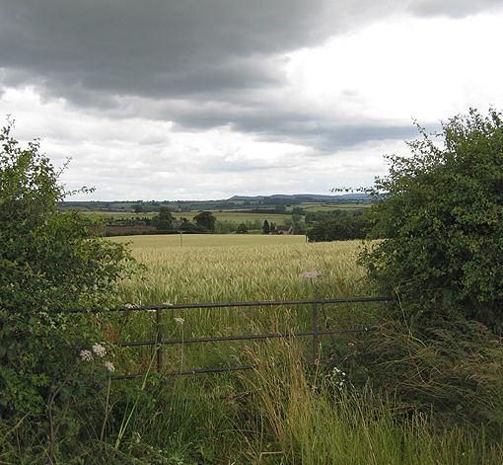
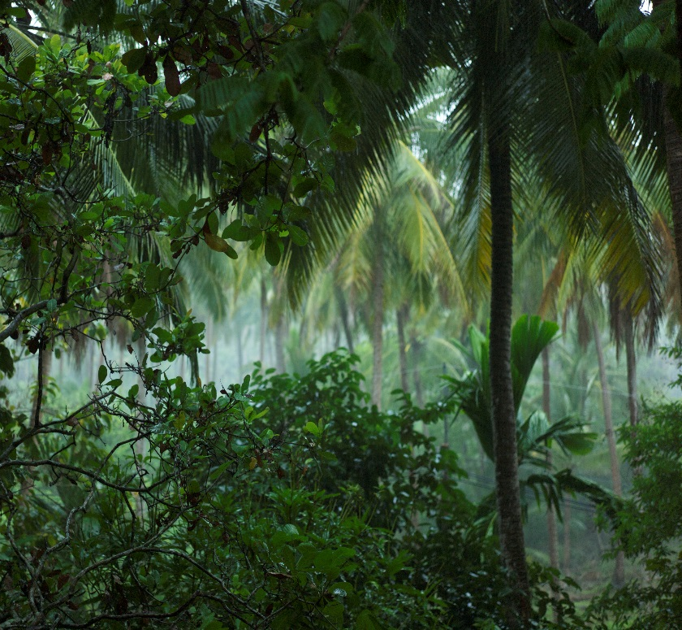
Comparing the UK and the Tropics
What is the weather like in the UK?
What is the weather like in the tropics?
Photo courtesy of Michael Cory , Pauline Eccles (@flickr.com) - granted under creative commons licence – attribution

Slide 11



Comparing the UK and the Tropics
How would the weather in the tropics be different to the weather in the UK?
How would the weather in the tropics be similar to the weather in the UK?
There are no cold seasons
It is always hot
It feels very humid or sweaty
Some areas have lots of rain all year round
Some areas are very dry all year round
It is hot when it rains
It never snows
The sun shines every day
Sometimes we have a lot of rain here; we can have big rain storms as you do in the tropics
It can be hot in summer in the UK (but not as hot as the tropics!)
The UK climate is very different to a tropical climate!

Slide 12

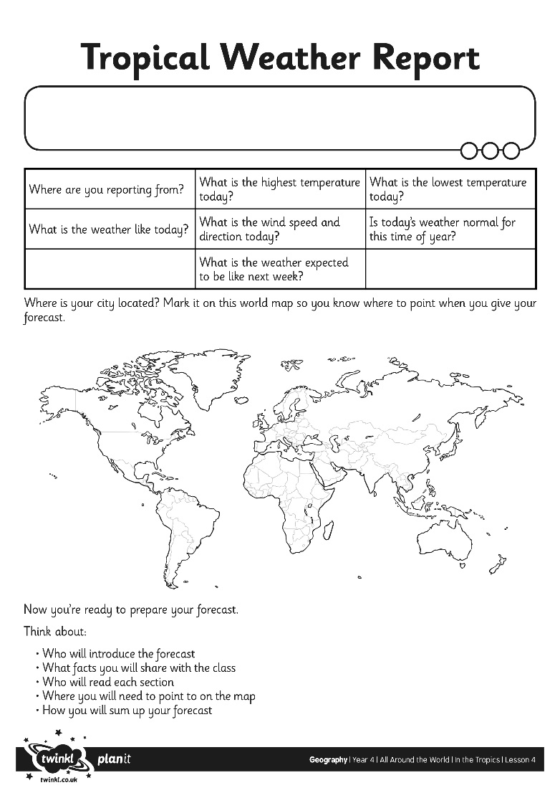
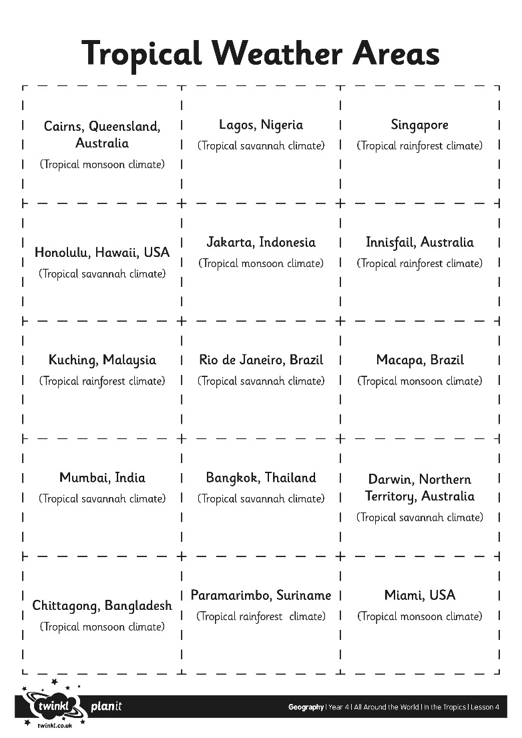
What’s the Weather Like?

Slide 13
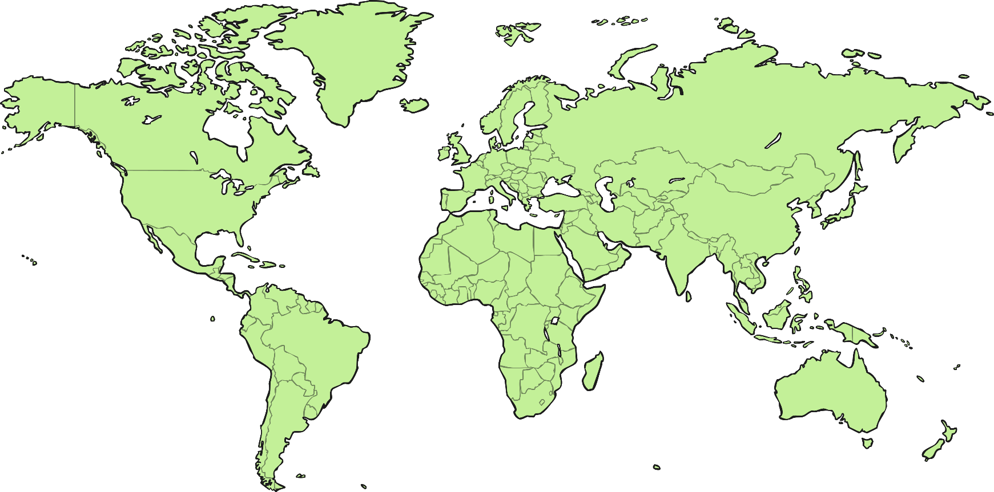
And Now, the Weather…

Slide 14

Aim
I can compare the climate of the tropics with the UK climate.
Success Criteria
I can identify the location of the Tropics of Cancer and Capricorn.
I can identify differences between the UK and the tropics.
I can identify similarities between the UK and the tropics. I can describe the climate in the tropics.

