Slide 1
Science - Year 3/4A Summer 1
States of Matter
What’s the Matter
Session 4
Teaching PowerPoint
© Original resource copyright Hamilton Trust, who give permission for it to be adapted as wished by individual users.
We refer you to our warning, at the foot of the block overview, about links to other websites.

Slide 2
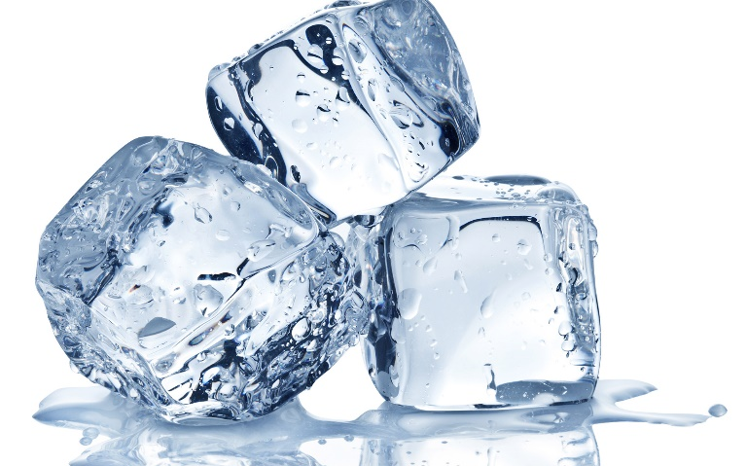
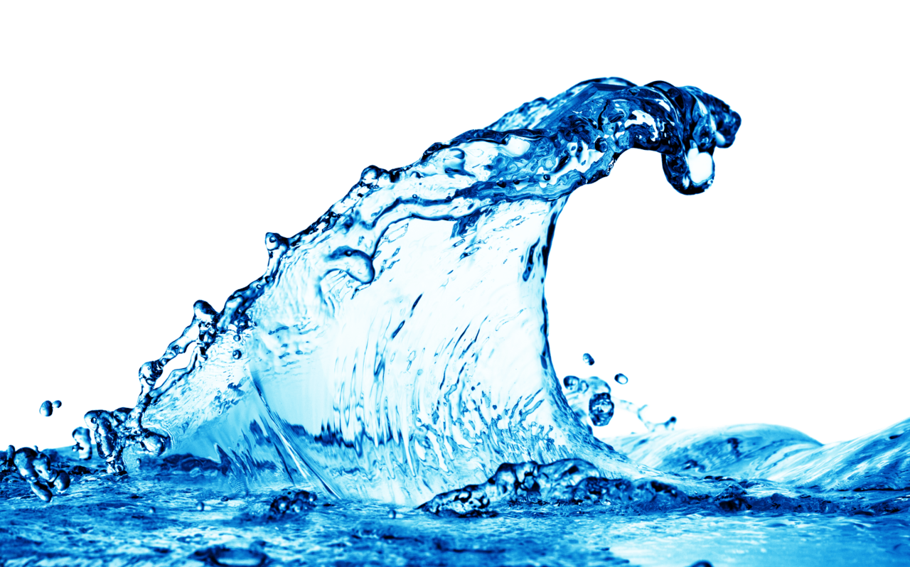
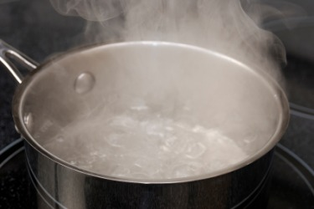
Water exists naturally on Earth in 3 different states. Can you name them?
Solid
Liquid
Gas
Remember you can’t actually see water vapour though
Water
Ice
Vapour
Water naturally changes state. Let’s recap on the scientific words for these changes.

Slide 3

Can you name these 2 changes?
Melting
Freezing

Slide 4
What are these 2 changes called?
Evaporation
Condensation

Slide 5
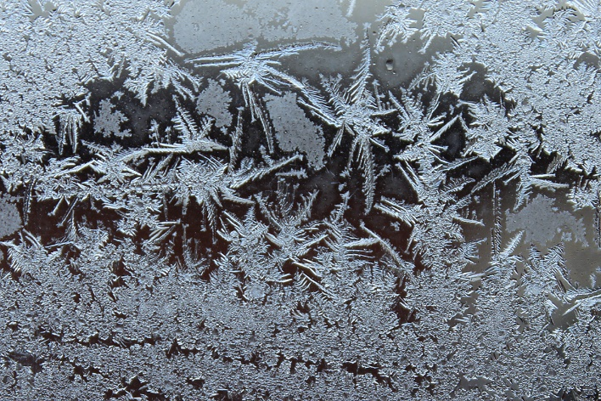
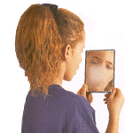
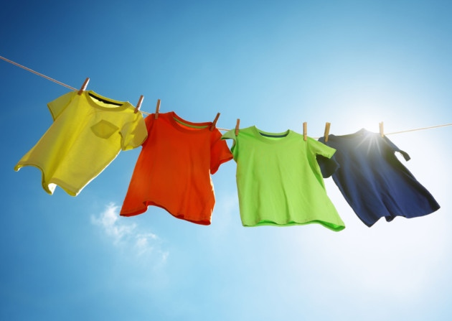
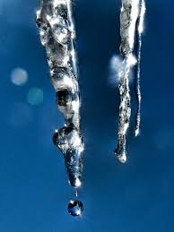
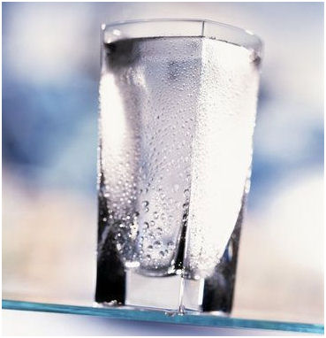
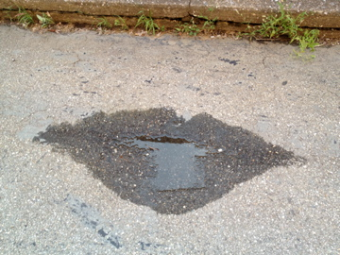
Here are some pictures of water changing state. Talk with a partner and try to name the change of state that is happening in each one.
1
2
3
Frost forming on a damp car windscreen
A mirror misting up when you breathe on it
Wet clothes drying on a line
5
4
6
Droplets appearing on the outside of a cold glass of water
Icicles dripping in the sun
A puddle drying up after rain

Slide 6
How did you do?
1
2
3
Freezing
Condensation
Evaporation
Frost forming on a damp car windscreen
A mirror misting up when you breathe on it
Wet clothes drying on a line
5
4
6
Condensation
Evaporation
Melting
Droplets appearing on the outside of a cold glass of water
Icicles dripping in the sun
A puddle drying up after rain

Slide 7
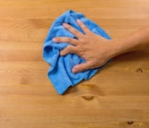
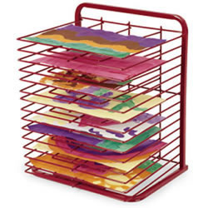
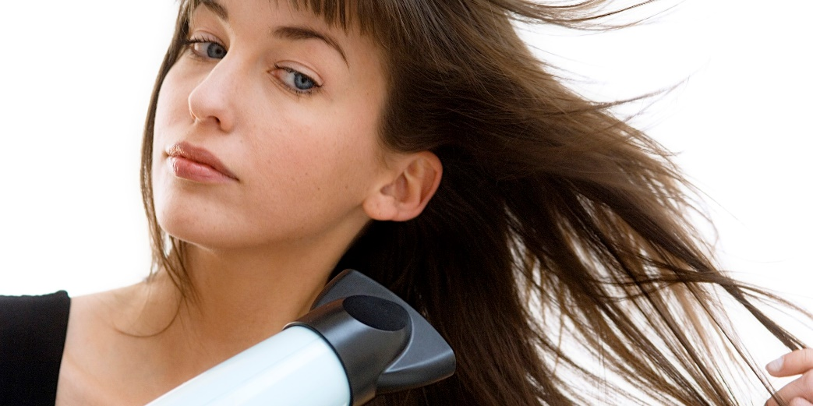
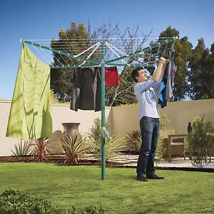
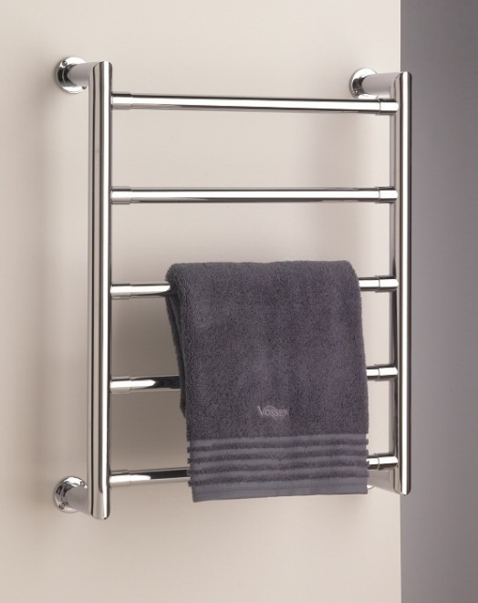
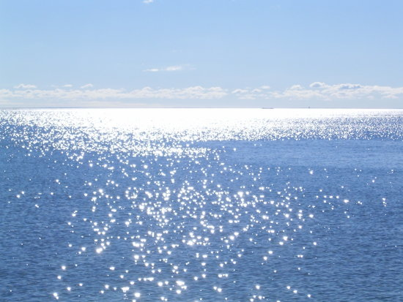
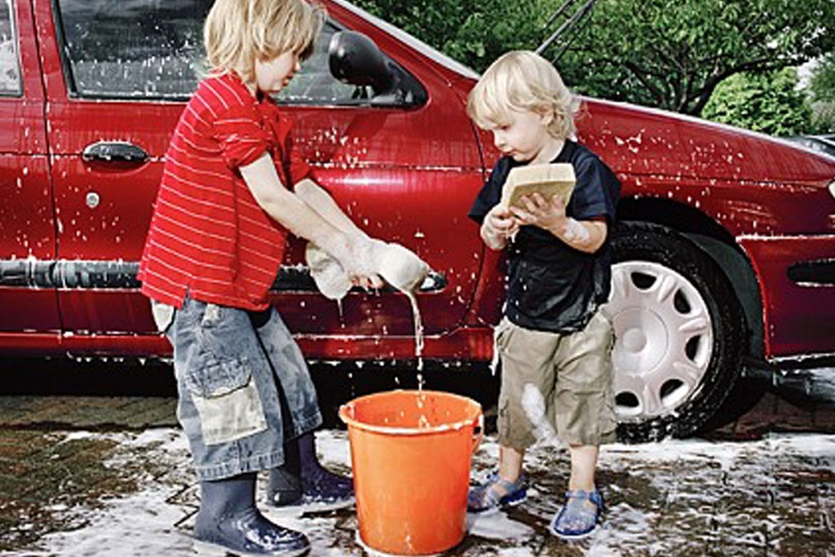
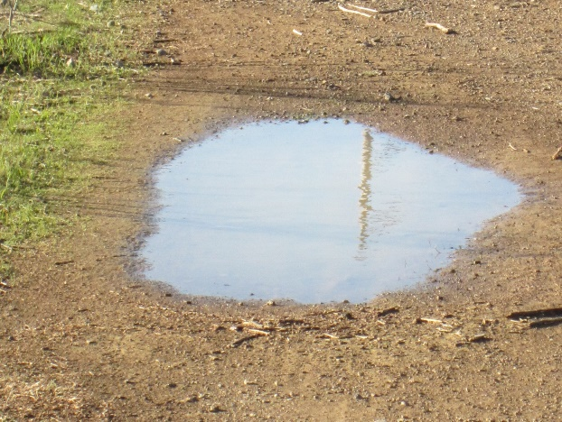
Let’s think a bit more about evaporation
What is happening in each picture?

Slide 8
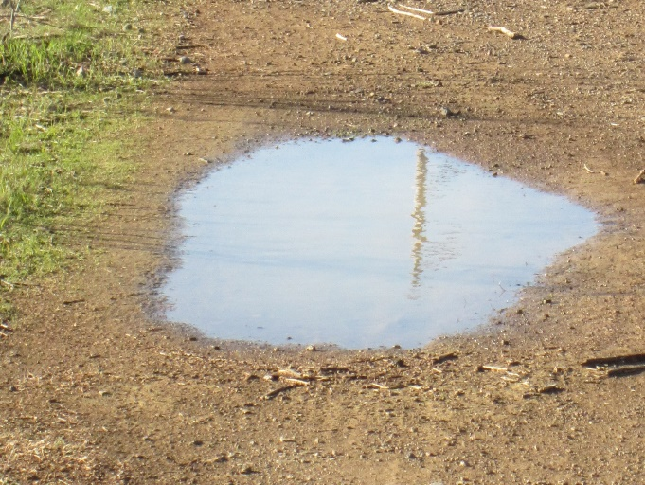
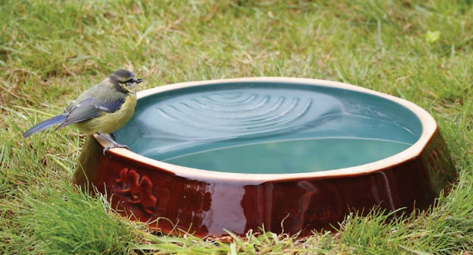

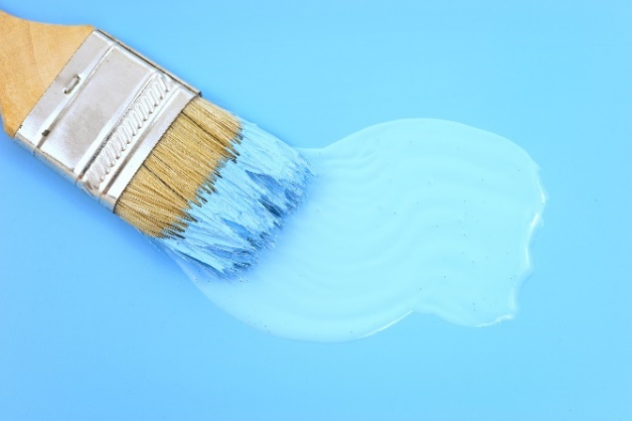
Sometimes things seem to dry up (evaporate) very quickly, whereas other times they don’t.
Why might that be?
Evaporation takes place when water particles on the surface of the liquid become free – they break their bonds with other particles and drift away into the air
What factors do you think could speed up evaporation?
What factors might slow it down?

Slide 9
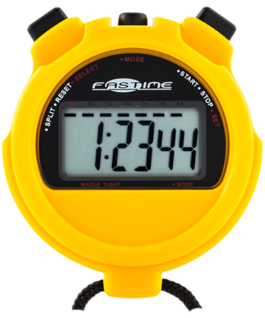
What is your theory?
Decide in your group what you think would speed up/ slow down evaporation
Here are some ideas you may have had:
Warmth / cold
Sunlight / shade
Or your group may have thought of a different idea
Wind / stillness
Indoors / outdoors
Your task is to design an experiment to test out your theory

Slide 10
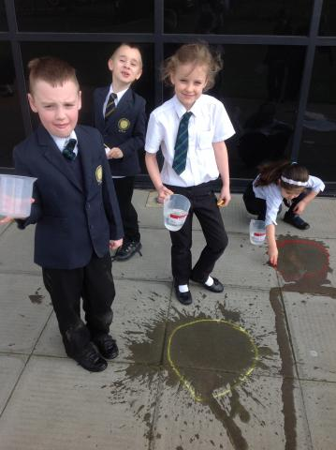
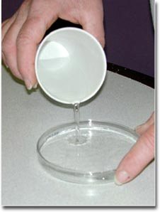

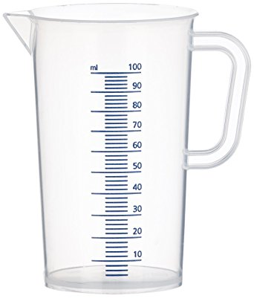
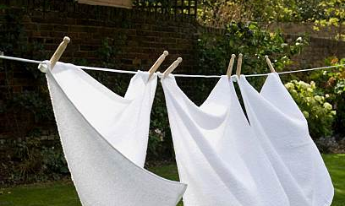
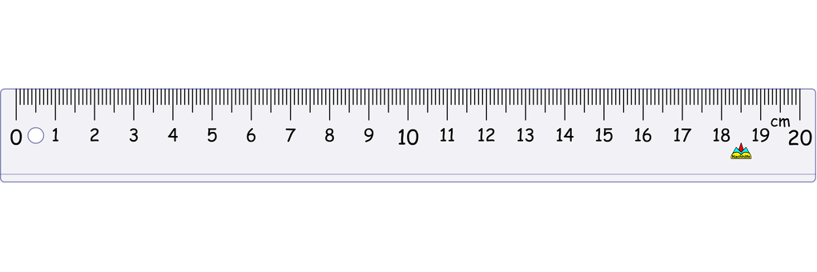

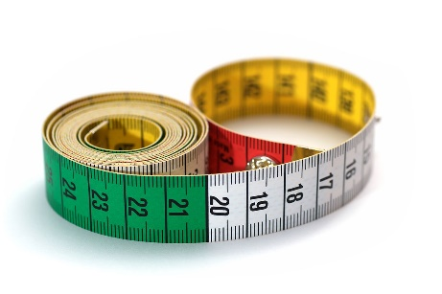
First, think of a way to measure evaporation. There are lots of different ways you could do it. These pictures might give you some ideas
Discuss ideas in your group and come up with a plan
Remember, it will need to be a fair test!

