Slide 1
Science - Year 3/4A Summer 1
States of Matter
What’s the Matter
Session 2
Challenge PowerPoint
© Original resource copyright Hamilton Trust, who give permission for it to be adapted as wished by individual users.
We refer you to our warning, at the foot of the block overview, about links to other websites.

Slide 2

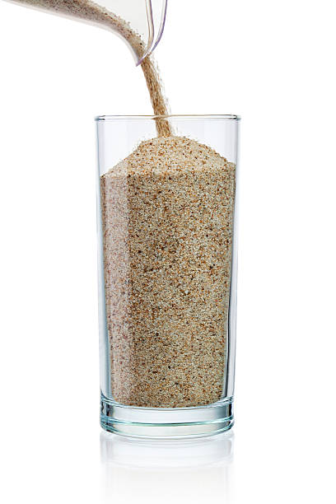
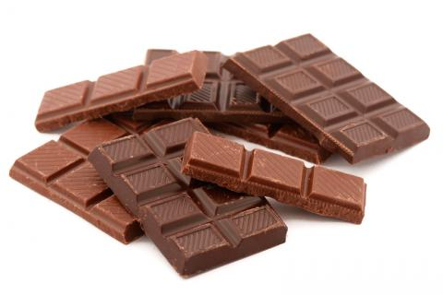
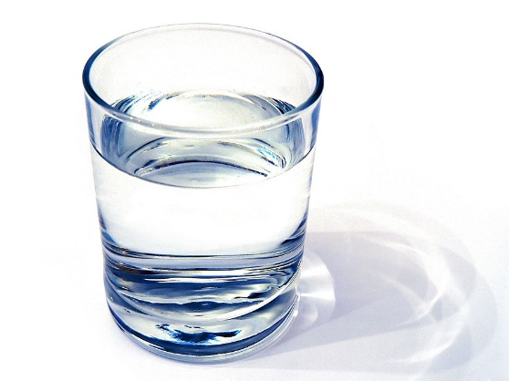
Challenge for Visitors on
Solids and Liquids
Dartspring Museum
With grateful thanks to the children in class at for their help with this resource

Slide 3
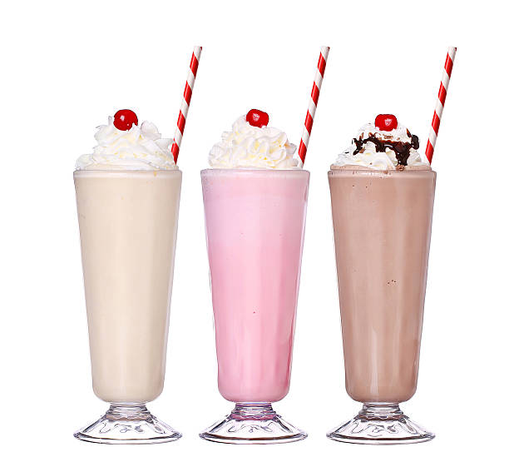
How well do you know your solids from your liquids?
Challenge yourself by taking part in this exciting puzzle!

Slide 4

All you need is:
A partner or a small group to work with
A strip of paper with 6 squares on it (to share between you)
Something to write with

Slide 5
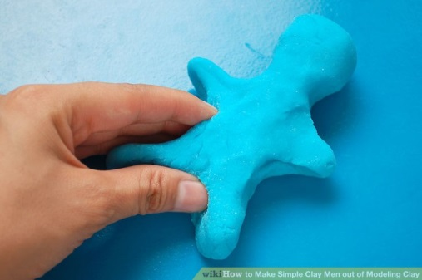

On each slide you will see 3 or 4 pictures of either solids or liquids or statements about them. They will all be about the same state of matter except for one. Your job is to find the odd one out.
For example if you saw these, which would be the odd one out?
I can be picked up
Why?
Because water is a liquid. The other 2 pictures show solids and solids can be picked up.
Let’s begin!

Slide 6
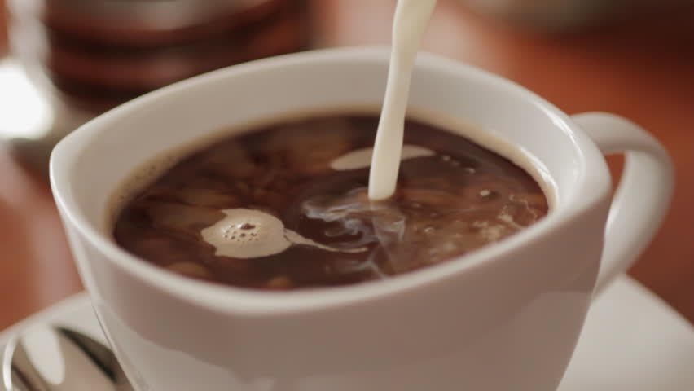
Which is the odd one out?
Agree in your group and write that letter in one of your squares.
A
B
C
D
I can be made into a pile or heap
I take up the shape of the container I am in
Diagram showing the arrangement of particles

Slide 7
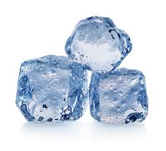
Which is the odd one out?
Agree in your group and write that letter in another one of your squares.
F
D
E
G
I flow down a slope
I can be cut or shaped
Diagram showing the arrangement of particles

Slide 8
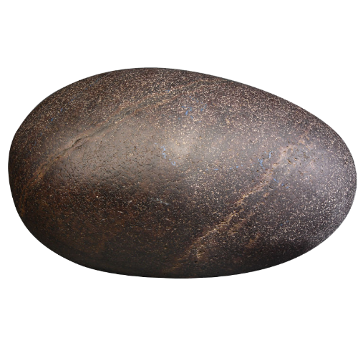

Which is the odd one out?
Agree in your group and write that letter in another of your squares.
Q
R
S
T
My particles are held loosely together so they can slide past each other
I feel wet or sticky if you touch me

Slide 9
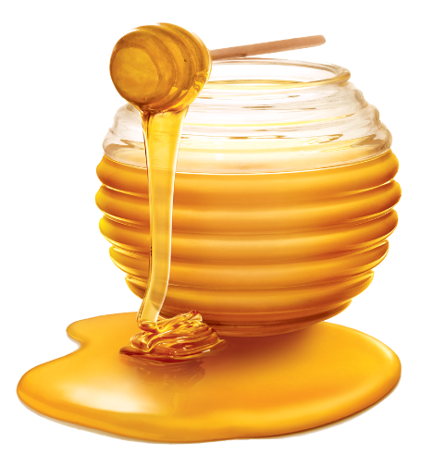
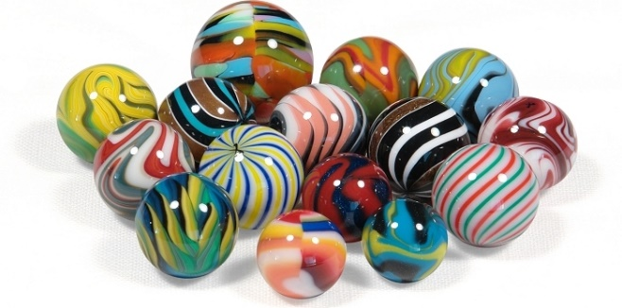
Which is the odd one out?
Agree in your group and write that letter in another of your squares.
L
O
M
N
My particles are held tightly together with strong bonds between them
I usually feel dry if you touch me

Slide 10
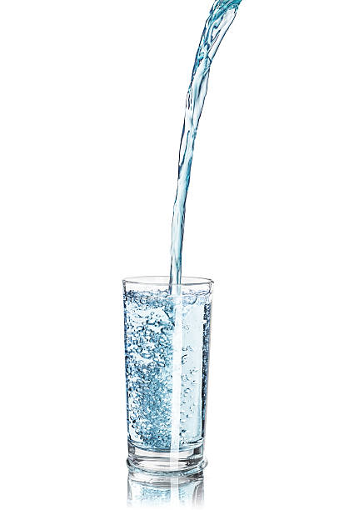
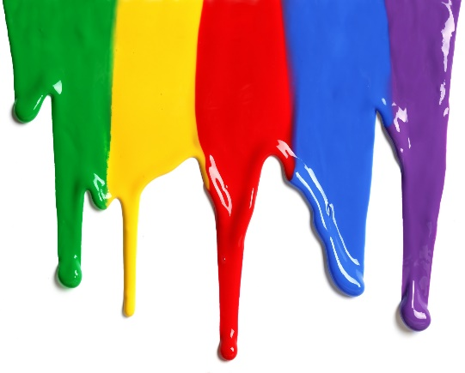
Which is the odd one out?
Agree in your group and write that letter in another of your squares.
R
S
T
U
If I am made of very small pieces, the pieces can be poured, but each tiny piece keeps its shape
I cannot keep my shape because I always level out

Slide 11
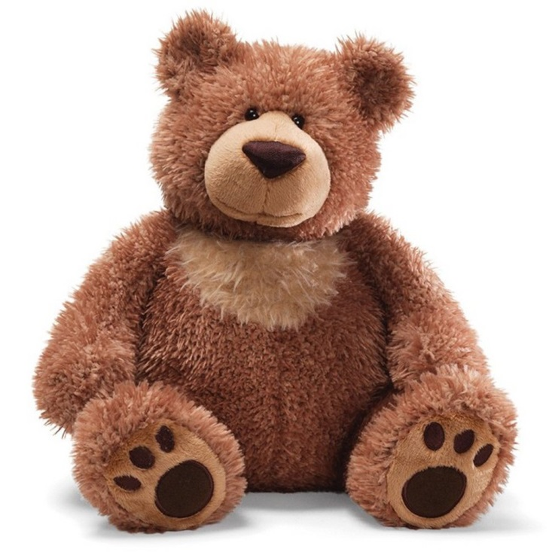
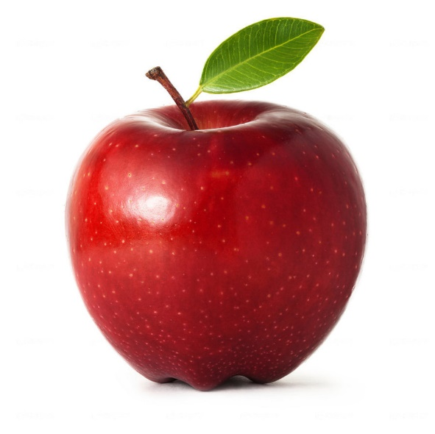
Which is the odd one out?
Agree in your group and write that letter in the last of your squares.
T
U
V
S
I form a puddle if I am not in a container
I keep my shape

Slide 12
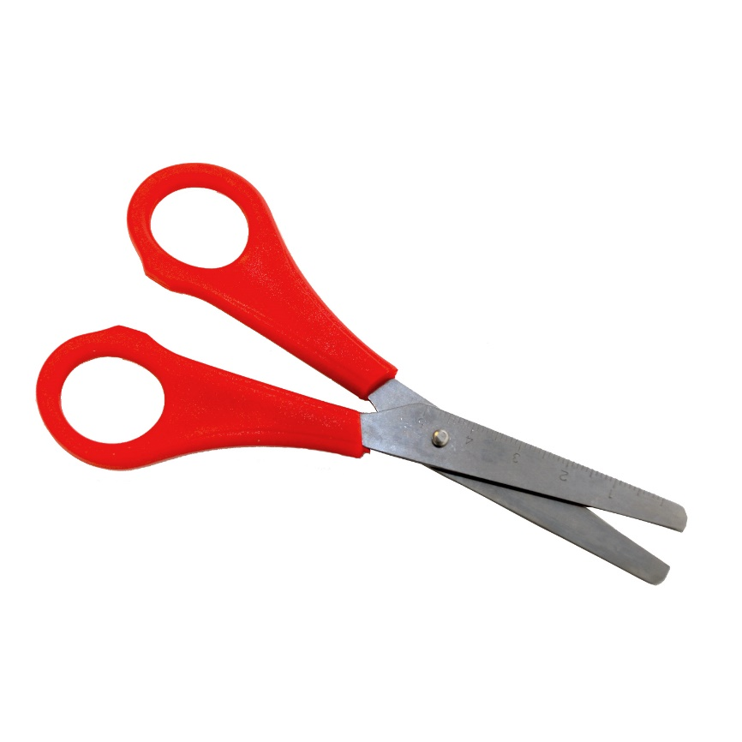
You should now have 6 letters written down; 1 in each square.
Cut them up into individual letters and arrange them to try and make a word.
Clue: It is a word related to both solids and liquids.
M
A
T
E
Have you guessed it?
T
R
All substances and materials, whether they are solid, liquid or gas are known as “matter.” Solid, liquid and gas are known as “States of Matter”.

