Slide 1
Science - Year 3/4A Summer 1
States of Matter
What’s the Matter
Session 2
Teaching PowerPoint
© Original resource copyright Hamilton Trust, who give permission for it to be adapted as wished by individual users.
We refer you to our warning, at the foot of the block overview, about links to other websites.

Slide 2
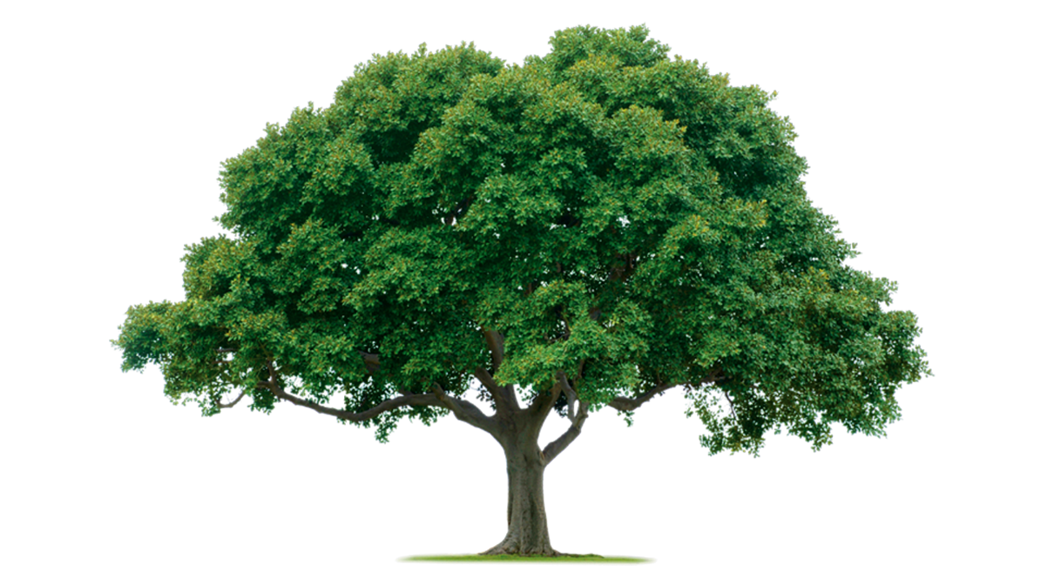
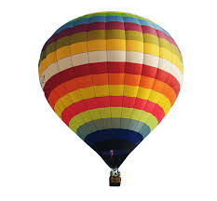
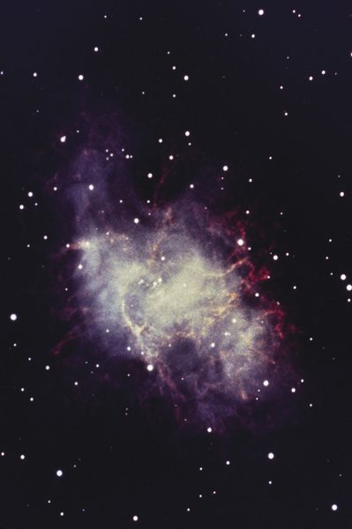
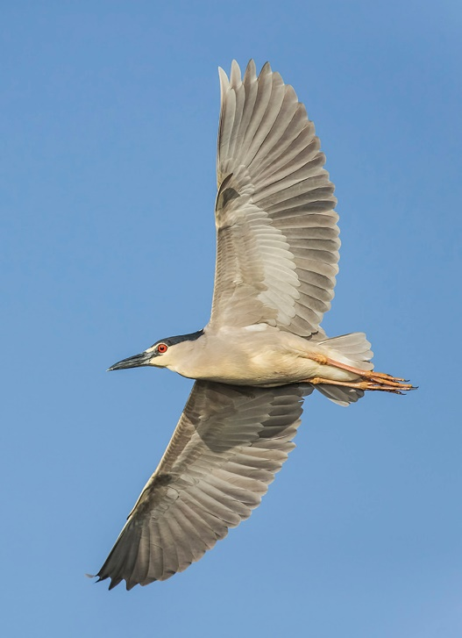
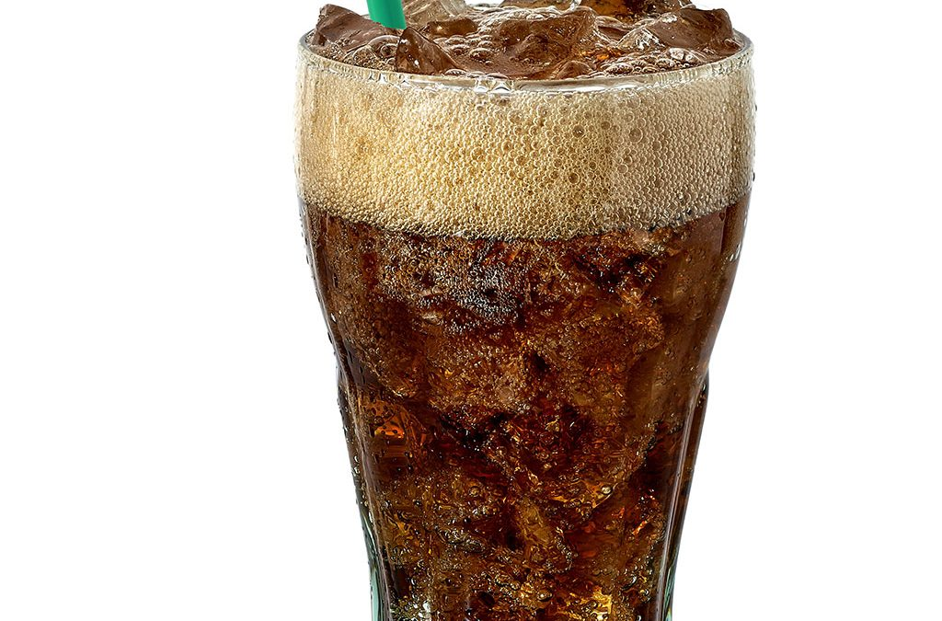
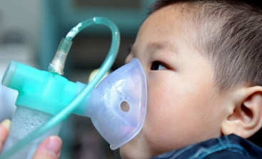
Gases are amazing!

Slide 3
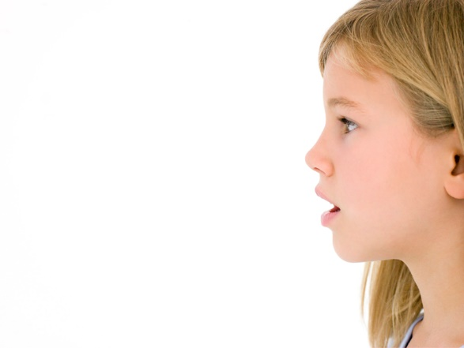

Without gases there would be no life on planet Earth!
Can you explain why?
All animals including humans need a gas called oxygen which is invisible but in the air all around us. They use oxygen to turn food into energy (respiration). They breathe out a waste gas called carbon dioxide.
Plants need carbon dioxide to make their food (this process is called photosynthesis). They release a waste gas too – oxygen.
What a perfect balance! Plants need us and we need them!

Slide 4


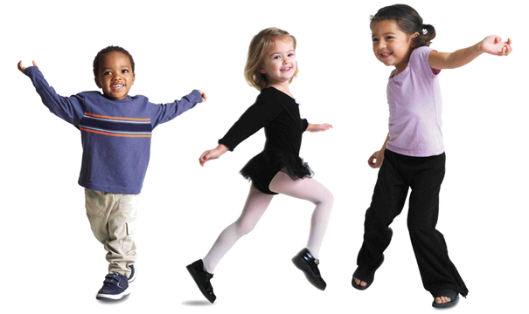
There is a mixture of invisible gases all around us. We call this air.
Can you name any of the gases in air?
Clue: 2 of them were mentioned on the previous slide!
The gas present in the largest quantity is Nitrogen.
Oxygen makes up about 20% of air.
Nitrogen and Oxygen together make up about 99 % of air.
Argon makes up less than 1%.
Carbon dioxide and a number of other gases make up a very small percentage of air .

Slide 5
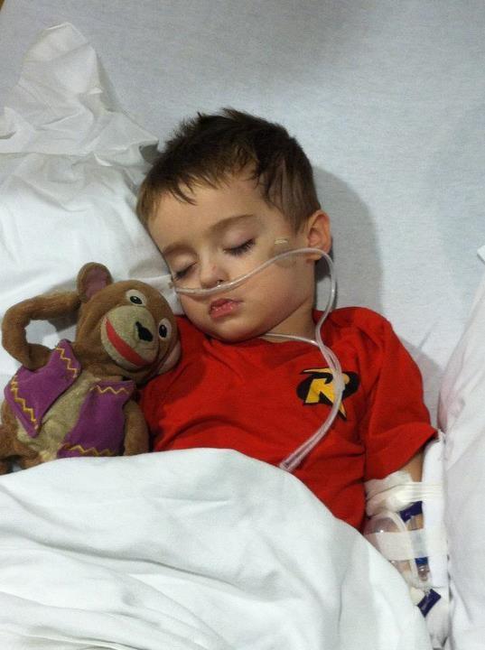
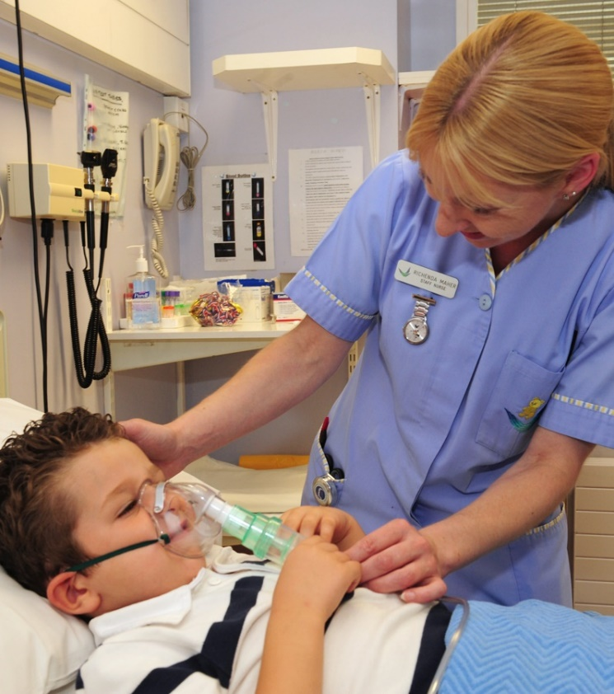
Sometimes when people are ill, they are given pure oxygen through a mask or a tube into their nose.
This makes it much easier for them to breathe.

Slide 6
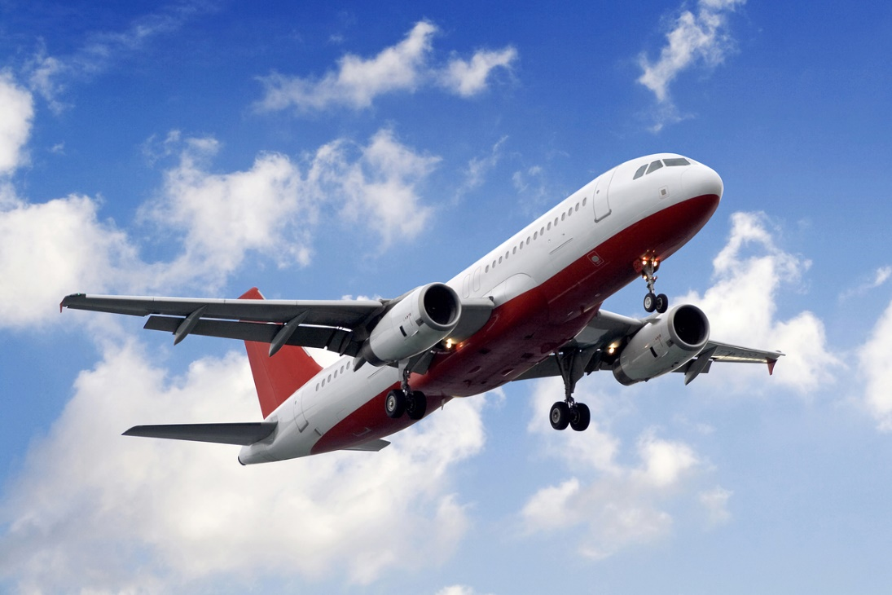

It is air that supports birds and planes as they fly.

Slide 7
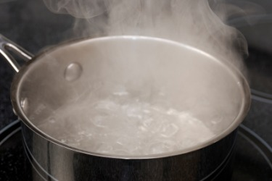
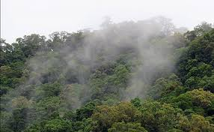
Air also contains water vapour. This is water that has changed its state from liquid to gas. Water vapour is invisible. The clouds, or mist that you can see is made of tiny droplets of liquid.
Every time you breathe out, there is invisible water vapour in your breath.
Try cupping your hand over your mouth as you breathe out. Can you feel the moisture?

Slide 8
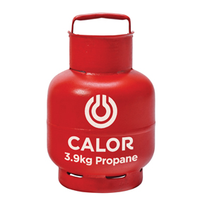
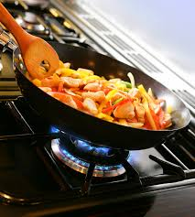
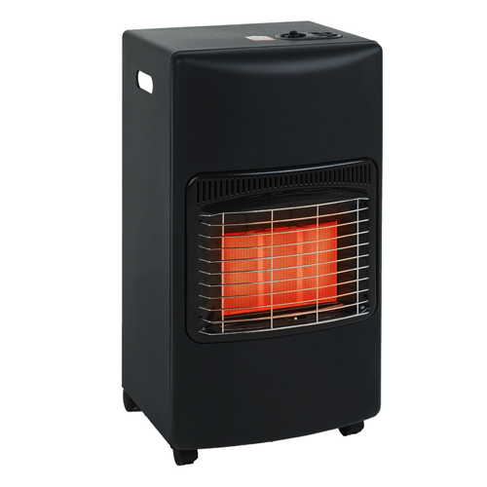
Many homes use gas for cooking and heating. Sometimes it comes into the house through pipes and sometimes it comes from a gas bottle.
This type of gas is called natural gas as it comes from the ground. It burns easily (is flammable) and this makes heat.

Slide 9
Fizzy drinks have carbon dioxide gas added to them in the factory.
When you open the cap on the bottle, the gas is released, so lots of bubbles form which rise to the surface.

Slide 10

Celebration balloons that float upwards are filled with a very light gas called helium.
The helium particles are less densely packed and lighter than the air particles around them. So the balloon floats upwards.

Slide 11
Hot air balloons fly using exactly the same principle. The air inside the balloon is heated by a large gas burner. This makes the air inside the balloon warmer than the air around the outside of it.
Warm air is less dense than cold air because the particles are more spread out. This means it is lighter so the balloon rises up.
Flame heating the air

Slide 12
What do you think gas particles would look like if you could see them?
Gas particles spread themselves out into the space available.
Solid
Liquid
In a solid, the particles are held tightly together with strong bonds between them. These particles do not move easily so a solid keeps its shape.
In a liquid, the particles are not held so tightly together because they have weaker bonds between them. This makes them more free to move around so liquids can flow. But a liquid can’t hold its shape unless it is in a container.

Slide 13
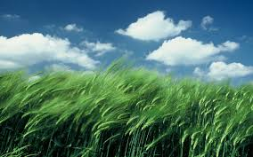
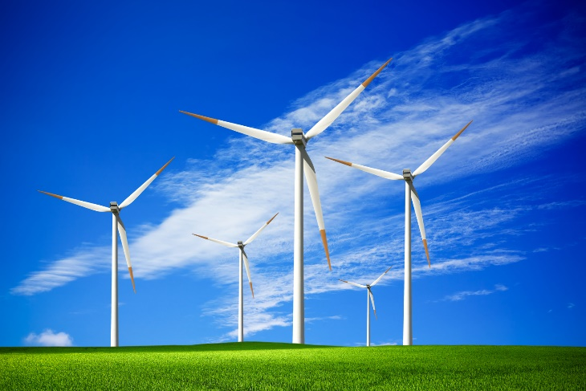
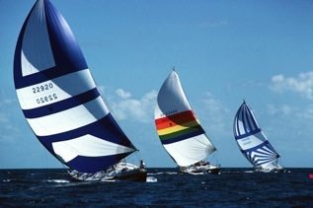
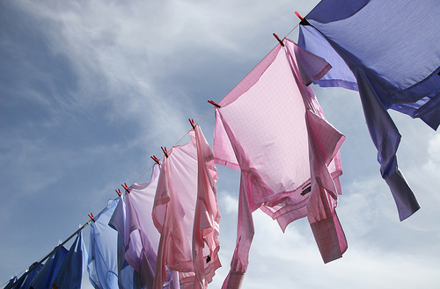
Air is constantly moving over the surface of the Earth. We call this movement wind.
Wind can be very helpful. Can you think how?
Here are just a few of the things wind can do:
It powers turbines to make electricity
It powers sailing boats
It dries washing

Slide 14
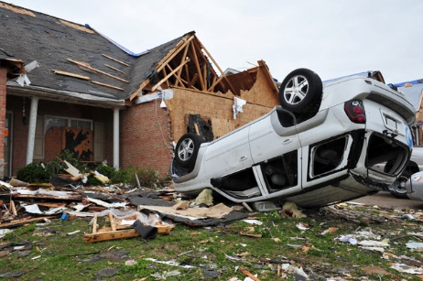
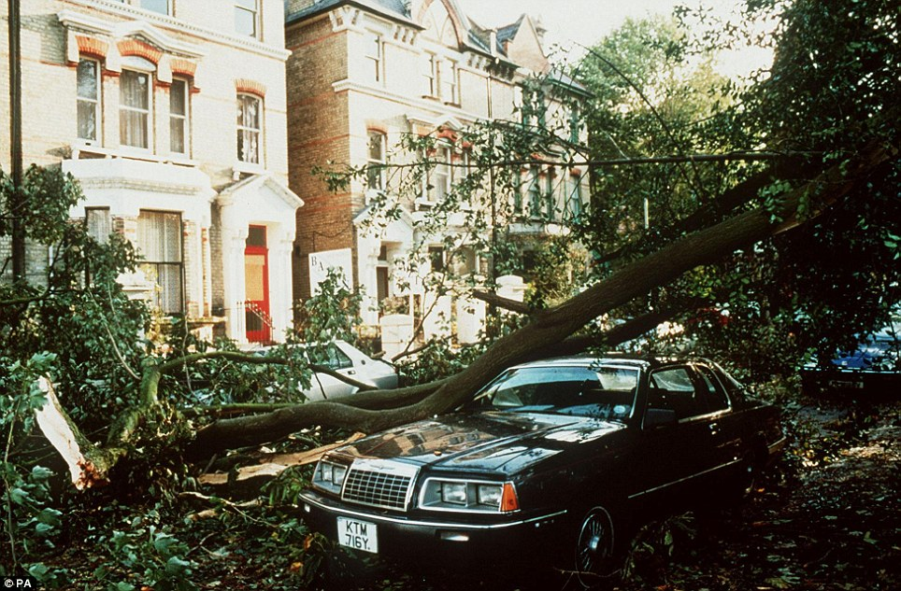
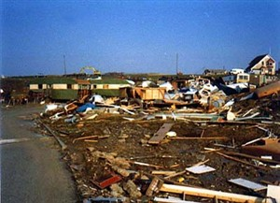
But wind can also be a terribly destructive force.

Slide 15
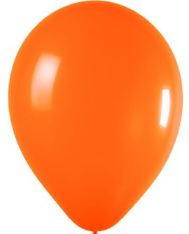
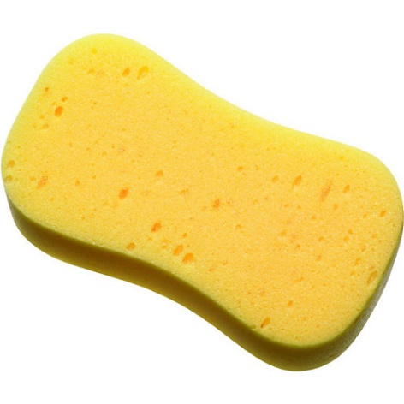
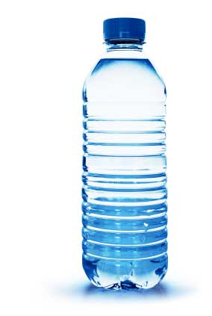
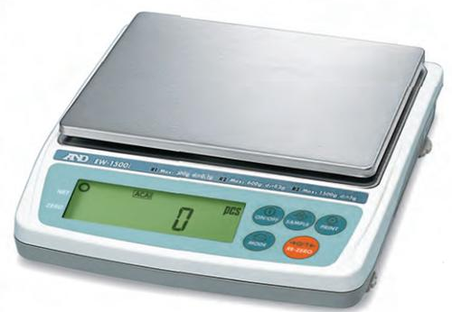

Carla, from the Dartspring Museum has asked if you could help develop some interesting activities for visitors that teach them all about gases.
You will need to:
Try out your activity
Write simple instructions for the visitors to follow
Explain what your activity teaches the visitors about gases

Slide 16

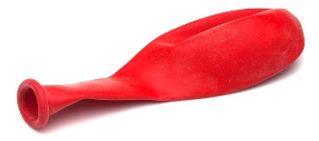
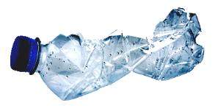
Carla has some ideas for you or you could choose an idea of your own. Work in a group of 3 or 4.
1. Weighing balloons
2. Crushing bottles
Experiment with weighing balloons before and after blowing them up.
Experiment with crushing plastic bottles. Try with the cap on, with the cap off and with the cap loosened.
What happens?
Why?
Is there any difference?
Why?
Can you challenge visitors with a balloon weighing activity?
Can you challenge visitors with a bottle crushing activity?
What does it tell you about gases?
What does it tell you about gases?

Slide 17



Wafting Feathers
Squeezing sponges
Experiment with a sponge in water. Try floating it, prodding it and squeezing it.
Can you move a feather without even touching it?
How?
Could you think of a feather challenge for visitors?
What does it tell you about gases?
Can you think of a sponge and water activity for visitors?
What does it tell you about gases?

Slide 18
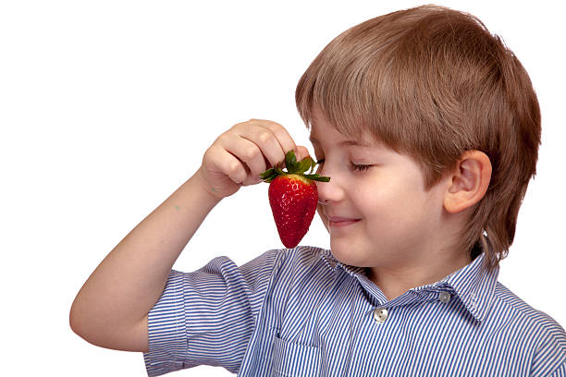
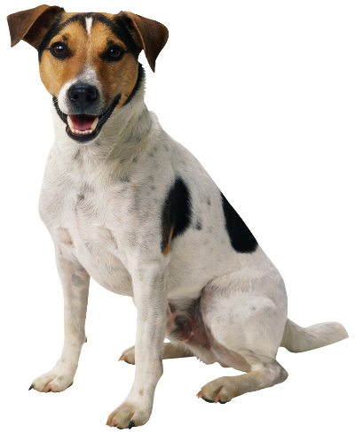
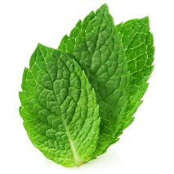
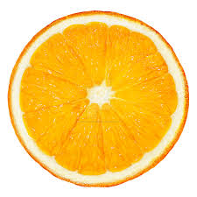
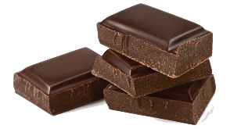
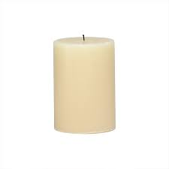



Detecting smells
Locating Smells
Dogs are famous for tracking down smells but can humans use their noses to locate the source of a smell too?
Can you think of a smell locating activity for visitors?
Do people know what they are smelling without looking or touching?
How?
Can you think of a smell detection activity for visitors?
What does this tell you about gases?
What does it tell you about gases?

