Slide 1
Science - Year 3/4A Summer 1
States of Matter
What’s the Matter?
Session 1
Plenary PowerPoint
© Original resource copyright Hamilton Trust, who give permission for it to be adapted as wished by individual users.
We refer you to our warning, at the foot of the block overview, about links to other websites.

Slide 2
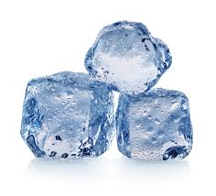
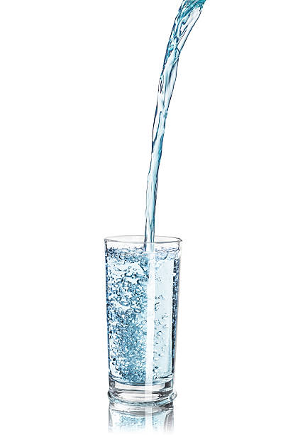
Why do solids hold their shape?
Why do liquids flow?

Slide 3
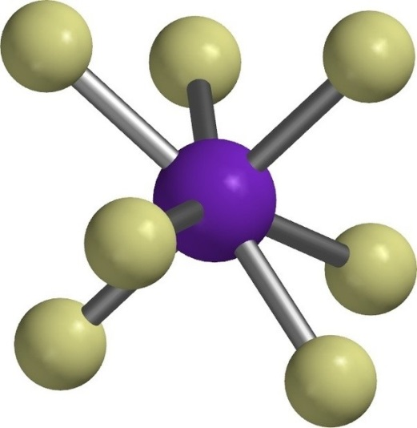
Materials are made of tiny particles that are far too small to see. Particles are made of atoms.

Slide 4
Solids
In a solid, the particles are held tightly together with strong bonds between them. These particles do not move easily so a solid keeps its shape.
Liquids
In a liquid, the particles are not held so tightly together because they have weaker bonds between them. This makes them more free to move around so liquids can flow. But a liquid can’t hold its shape unless it is in a container.

