Slide 2
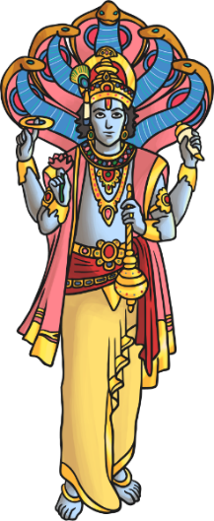
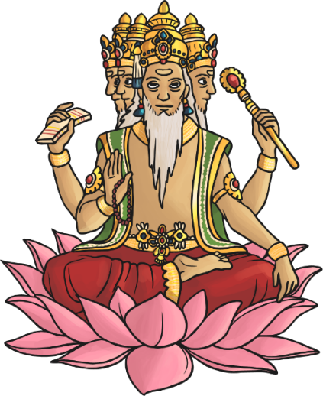
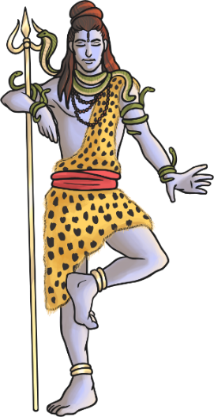
Hindu Deities
Hindus recognise one God, Brahman. The gods of Hinduism are different expressions of Brahman.
These are considered the Trimurti
- the three aspects of the universal supreme God.
v
Vishnu
Brahma
Shiva

Slide 3
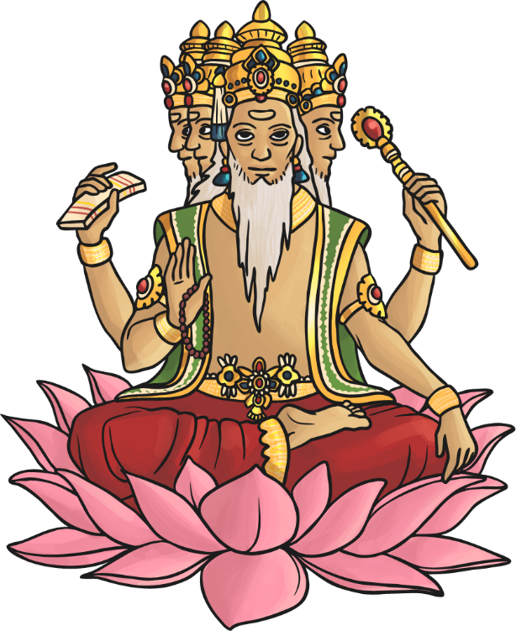
Hindu Deities - Brahma
Brahma is the god (deva) of creation.
He has four arms and four faces, looking in the four directions.
Each of his four heads is believed to be responsible for one of the four Vedas (sacred Hindu texts).
Brahma is not worshipped as much as the other gods, as it is believed his role as creator is over.
His wife is Saraswati – the goddess
of knowledge.

Slide 4
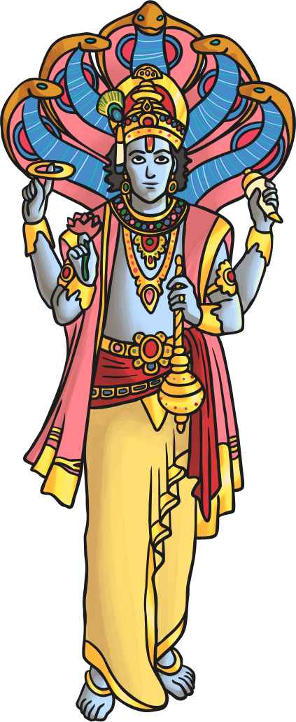
Hindu Deities - Vishnu
Vishnu is the god responsible for preserving and protecting the universe.
His role is to return to Earth during troubled times to restore the balance between good and evil.
His incarnations (human forms of Vishnu) include Rama and Krishna.
His last incarnation is said to be Siddartha Gautama – otherwise known as ‘Buddha’ (the founder of Buddhism).
His wife is Lakshmi.

Slide 5

Hindu Deities - Shiva
Shiva is the god of destruction. His role is to destroy the universe in order to re-create it.
He is seen as the source of both good and evil.
His wife, Shakti, is said to enable him to gain balance.
He is often depicted with . . .
a third eye (representing wisdom and insight);
a cobra necklace (representing destruction and recreation – snakes represent this in the way they shed their old skin for new skin);
vibhuti (three lines drawn across the face to represent his power);
a trident (which represents the three functions of the Trimurti).

