Slide 1

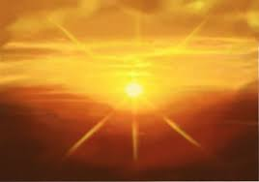

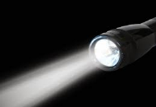
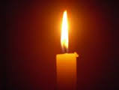
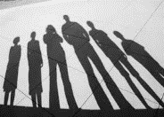
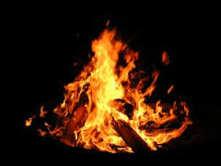
Introduction: Science
What do you already know about light and dark?
What do you already know about day and night?
 | What do I already know? | What I would like to find out?

Slide 2
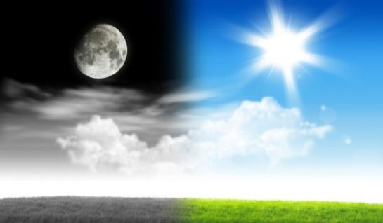
Introduction: Science
Explore day and night (light and dark)
Introductory activity
What questions do you have about the dark? | What questions do you have about the light?

Slide 3
Unit 1: Science Activity
Light and dark
Look at the following link on the bbc website www.bbc.co.uk/education/clips/z74hgk7
Now, read the following explanation about what light and dark is.
The moon is the main, and only, evidence of natural light at night. It derives its light from the sun. Therefore, when the moon circulates around the earth we see it reflect differing amounts of light. As the moon orbits the Earth, it reflects different amounts of sunlight. So, in some nights a lot of the sun's light is reflected and in some nights much less of its light is reflected. This is why some nights are darker than others. Using your knowledge from the internet clips and the explanation above, explain in your words, what makes light and dark.

Slide 4
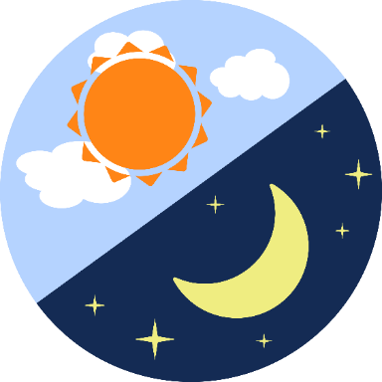
Unit 1: Science activity
What makes light and dark

Slide 5
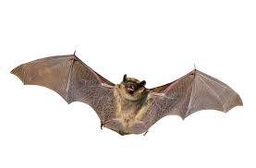
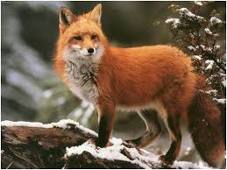
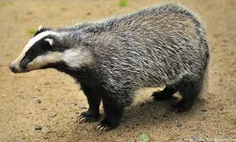
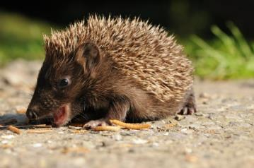
Nocturnal Animals: active at night
Look at the 4 nocturnal animals below. Choose one and find out 10 interesting facts about it (including reasons why these animals are suited to the dark). You can use books or the internet or even your adults!
bats
foxes
badgers
hedgehogs

