Slide 1
ICT i-simulate
What is a computer simulation?
a computer simulation is a program that imitates a real life scenario.
Simulations let you make choices to try out things that would
be too difficult, dangerous or expensive to do in real life

Slide 2
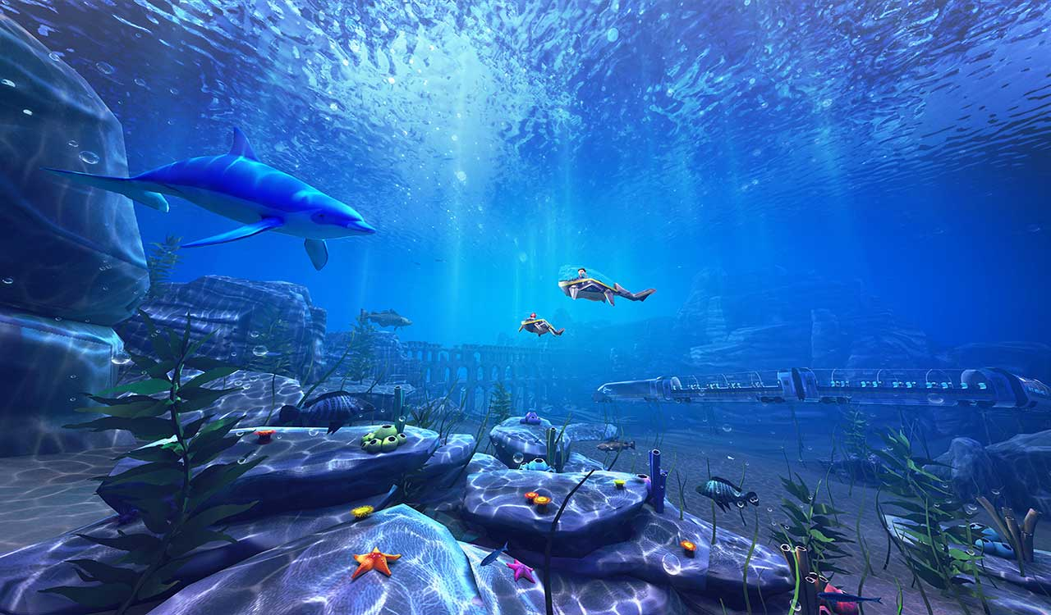
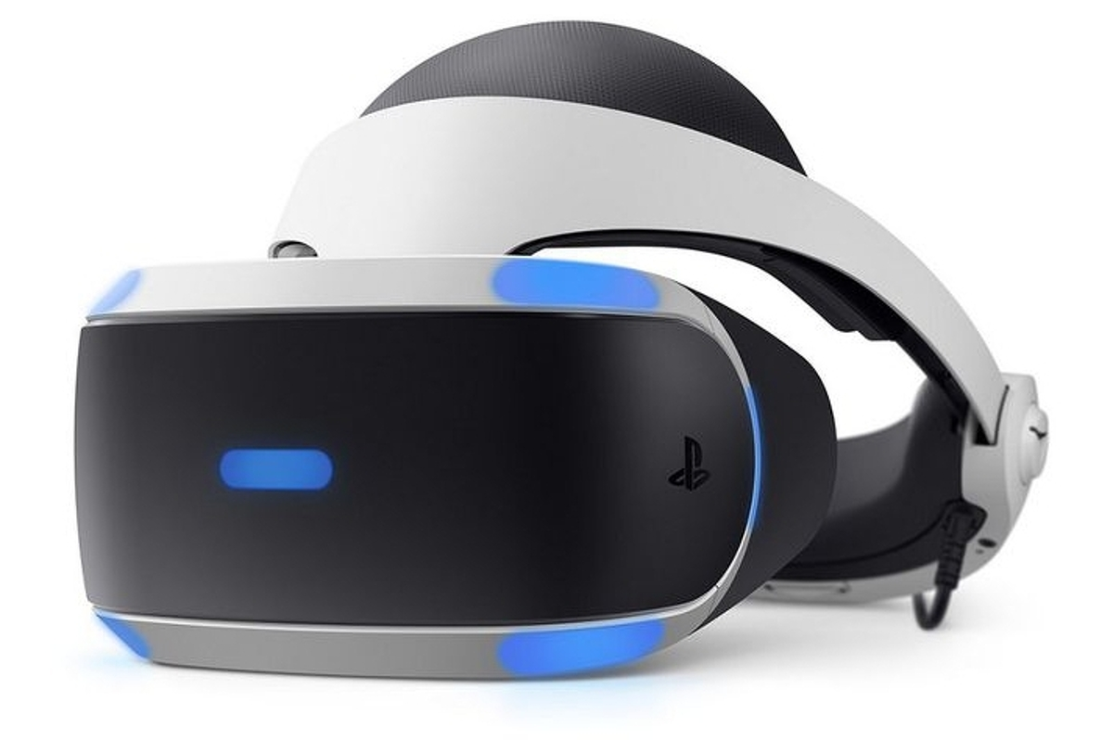
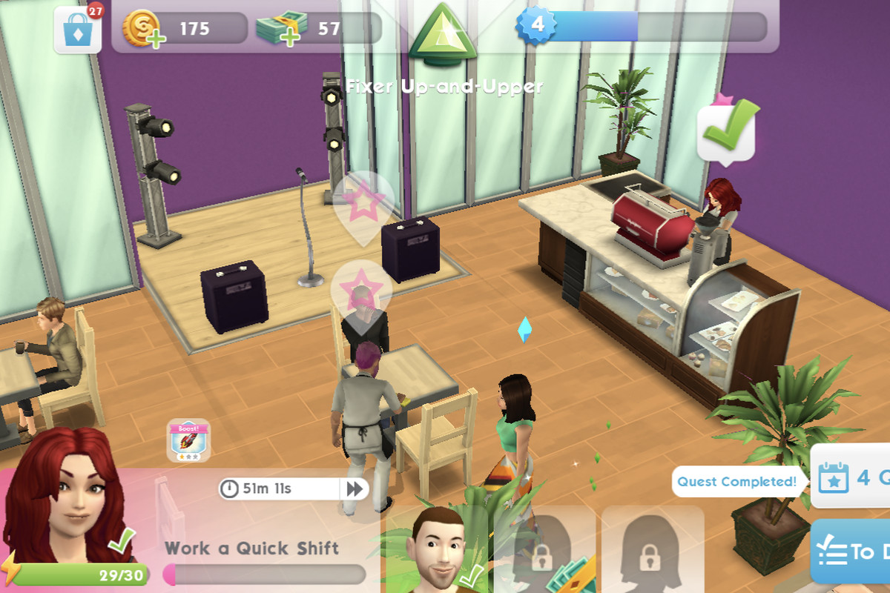
Do you play any computer games that are simulation games?

Slide 3
Real world simulations
Not all simulations are on computers
We have been using simulations for centuries
We play board games
We role play with our friends from an early age
A true simulation involves the use of rules and variables as well as a way to interact with the simulation.

Slide 4
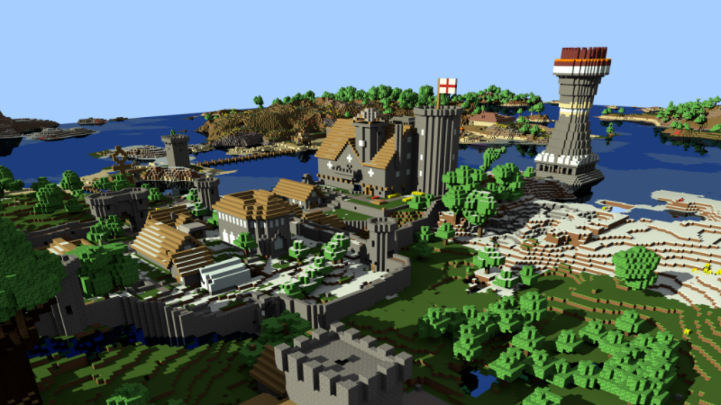
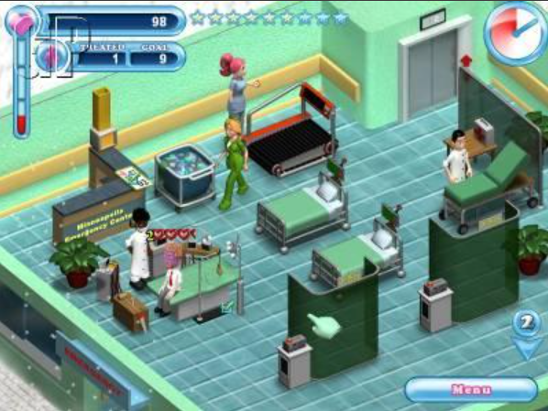
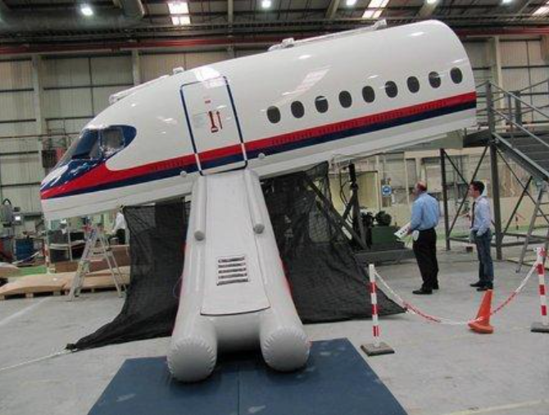
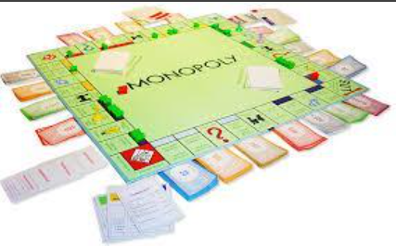
How are each of these simulations used in real life?

Slide 5
EXPLORE THESE SIMULATIONS:
http://icomp.site/rollercoaster
https://icomp.site/getreadyforwork
HAVE FUN!

