Slide 2

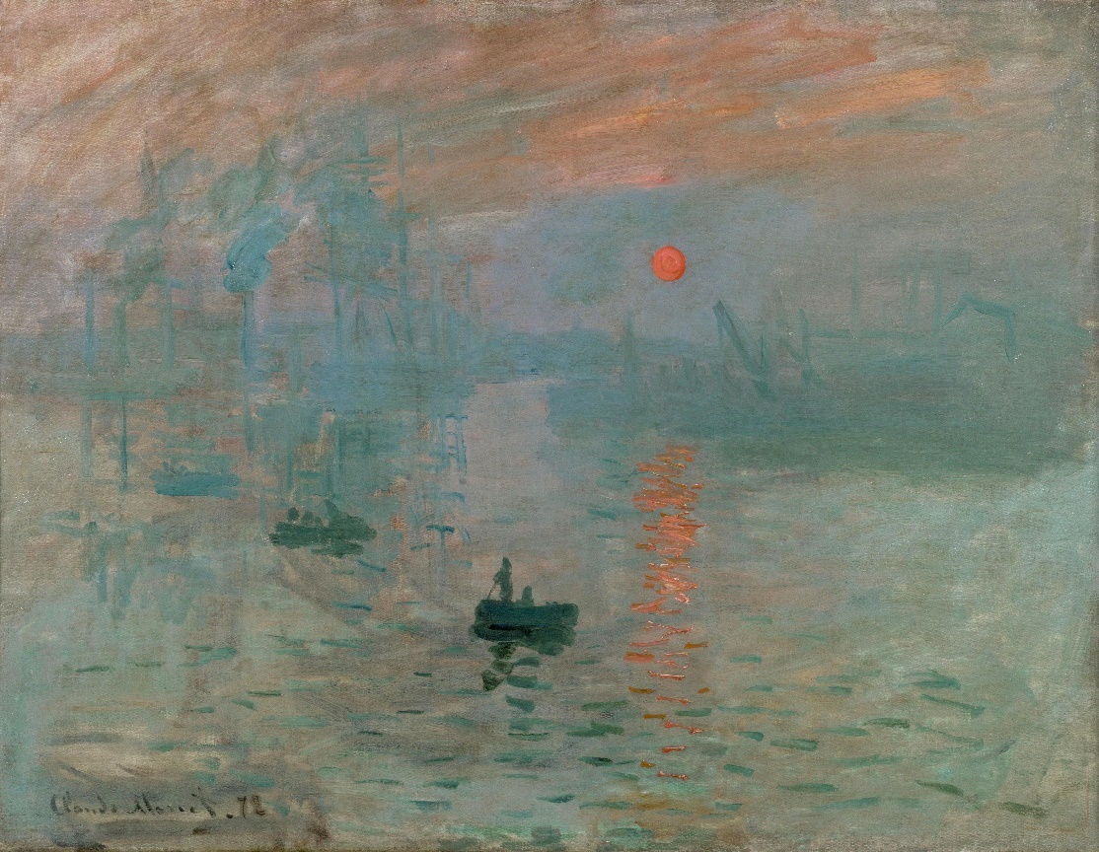
Impressionism
Monet is known as one of the founders of the Impressionist movement, along with the other artists experimenting with painting styles at that time.
In fact, the name, Impressionist, comes from a painting Monet exhibited called Impression, Sunrise.

Slide 3
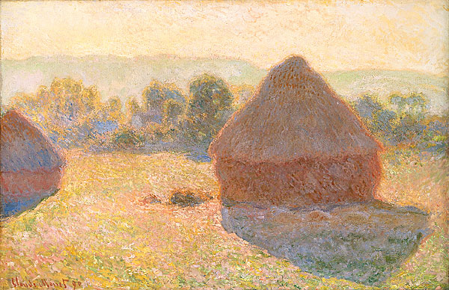
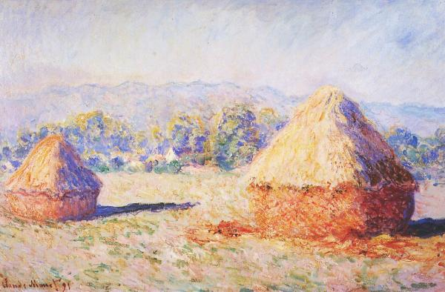
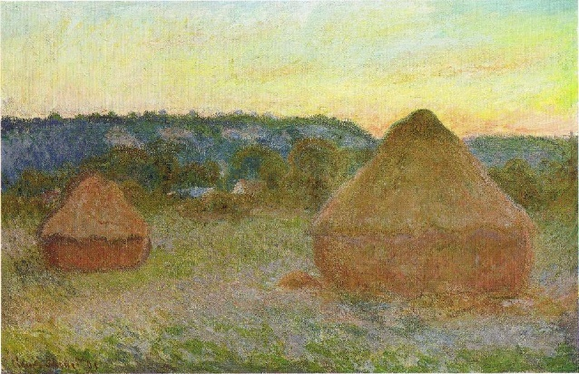
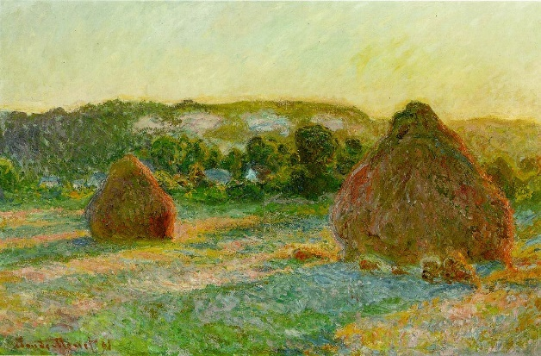
Changing Light
Monet often painted the same scene many times, to capture the changing light and seasons.
Look at the pictures of the haystack paintings
How does the changing light affect the feel of the paintings?

Slide 4
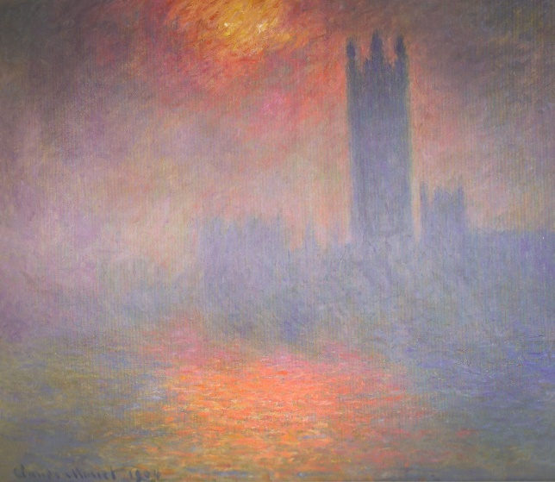
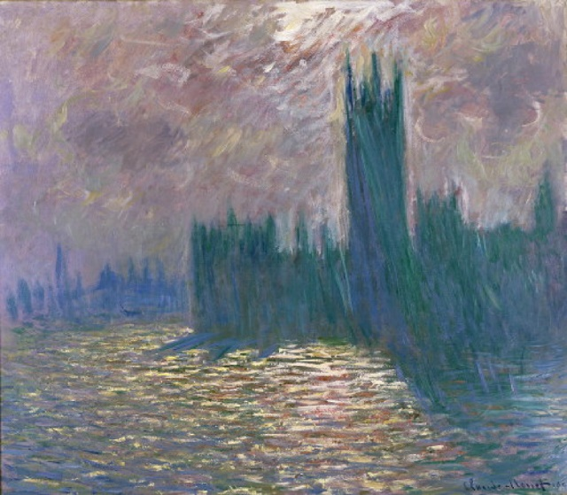
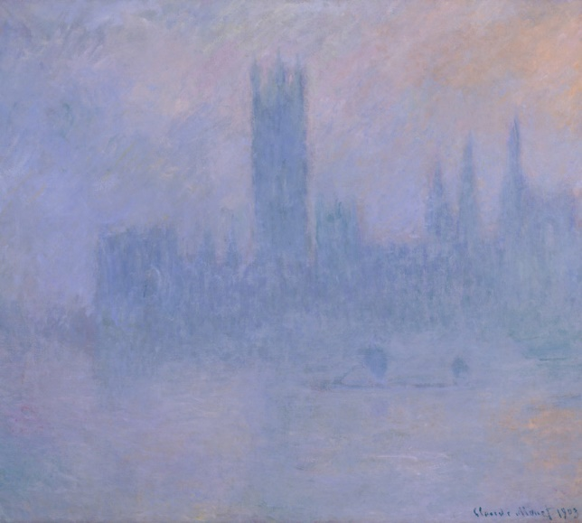
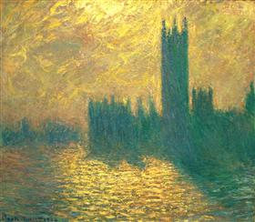
The Houses of Parliament

Slide 5
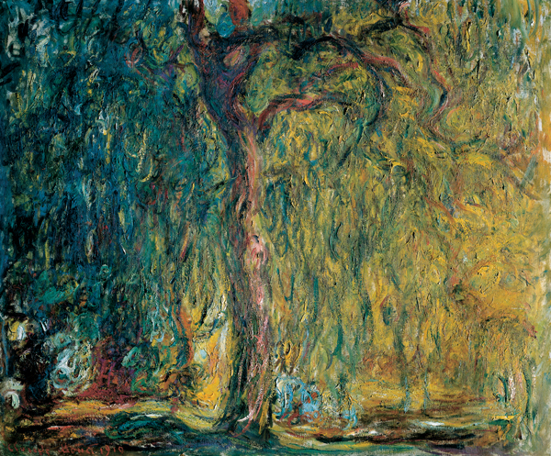
Weeping Willow
Monet painted this in honour of all the fallen soldiers in World War I.

Slide 6
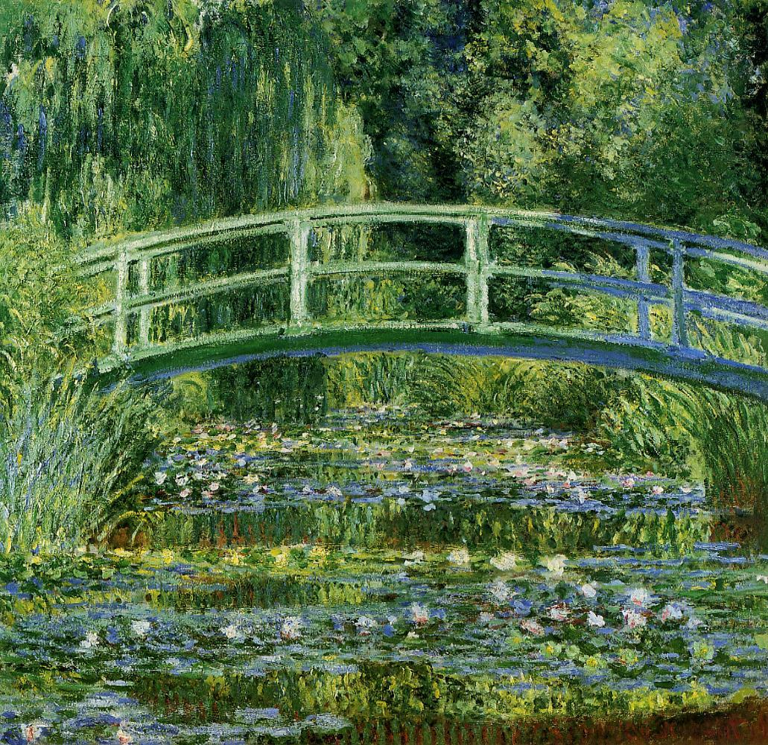
Water Lilies and Japanese Bridge
Monet moved to Giverny in France, and he spent many hours painting the water lilies and the bridge in a series of huge paintings. Paintings of the water lilies are displayed in a purpose built, curved room at Musée de l’Orangerie, Paris.

Slide 7
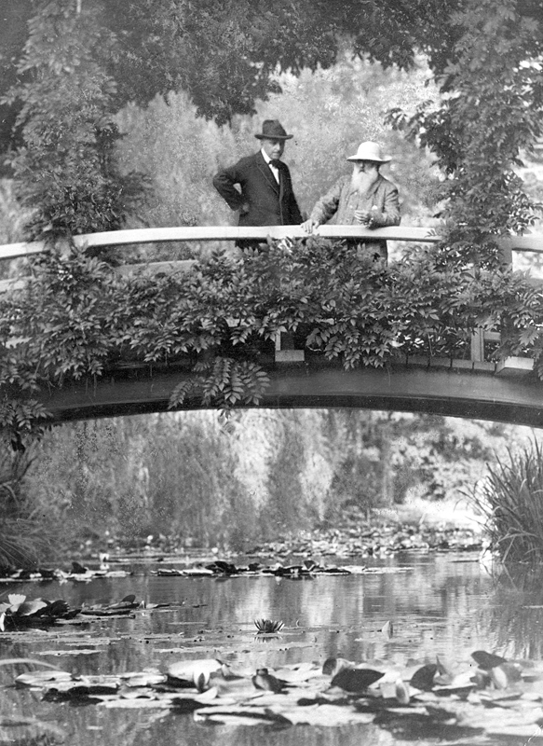
On The Bridge
Claude Monet on the bridge at Giverny, with an unnamed visitor, in 1922.

Slide 8
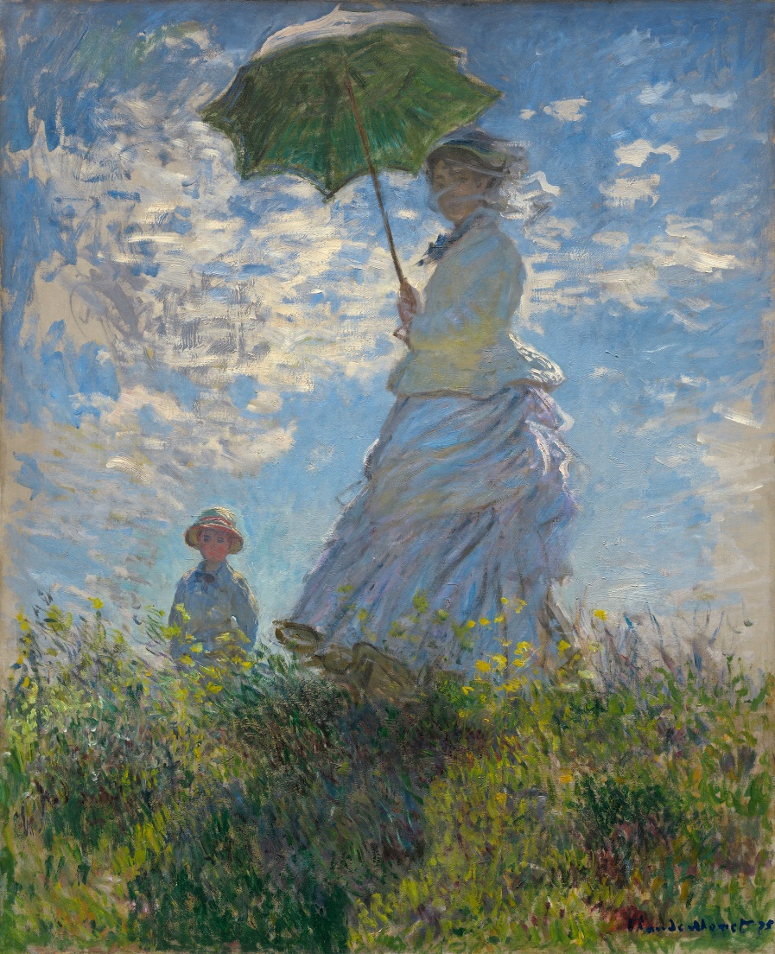
Woman With An Umbrella
“I'm working like never and at new attempts, figures in the open air as I understand them, made like landscapes. It is an old dream that still worries me and that I want to fulfil once and for all; but it is hard !”
Claude Monet

Slide 9
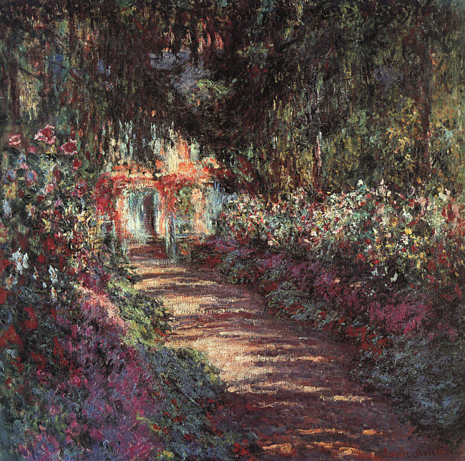
The Garden In Flower

Slide 10
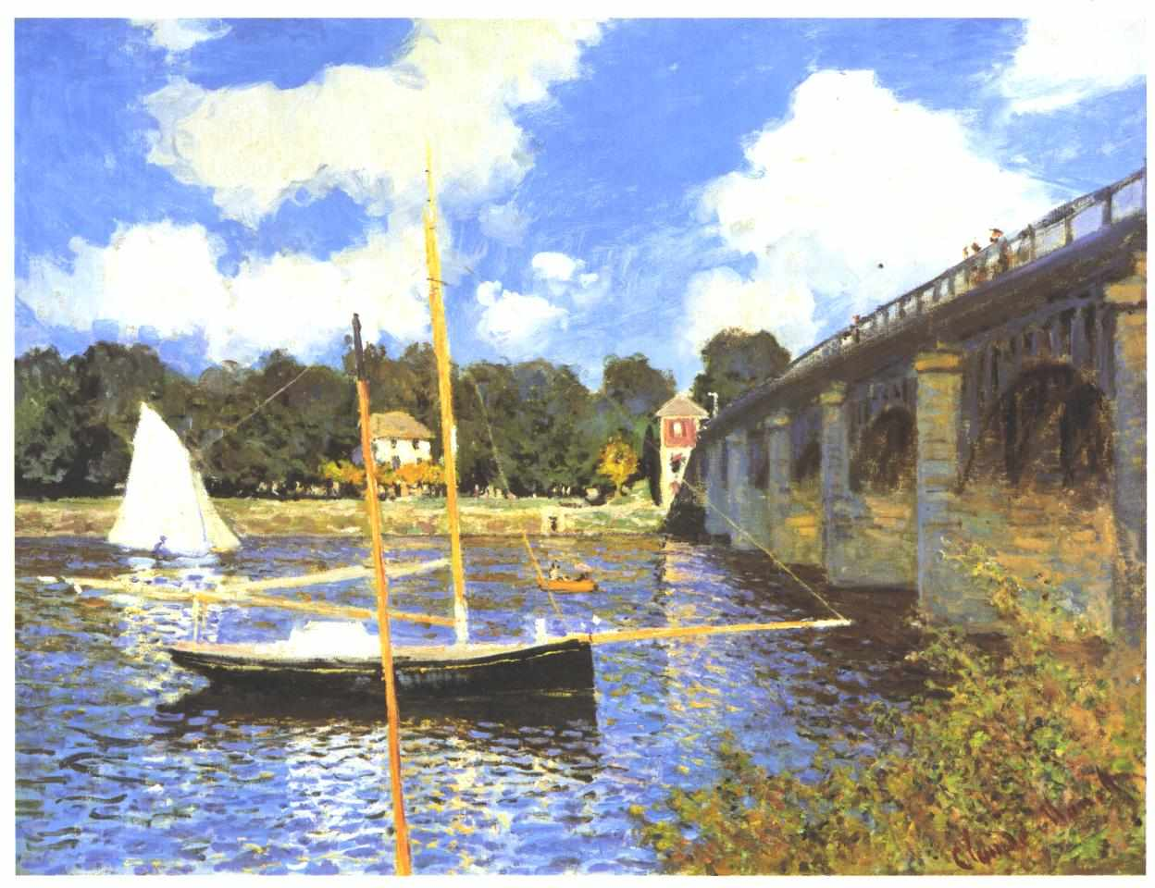
Bridge In Argenteuil

Slide 11
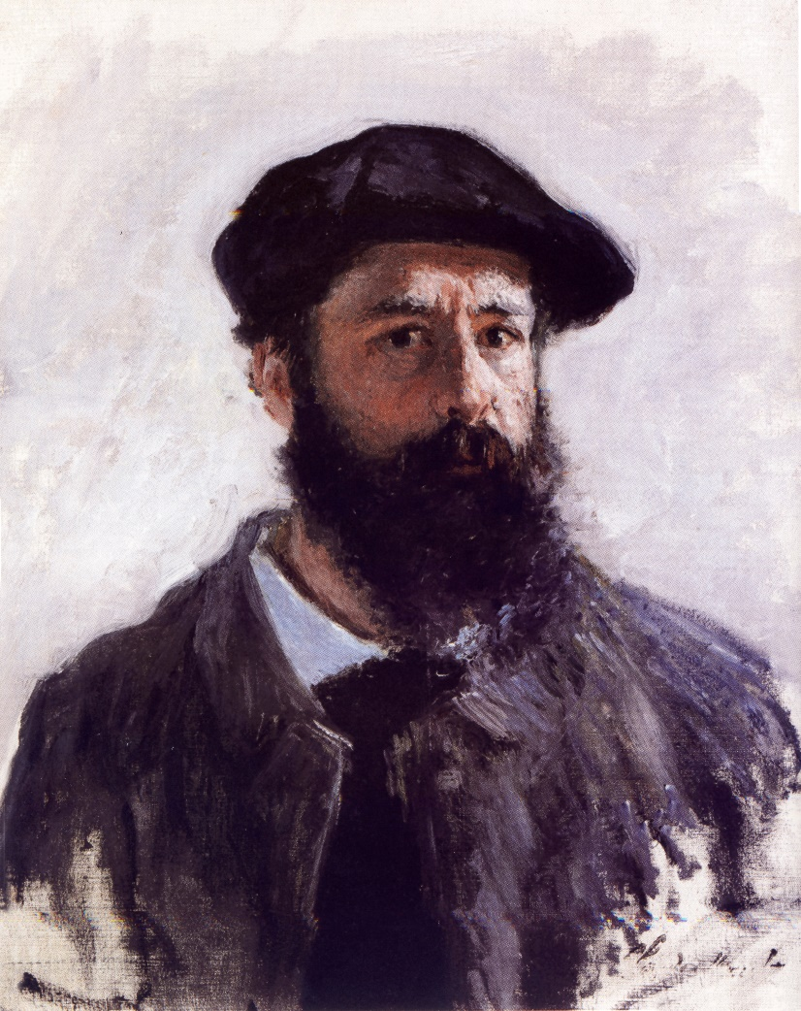
Self Portrait With Beret
Monet painted this self portrait in 1886.

Slide 12
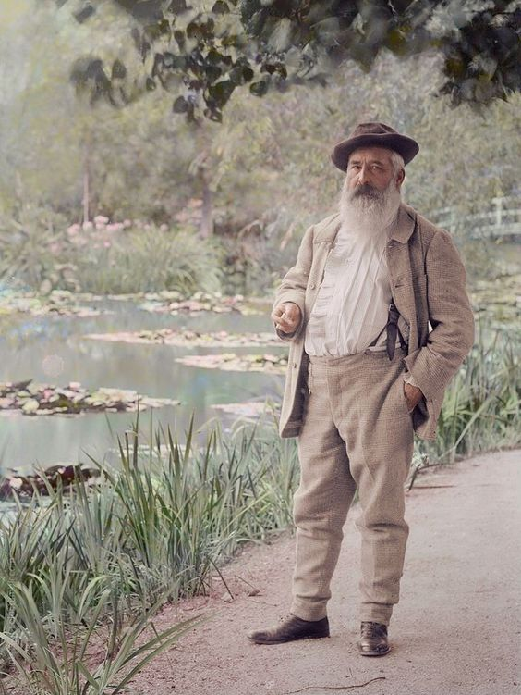
On The Bridge
Claude Monet developed problems with his sight. This affected the colours used in his paintings, and following a cataract operation in 1923, he repainted some of his works of art, to add more blue.
Monet developed lung cancer at the age of 86, and died on 5th December, 1926. He is buried in Giverny cemetery.
Monet had an enormous impact on the art world, creating many of the world’s most iconic oil paintings.

