Slide 1
Unit 3: History
Fishing
For most of the Stone Age, humans lived as hunter-gatherers. This means that instead of growing their own food, they went out and found it. They hunted and fished for food, especially during the Ice Age. Later, they learned to gather edible plants, collect eggs from birds’ nests, and, for a sweet treat, they took honey from wild beehives. What the hunter-gatherers ate depended on what they could find each season, eating fruit and berries when they ripen and eating meat from animals when they were most plentiful. They travelled from place to place in search of the best hunting grounds, living in temporary shelters. Humans who lived by the sea, rivers or lakes used barbed spears to catch fish and, later, traps to catch eels, crabs and lobsters. Eventually, humans learned to grow their own crops and began to settle in one place. These people became the first farmers.
Read this extract carefully and choose ten key words or phrases that would help you remember what you read.
Check your list with your partner. Use your key words/phrases to explain your understanding to each other.

Slide 2
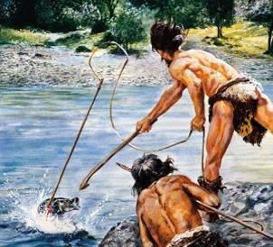
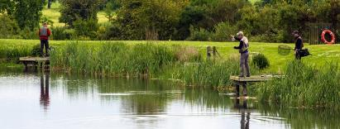
Unit 3: History
Hunter-gatherers
How did stone-age people fish?
What is different about the way we catch fish today?

