Slide 1
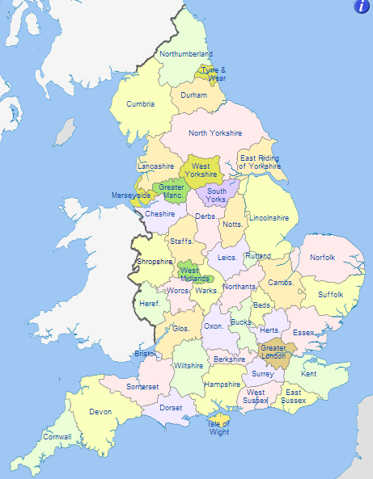
Counties of England
Source: https://en.wikipedia.org/wiki/Counties_of_England

Slide 2
Counties of England
Abbreviated counties
Greater Manchester South Yorkshire
Derbyshire Nottinghamshire
Staffordshire Leicestershire
Herefordshire Worcestershire
Warwickshire Northamptonshire
Cambridgeshire Bedfordshire
Gloucestershire Buckinghamshire
Oxfordshire Hertfordshire
© SaveTeachersSundays.com 2013

Slide 3
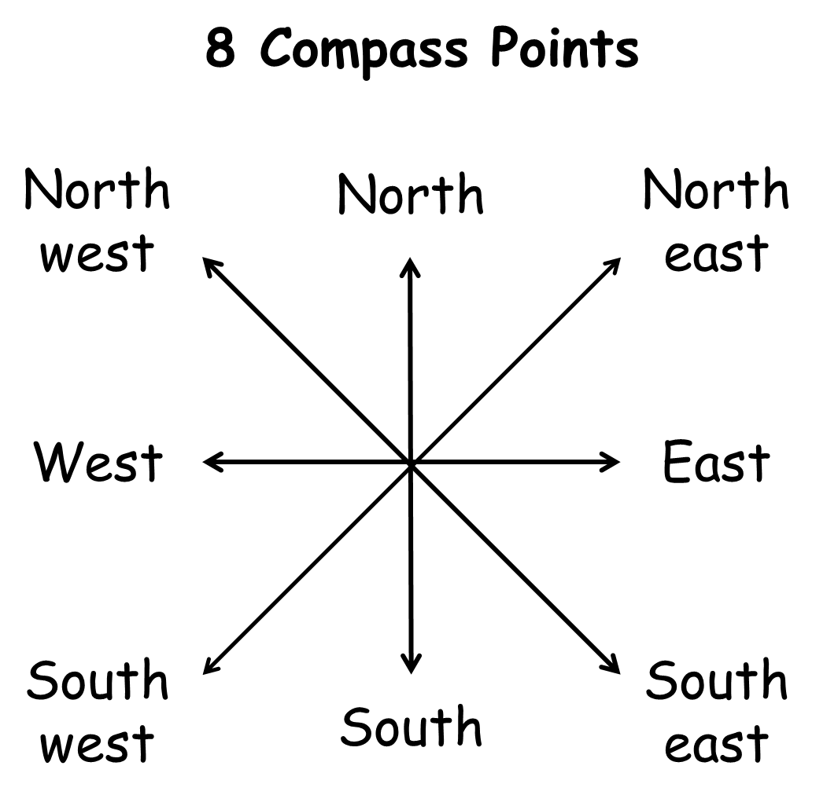

Slide 4
Name: Date:
Locate the counties of England
Norfolk is north of .
Herefordshire is west of .
Buckinghamshire is east of .
Hampshire is south of .
Merseyside is bordered by , and .
Essex is of Hertfordshire.
Berkshire is of Greater London.
East Riding of Yorkshire is of Lincolnshire
Wiltshire is of Gloucestershire.
The most south-western county is .
The most south-eastern county is .
is bordered by East Sussex, Surrey and Hampshire.
West Yorkshire is south-west of .
Surrey is north-east of .
Somerset is north-west of .
The counties that border Scotland are and .
The counties that border Wales are , , and .
© SaveTeachersSundays.com 2013

Slide 5
Answers
Norfolk is north of Suffolk.
Herefordshire is west of Worcestershire.
Buckinghamshire is east of Oxfordshire.
Hampshire is south of Berkshire.
Merseyside is bordered by Lancashire, Greater Manchester and Cheshire.
Essex is east of Hertfordshire.
Berkshire is west of Greater London.
East Riding of Yorkshire is north of Lincolnshire
Wiltshire is south of Gloucestershire.
The most south-western county is Cornwall.
The most south-eastern county is Kent.
West Sussex is bordered by East Sussex, Surrey and Hampshire.
West Yorkshire is south-west of North Yorkshire.
Surrey is north-east of Hampshire.
Somerset is north-west of Dorset.
The counties that border Scotland are Northumberland and Cumbria.
The counties that border Wales are Gloucestershire, Hereforshire, Shropshire and Cheshire.
© SaveTeachersSundays.com 2013

Slide 6
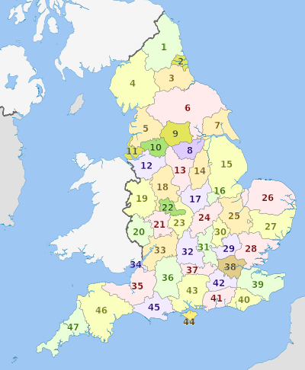
Counties of England
Source: http://commons.wikimedia.org/wiki/Category:Maps_of_counties_of_England

Slide 7
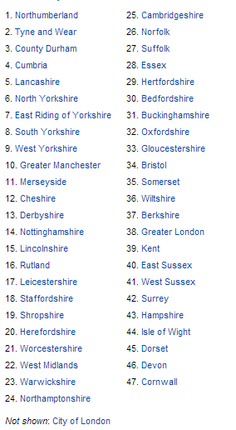
Counties of England
Source: http://commons.wikimedia.org/wiki/Category:Maps_of_counties_of_England

