Slide 1
Science - Year 3
Light – Block 3L
Light and Shadows
Session 2
Five Lives PowerPoint
© Original resource copyright Hamilton Trust, who give permission for it to be adapted as wished by individual users.
We refer you to our warning, at the foot of the block overview, about links to other websites.

Slide 2
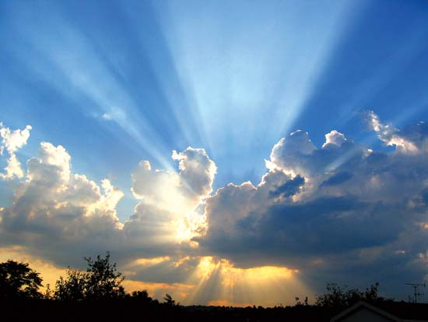
Let’s play Five Lives to recap on everything we already know about light

Slide 3
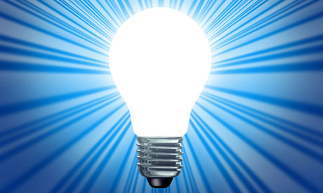
This game is called “Five Lives” because each time you make a mistake you lose a life.
Once you have lost all five of your lives, you are out.
Some questions are easy and some are hard. Just give each question your best guess.

Slide 4
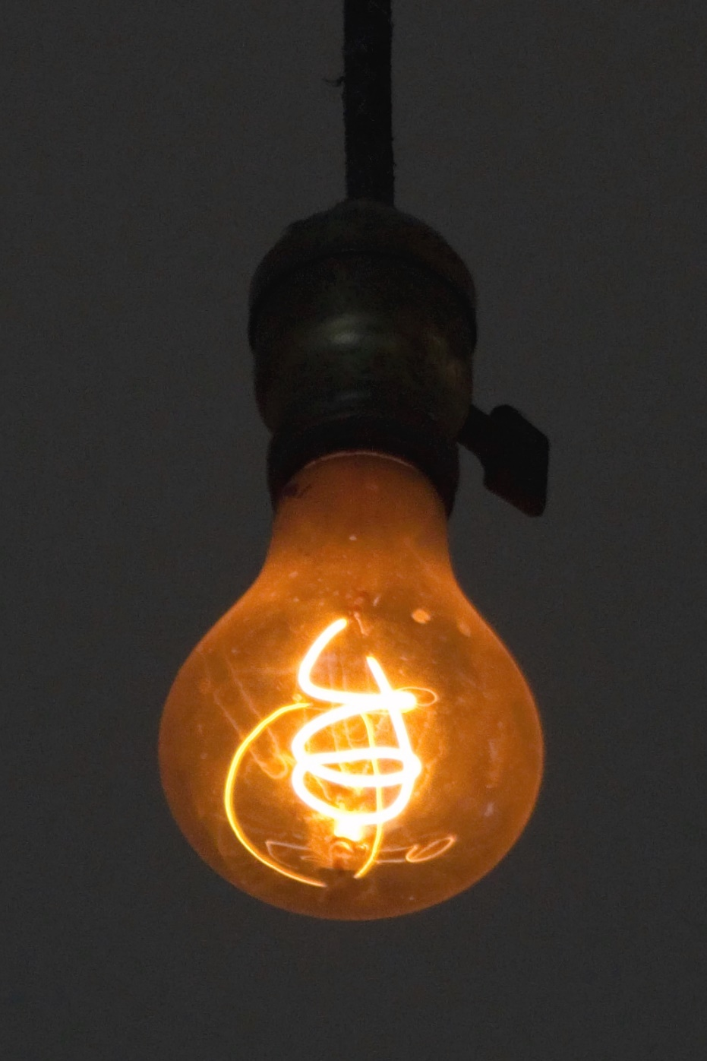
Each question has 2 possible answers: one on the left and one on the right. You must choose which you think is correct and stand on that side of the line. If you are wrong, you lose a life!
Count the lives you have lost by holding up fingers in front of you. Hold up one finger for each life lost. If the whole class is out, then everyone is back in again!

Slide 5
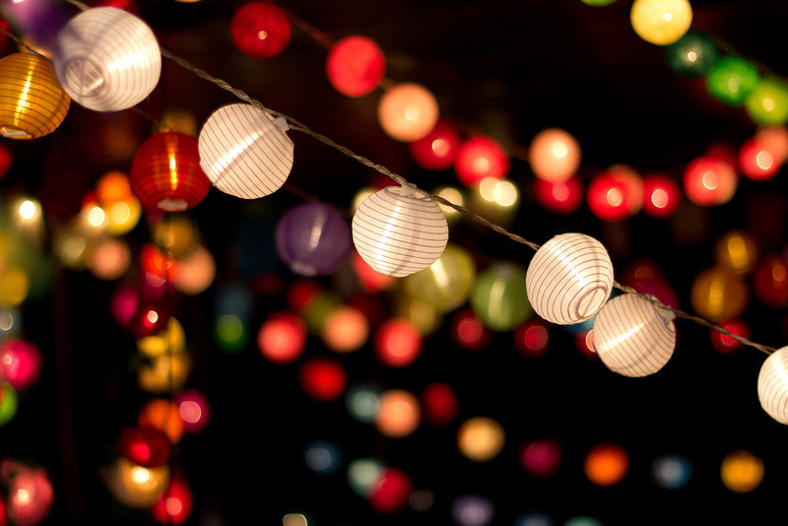
There are 12 questions altogether
Good Luck!

Slide 6
Year 3 Science Light– Block 3L – Light and Shadows Session 2
1. Total darkness is the same thing as …
Being in space
No light
© Original resource copyright Hamilton Trust, who give permission for it to be adapted as wished by individual users.
We refer you to our warning, at the foot of the block overview, about links to other websites.

Slide 7
Year 3 Science Light– Block 3L – Light and Shadows Session 2
2. If there is no light you …
Can only see once your eyes get used to the dark
Cannot see at all
© Original resource copyright Hamilton Trust, who give permission for it to be adapted as wished by individual users.
We refer you to our warning, at the foot of the block overview, about links to other websites.

Slide 8
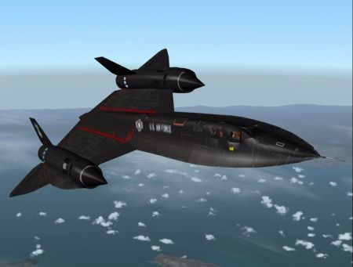
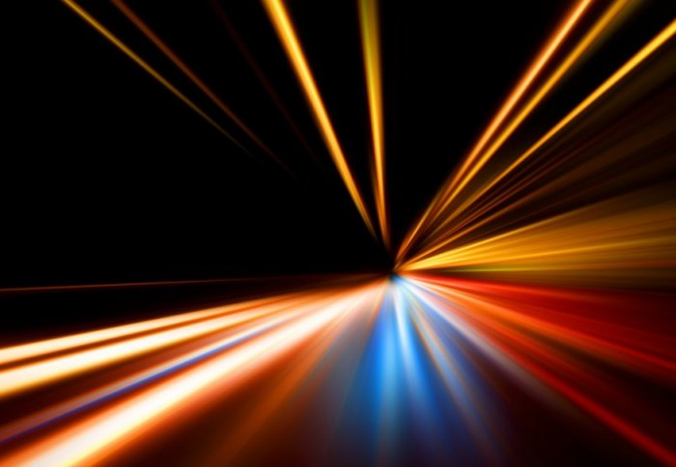
3. Light travels …
Almost as fast as the fastest plane on Earth
Faster than anything else in the universe

Slide 9
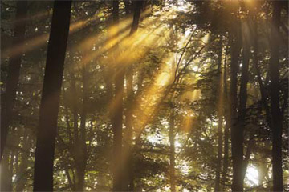
4. Light travels at …
300,000 metres
per second
300,000,000 metres
Per second

Slide 10
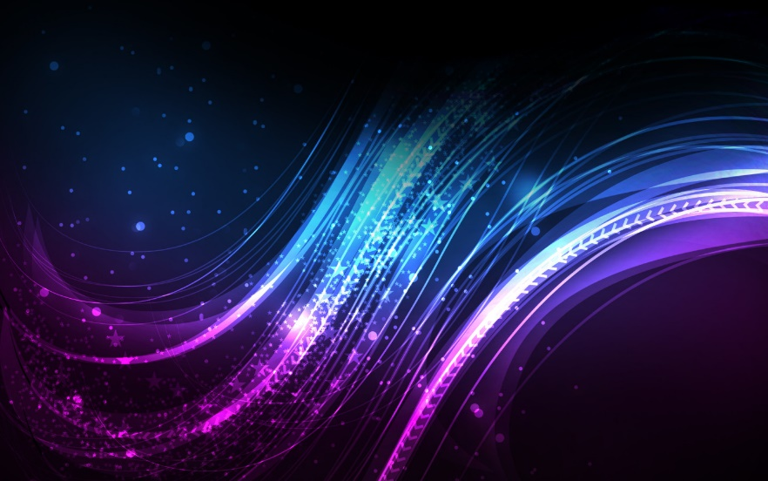
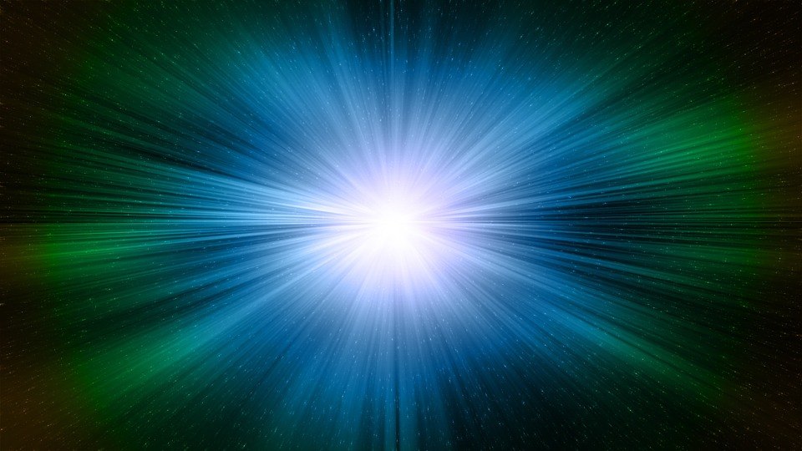
5. Light travels in…
Waves
Straight lines

Slide 11
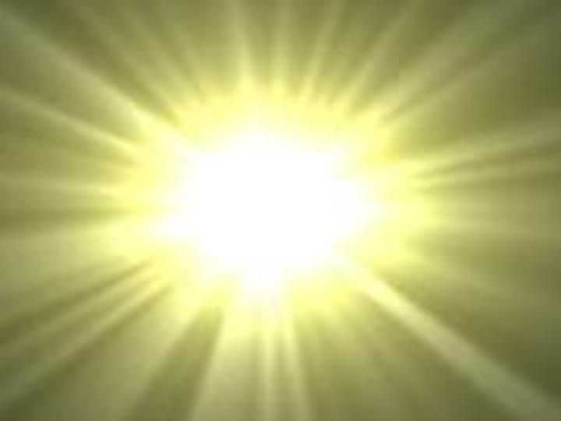
6. Light that we can see is called visible light. It is also known as …
White light
Bright light

Slide 12
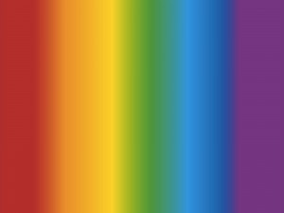
7. White light is in fact made of …
7 different colours
6 different colours

Slide 13
8. Together these 7 colours are known as the …
Spectate
Spectrum

Slide 14
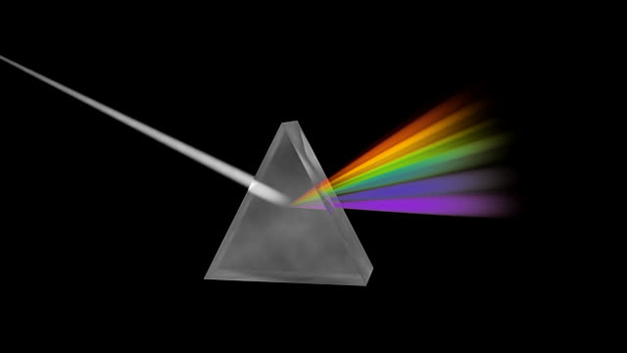
9. The 7 colours of the spectrum are red, orange, yellow, green, blue, indigo and …
violet
purple

Slide 15
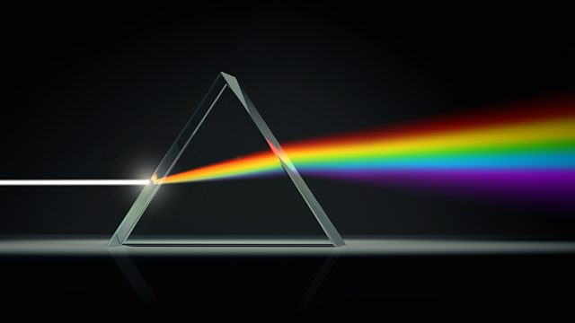
10. White light can be split into the colour spectrum by shining it through a triangular block of glass called a …
Prison
Prism

Slide 16
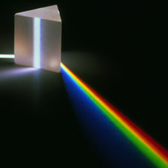
11. When white light is split into a spectrum, this is called …
Reduction
Refraction

Slide 17
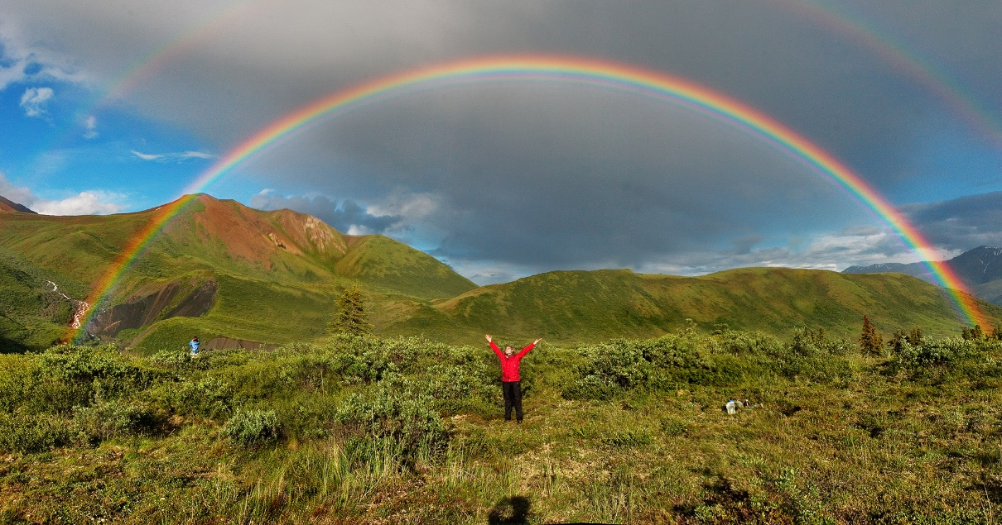
12. A rainbow is made when sunlight is refracted by
Dust particles in the air
Raindrops

Slide 18
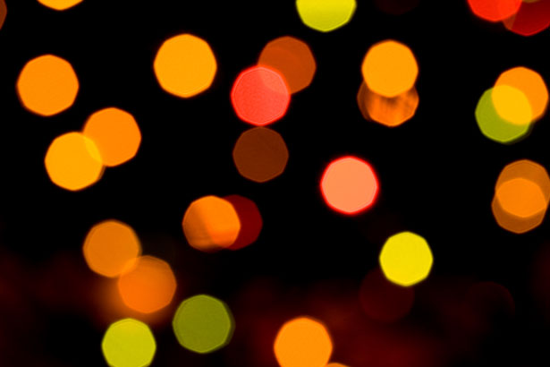
Congratulations if you are still in!
You are an expert on Light!

