Slide 1




Year 3 - Autumn - Block 3
Multiplication & Division

Slide 2
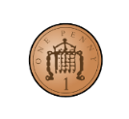








Which row of money is the odd one out?
Explain why.

Slide 3









Match the equal groups together.
Three 5s
Two 10s
Two 3s

Slide 4



There are 8 children.
Each child has 3 sweets.
How many sweets altogether?
Use concrete or pictorial representations to show this problem.
Write another repeated addition and multiplication problem and ask a friend to represent it.

Slide 5
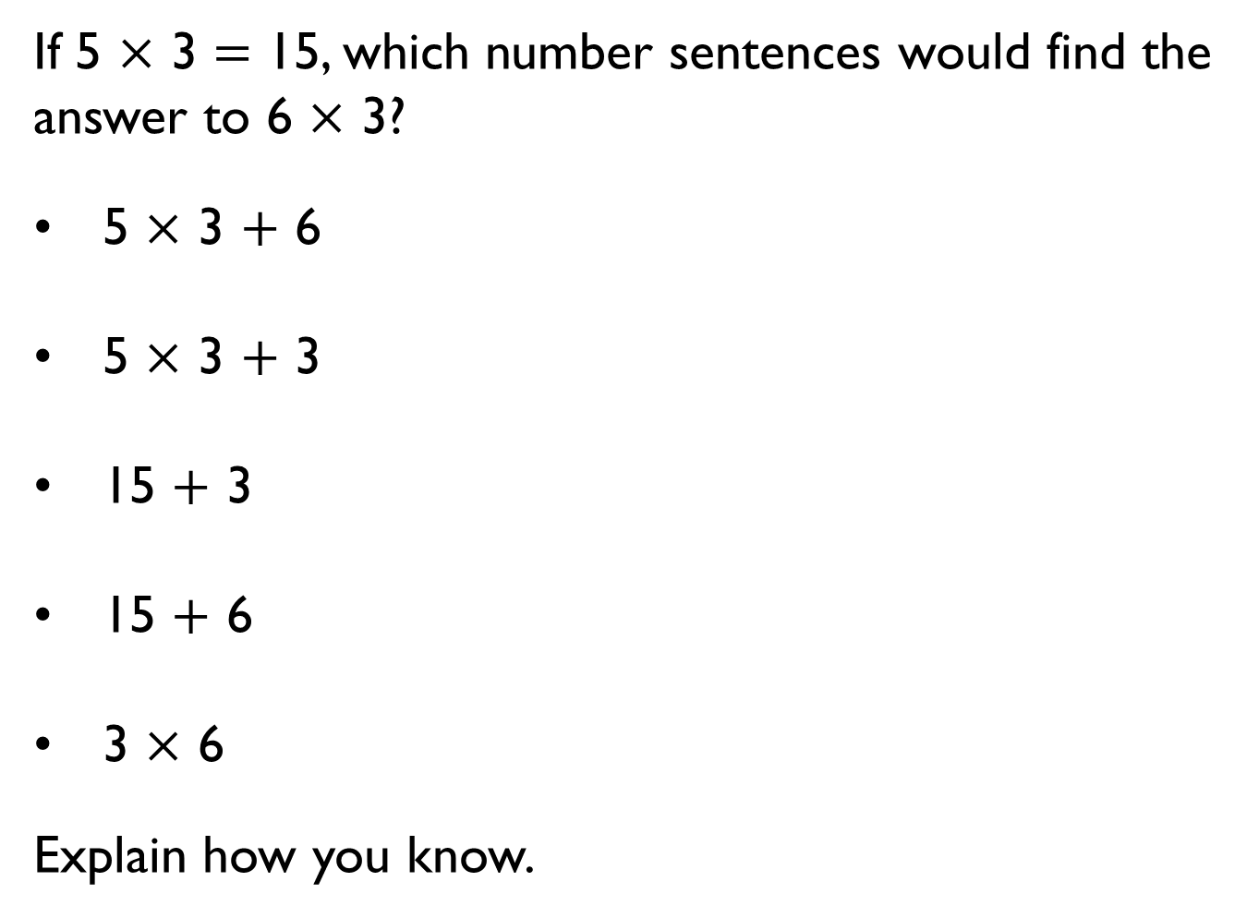
If 5 $×$ 3 $=$ 15, which number sentences would find the answer to 6 $×$ 3?
• 5 $×$ 3 $+$ 6
• 5 $×$ 3 $+$ 3
• 15 $+$ 3
• 15 $+$ 6
• 3 $×$ 6
Explain how you know.

Slide 6

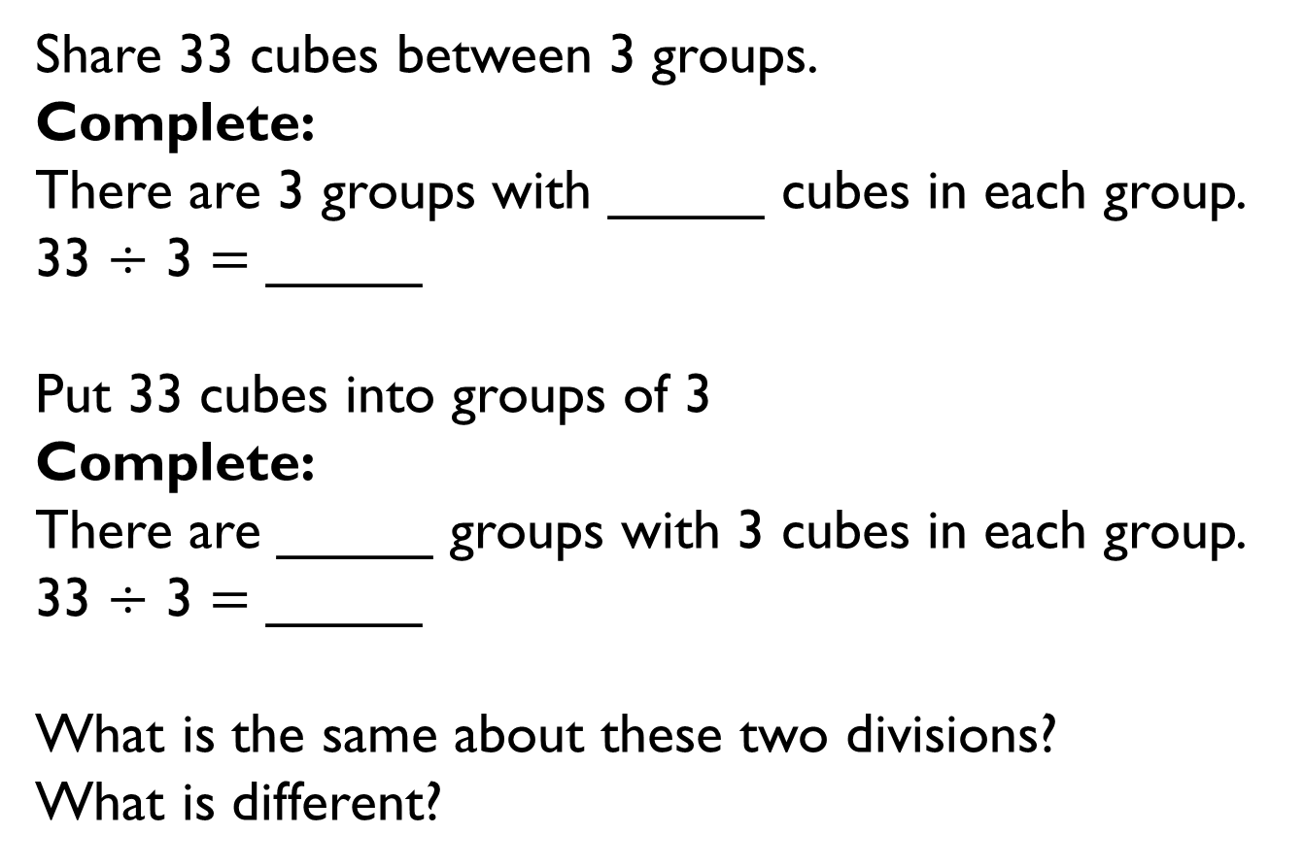
Share 33 cubes between 3 groups.
Complete:
There are 3 groups with _____ cubes in each group.
33 $÷$ 3 $=$ _____
Put 33 cubes into groups of 3
Complete:
There are _____ groups with 3 cubes in each group.
33 $÷$ 3 $=$ _____
What is the same about these two divisions?
What is different?

Slide 7
Jack has 18 seeds.
He plants 3 seeds in each pot.
Which bar model matches the problem?
A
B
Explain your choice.
18
6 | 6 | 6
18
3 | 3 | 3 | 3 | 3 | 3

Slide 8
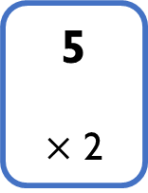
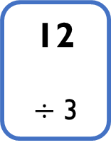
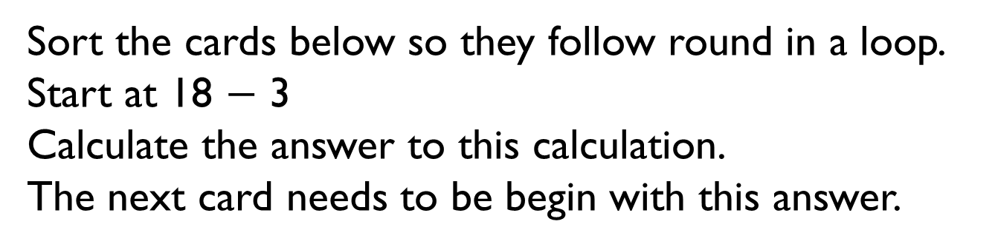
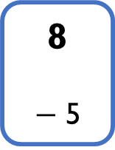
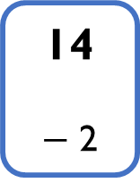
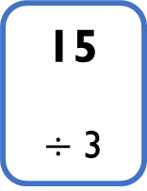
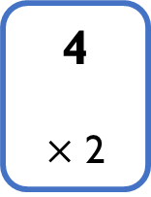
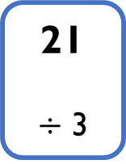
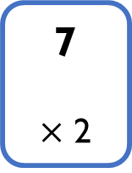
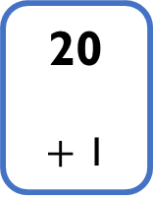
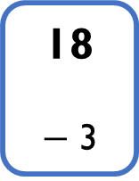
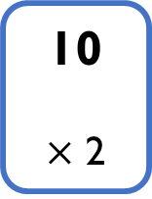
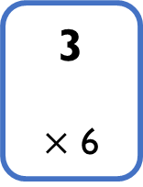
Sort the cards below so they follow round in a loop.
Start at 18 $−$ 3
Calculate the answer to this calculation.
The next card needs to be begin with this answer.
18
$−$ 3
21
$÷$ 3
15
$÷$ 3
8
$−$ 5
5
$×$ 2
10
$×$ 2
20
$+$ 1
4
$×$ 2
14
$−$ 2
12
$÷$ 3
3
$×$ 6
7
$×$ 2

Slide 9
Start this rhythm:
Clap, clap, click, clap, clap, click.
Carry on the rhythm, what will you do on the 15th beat?
How do you know?
What will you be doing on the 20th beat?
Explain your answer.

Slide 10
Tommy has four bags with five sweets in each bag.
Annie has six bags with four sweets in each bag.
Who has more sweets?
How many more sweets do they have?
Draw a picture to show this problem.

Slide 11


Here is a blue strip of paper.
An orange strip is four times as long.
The strips are joined end to end.
How long is the blue strip?
How long is the orange strip?
Explain how you know.
20 cm

Slide 12
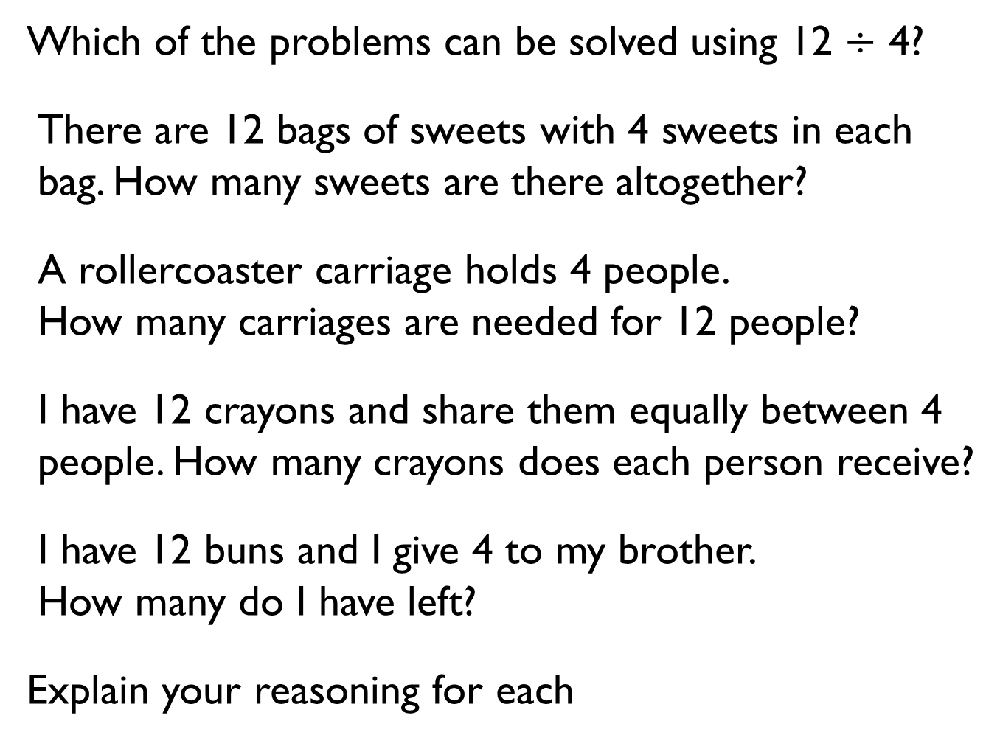
Which of the problems can be solved using 12 $÷$ 4?
There are 12 bags of sweets with 4 sweets in each bag. How many sweets are there altogether?
A rollercoaster carriage holds 4 people.
How many carriages are needed for 12 people?
I have 12 crayons and share them equally between 4 people. How many crayons does each person receive?
I have 12 buns and I give 4 to my brother.
How many do I have left?
Explain your reasoning for each

Slide 13
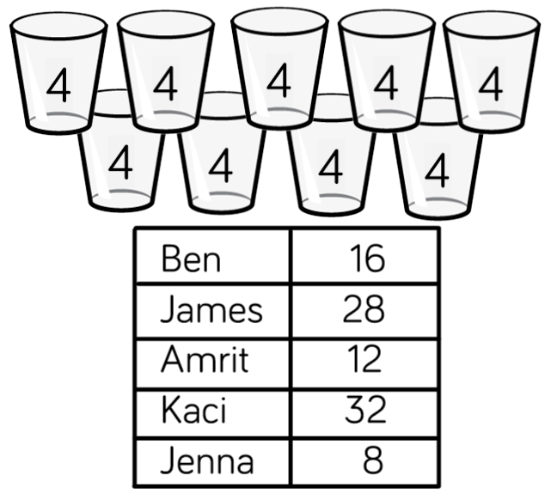
Five children are playing a game.
They score 4 points for every bucket they knock down.
How many buckets did they knock down each?
How many buckets did they knock down altogether?
How many more buckets did Eva knock down than Mo?
Mo | 16
Eva | 28
Tommy | 12
Amir | 32
Dora | 8

Slide 14

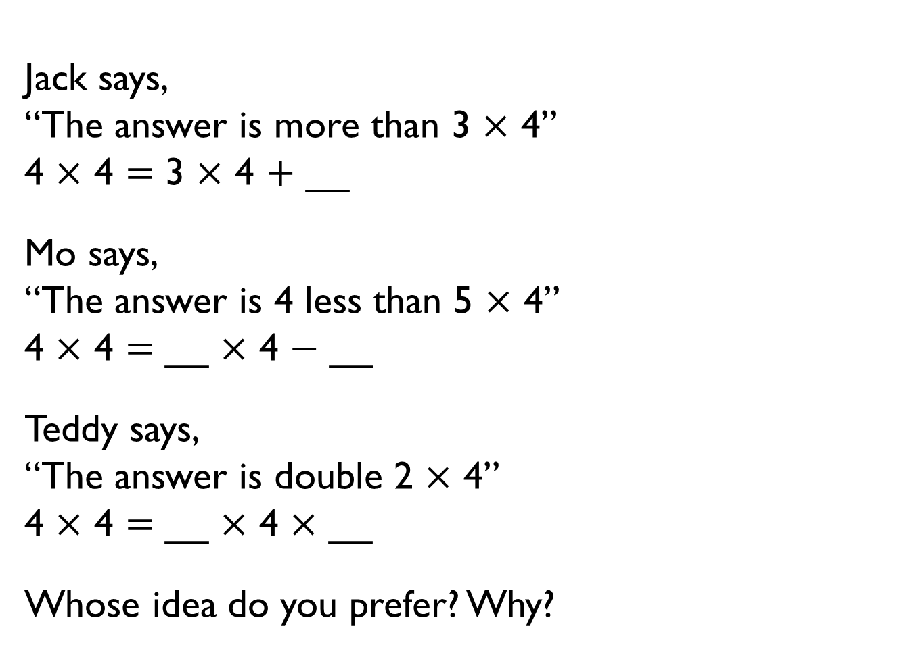
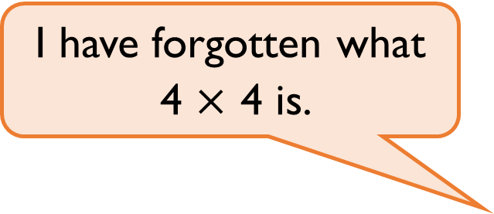
I have forgotten what
4 $×$ 4 is.
Jack says,
“The answer is more than 3 $×$ 4”
4 $×$ 4 $=$ 3 $×$ 4 $+$ __
Mo says,
“The answer is 4 less than 5 $×$ 4”
4 $×$ 4 $=$ __ $×$ 4 $−$ __
Teddy says,
“The answer is double 2 $×$ 4”
4 $×$ 4 $=$ __ $×$ 4 $×$ __
Whose idea do you prefer? Why?

Slide 15







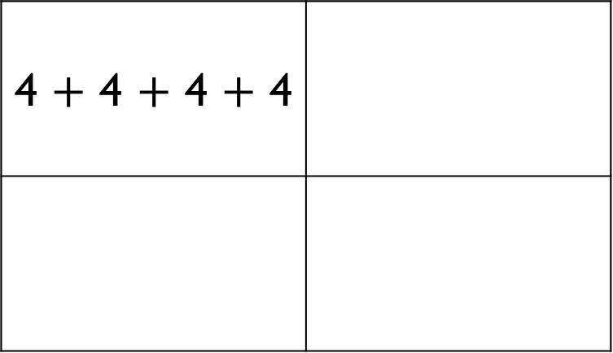
Which part below does not show counting in fours?
Explain why.
4 $+$ 4 $+$ 4 $+$ 4
4 | 4 | 4

Slide 16
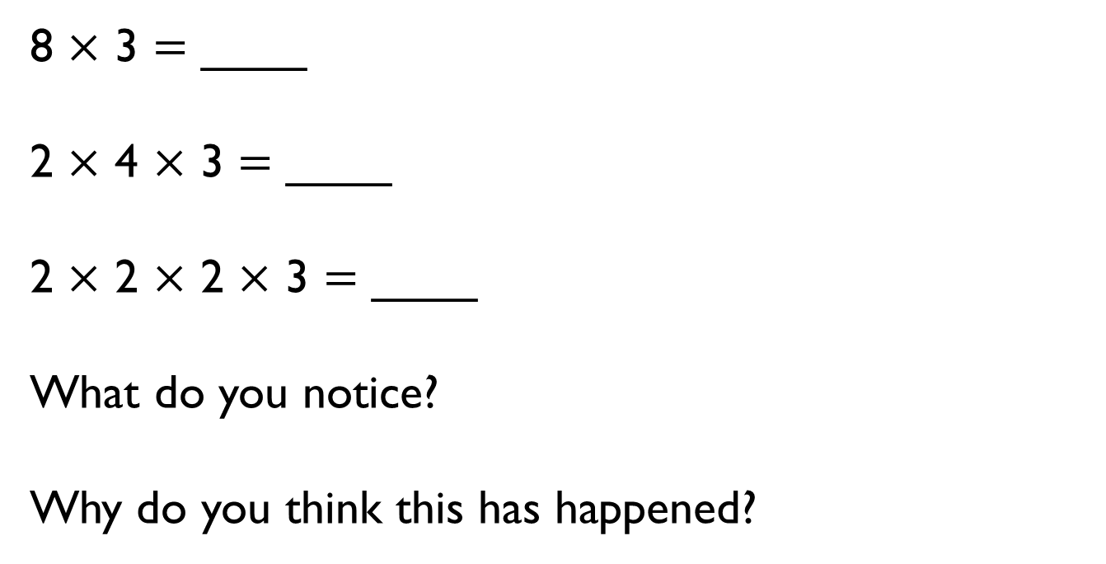
8 $×$ 3 $=$ ____
2 $×$ 4 $×$ 3 $=$ ____
2 $×$ 2 $×$ 2 $×$ 3 $=$ ____
What do you notice?
Why do you think this has happened?

Slide 17
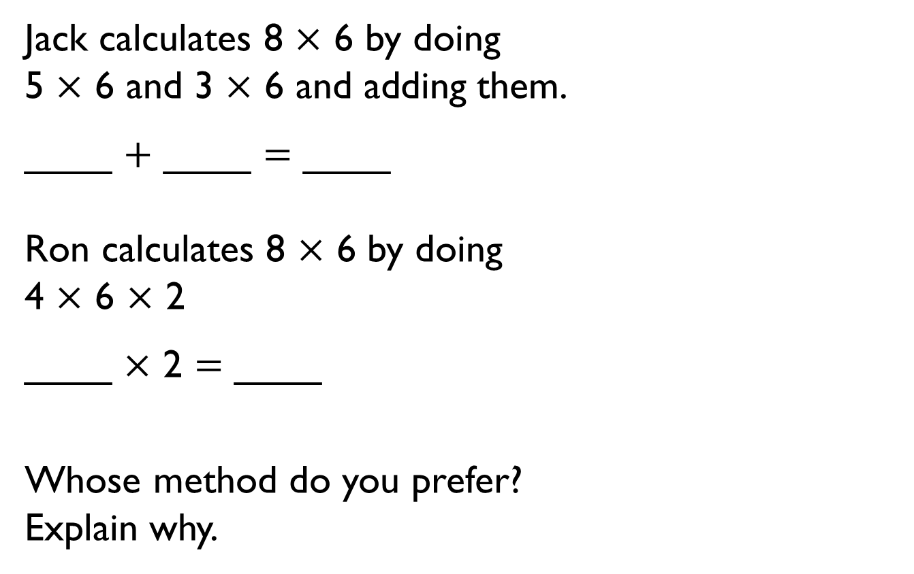
Jack calculates 8 $×$ 6 by doing
5 $×$ 6 and 3 $×$ 6 and adding them.
____ $+$ ____ $=$ ____
Ron calculates 8 $×$ 6 by doing
4 $×$ 6 $×$ 2
____ $×$ 2 $=$ ____
Whose method do you prefer?
Explain why.

Slide 18






Start each function machine with the same number.
What do you notice about each final answer?
Tommy knows the 4 times table table, but is still learning the 8 times table table.
Which colour row should he use? Why?
$×$ 2
$×$ 2
$×$ 2
$×$ 4
$×$ 2
$×$ 8

Slide 19
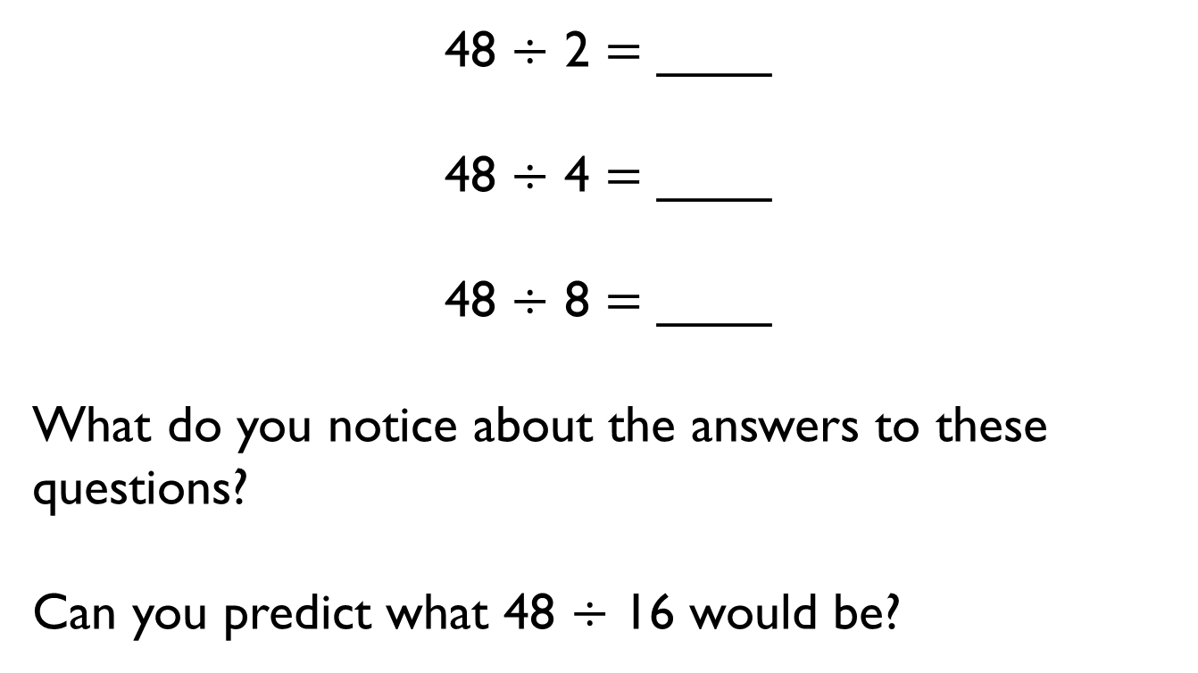
48 $÷$ 2 $=$ ____
48 $÷$ 4 $=$ ____
48 $÷$ 8 $=$ ____
What do you notice about the answers to these questions?
Can you predict what 48 $÷$ 16 would be?

Slide 20
Which numbers can be divided by 8 without a remainder?
64
32
800
18
200
42

Slide 21



Amir shares 24 sweets equally between 8 friends.
How many do they get each?
Which bar model would you use to represent this problem? Why?
24
24

Slide 22

Explain why
All the numbers in the 8 times table are even.

Slide 23
1 | 2 | 3 | 4 | 5 | 6 | 7 | 8 | 9 | 10
11 | 12 | 13 | 14 | 15 | 16 | 17 | 18 | 19 | 20
21 | 22 | 23 | 24 | 25 | 26 | 27 | 28 | 29 | 30
31 | 32 | 33 | 34 | 35 | 36 | 37 | 38 | 39 | 40
41 | 42 | 43 | 44 | 45 | 46 | 47 | 48 | 49 | 50
51 | 52 | 53 | 54 | 55 | 56 | 57 | 58 | 59 | 60
61 | 62 | 63 | 64 | 65 | 66 | 67 | 68 | 69 | 70
71 | 72 | 73 | 74 | 75 | 76 | 77 | 78 | 79 | 80
81 | 82 | 83 | 84 | 85 | 86 | 87 | 88 | 89 | 90
91 | 92 | 93 | 94 | 95 | 96 | 97 | 98 | 99 | 100
On a blank hundred square, colour multiples of 8 red and multiples of 4 blue.
Always, Sometimes, Never
• Multiples of 4 are also multiples of 8
• Multiples of 8 are also multiples of 4

Slide 24

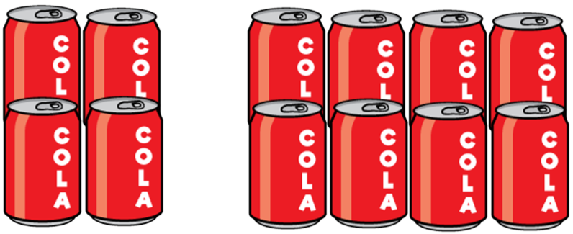
Rosie has some packs of cola which are in a box.
Some packs have 4 cans in them, and some packs have 8 cans in them.
Rosie’s box contains 64 cans of pop.
How many packs of 4 cans and how many packs of 8 cans could there be?
Find all the possibilities.

