Slide 1
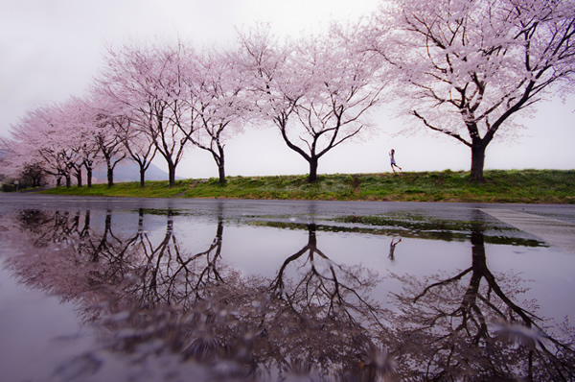
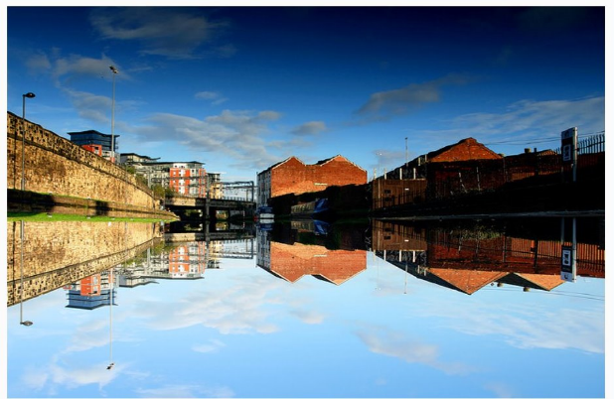
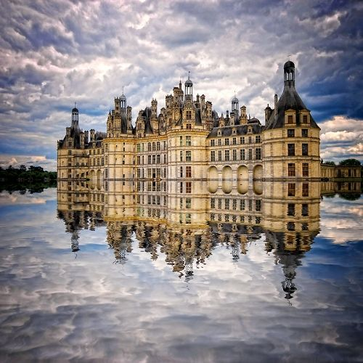
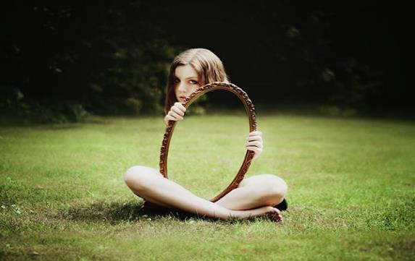
Unit 2: Science activity
Photographic reflections

Slide 2


Unit 2: Science activity
Reflection challenge:
Your challenge is to look closely at the reflection photographs on the previous page and to carefully select a subject to photograph OR draw. You could be brave and try something unusual like the invisible girl or just aim at finding an example of reflection around the school or at home. We are aiming to create a photographic/art exhibition on the theme of reflection which will be made up of all the photographs/artwork we have taken. https://www.youtube.com/watch?v=hC3ex46jRuA This video shows a lovely example.

