Slide 1

I Simulate lesson 2
To understand that computer simulations are guided by rules

Slide 2
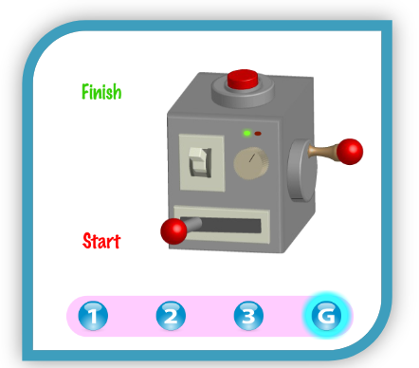
There is a particular way to use this machine so it goes from start to finish, but it’s a secret!
Which combinations could you press the levers and switches and buttons in?
How many different ways are there?
Write down 5!
For example: start lever, switch, side handle, side handle, switch, top button.

Slide 3
There are rules that need to be followed to make the gauge get to the finish point. They might not be obvious but they can be worked out.
When we know the rules this helps the situation become a simulation.

Slide 4
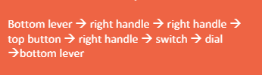
The secret combination:

Slide 5

try this growing plants simulation and see if you can find out the rules, then have a go at answering the questions
https://icomp.site/growing-plants

Slide 6
Questions
Can you explain the rule that says the plant has stopped growing because the conditions are too cold?
What about the rule when the conditions are too hot?
How many rules do you think there are?
What do you think would happen if you were playing a game without rules?
What do you think would happen in a simulation without rules?
Simulations need rules even if we can’t see them

