Slide 1

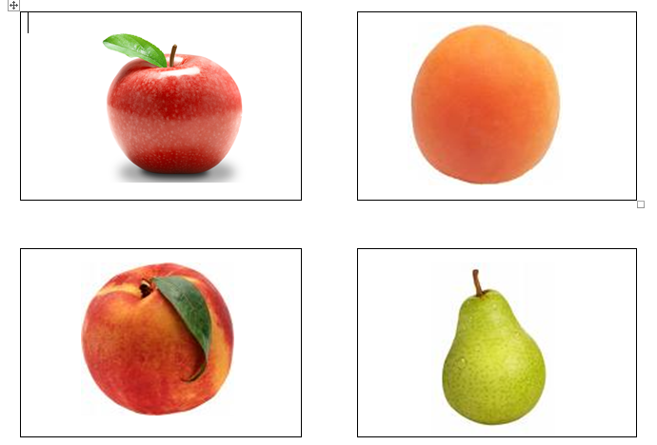
Tutti Frutti
Click on the speakers to hear the pronunciation of the fruit and learn the pronunciation.
Une pomme
Un abricot
Une peche
Une poire

Slide 2

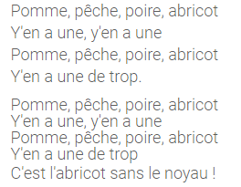
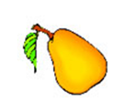
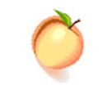
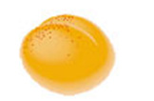
Pomme, peche, poire abricot song

Slide 3
Pomme, Peche, Poire and Abricot Activity
(Apple, Peach, Pear and Apricot)
This activity will need to be completed with an adult or an older sibling.
Put the pictures (on the following slides) of the fruit on four different walls in a room, garden or maybe take them to a park and get some exercise in the process. The adult/older sibling calls out one of the fruits in French and you need to run to the correct wall. If you complete the activity and video it, it will be worth 10 dojos.
Go for it- you can do it!!

Slide 4
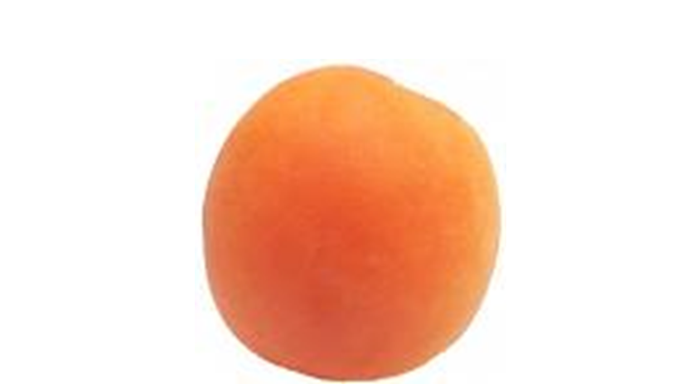

Slide 5
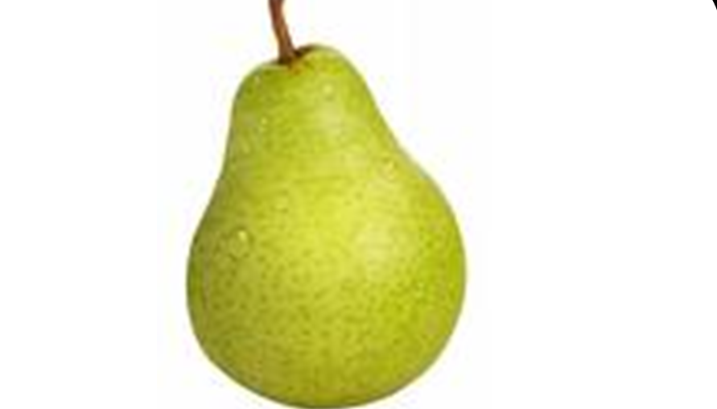

Slide 6
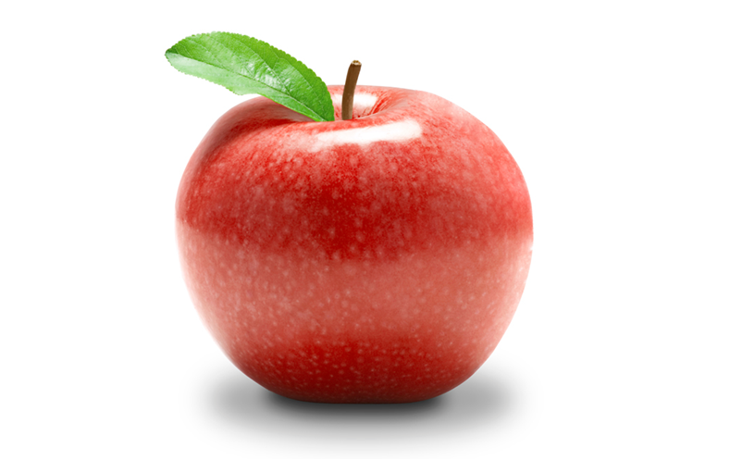

Slide 7


