Slide 1
PHSE
Being fit and healthy!

Slide 2
Today we will:
know that the amount of calories, fat and sugar I put into my body will affect my health
Some words we will use today:
Energy, Calories, Kilojoules, Labels, Sugar, Fat, Saturated Fat

Slide 3
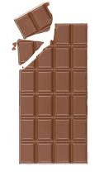
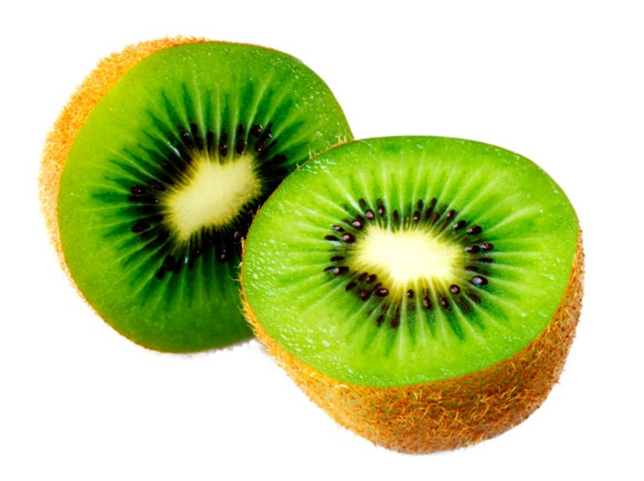
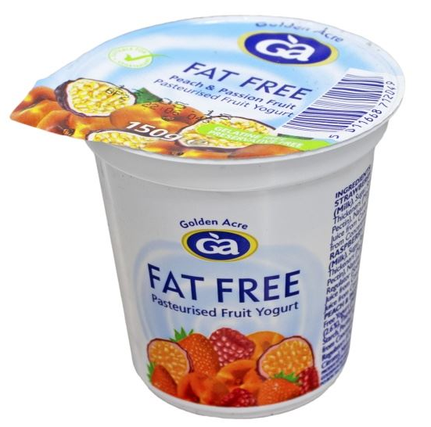
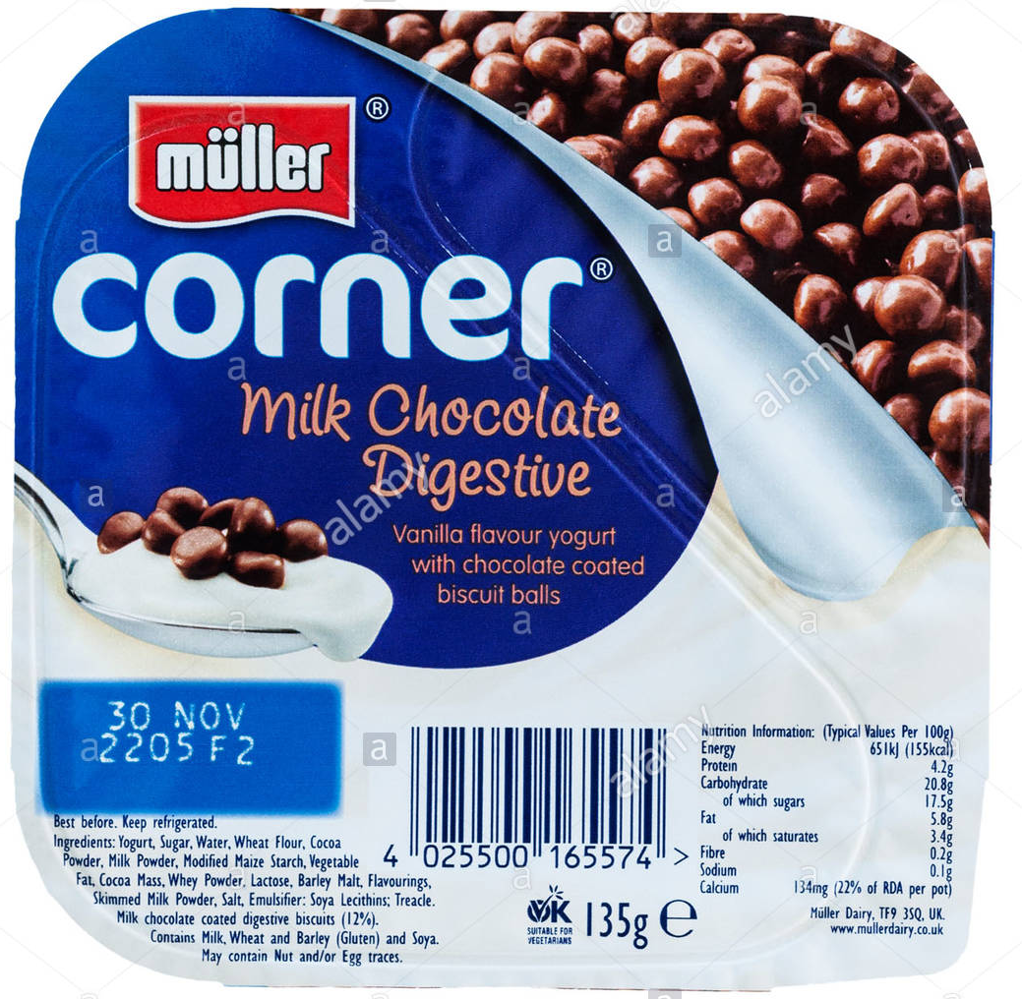
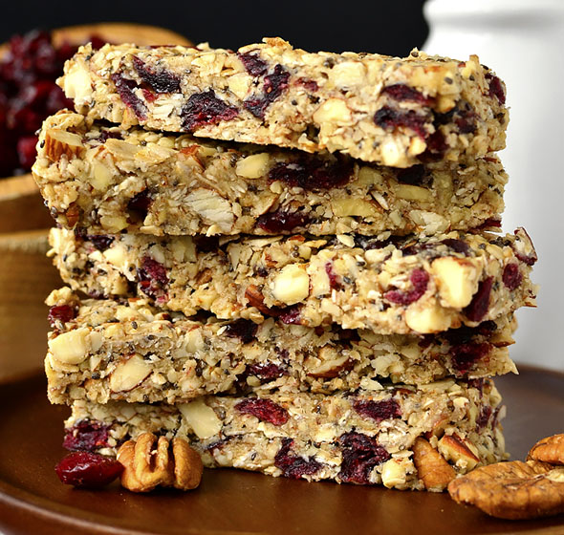
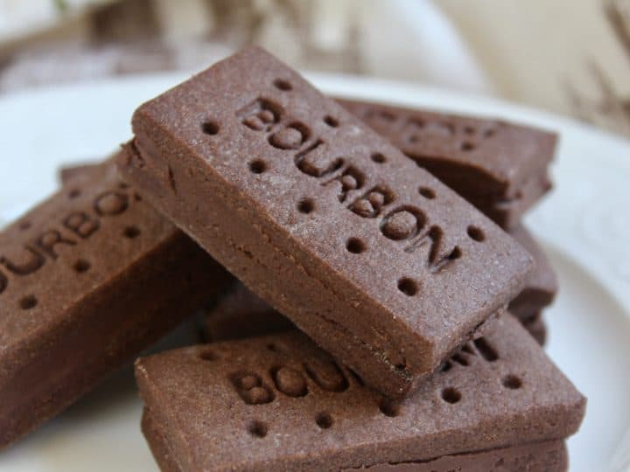
Healthy Choice | Less Healthy Choice
Can you sort the food into the correct column?

Slide 4
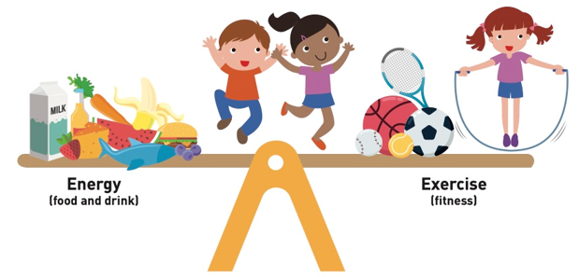
Less healthy choices often contain more sugar, salt and saturated fat than the healthy choices.
-Why do we need some sugar and fat in our diet?
-Would it be healthy if we didn’t eat any fat or sugar?
-What could happen to the balance of the body if a person takes in too much sugar and saturated fat, but doesn’t do enough exercise to use it?

Slide 5
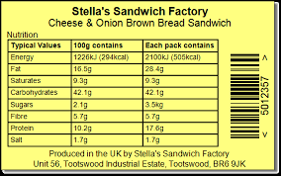
Our bodies need energy from food and drink but we have to make sure that we take in the right amounts so our bodies stay healthy and in balance.
Do you know what calories and/or kilojoules are?
They show the amount of energy in foods, so foods with higher number of calories/ kilojoules have more energy.

Slide 6
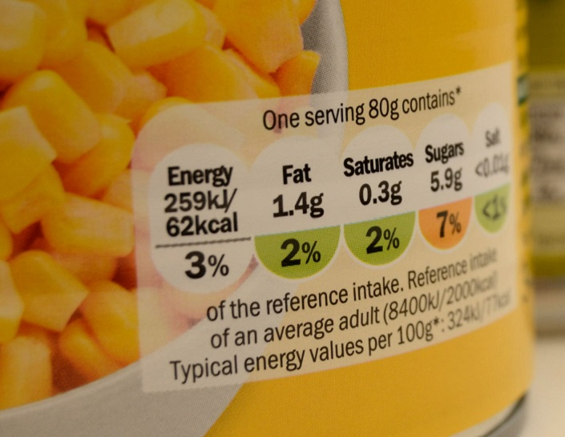
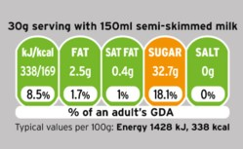
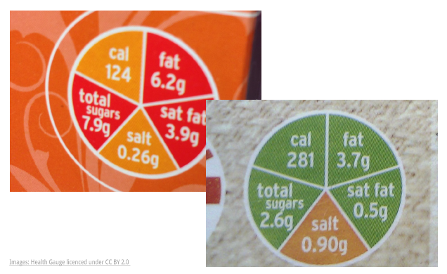
Food packaging should always have information about calories on it to help you make a healthier choice.
Look at these labels can you find how many calories there are in these foods?
Can you also see how much fat and sugar are in them?
Can you find three examples of food labels like this in your cupboards at home?

Slide 7
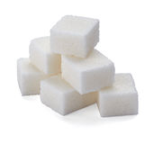
Did you know?
Children your age should have no more than 24g of sugar/ 6 sugar cubes per day (this does not include natural sugars in foods such as milk, fruits and vegetables).

Slide 8
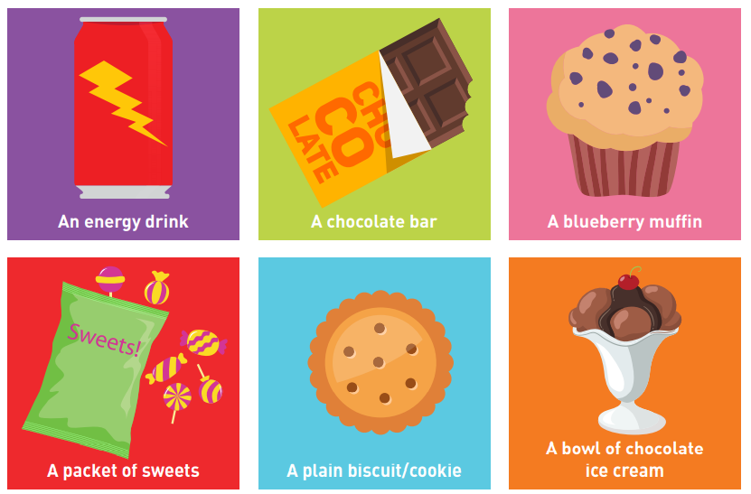
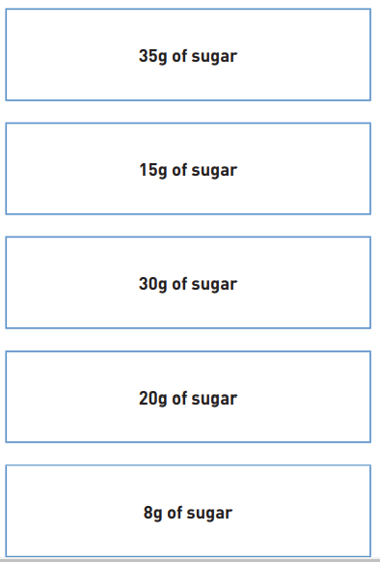
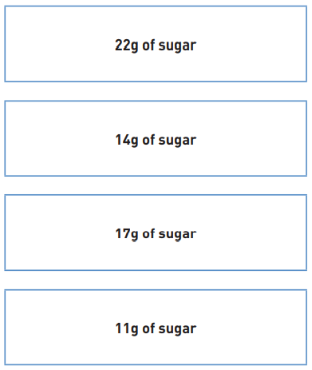
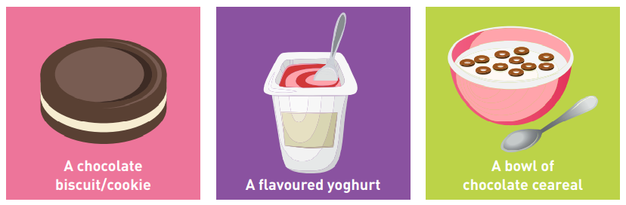
How much sugar?
Match the pictures to the correct sugar amount (answers on the next slide- please don’t cheat!).

Slide 9


