Slide 1
How can we tell if a material is magnetic or not?
Science
Miss Roberts

Slide 2
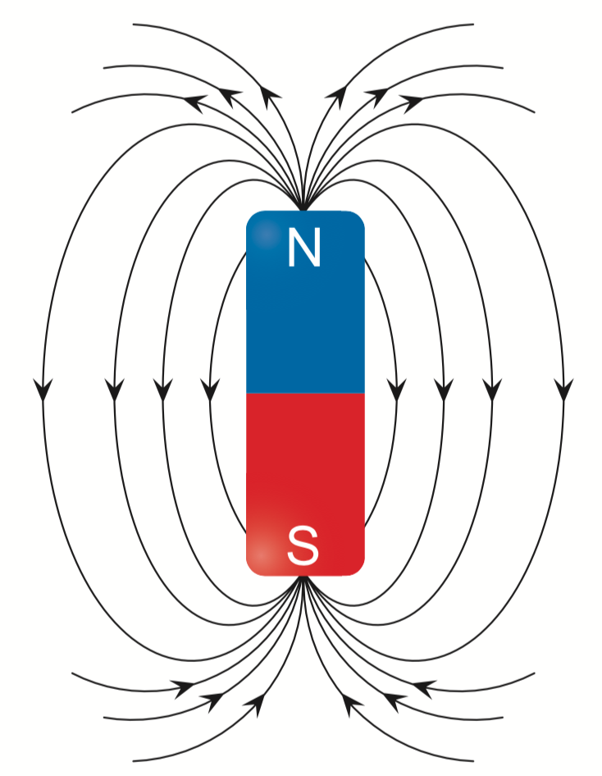
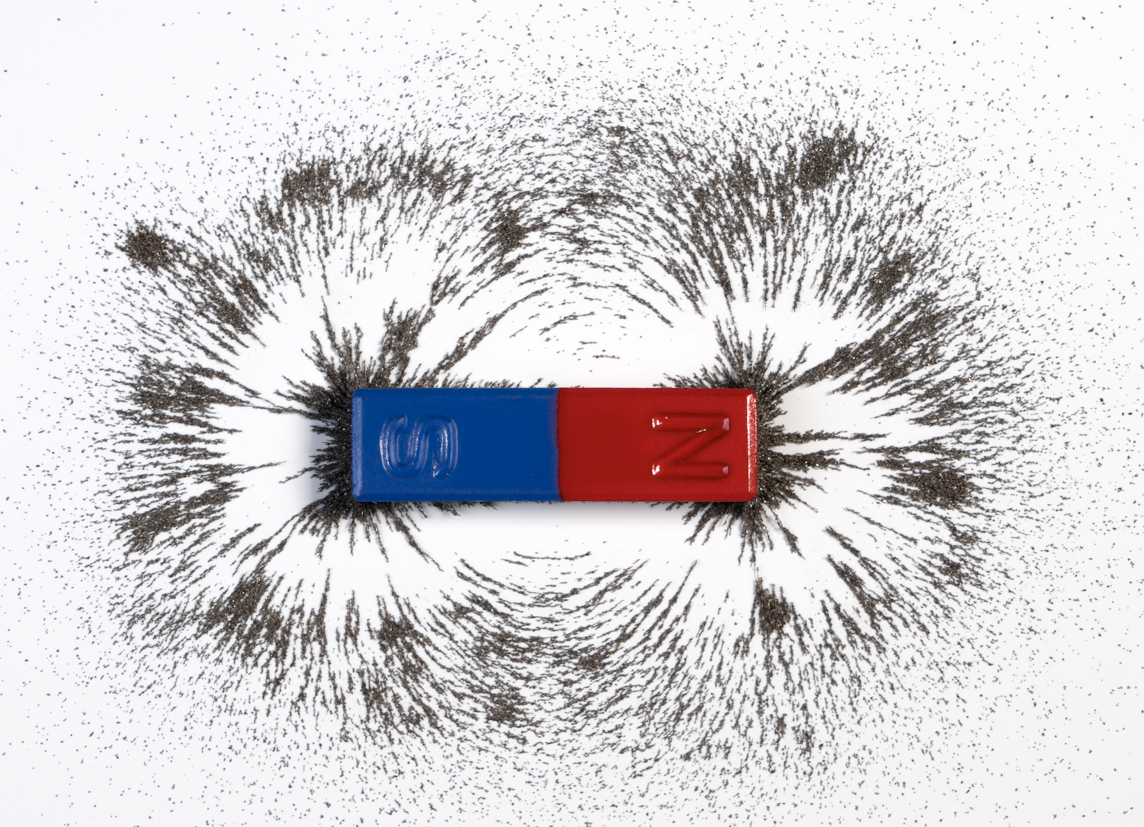
Field lines
Shutterstock - magnetic field vector by - attaphong
Shutterstock - Red and blue bar magnet or physics magnetic with iron powder magnetic field on white background. Scientific experiment in science class in school by: ShutterStockStudio

Slide 3




Resources you will need...
Optional
Pencil or pen
Ruler
Notebook
Magnet
Icons from The Noun project

Slide 4
STAR words
Permanent and temporary magnets
Making a magnet
Magnetic and non-magnetic materials
Think question

Slide 5

STAR WORDS
magnetic
force
permanent
temporary
poles
field

Slide 6
Permanent and temporary magnets

Slide 7

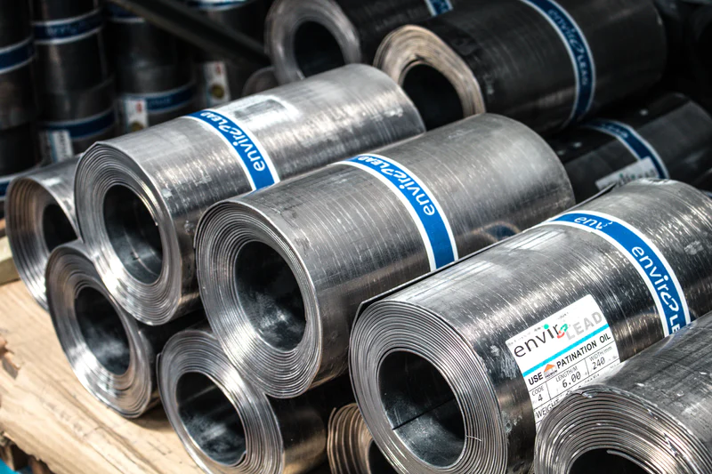
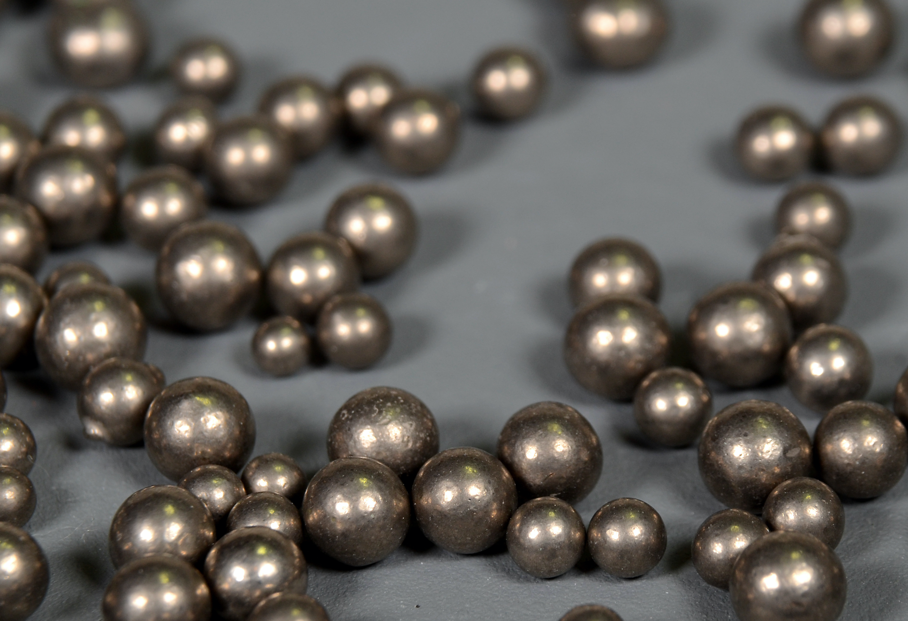
Magnetic materials
iron
steel
nickel
Images from Unsplash
Image from Shutterstock: Sample of Nickel pellets (Ni) by: Kim Christensen

Slide 8

Magnetic materials
N
iron
Image from Unsplash
S
Icon from The Noun project

Slide 9
Magnetic materials
iron
steel
nickel
Images from Unsplash
Image from Shutterstock: Sample of Nickel pellets (Ni) by: Kim Christensen
Icons from The Noun project

Slide 10
Discovery
temporary
permanent

Slide 11
Magnetic materials
iron
Stroke
Heat
Image from Unsplash
Icon from The Noun project

Slide 12
TASK
What are three examples of magnetic materials?
a) I_______________________
b) S_______________________
c) N_______________________
What will happen when you place a magnetic material close to a magnet?
____________ magnet - can stay magnetic for a short time

Slide 13


Pause the video to complete your task
Resume once you’re finished

Slide 14
TASK
What are three examples of magnetic materials?
a) Iron
b) Steel
c) Nickel
What will happen when you place a magnetic material close to a magnet? It will be attracted to both poles.
Temporary magnet - can stay magnetic for a short time

Slide 15
Making a magnet

Slide 16
Pause the video and go to slide 3 of the worksheet to watch the demonstration
Resume once you’re finished

Slide 17
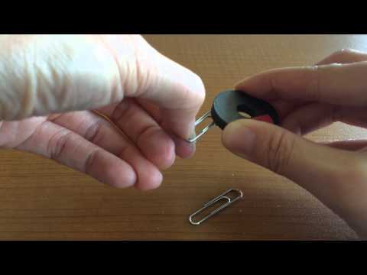
Making a magnet
Video from Youtube. Lesson 4b Making Temporary Magnets Demo by: Laura Wilson

Slide 18
Single touch method
The ‘single touch’ method involves moving a single ____________ along the surface of magnetic material in the same ____________ from top to _____________ many times.
direction bottom magnet

Slide 19
Single touch method
The ‘single touch’ method involves moving a single magnet along the surface of magnetic material in the same direction from top to bottom many times.
direction bottom magnet

Slide 20
Magnetic and non-magnetic materials

Slide 21
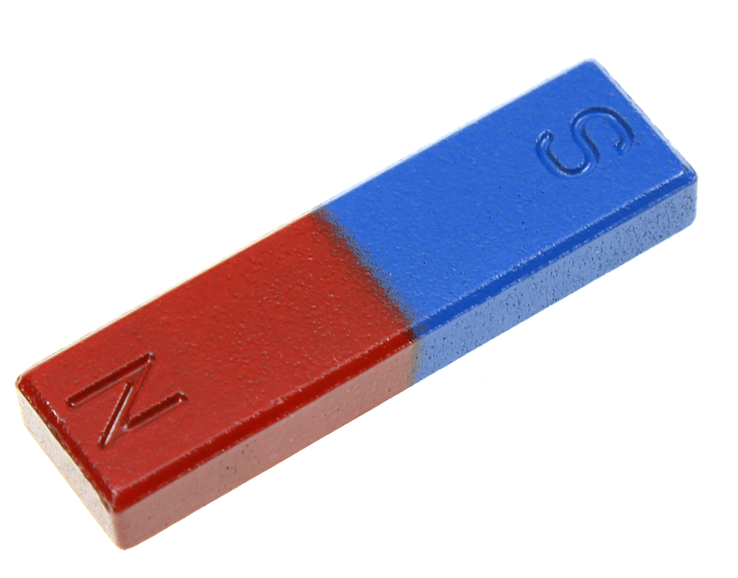
Sorting materials
 | Magnetic | Non-magnetic
Image from shutterstock: Blue and red bar magnet over white background by: redknapper

Slide 22
Sorting materials
Magnet | Magnetic | Non-magnetic
Wooden pencil
Safety pins
Plastic ruler
Coin
Spoon
Fridge magnet
Glass cup
Image from shutterstock: Blue and red bar magnet over white background by: redknapper

Slide 23
Pause the video to complete your task
Resume once you’re finished

Slide 24
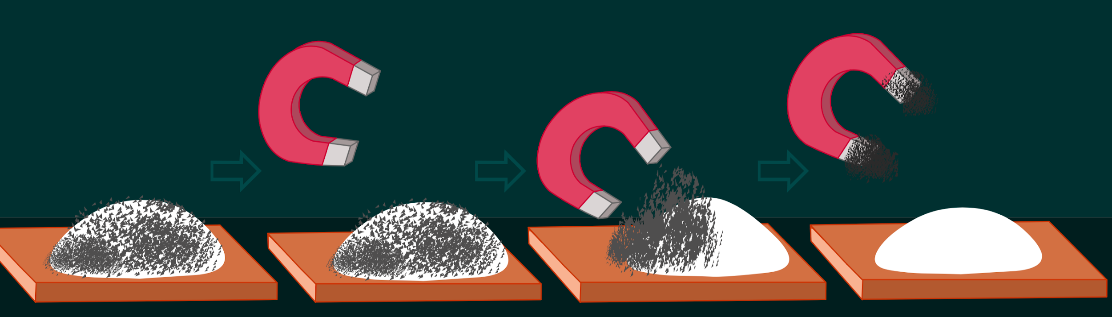
Sorting materials
Image from shutterstock: Magnet, Magnetism. Magnetics; iron, cobalt, nickel etc. These metals; With a magnet, flour, sand, salt, rice, gold, aluminum, silver is removed from the mixture. by: grayjay

Slide 25

How could magnets help us to sort recycling materials if iron is mixed in with the recycling?
Icon from The Noun project

