Slide 1
How does an earthquake occur?
Lesson 4 of 7
Geography
Miss Reid

Slide 2


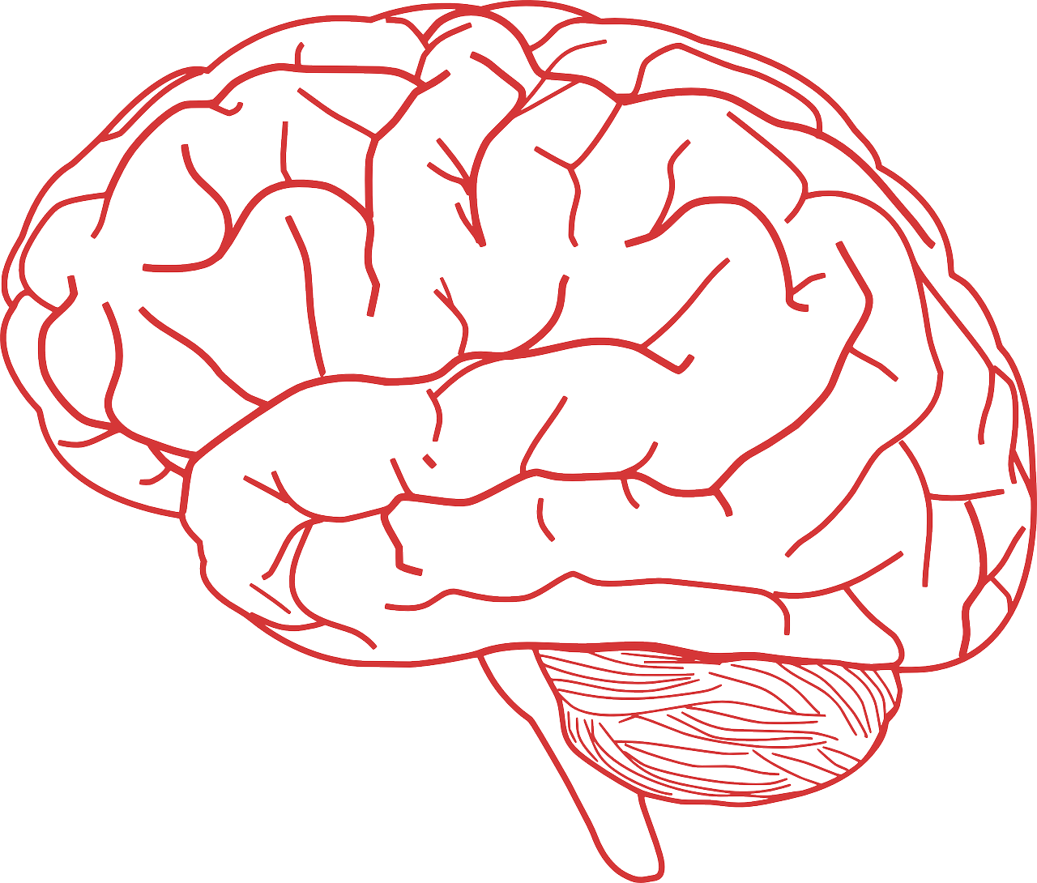
In this lesson, you will need:
Exercise book or paper
Pencil
Brain

Slide 3

We are Geographers!
Geographers are types of scientists who study the Earth; this includes the land (the physical features) and the people who live within it (the human features).

Slide 4
Why are tectonic plates moving?
What is an earthquake?
What causes an earthquake?

Slide 5
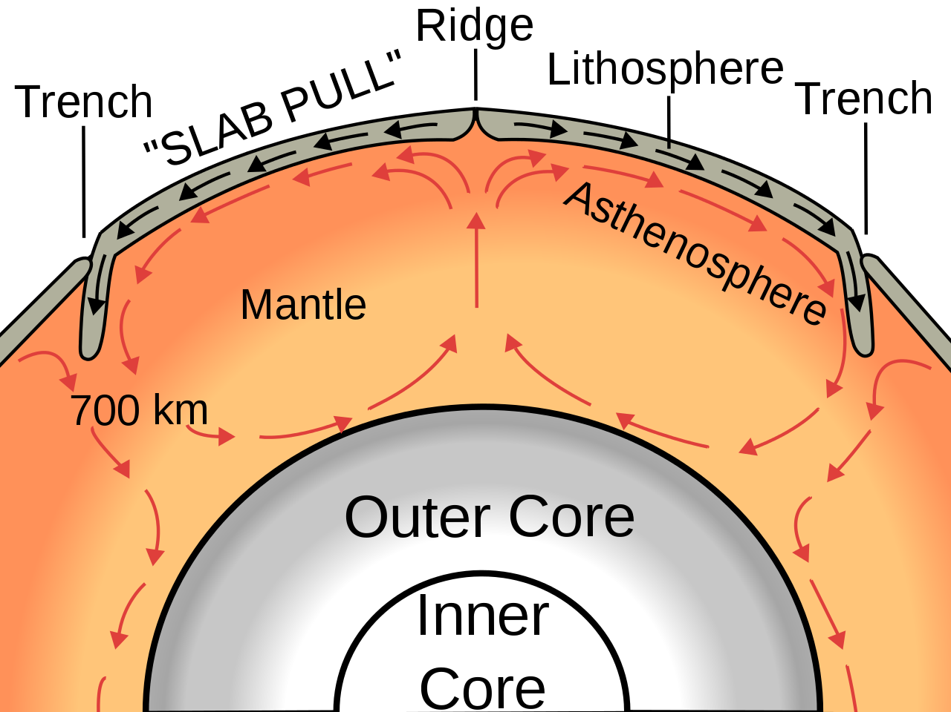
Why are tectonic plates moving?
Convection current:
Hot molten rock rises;
Molten rock cools;
Cooler molten rock sinks;
Molten rock is heated again and rises.
Tectonic plates are moved by currents in the mantle.

Slide 6
Convection currents happen when...
a.
b.
warm material rises while cool material sinks in a circular pattern.
cool material rises while warm material sinks in a circular pattern.
c.
d.
warm material sinks while cool material rises in a circular pattern.
warm material rises while cool material sinks in a vertical pattern.

Slide 7
Convection currents happen when...
a.
warm material rises while cool material sinks in a circular pattern.

Slide 8
Tectonic plates move, because...
a.
b.
they are moved by the convection currents in the inner core.
they are moved by the convection currents in the mantle.
c.
d.
they are moved by the convection currents in the atmosphere.
they are moved by the convection currents in the outer core.

Slide 9
Tectonic plates move, because...
b.
they are moved by the convection currents in the mantle.

Slide 10
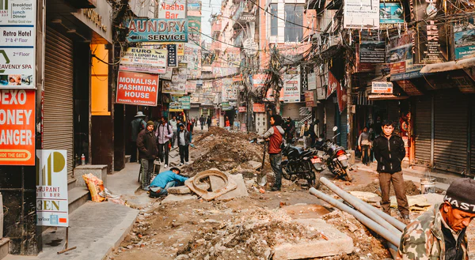
What is an earthquake?
Sometimes, when tectonic plates move, pressure that has built up over time is released. This causes the ground to shake.
This is called an earthquake
  Measured using the Richter Scale

Slide 11
What is an earthquake?
$B
Over 1,000 dead
The size of an earthquake is measured using the Richter Scale.
Measures earthquakes from 0-9
Earthquakes that measure over 6.0 on the Richter scale can cause lots of damage
$M
10 - 1,000 dead
$Th
Less than 10 dead
$H
0 1 2 3 4 5 6 7 8 9

Slide 12
What do scientists use to measure the strength of an earthquake?
The ___________ Scale

Slide 13
What do scientists use to measure the strength of an earthquake?
The Richter Scale

Slide 14
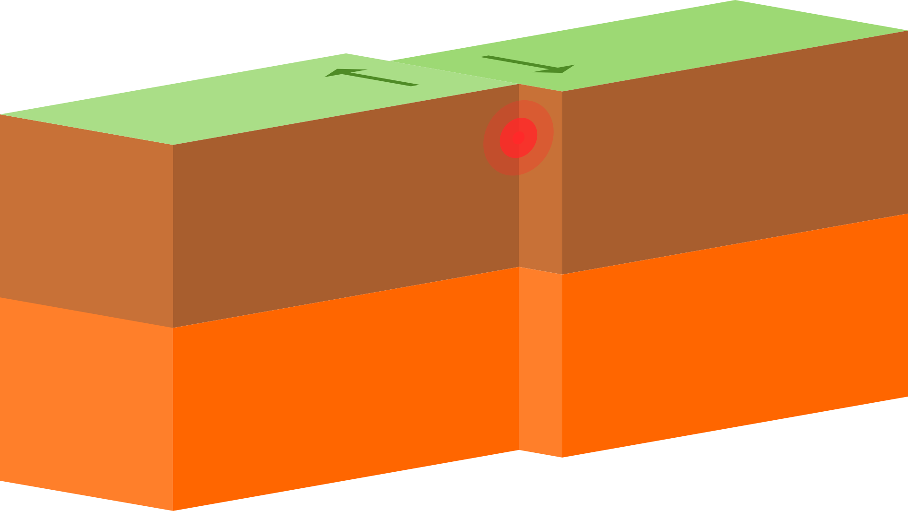
What causes an earthquake?
Epicentre
Focus
Fault line

Slide 15
The epicentre of an earthquake is...
a.
b.
the centre of an earthquake.
the place where the rock broke.
c.
d.
the place on the earth’s surface above where the rock broke.
the crack in the Earth’s surface left behind after an earthquake

Slide 16
The epicentre of an earthquake is...
c.
the place on the earth’s surface above where the rock broke.

Slide 17
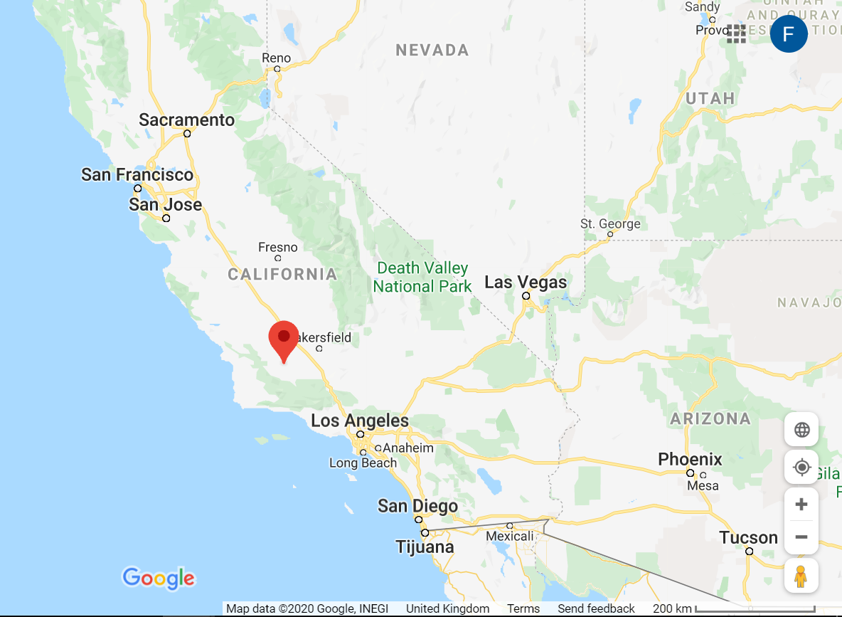
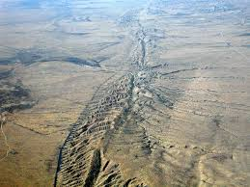
What causes an earthquake?
The North American Plate and the Pacific Plate move between 3 and 5 cm per year.

Slide 18
Earthquakes happen when...
a.
b.
two plates move toward each other.
two plates rub against each other.
c.
d.
two plates move away from each other.
one plate breaks in two.

Slide 19
Earthquakes happen when...
b.
two plates rub against each other.

Slide 20
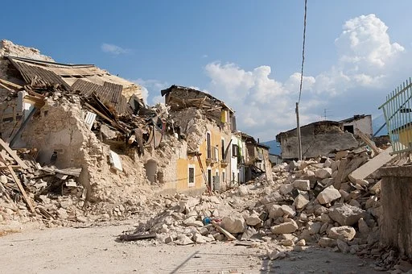
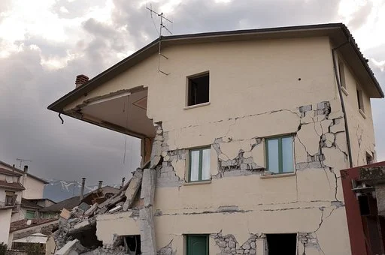
What causes an earthquake?
Around 50,000 earthquakes happen every year across the globe.

Slide 21


Pause the video to complete your task
Complete the sentences.
Why are earthquakes often a surprise?
Earthquakes are often a surprise, because...
Resume once you’re finished

Slide 22
Answer
Complete the sentences.
Why are earthquakes often a surprise?
Earthquakes are often a surprise, because scientists have not found a way to predict when an earthquake will happen.
Resume once you’re finished

Slide 23
Share your work with Oak National
If you'd like to, please ask your parent or carer to share your work on Instagram, Facebook or Twitter tagging @OakNational and #LearnwithOak

Slide 24
References
Slide [5] - Oceanic spreading, Surachit CC BY-SA 3.0 (Wikimedia)
Slide [15] - faultfind_48, Doc Searls CC BY-SA 2.0 (Flickr)

