Slide 1


Slide 3
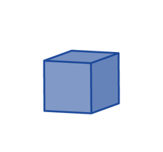
1) 52 × 10 =
2) What is the volume of this shape in cubes?
3) One end of a prism looks like this.
The prism has 8 layers of cubes.
What is the volume of the prism in cubes?
4) What does the word ‘estimate’ mean?

Slide 4
1) 52 × 10 =
2) What is the volume of this shape in cubes?
3) One end of a prism looks like this.
The prism has 8 layers of cubes.
What is the volume of the prism in cubes?
4) What does the word ‘estimate’ mean?
520
10 cubes
5 × 8 =
40 cubes

Slide 6

3
Each cube has a volume of 1 cm
What is the volume of the shape?
4 cubes
Have a think
4 cubes
2 cubes
4 cubes
6 cubes
6 × 4 =
3
24 cm
4 × 4 =
16 cubes
4 layers
2 × 4 =
8 cubes
16 + 8 =
3
24 cm

Slide 7
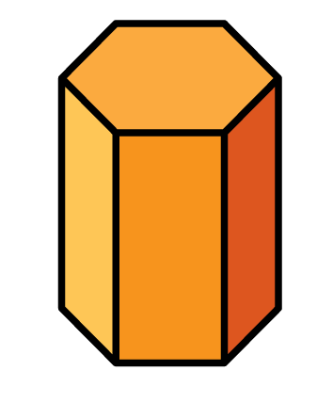
How can we estimate the volume of the hexagonal prism?
8 cubes
7 layers
7 × 8 =
56 cubes
3
3
Each cube has a volume of 1 cm
56 cm

Slide 8
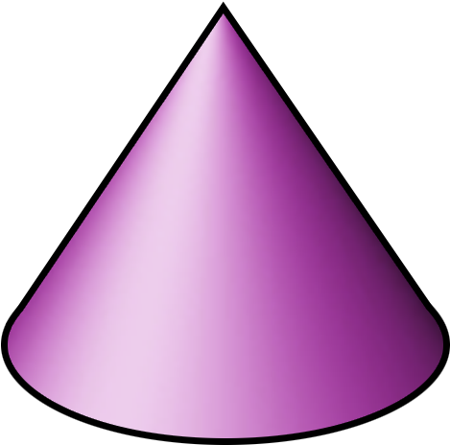
Have a think
Can we use exactly the same method to estimate the volume of the cone?
Why or why not?

Slide 9
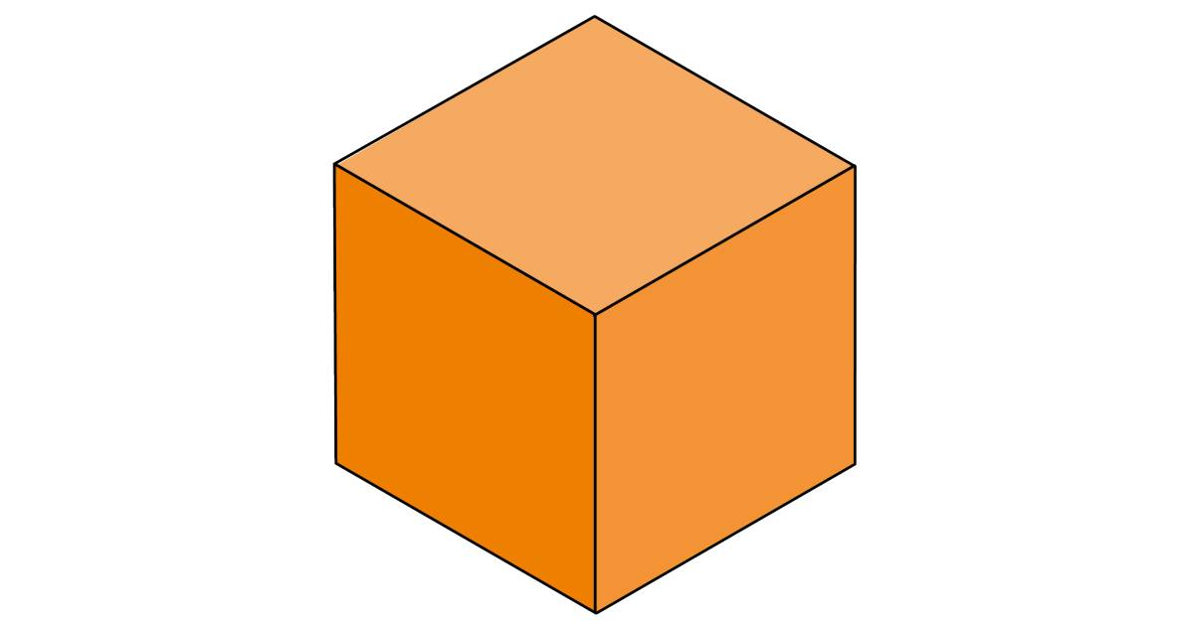
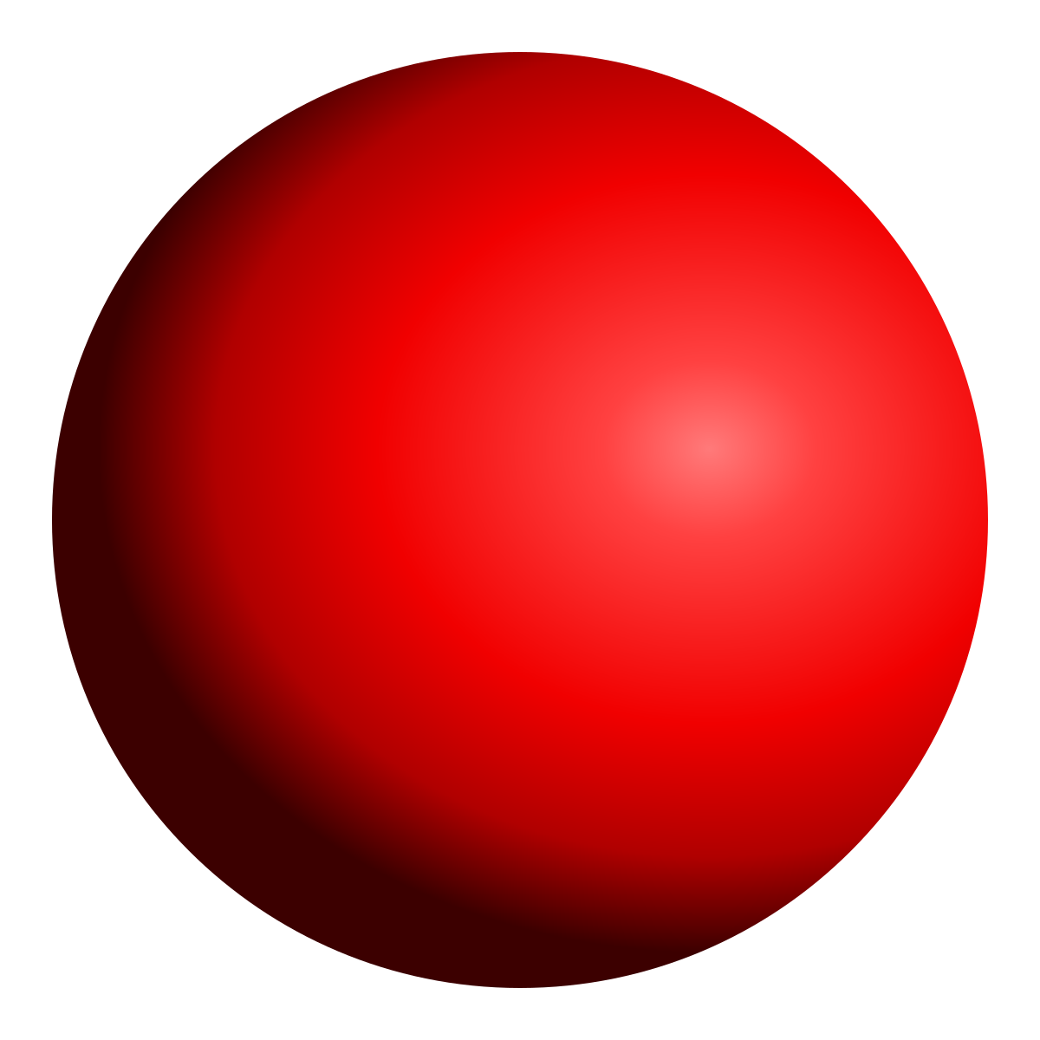
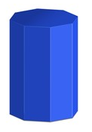
Sphere
Cuboid
Octagonal prism
Have a think
For which shape could we use small cubes to find the exact volume?
Cuboid

Slide 10
Have a go at questions
1 - 3 on the worksheet

Slide 11
Have a think
What is the volume of this shape?
5 × 4 =
20 cubes
2 cubes
+ 20 cubes
= 22 cubes
3
Each cube has a volume of 10 cm .
22 × 10 =
3
220 cm

Slide 12
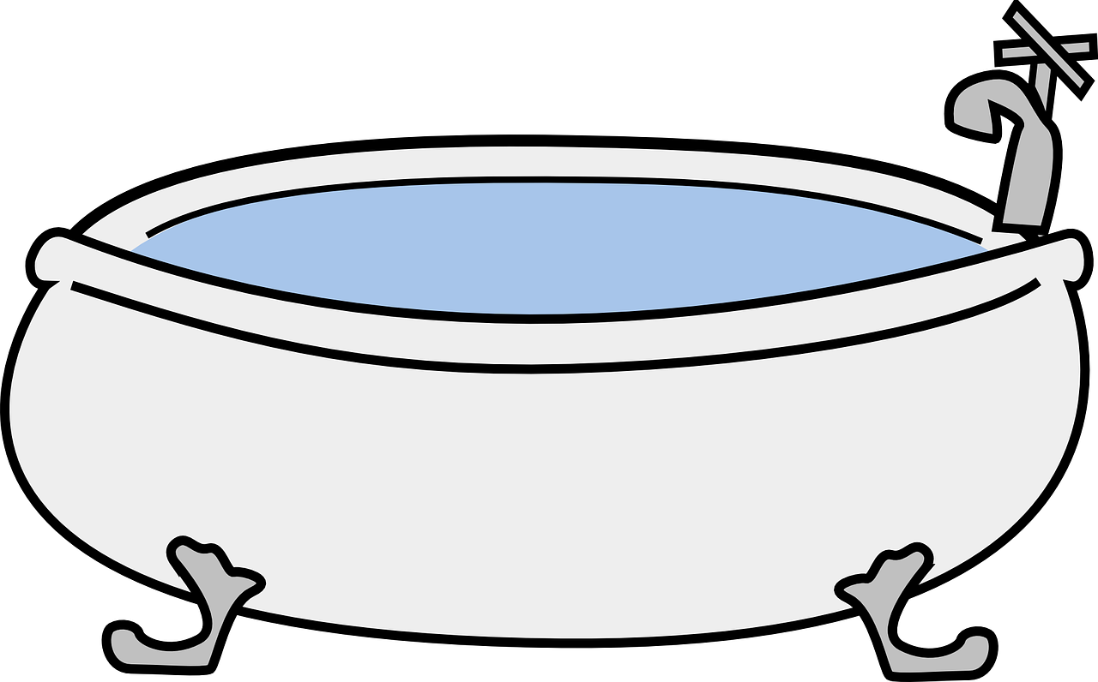

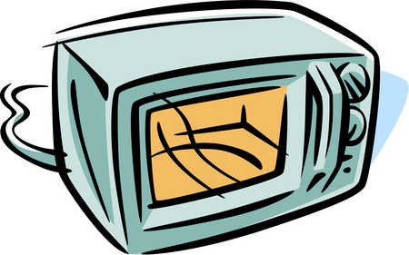

3
The volume of a small bath is 250,000 cm
Have a think
Estimate the volume of
A microwave
A sports water bottle
A rucksack
3
3
3
20,000 cm
34,000 cm
1,000 cm

Slide 13
Have a go at questions
4 - 6 on the worksheet

