Slide 1


French
Let’s Visit a French Town
Year One
French | Year 6 | Let’s Visit a French Town | Where Is the Library? | Lesson 3

Slide 2
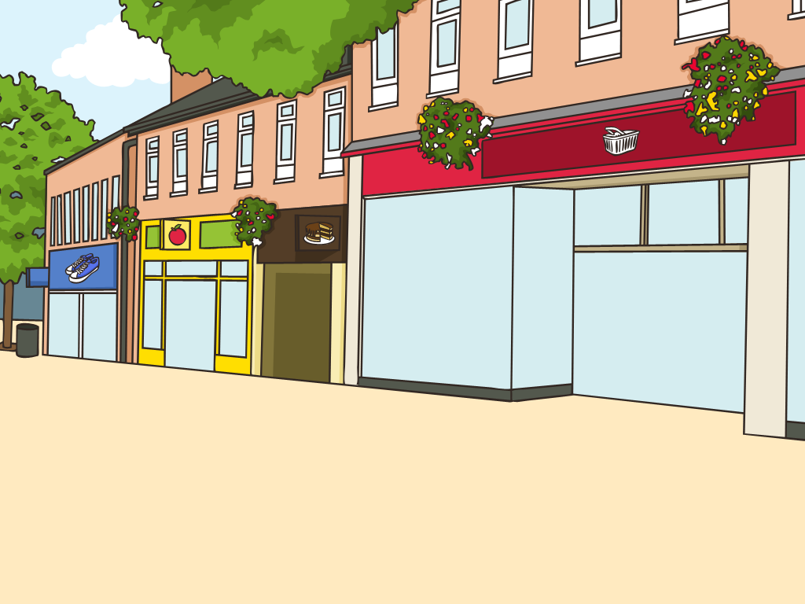

Où est la bibliothèque ?
(Where Is the Library?)

Slide 3
Aim
I can locate new vocabulary in a bilingual dictionary.
I can describe the position of places in French towns.
Success Criteria
I can use a bilingual dictionary.
I can identify places in a French town or city.
I can use simple prepositional phrases.
I can ask/answer questions about where a place is.

Slide 4














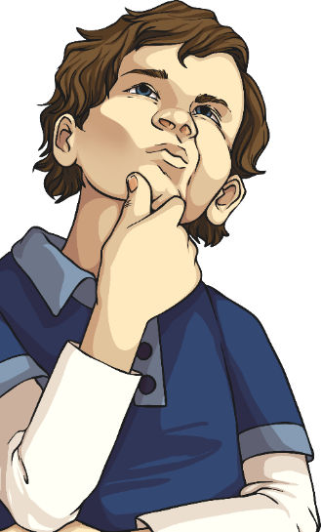
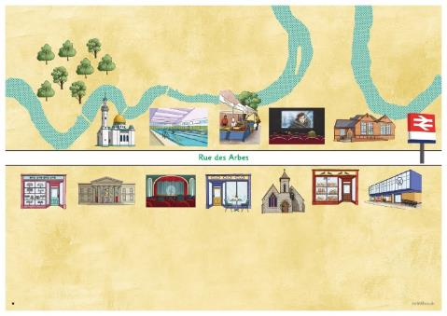
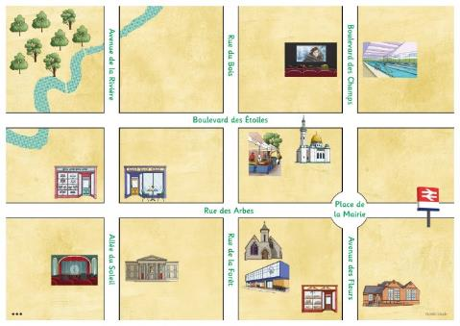
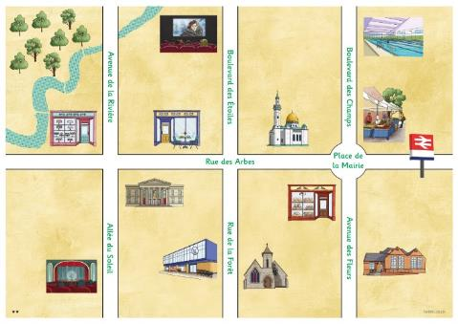
What Can You Remember?
How many places, buildings and facilities can you name in a French town or city?
Explore your map of Twinklville and attach the correct labels to each picture.

Slide 5


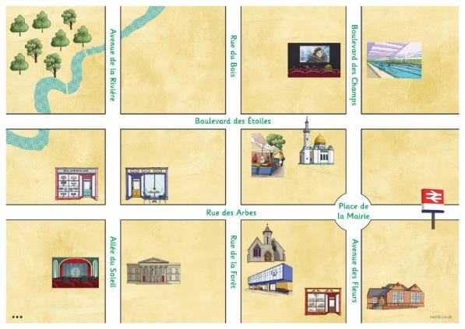


What Can You Remember?
Let’s have a quick recap together...

Slide 6
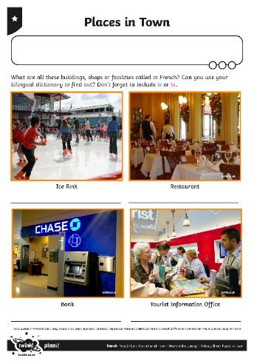
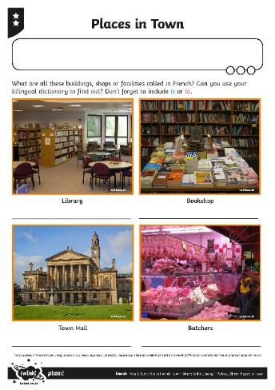
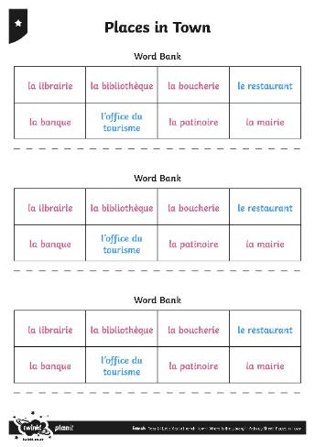

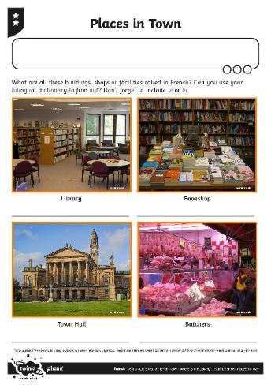
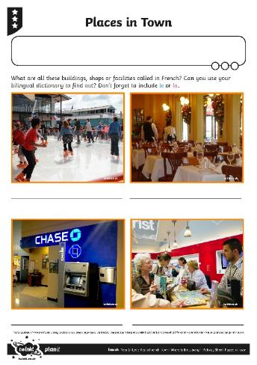
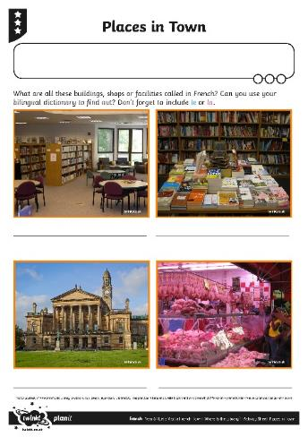





Quoi de neuf ?
(What’s New?)
Can you use your bilingual dictionary resources to find the translations for some new places in town?

Slide 7


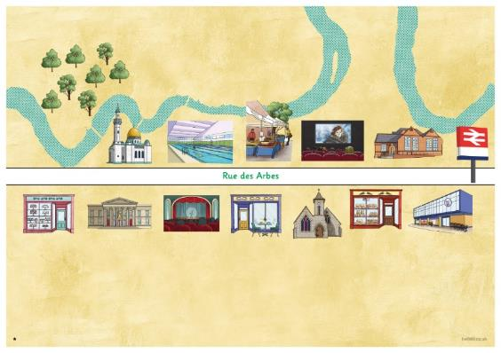
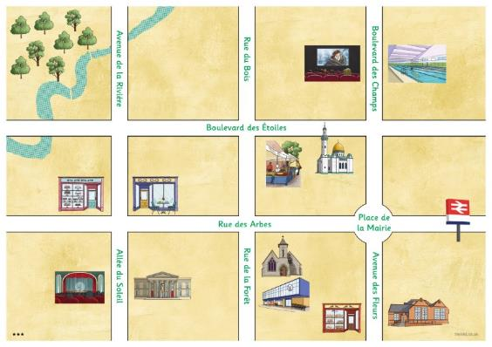

Où est ___ ?
(Where Is ___?)
Click play buttons throughout to hear phrases and words.
If we want to describe the position of each place, relative to another, what type of words do we need?
Prepositions or Prepositional Phrases

Slide 8
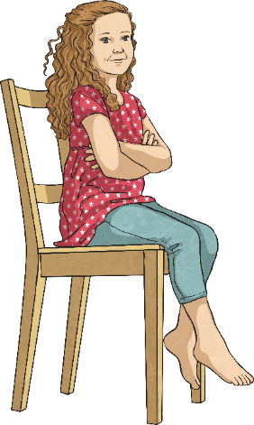
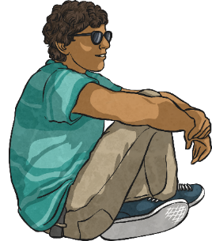
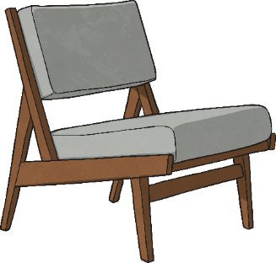
Où est ___ ?
(Where Is ___?)
In French: les prépositions
Où est Annelise ?
Où est Pierre ?
Annelise est en face de Pierre.
Pierre est en face d’Annelise.
Annelise
Pierre
en face de = opposite

Slide 9

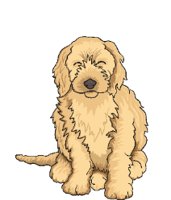
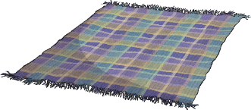
Où est ___ ?
(Where Is ___?)
In French: les prépositions
Où est Marguerite ?
Où est Gigi ?
Marguerite est à côté de Gigi.
Gigi est à côté de Marguerite.
Gigi
Marguerite
à côté de = next to

Slide 10




Où est ___ ?
(Where Is ___?)
In French: les prépositions
Où est la pomme ?
La pomme est en face de la banane.
Où est la carotte ?
La carotte est à côté du saucisson sec.

Slide 11
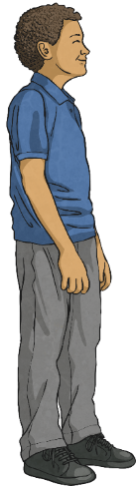

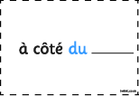
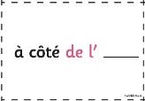

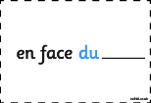
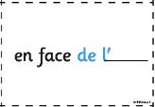
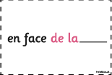
Où est ___ ?
(Where Is ___?)
In French: les prépositions
Où est Sayed ?
Où est Amelia ?
Sayed
Amelia

Slide 12



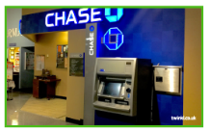

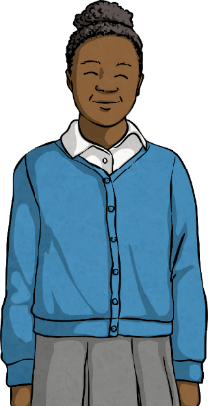


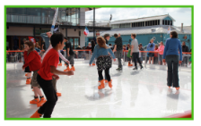
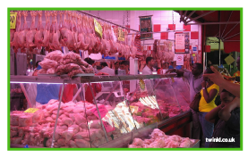






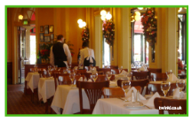
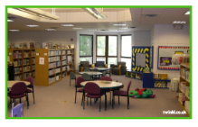

Allez-y !
(Your Turn)
Can you listen to the sentence and position yourselves accordingly?
Où est la mairie ?
La mairie est à côté de la boucherie.

Slide 13

Aim
I can locate new vocabulary in a bilingual dictionary.
I can describe the position of places in French towns.
Success Criteria
I can use a bilingual dictionary.
I can identify places in a French town or city.
I can use simple prepositional phrases.
I can ask/answer questions about where a place is.

