Slide 1


French
Let’s Visit a French Town
Year One
French | Year 6 | Let’s Visit a French Town | I Go to School to Learn | Lesson 2

Slide 2
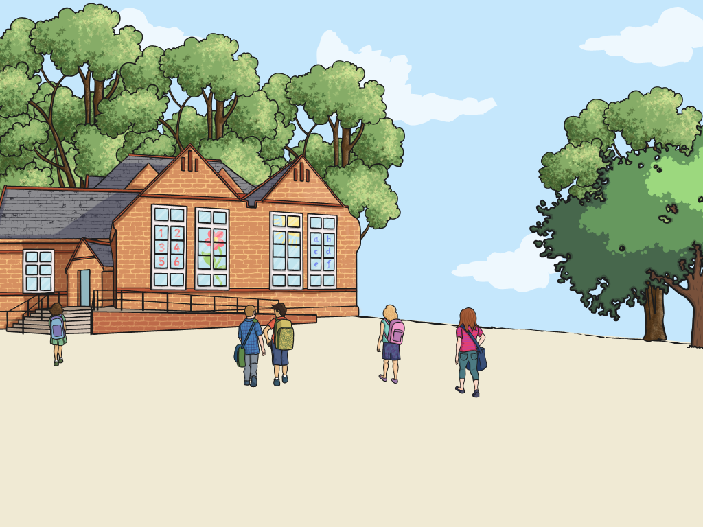

Je vais à l’ école pour apprendre
(I Go to School to Learn)

Slide 3
Aim
I can explain to someone why I do something.
Success Criteria
I can vary the noun and verb appropriately for my purpose.
I can talk about what there is to do in my town.
I can use gestures to support what I am saying.

Slide 4







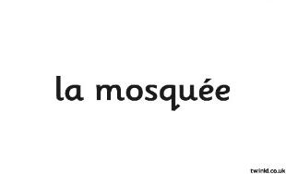





Cherchez vos partenaires
(Find Your Partners)
Do you know the names of places in a town?
Can you match up the English and French words?

Slide 5
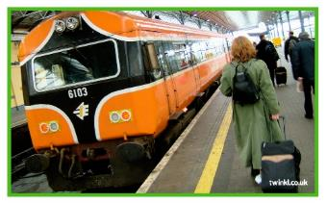
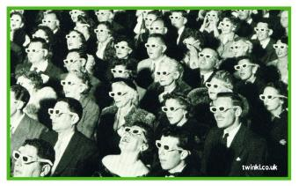
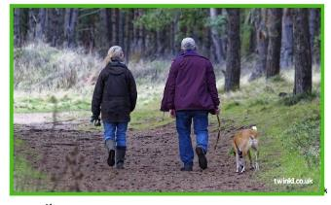
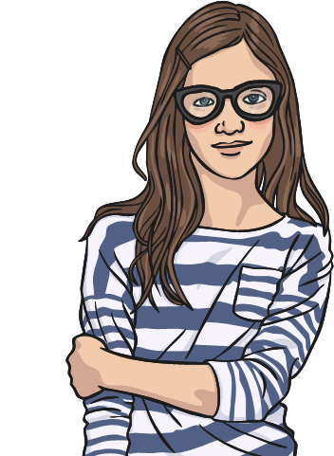
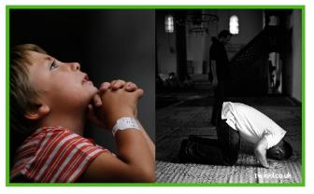
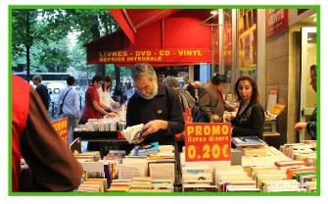
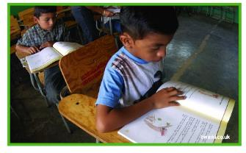
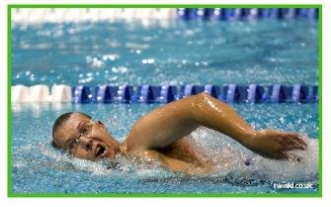
Qu’est-ce qu’on fait?
(What Are We Doing?)
Can we create an effective mime/gesture to help everyone guess the verb?

Slide 6


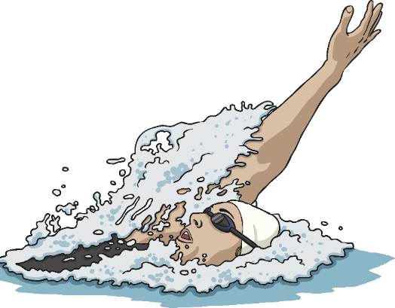
Les verbes
(Verbs)
Which gesture goes with this one?
nager

Slide 7
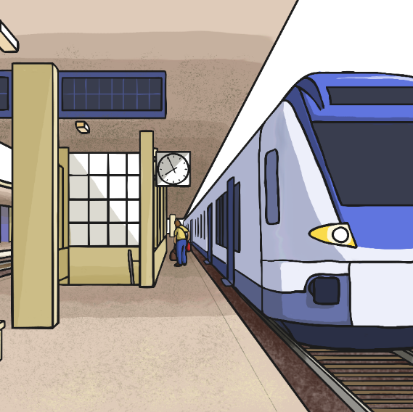
Les verbes
(Verbs)
Which gesture goes with this one?
prendre le train

Slide 8
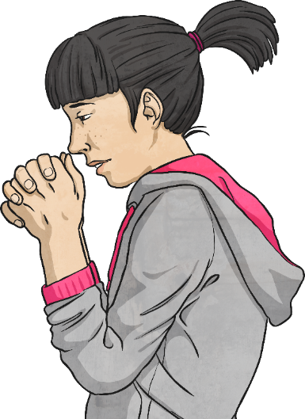
Les verbes
(Verbs)
Which gesture goes with this one?
prier

Slide 9
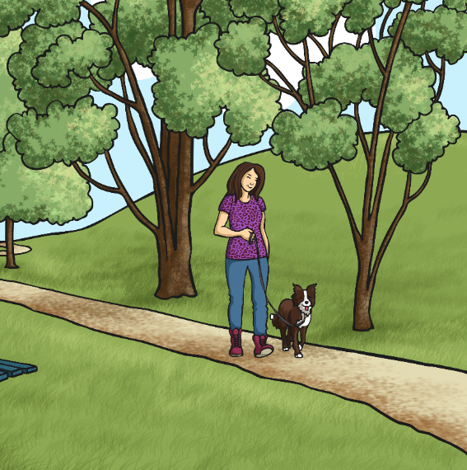
Les verbes
(Verbs)
Which gesture goes with this one?
faire une promenade

Slide 10
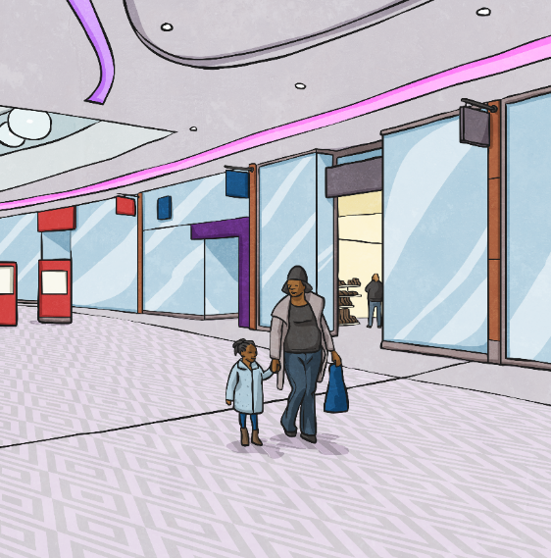
Les verbes
(Verbs)
Which gesture goes with this one?
acheter

Slide 11
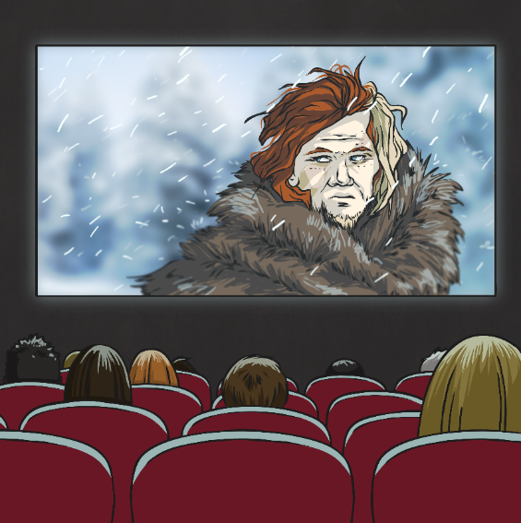
Les verbes
(Verbs)
Which gesture goes with this one?
regarder un film

Slide 12
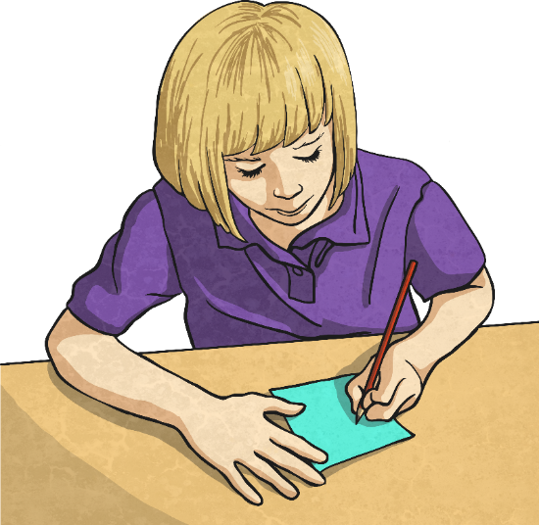
Les verbes
(Verbs)
Which gesture goes with this one?
apprendre

Slide 13





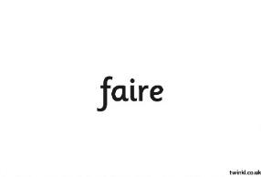

Les verbes
(Verbs)
Can you remember each one?

Slide 14
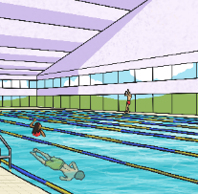
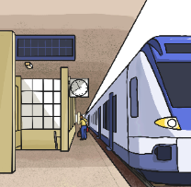


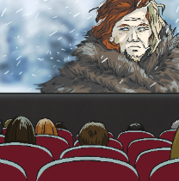
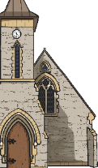
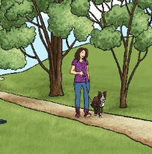

Je vais à la/à l'/au _pour faire _
(I Go to the _ to Do _)
Click here to reveal the answers!
Game – can you find the matching pairs?
?
?
?
nager
prier
?
?
?
?
?
apprendre
prendre le train
?
?
faire une promenade
?
?
regarder
un film

Slide 15


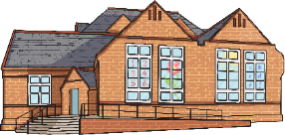
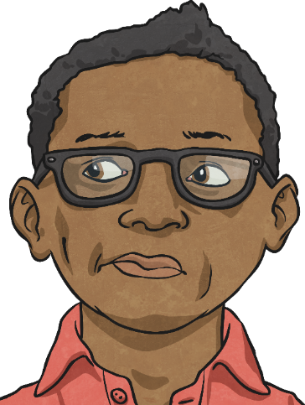

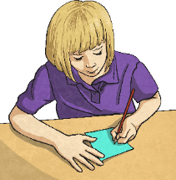
Je vais à la/à l'/au _pour faire _
(I Go to the _ to Do _)
Je vais à l’école pour apprendre.

Slide 16
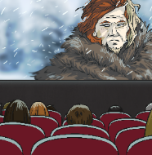
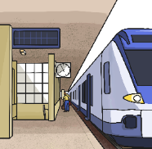
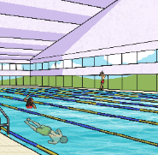




Je vais à la/à l'/au _pour faire _
(I Go to the _ to Do _)
apprendre
faire une promenade
prendre le train
regarder
un film
prier
nager

Slide 17

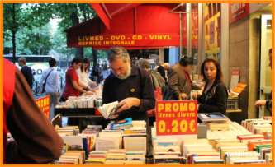
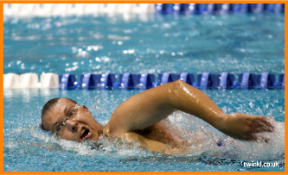

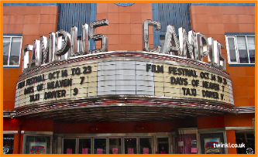
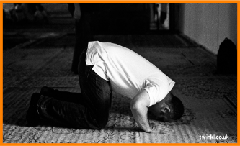
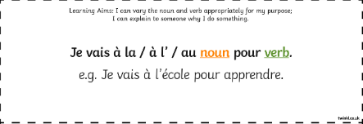
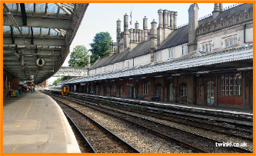
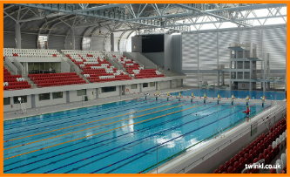
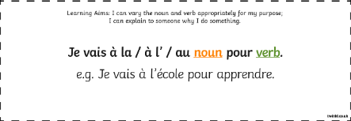
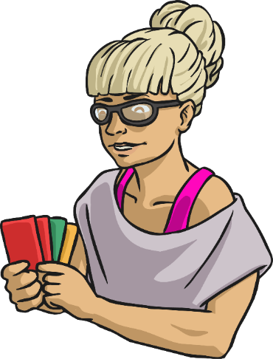
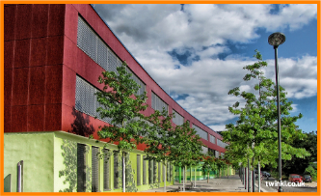
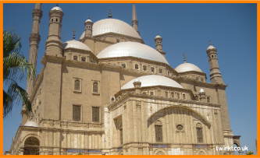

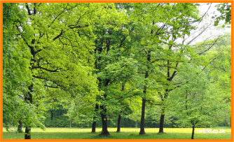

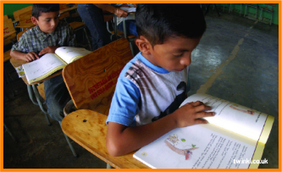

Jouons !
(Let’s Play!)

Slide 18

Aim
I can explain to someone why I do something.
Success Criteria
I can vary the noun and verb appropriately for my purpose.
I can talk about what there is to do in my town.
I can use gestures to support what I am saying.

