Slide 1
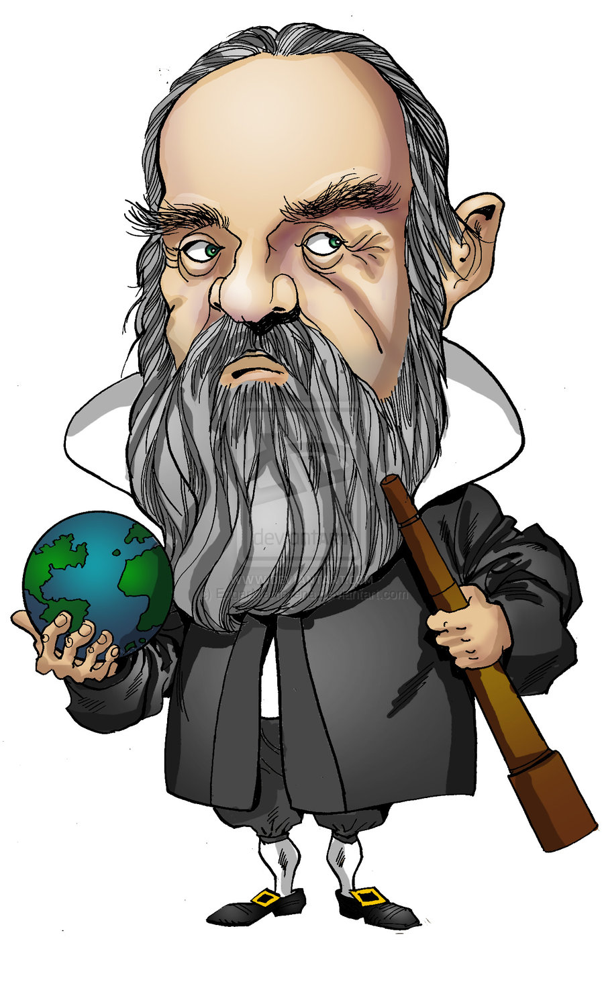
The Galileo Experiment

Slide 2
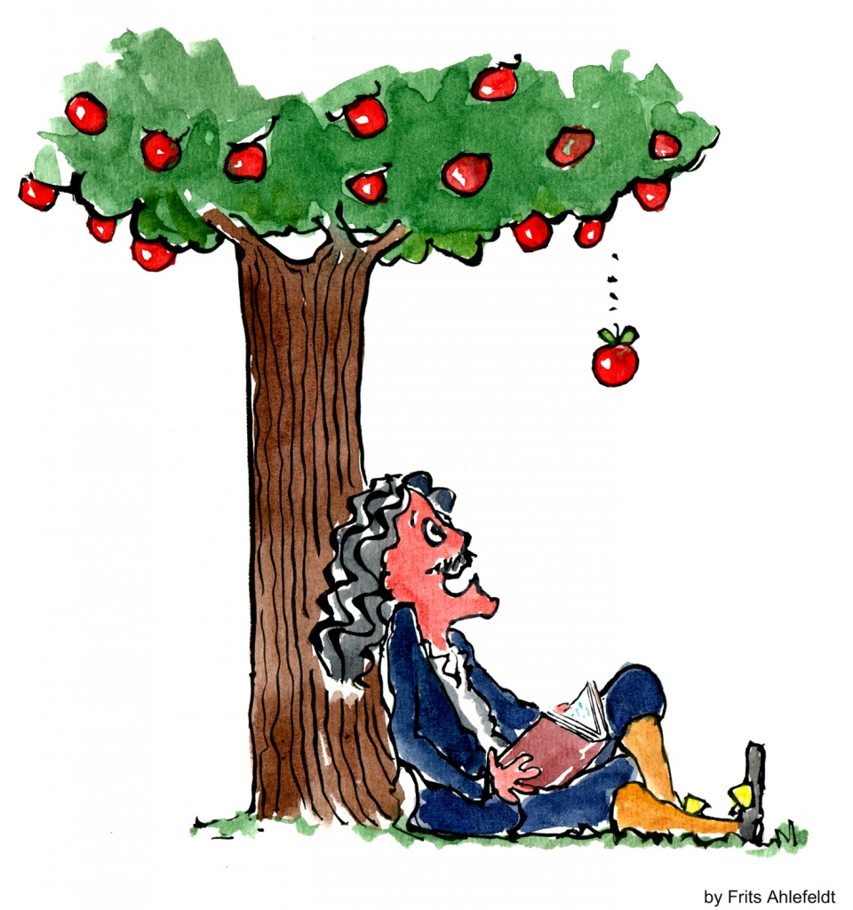
Background information
https://www.youtube.com/watch?v=ljRlB6TuMOU

Slide 3
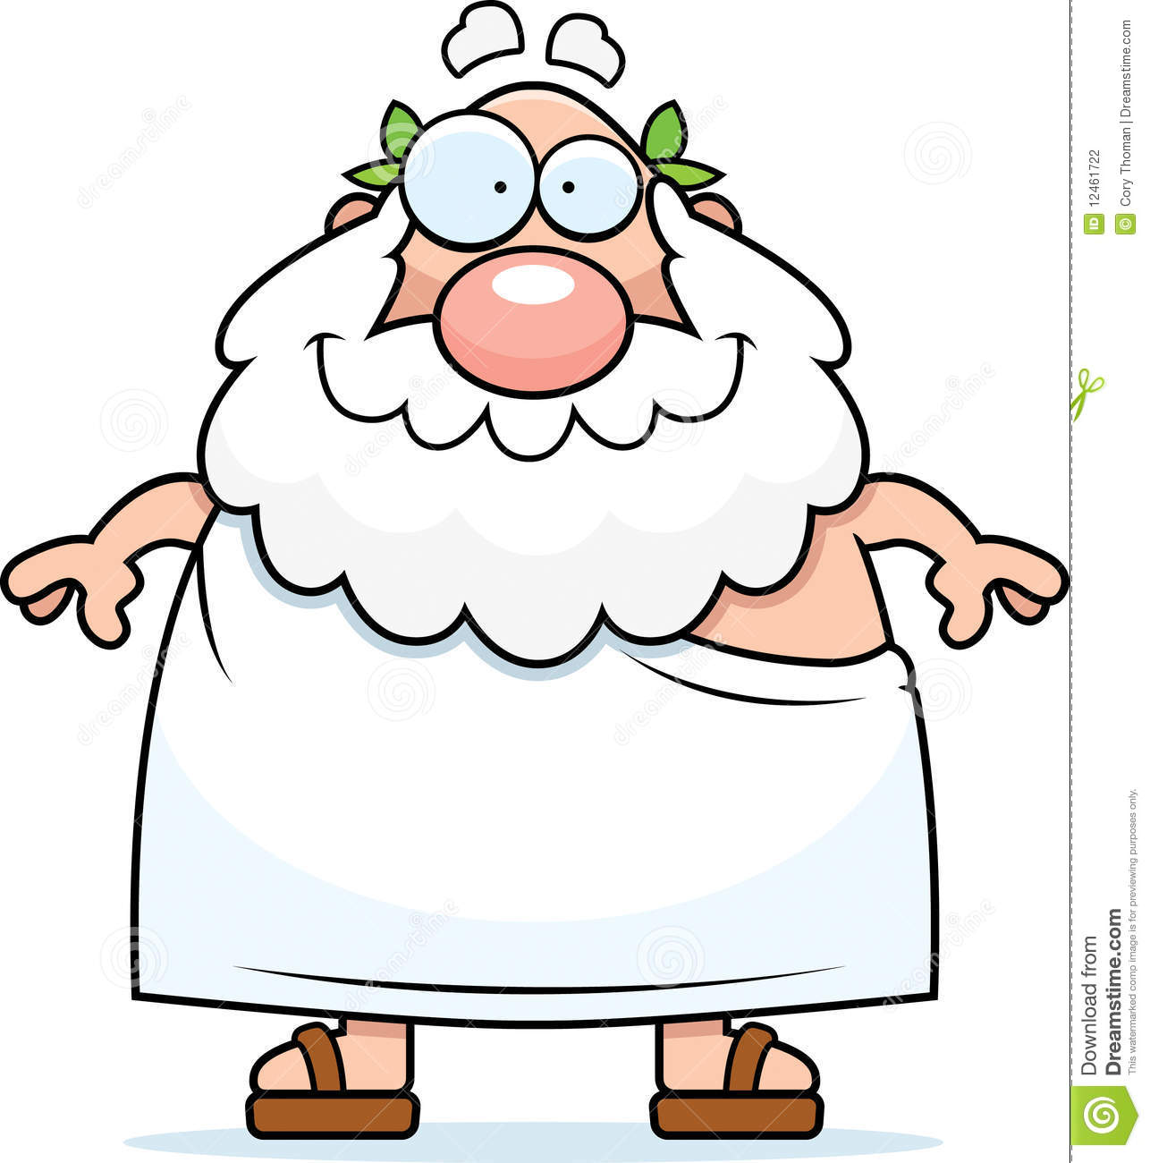
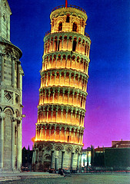
Background information
A Greek philosopher called Aristotle claimed heavy items would always fall to the ground before light items because of their mass. The heavier an item, the quicker it would fall. Despite Aristotle never actually conducting an experiment to prove his hypothesis, most people believed that this was the case.
However, a wise man called Galileo wanted to test Aristotle’s theory. Can you help Galileo design and conduct an experiment to test Aristotle’s theory?
Galileo is at the top of the Leaning Tower of Pisa, meet him there.

Slide 4
What do I want to find out?
I want to find out whether heavier objects fall faster than lighter objects. For example, if we dropped two tomatoes of different weights which would hit the floor first?

Slide 5
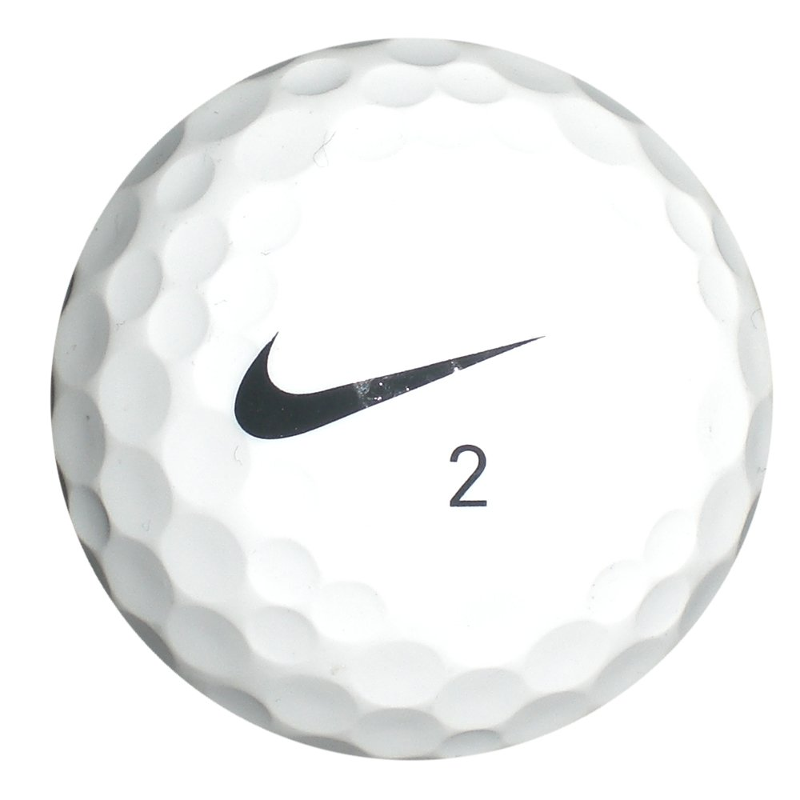

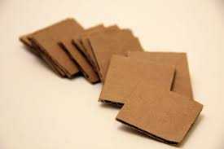

What experiment could you design to help Galileo find out whether Aristotle was correct or incorrect?
To help Galileo I have designed an experiment where I will drop 2 objects that weigh different amounts from a height. I will drop the items simultaneously and at the same height.
Notes:
In order to answer the question posed by Galieo of Aristotle’s theory I will …

Slide 6
What will your experiment measure?
In my experiment I will measure whether the heavier or lighter item lands first.
Notes:
Dependent variable. In my experiment I will measure whether the heavier or lighter item lands first.

Slide 7
What do you think will happen? Make a prediction
I predict that … because ... .

Slide 8
What will you ensure stays the same during the tests? Make sure your test is fair
I will make my experiment fair by ...
Notes:
Control variables. The height the objects are dropped from. That the two objects are simultaneously dropped. That one object is heavier than the other. That we drop each item the same way.

Slide 9
What will you change each time? Decide on one variable to change
In the test I will change the …. because ... .
Notes:
Independent variable – The object

Slide 10
Carry out the experiment
Heavier item | Lighter item | Which landed first?

Slide 11
Can you explain what happened?
What did you find out?
Was your prediction correct?
Why do you think this happened?

Slide 12
The Science behind it all
http://www.bbc.co.uk/education/clips/zqshfg8
https://www.youtube.com/watch?v=akWo3QpiL2I
http://www.planetseed.com/files/uploadedfiles/Science/Laboratory/Air_and_Space/Galileo_Drops_the_Ball/anim/en/index.html?width=440&height=670&popup=true

Slide 13
Thinking more about Gravity
What about items of different size? How might that change our results?

