Slide 1


Slide 2


Slide 3


Slide 4
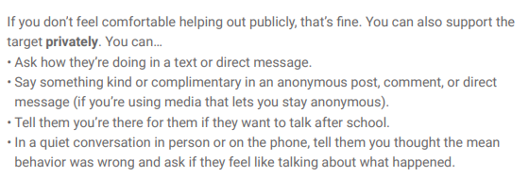

Slide 5


Slide 6
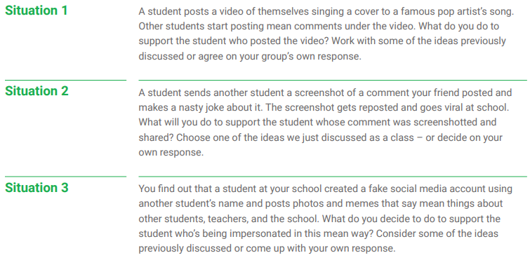
Use the information that you have read to decide how you would respond to these three scenarios:

Slide 7


