Slide 1
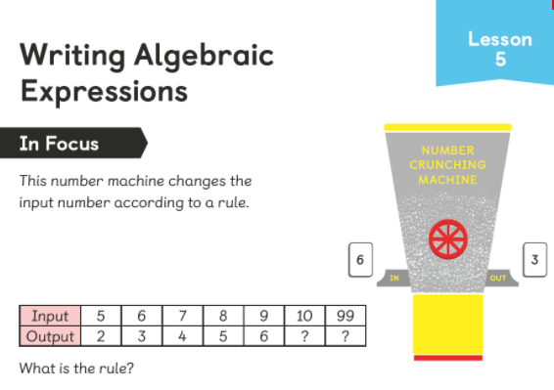
What is happening to each input number?
So, what is the rule?

Slide 2
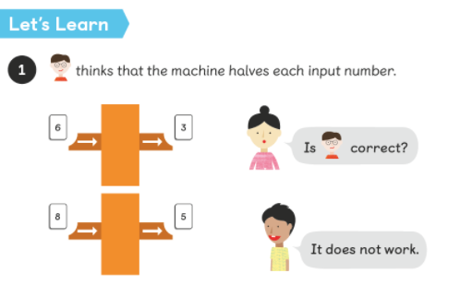
Halving only works for the number 6.
A rule has to work for ALL the input numbers.

Slide 3
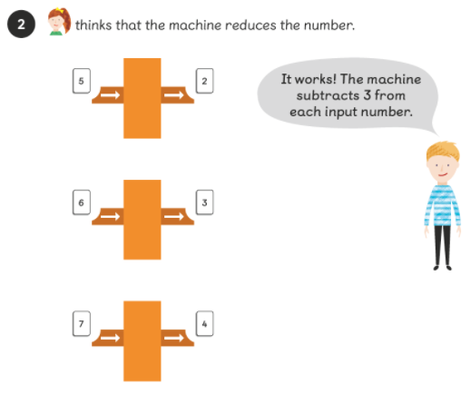
The rule subtract 3 works for all the input numbers.
So, what will 10 and 99 come out as?

Slide 4
10 will come out as 7
99 will come out as 96

Slide 5
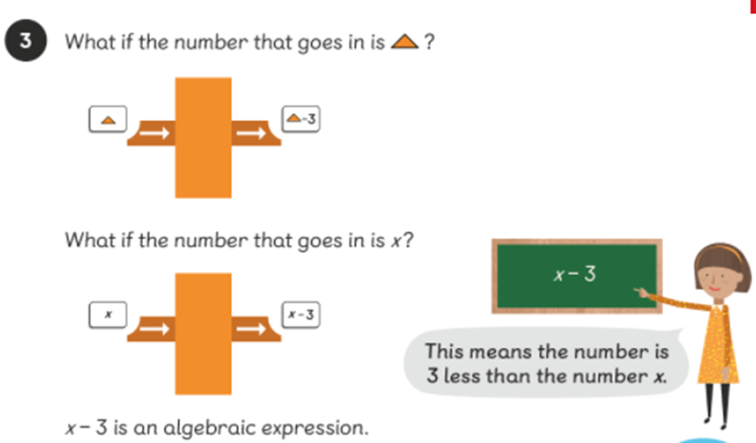
Amira uses the letter x to represent any whole number.

Slide 6
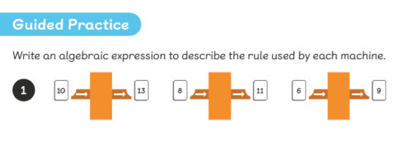
Use the letter y each time to describe the rule.
For this example, the rule is add 3.
So, we can describe the rule as y+3

Slide 7
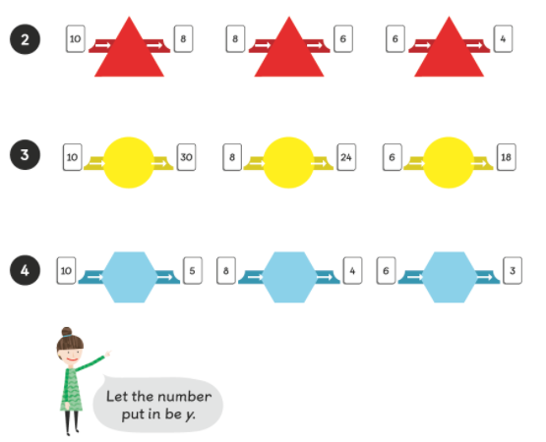

Slide 8
Now have a go at the worksheet.

