Slide 1
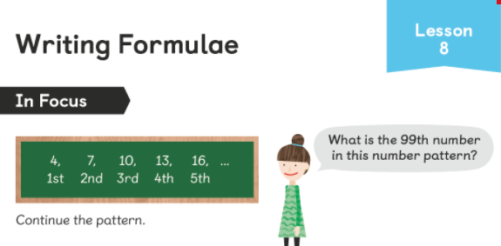
What is the rule? Think back to yesterday’s lesson. This is a two-step rule.

Slide 2
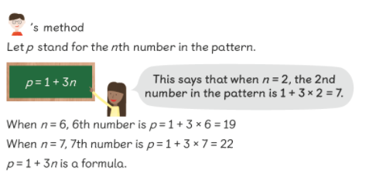
Did you get it right?
3n + 1 or 1+ 3n
So, the 99th number is 99 x 3 +1 = 298

Slide 3
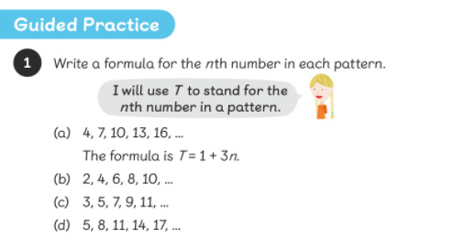

Slide 4
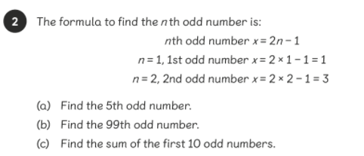

Slide 5
Complete the worksheet

