Slide 1
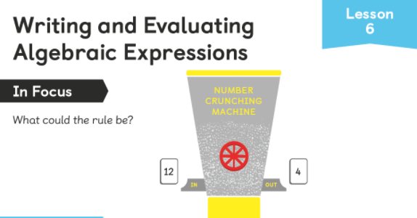
What could be happening? What are all the possibilities? Use the letter x to describe the rule.

Slide 2
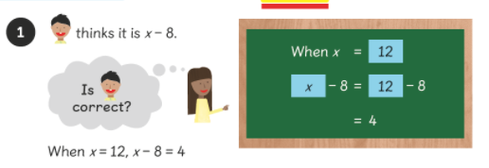
Ravi could be correct as 12 – 8 = 4.
So, if we call the whole number going in x, we can describe the rule as x – 8

Slide 3
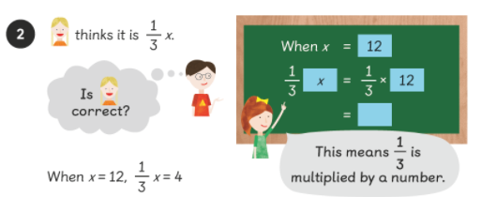
Hannah could be correct as 1/3 of 12 = 4.
So, if we call the whole number going in x, we can describe the rule as 1/3 x (one third of x)

Slide 4
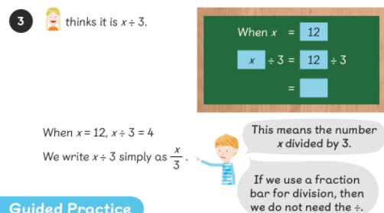
Hannah could also be correct here as 12 ÷ 3 = 4.
So, if we call the whole number going in x, we can describe the rule as x ÷ 3. Look at Sam showing you how we can also write this.

Slide 5
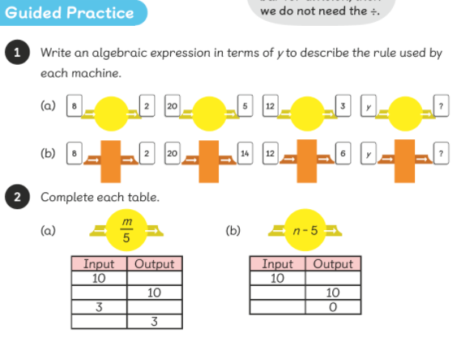

Slide 6
Complete the worksheet

