Slide 1
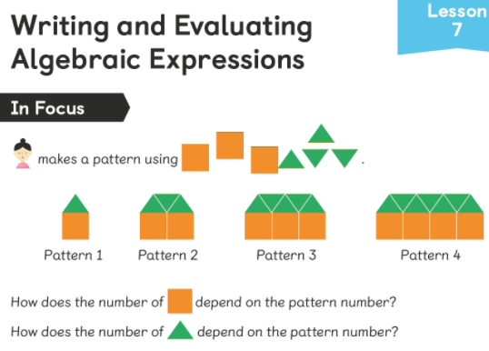
It might help if you draw a table to record the relationship:
If you need a hint then look at the next slide.
Number of triangles | 1 | 3
Pattern number | 1 | 2

Slide 2
If we double the pattern number, are we closer to the number of triangles?
What do we then need to do to the double to get the number of triangles?
There is more than one step to this rule.

Slide 3
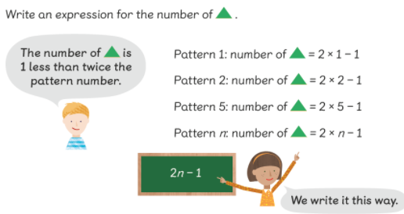
The rule is we double the pattern number and subtract 1.
If we use the letter n to represent any pattern number, we can write
2n – 1.

Slide 4
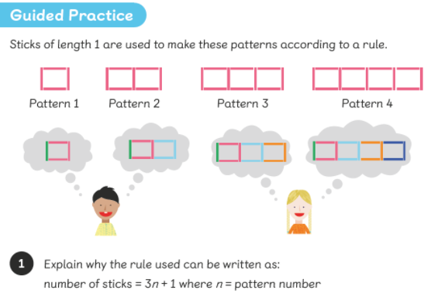

Slide 5
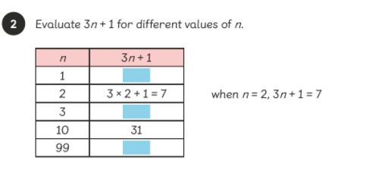


Slide 6
Complete the worksheet.

